Slide 2
d

Slide 4
Research Question

Slide 5
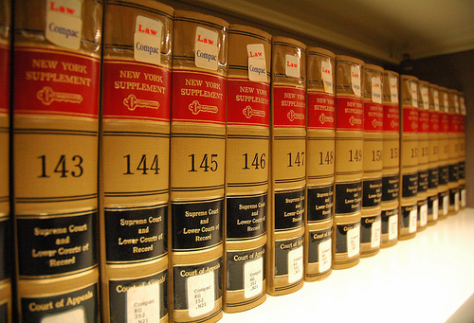
INFORMATION SEARCH PROCESS OF LAWYERS: A CALL FOR ‘JUST FOR ME’ INFORMATION SERVICES
by C.C. KUHLTHAU
and S.L. TAMA

Slide 6
Article Summary
Writers compare searching for information in an electronic database to searching in a library of law books. Findings revealed that these lawyers frequently were involved in complex tasks that required a constructive process of interpreting, learning and creating.
Databases results:
Provided a narrow
window into information
Did not give any context
Law book results
Provided context
A visual history of the search
Possibility of serendipity.
Lawyers preferred printed texts over computer databases primarily because computer databases required well-specified requests and did not offer an option for examining a wide range of information at one time.

Slide 8
“Information Search Process of Lawyers:
A Call for ‘Just for Me’ Information Services”
By C.C. Kuhlthau and S.L. Tama (2001)

Slide 9
Information Search
Database vs. Law Books

Slide 10
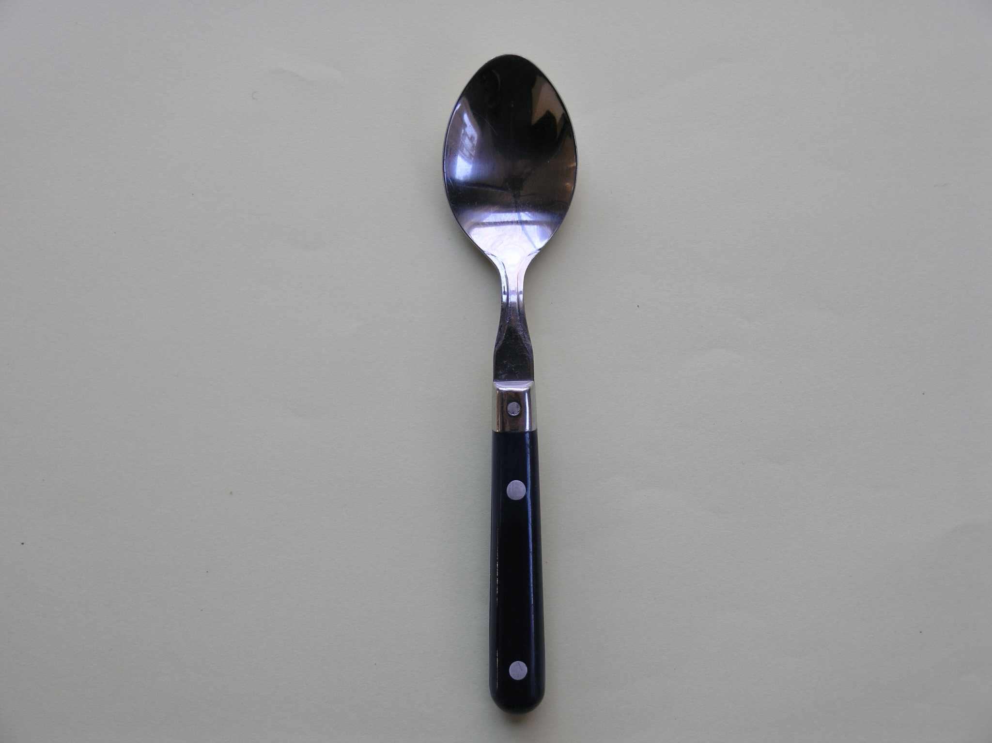
Lawyer’s Question

Slide 11
Database
Search

Slide 12
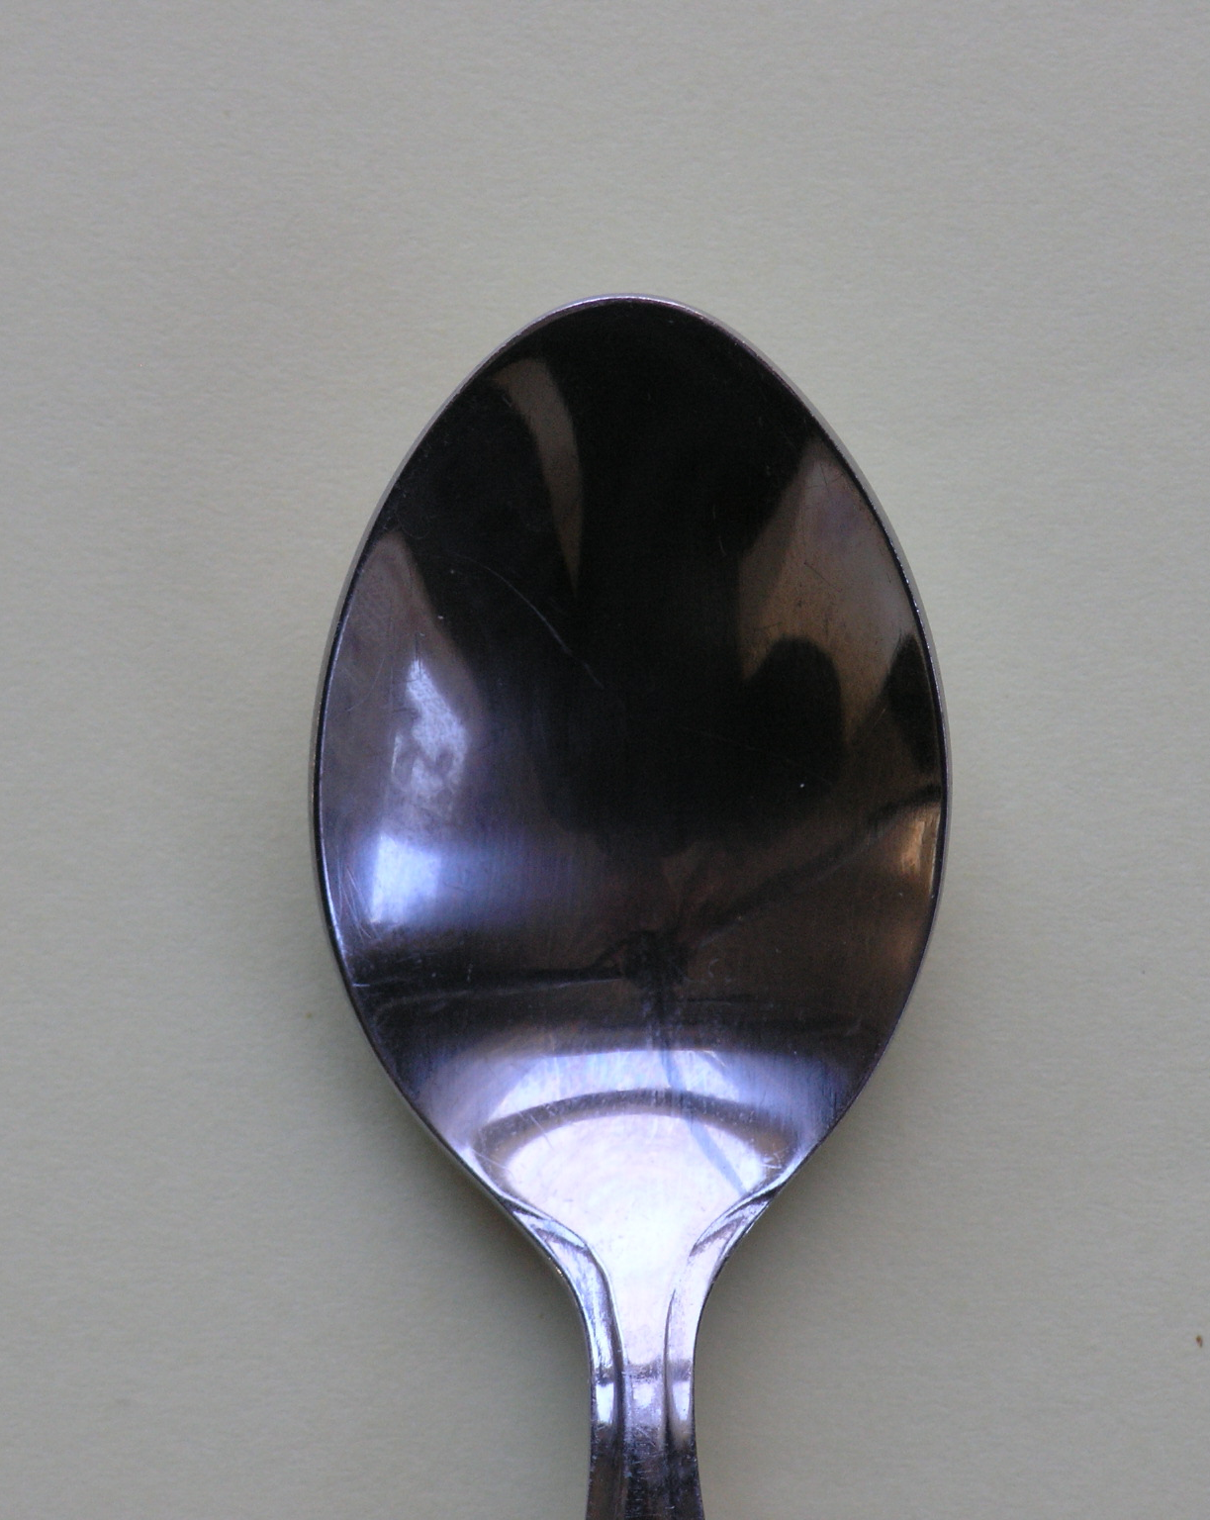
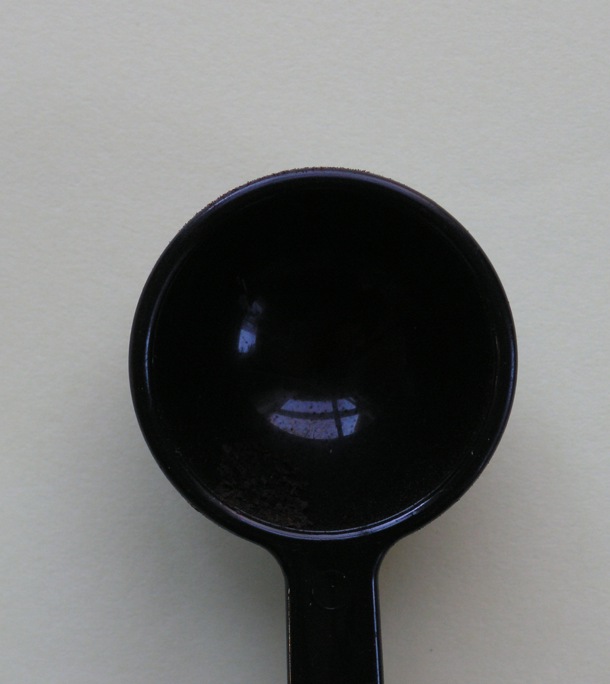
Search Question
Result

Slide 13
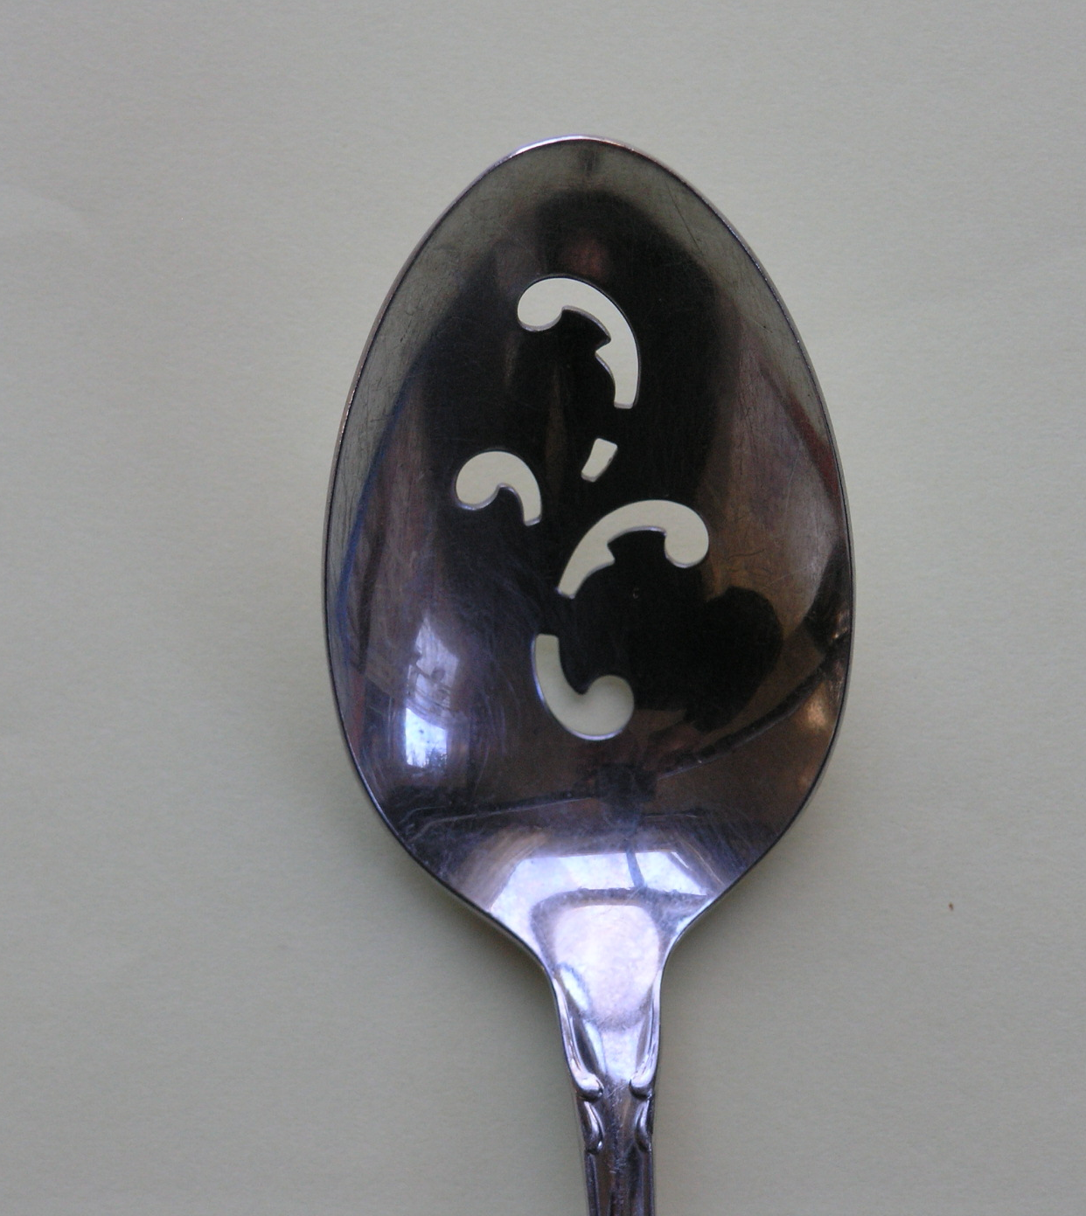

Slide 15
Modified
search
question

Slide 16
Modified
Search Question
Result

Slide 17
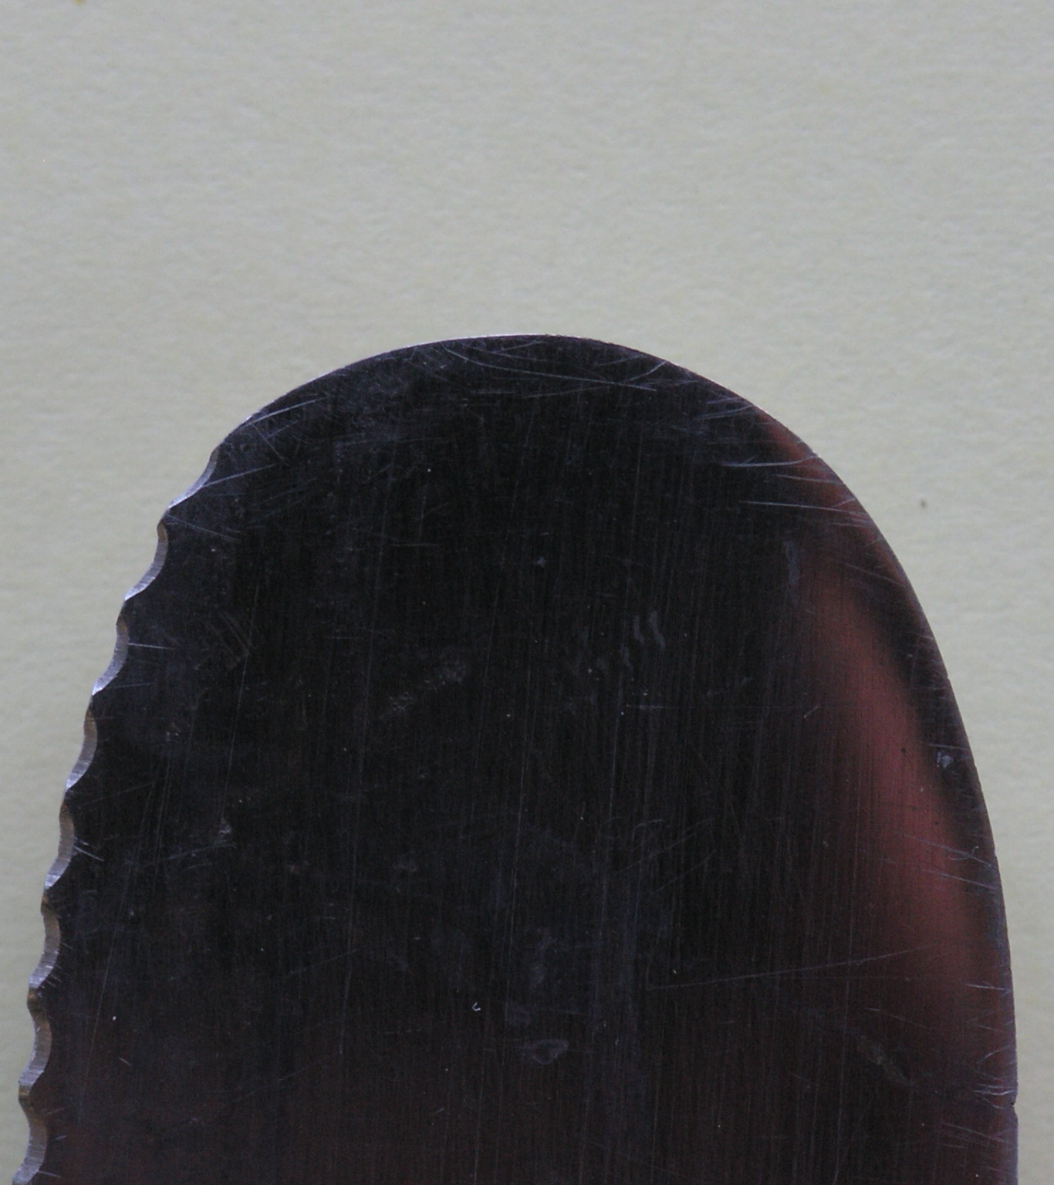

Slide 18
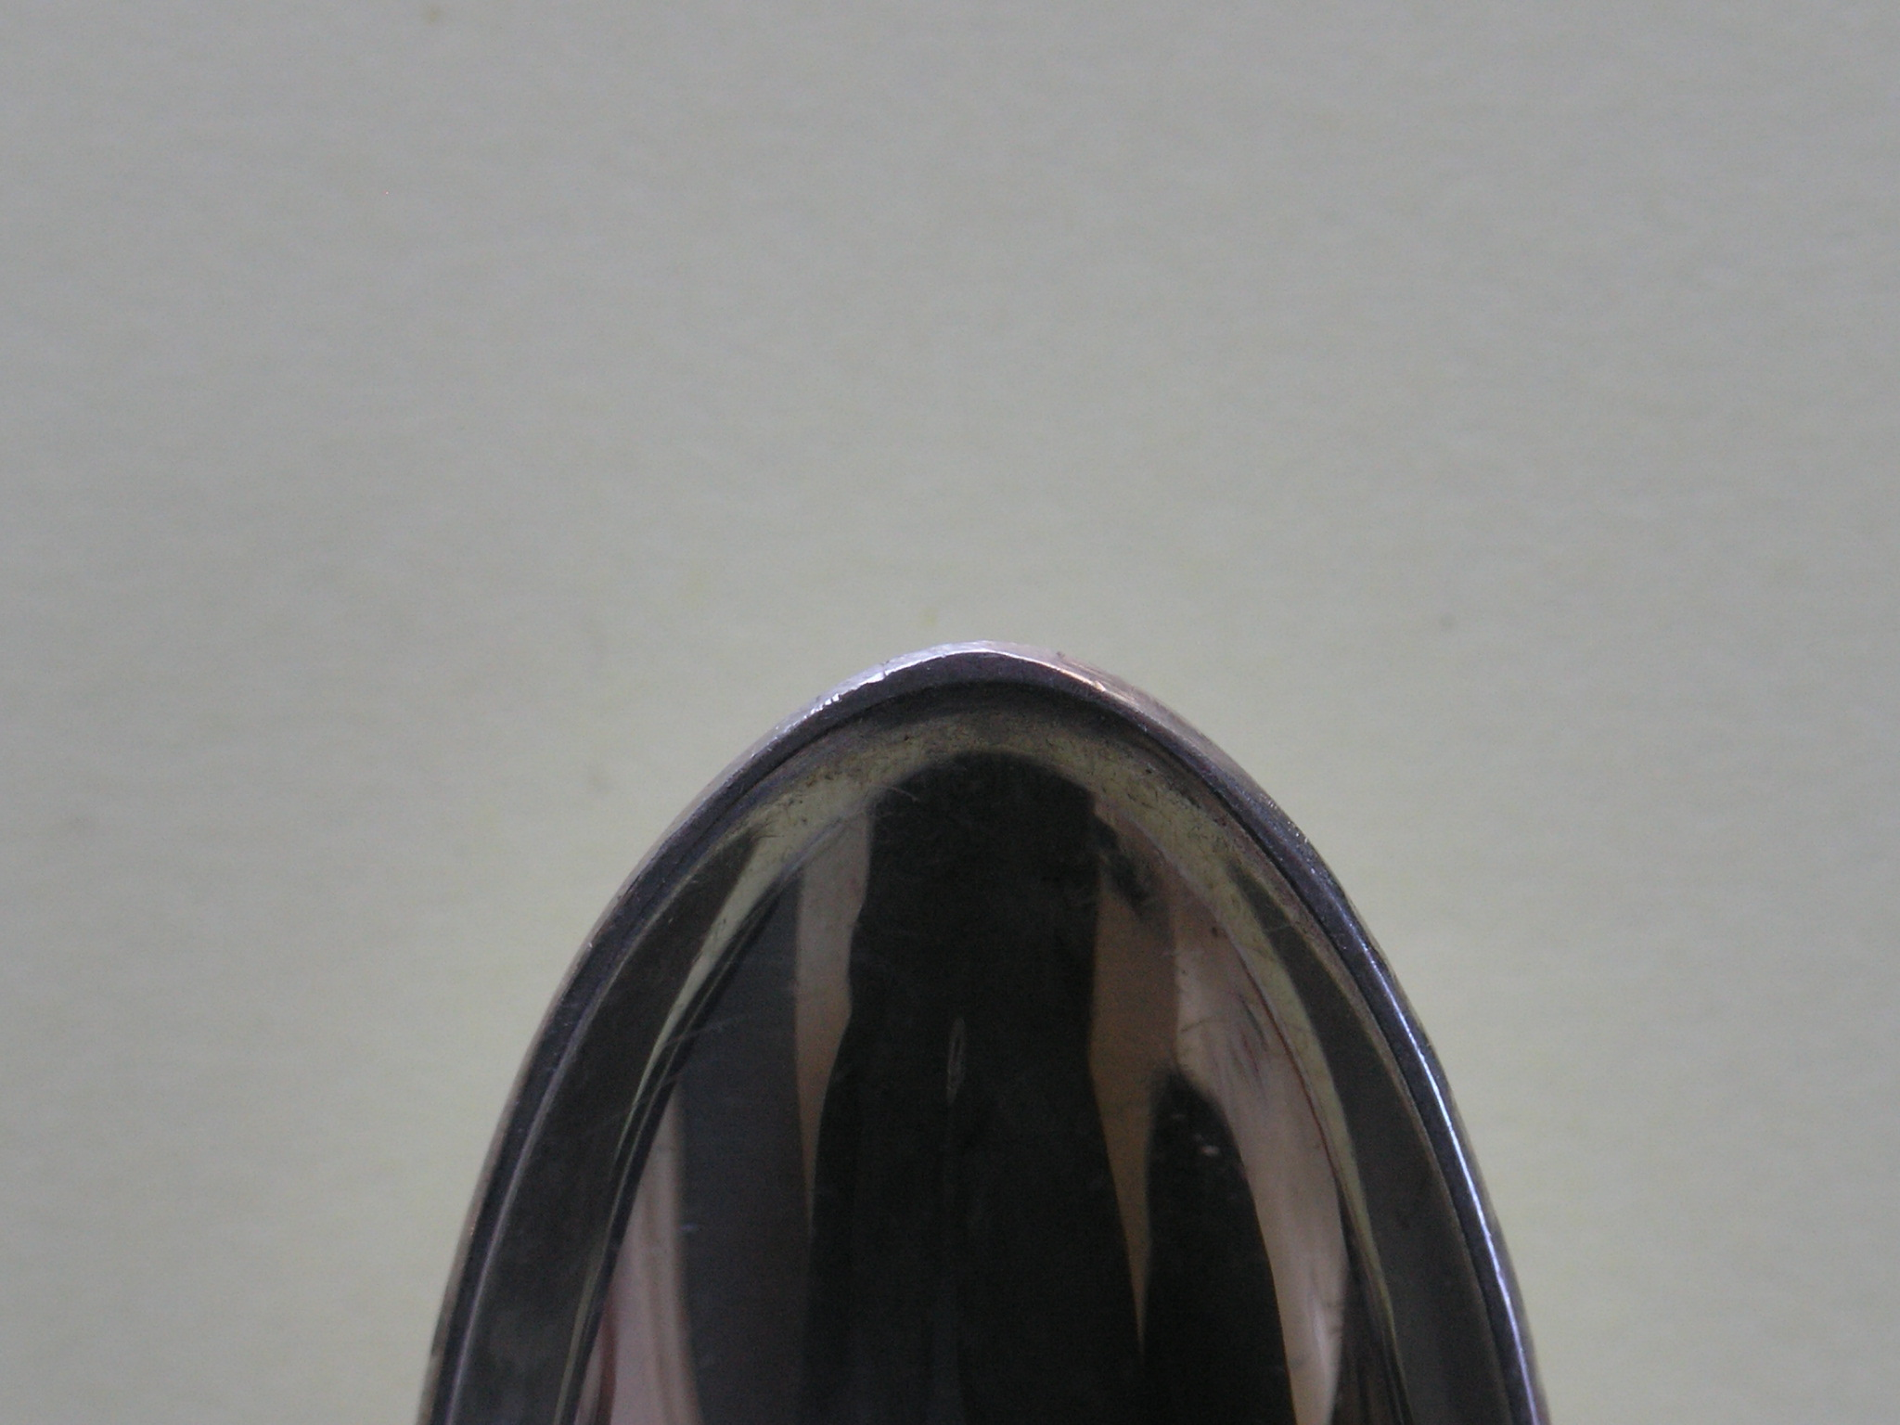

Slide 20
Best results

Slide 21
Law Book Search

Slide 22
Search Question
Result

Slide 26
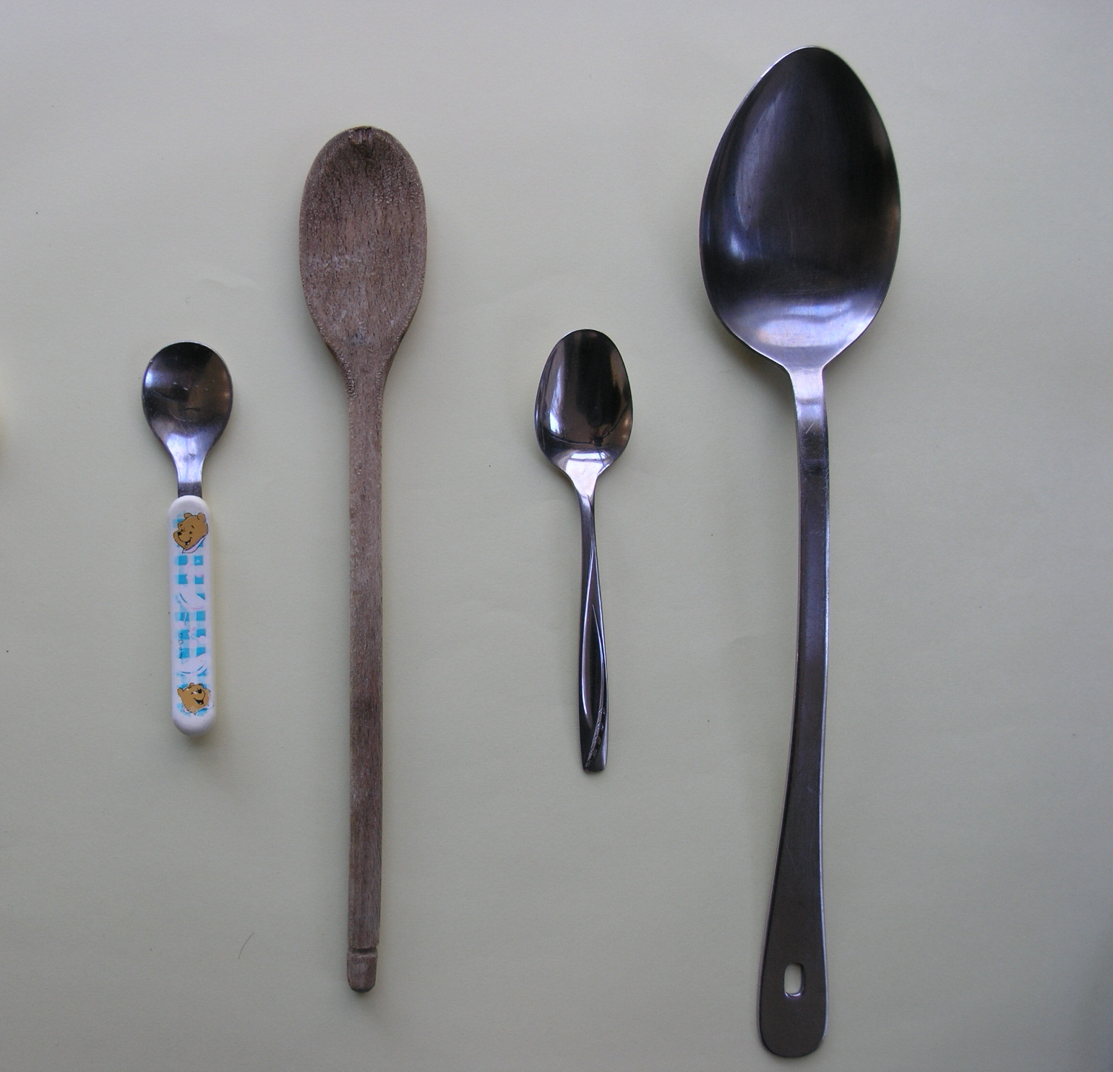

Slide 28
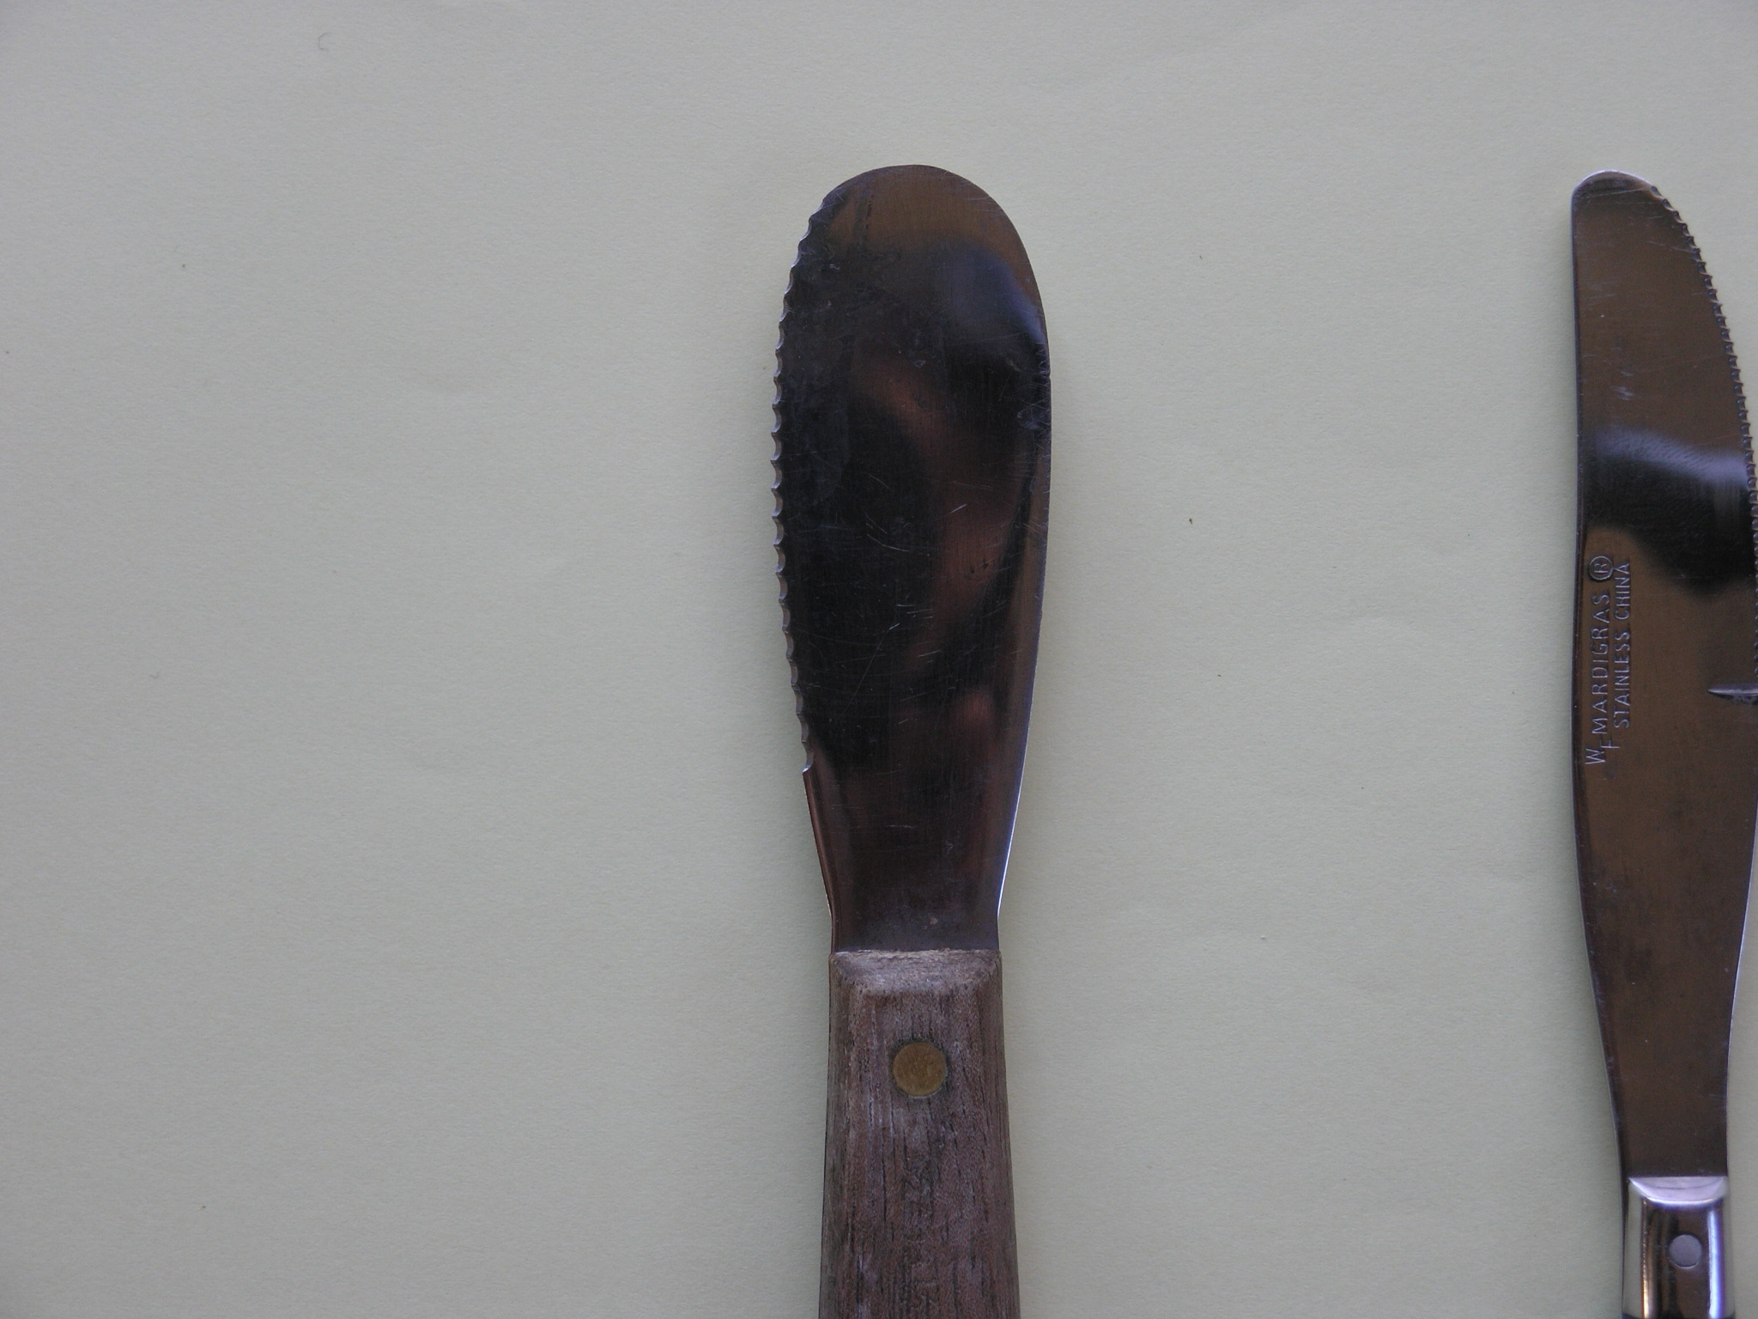

Slide 30
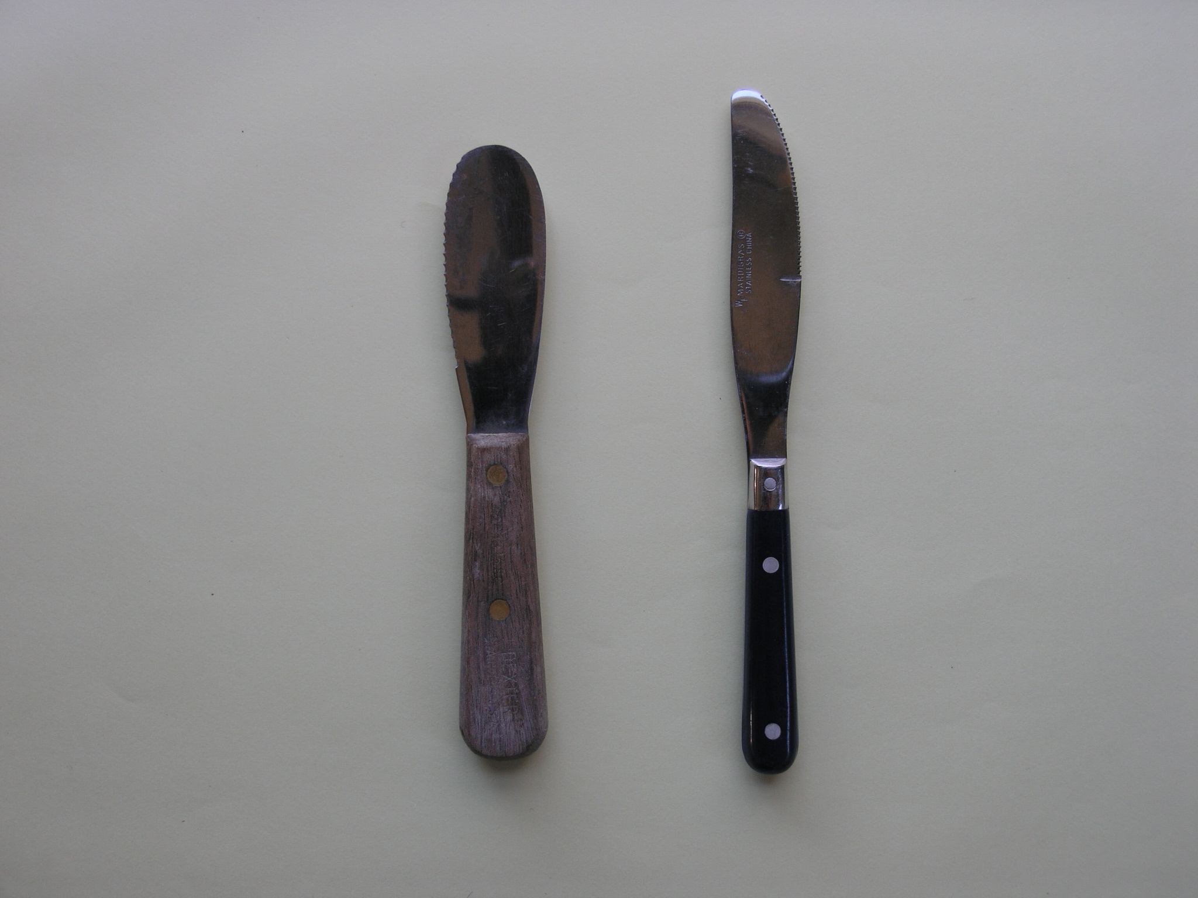

Slide 31
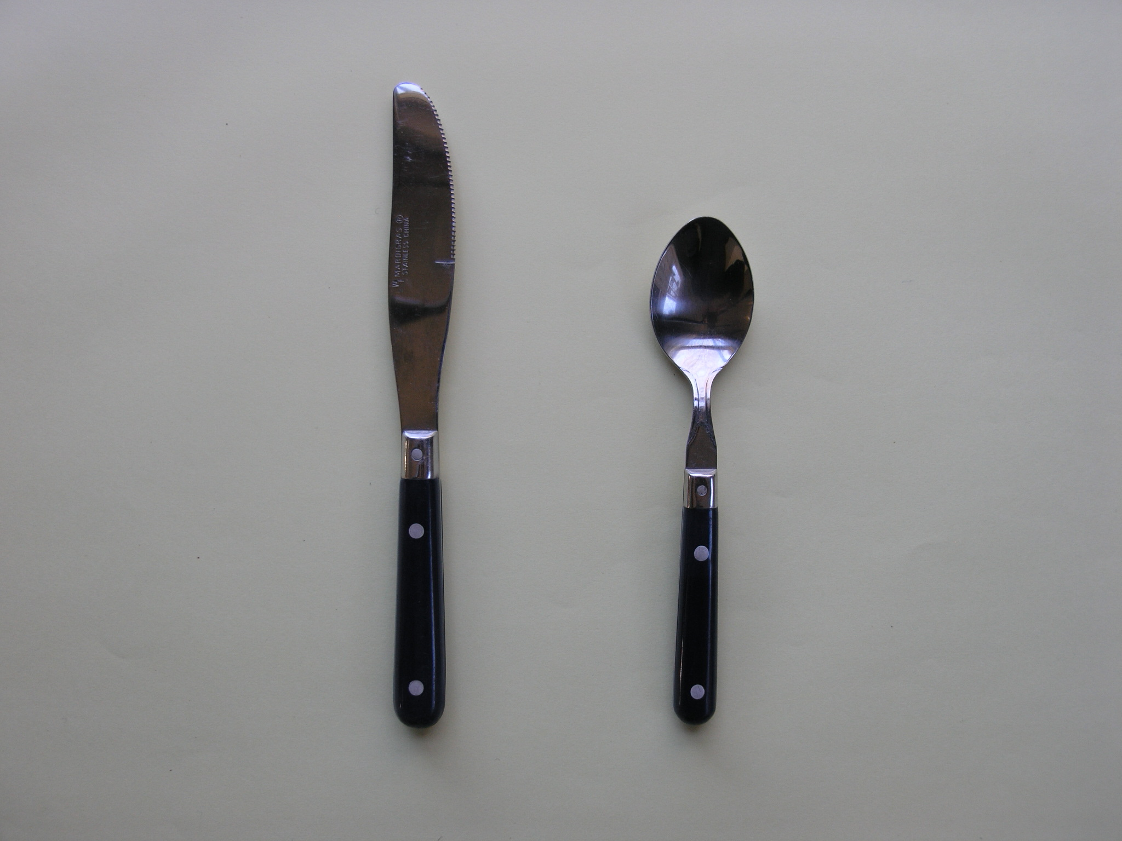

Slide 32
New
Question

Slide 33
Result

Slide 39
Public Speaking & David Lee Roth
Part 1 of 3: Image and Text
Image source: Swanson Leadership. swansonleadership.com
Notes:
http://www.swansonleadership.com/the-secrets-to-public-speaking/

Slide 40
Notes:
StormwaterMgt ppt

Slide 41
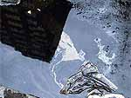
Notes:
StormwaterMgt ppt

Slide 43
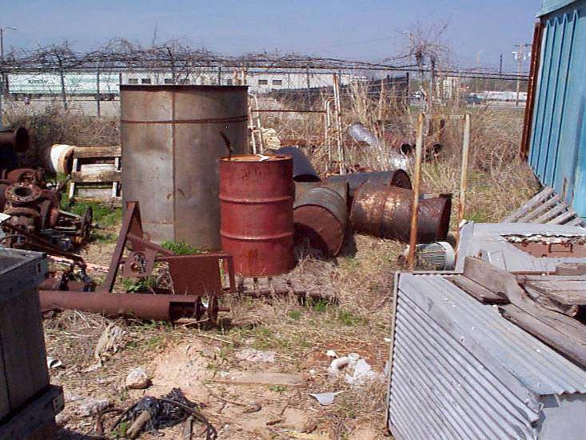
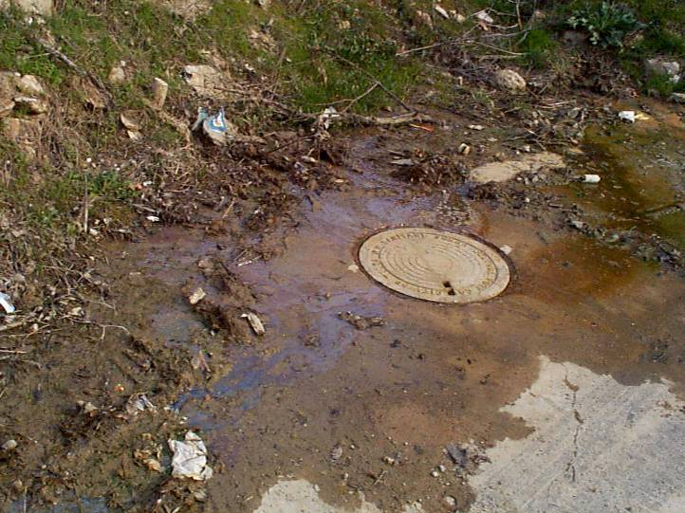
Affect on Water Quality
Increased Pollutant Loading
Sediment
Oil, grease, lubricants
Pesticides and nutrients from lawns
Microorganisms & nutrients from pet waste & failing septic systems
Road salts
Heavy metals from roof shingles, etc.
Thermal pollution from dark impervious surfaces
Source: City of Sapulpa, OK. cityofsapulpa.net

Slide 44
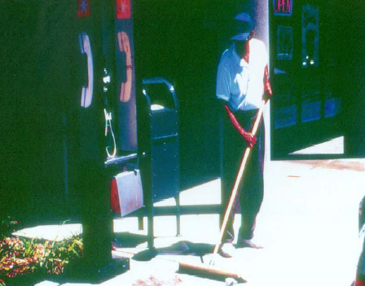
Source: County of San Bernardino. sbcountystormwater.org
Notes:
III maintenance Activities ppt

Slide 45
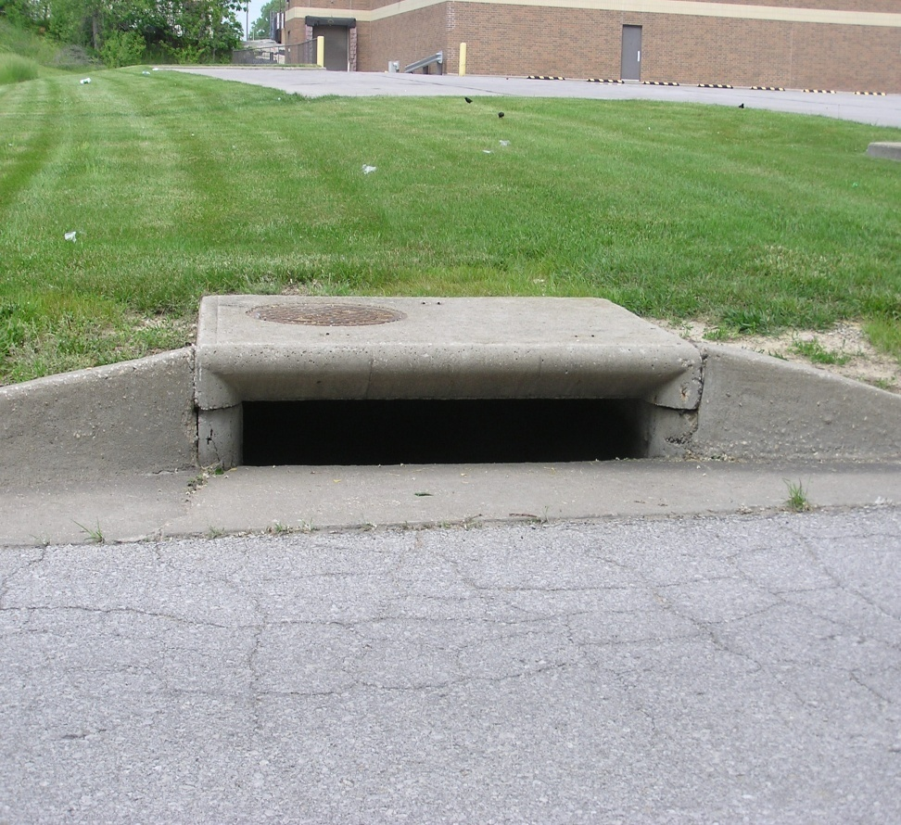
Source: Unified Government of Wyandotte County and Kansas City, Kansas. wycokck.org
Notes:
Stormwater Runoff Management power point with background color ppt

Slide 46
Notes:
Stormwater Runoff Management power point with background color ppt

Slide 47
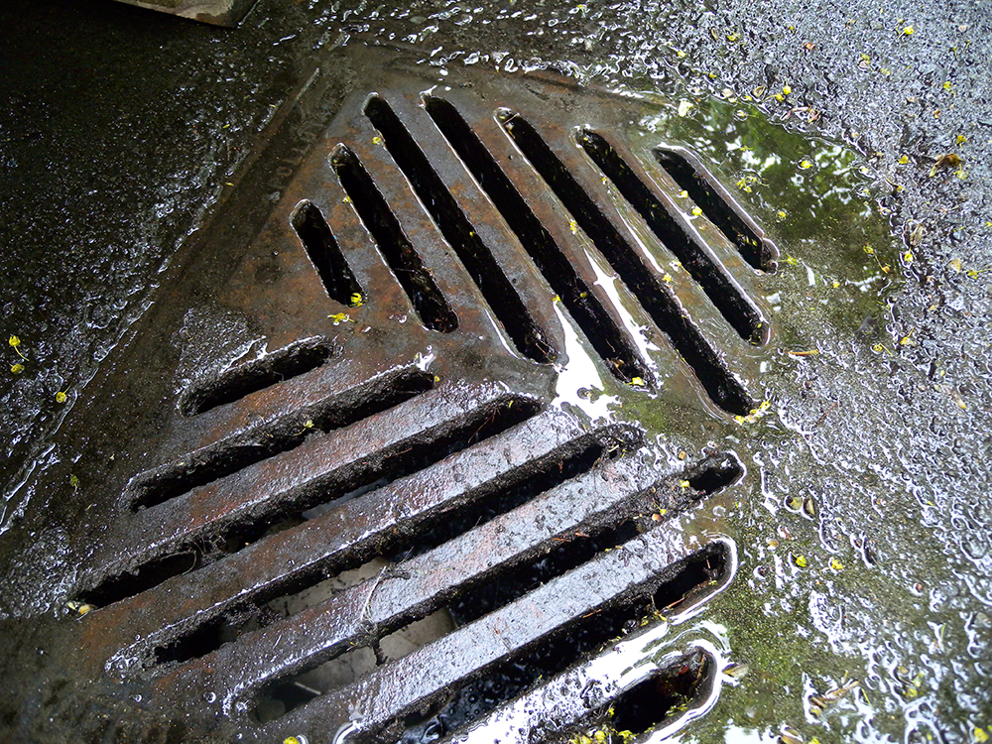

Slide 49
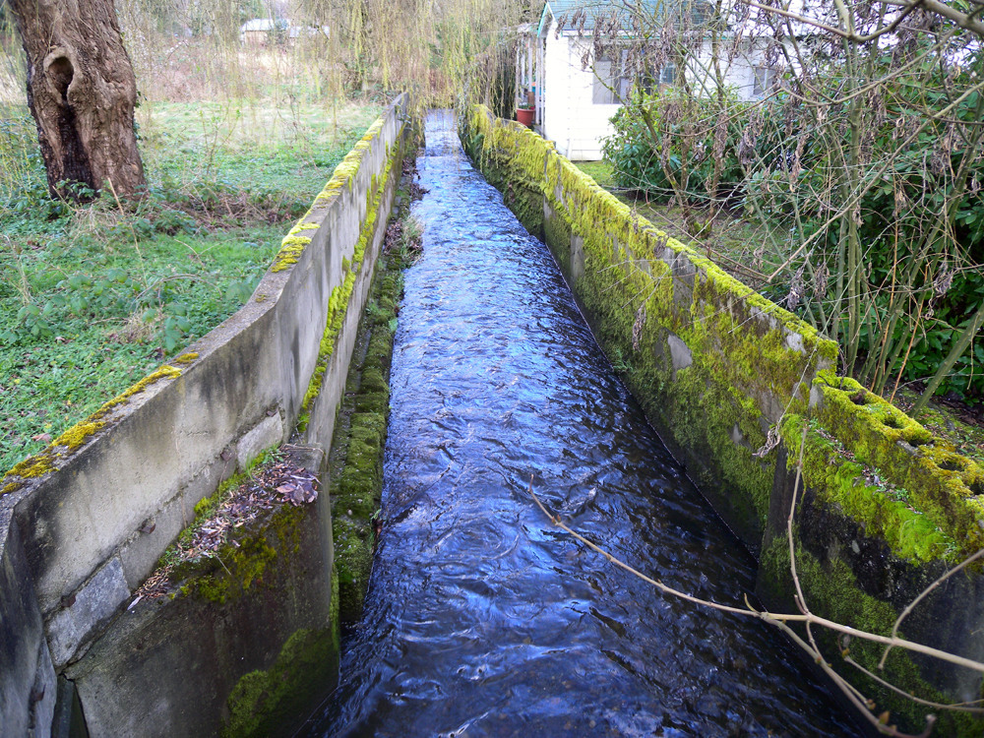

Slide 50
Affect on Water Quality
Increased Pollutant Loading
Sediment
Oil, grease, lubricants
Pesticides and nutrients from lawns
Microorganisms & nutrients from pet waste & failing septic systems
Road salts
Heavy metals from roof shingles, etc.
Thermal pollution from dark impervious surfaces
Source: City of Sapulpa, OK. cityofsapulpa.net

Slide 51
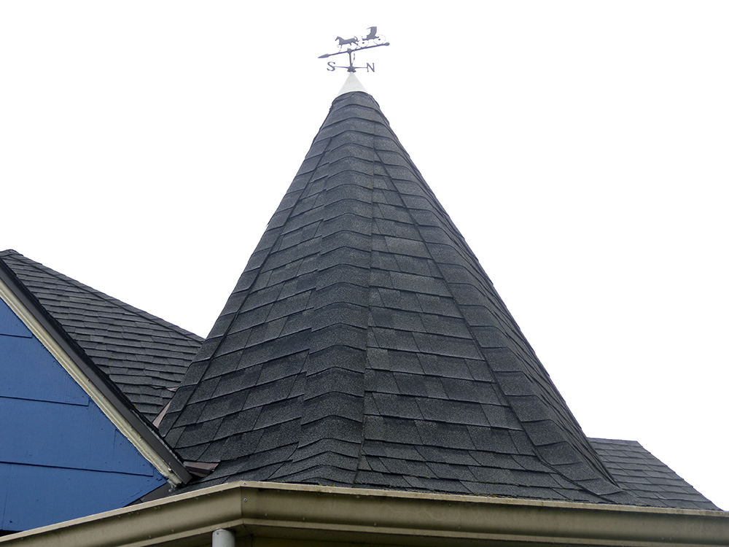

Slide 52
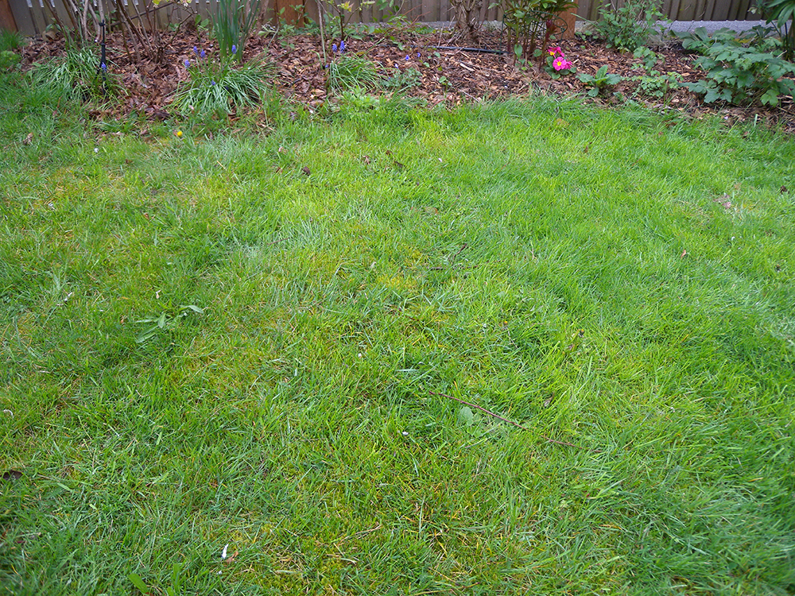

Slide 57
Affect on Water Quality
Increased Pollutant Loading
Sediment
Oil, grease, lubricants
Pesticides and nutrients from lawns
Microorganisms & nutrients from pet waste & failing septic systems
Road salts
Heavy metals from roof shingles, etc.
Thermal pollution from dark impervious surfaces

Slide 59
Please

Slide 60
avoid

Slide 61
repetitive,

Slide 62
busy

Slide 63
backgrounds.

Slide 64
Instead,

Slide 65
keep

Slide 66
it

Slide 67
simple.

Slide 77
maximum of six words per slide

Slide 78
maximum of six words per slide

Slide 79
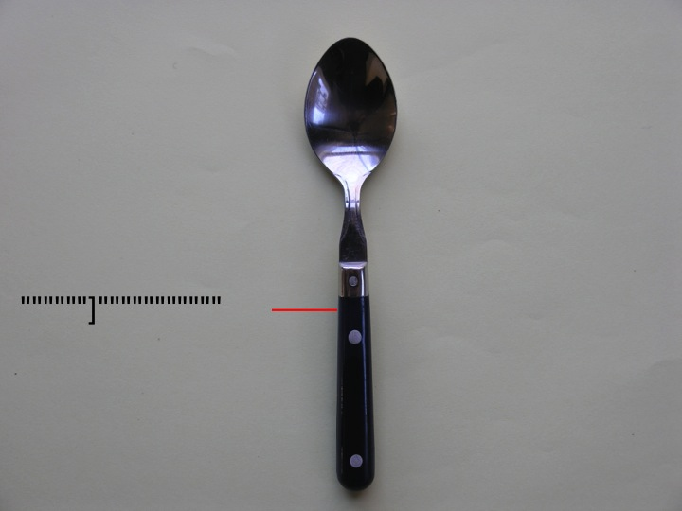

Slide 80
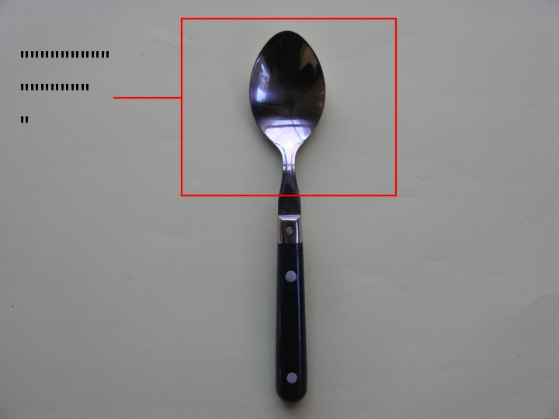

Slide 81
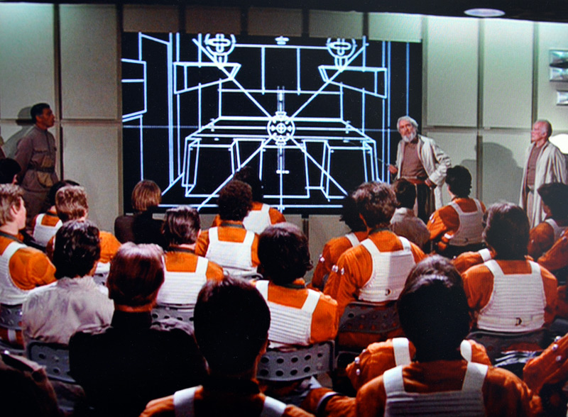
Source: Garr Reynolds | www.presentationzen.com
Notes:
Garr Reynonlds
A long time ago, before death by PowerPoint
A long time ago — before PowerPoint was invented — in a galaxy far, far away, leaders gave presentations backed by large electronic wall displays. Below, for example, is a photo of General Dodonna (from Star Wars IV) briefing a packed room full of starpilots, navigators, and droids. Notice how he uses the entire wide screen to display only visual information, a digital vector animation of the inner workings of the death star. Notice too how he has gathered the troops close to the front, how he himself stands close to the back-lit screen (even slightly in front of it at times), and maintains eye-contact with the audience, occasionally pointing to key areas of the animation on screen.
http://www.presentationzen.com/presentationzen/2010/08/a-long-time-ago-before-death-by-powerpoint.html

Slide 82
Source: Garr Reynolds | www.presentationzen.com

Slide 83
Source: Garr Reynolds | www.presentationzen.com

Slide 85
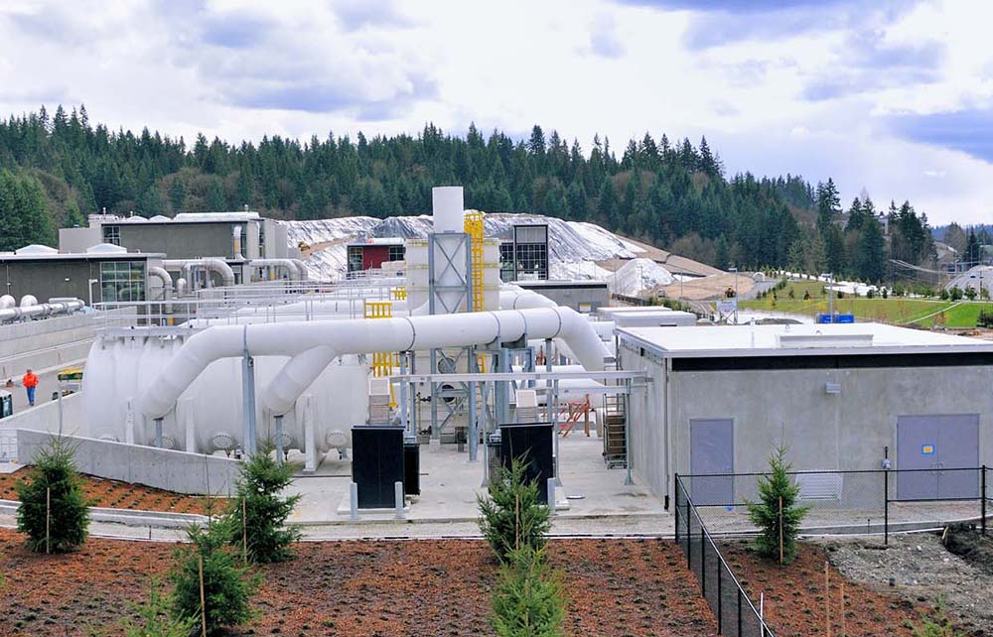
2. Simplify

Slide 87
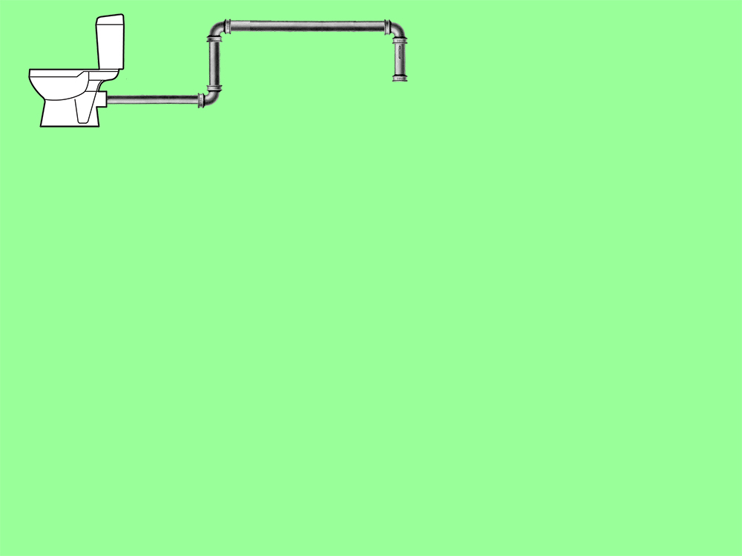

Slide 88
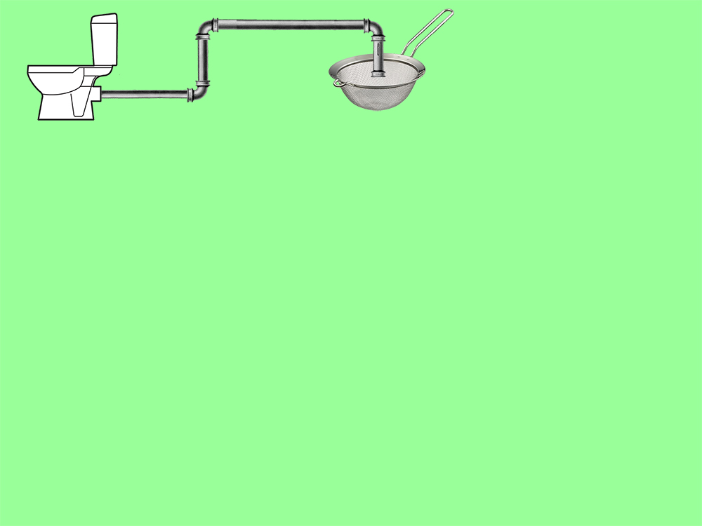

Slide 89
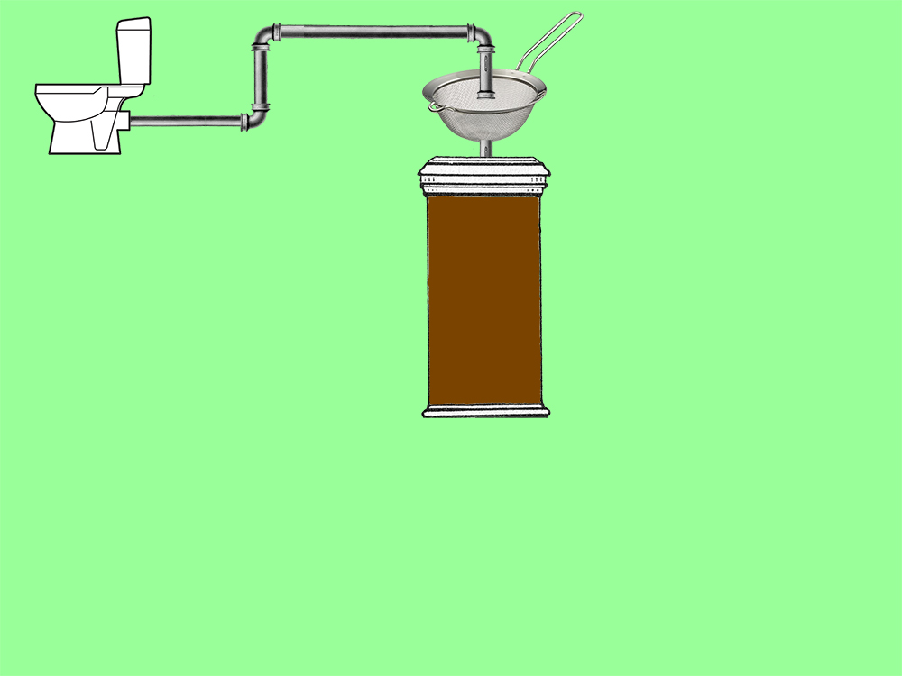

Slide 98
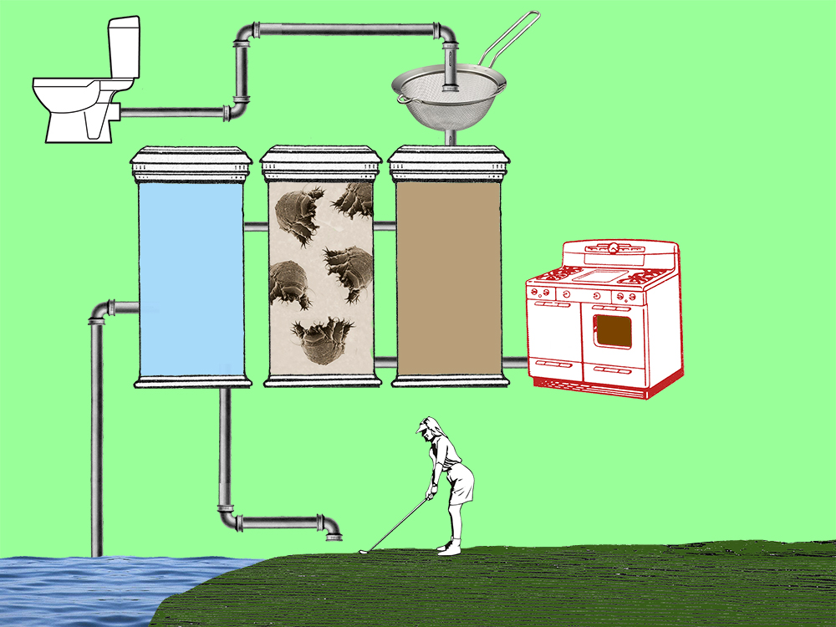

Slide 100
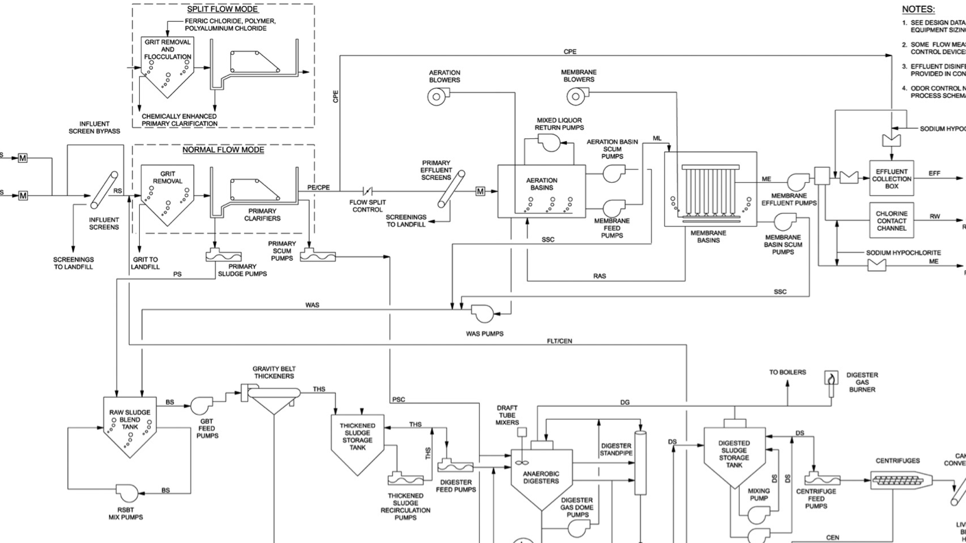

Slide 101
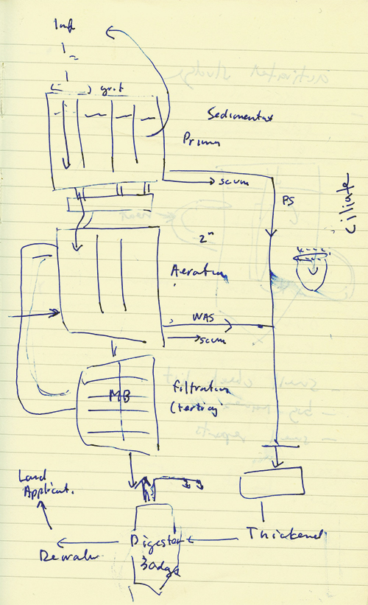

Slide 102
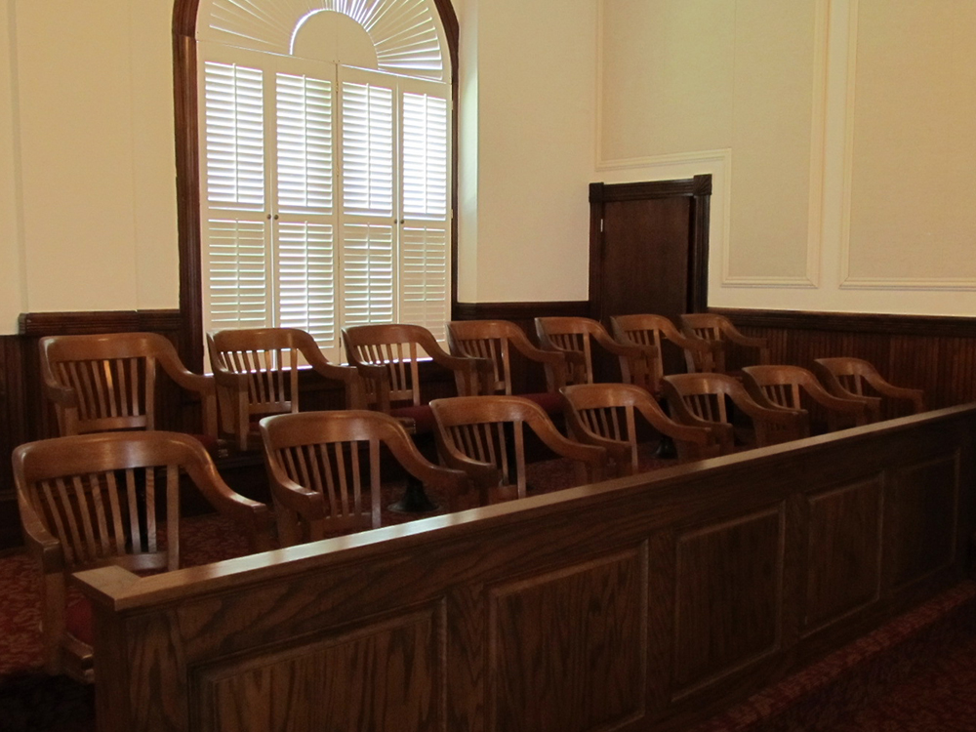
Notes:
http://www.waynecountyclerkofcourt.com/index.cfm/jury-information1/

Slide 104
Source: Garr Reynolds | www.presentationzen.com
Notes:
Garr Reynonlds
A long time ago, before death by PowerPoint
A long time ago — before PowerPoint was invented — in a galaxy far, far away, leaders gave presentations backed by large electronic wall displays. Below, for example, is a photo of General Dodonna (from Star Wars IV) briefing a packed room full of starpilots, navigators, and droids. Notice how he uses the entire wide screen to display only visual information, a digital vector animation of the inner workings of the death star. Notice too how he has gathered the troops close to the front, how he himself stands close to the back-lit screen (even slightly in front of it at times), and maintains eye-contact with the audience, occasionally pointing to key areas of the animation on screen.
http://www.presentationzen.com/presentationzen/2010/08/a-long-time-ago-before-death-by-powerpoint.html

Slide 106
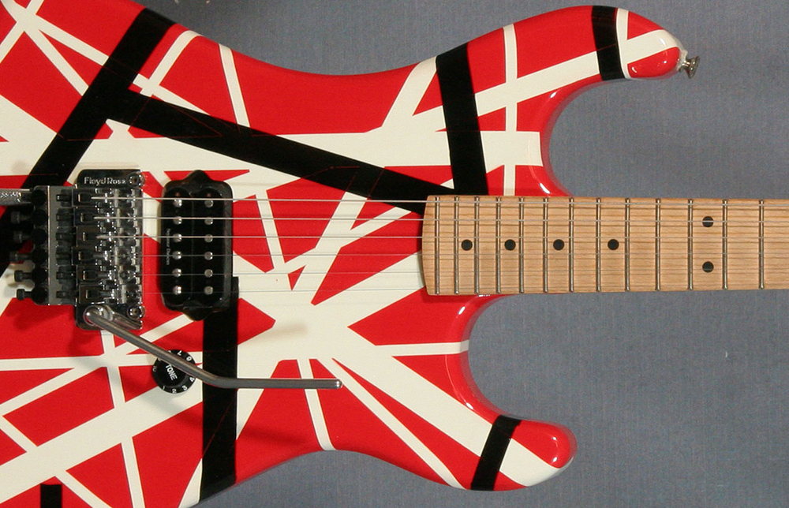
Source: https://www.lasvegasguitarworks.com/technical-articles/examples-of-artist-guitars.asp
Part 3: David Lee Roth story (four versions)
Notes:
https://www.lasvegasguitarworks.com/technical-articles/examples-of-artist-guitars.asp

Slide 107
David Lee Roth (1)

Slide 109
David Lee Roth (2)

Slide 111
Source: SEI Partners, http://aplndc.com
Notes:
SEI Partners
http://www.google.com/url?sa=t&rct=j&q=&esrc=s&source=web&cd=1&sqi=2&ved=0CDUQFjAA&url=http%3A%2F%2Faplndc.com%2FeventSlides%2FYear2010%2F2010-March-CMMIAndAgile-PartnersInDrivingRadicalChangeInEngineering-JeffDalton-March2010.pdf&ei=3S4cUd7fDs3RiALuyYDIBg&usg=AFQjCNHfH47WmvlxnsAtjm2HvjPv3rw3aA&sig2=5kqZPZ9ikR9qzrIkRkyrBA&bvm=bv.42452523,d.cGE

Slide 112
Source: SEI Partners, http://aplndc.com

Slide 113
Source: SEI Partners, http://aplndc.com

Slide 114
Source: SEI Partners, http://aplndc.com

Slide 115
Source: SEI Partners, http://aplndc.com

Slide 116
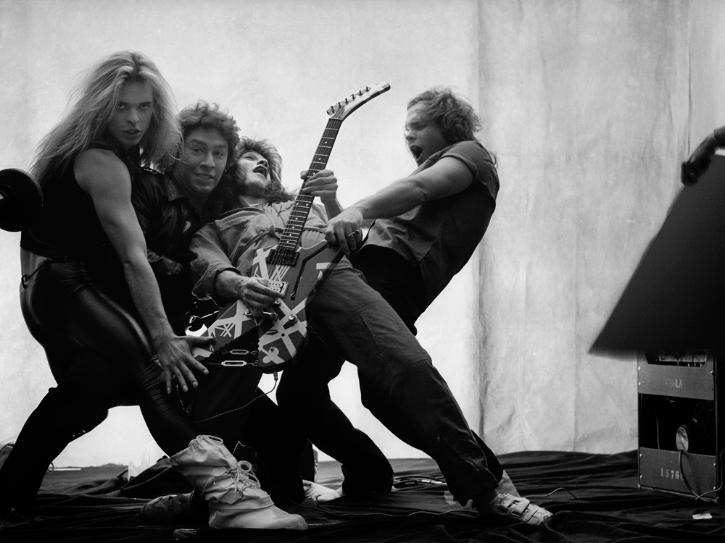
Source: Norman Seeff. http://normanseeffphotography.com/wordpress/gallery-musicians/
Notes:
http://normanseeffphotography.com/wordpress/gallery-musicians/
Norman Seeff

Slide 117
Source: SEI Partners, http://aplndc.com

Slide 119
David Lee Roth (3)

Slide 121
Source: http://explow.com/David_Lee_Roth_Yankee_Rose

Slide 122
Source: http://explow.com/David_Lee_Roth_Yankee_Rose
Notes:
http://explow.com/David_Lee_Roth_Yankee_Rose

Slide 124
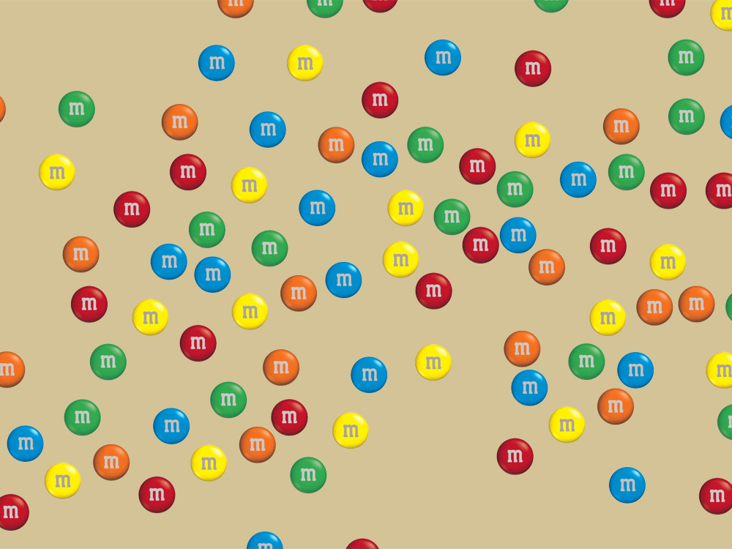

Slide 125
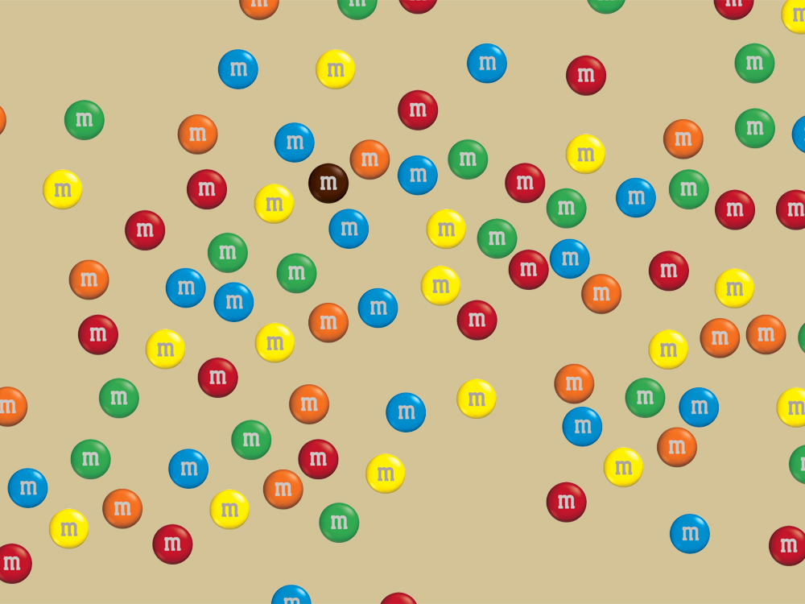

Slide 126
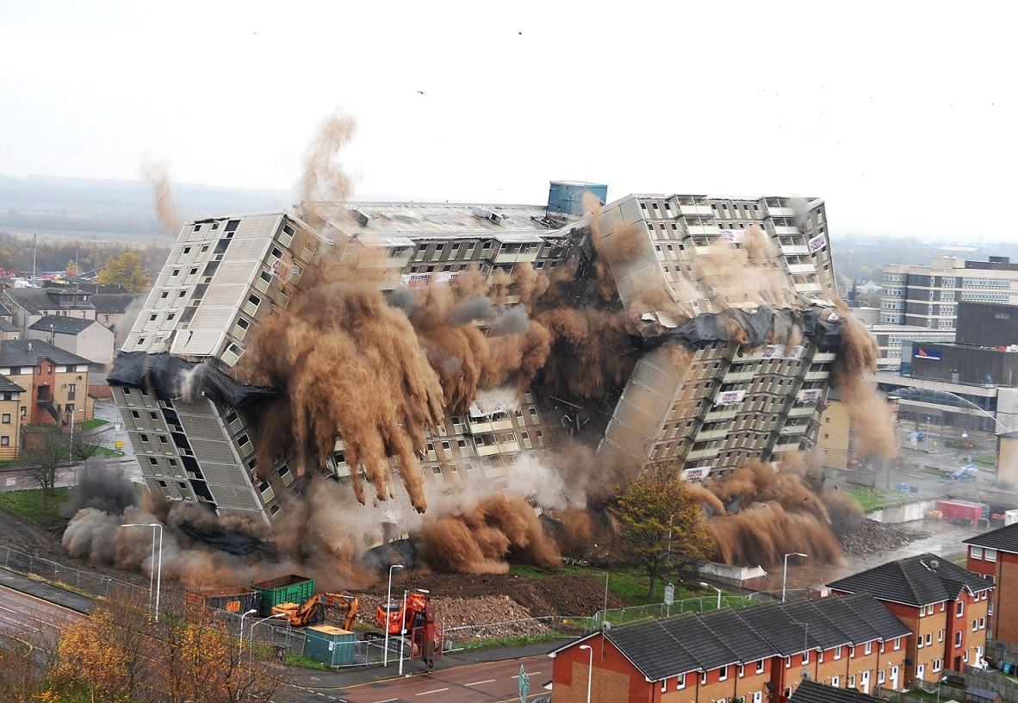
Source: Urban Rhealm. http://www.urbanrealm.com/news/3210/Motherwell_tower_block_meets_explosive_demise.html
Notes:
Urban Rhealm
http://www.urbanrealm.com/news/3210/Motherwell_tower_block_meets_explosive_demise.html

Slide 132
David Lee Roth (4)

Slide 134
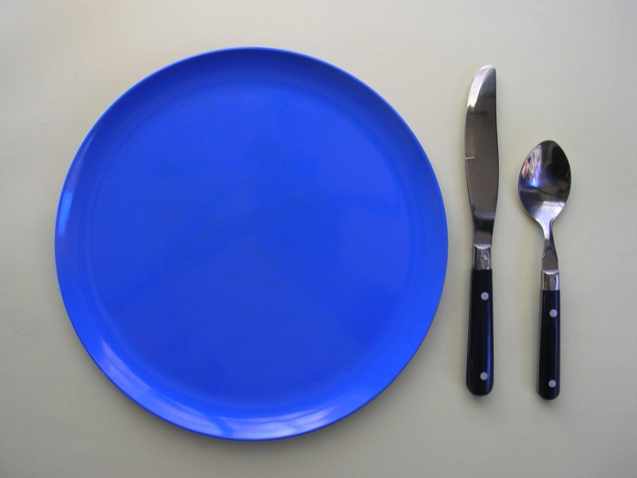

Slide 135
Image Sources:
Star Wars: Source: Garr Reynolds | www.presentationzen.com
Corporate PowerPoint: SEI Partners, http://aplndc.com
Afghanistan diagram: http://www.dansappassociates.com/
Van Halen: Norman Seeff. http://normanseeffphotography.com/wordpress/gallery-musicians/
Roth as king: http://explow.com/David_Lee_Roth_Yankee_Rose
Building Collapse: Urban Rhealm. http://www.urbanrealm.com/news/3210/Motherwell_tower_block_meets_explosive_demise.html

