Slide 1
Virtual Exercises in California –
A DFW-OSPR Perspective
Presented by:
Chris Thixton, CDFW-OSPR
Preparedness Branch, Drills & Exercises Unit

Slide 2
Overview
OSPR Actions in 2020
Crawl / Walk / Run to a virtual exercise
OSPR D&E Unit virtual lessons learned
Cross-section of industry virtual lessons learned
Virtual platform exercises July – November 2020
Tour of our encounters with virtual exercises
2

Slide 3
OSPR Actions in 2020
Complete stand down of all exercises on March 13, 2020
No exercises from mid-March through early June
Committed to exercising all plans as required in 2020
How do we exercise all plans?
Virtual platforms
Remote (old fashion emails, phones, texts)
3

Slide 4
Crawl / Walk / Run to a Virtual Exercise
OSPR migrates to MS Teams in 2019
Spring 2020, D&E Unit (D&E) staff observe MS Teams exercise with Marathon refinery and Washington State Department of Ecology
OSPR participates in first MS Teams exercise in July with P66
4

Slide 5
OSPR D&E Virtual Lessons Learned
Virtual exercises require more of everything:
Design, evaluators, training, and behind the scenes management
Policies may limit file sharing capability
Preparation and practice with the technology is critical to the success of the exercise
5

Slide 6
Industry Lessons Learned
Virtual platform is only as useful as the user's knowledge of the tool. Players must be ready to operate in the platform and know their ICS roles
Utilizing contractors who have expertise in virtual platforms greatly improves the success of the exercise
Virtual platforms will be utilized during real-world responses to brief traveling away teams (SMT), regulators, and stakeholders
6

Slide 7
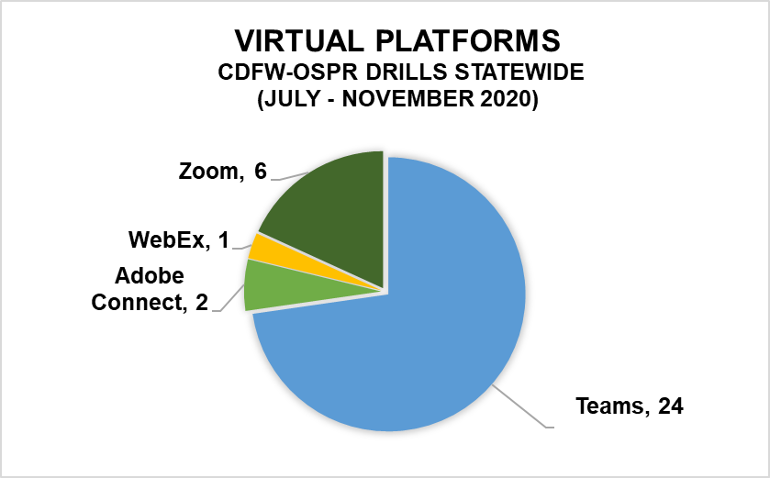
7
Notes:
NEED TO TRIM DOWN THE TEXT – ISSUE!

Slide 8
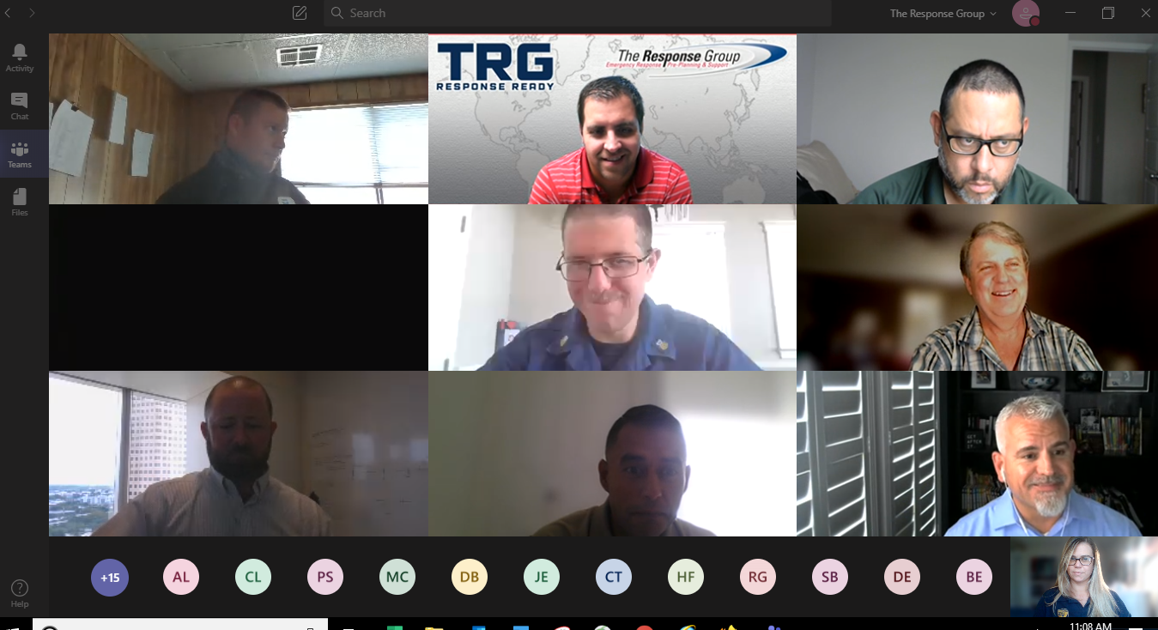
Teams - Virtual brings people together
8

Slide 9
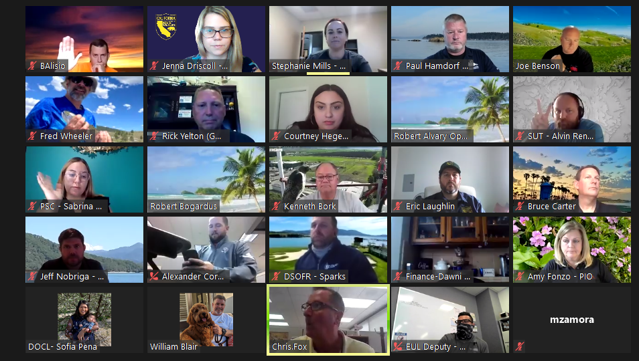
Zoom – Brings people together
9

Slide 10
Zoom – Safety messaging
10

Slide 11
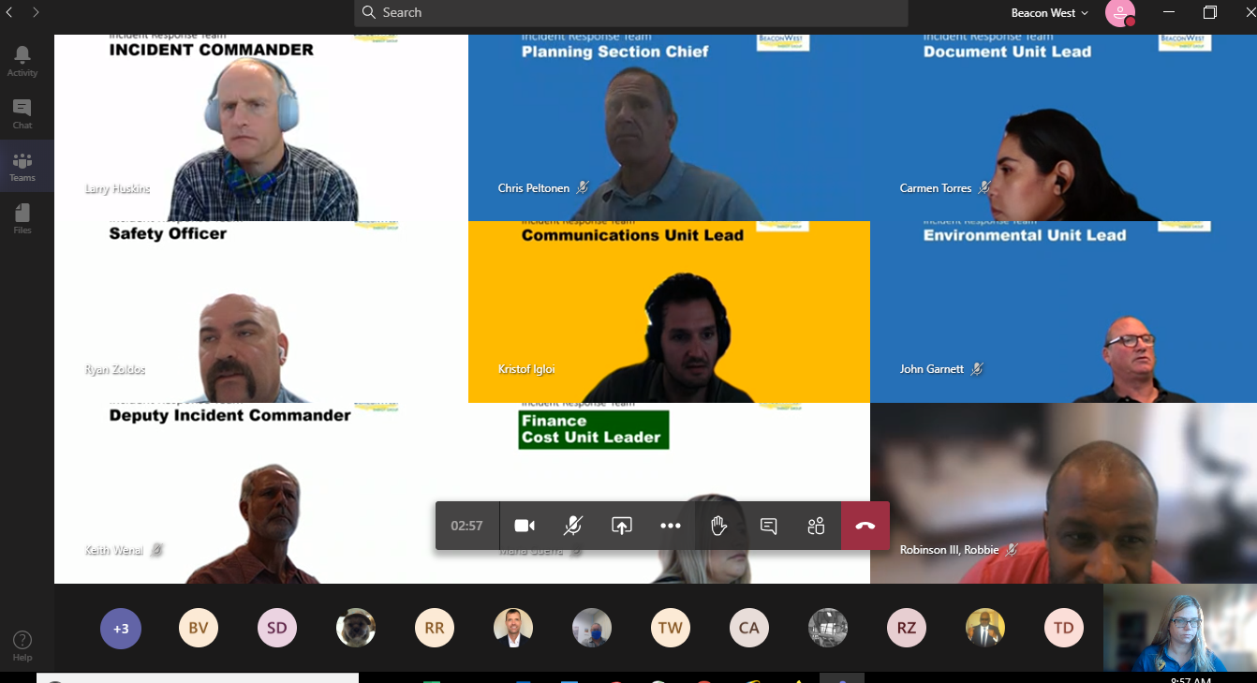
Teams – Staff identified
11

Slide 12
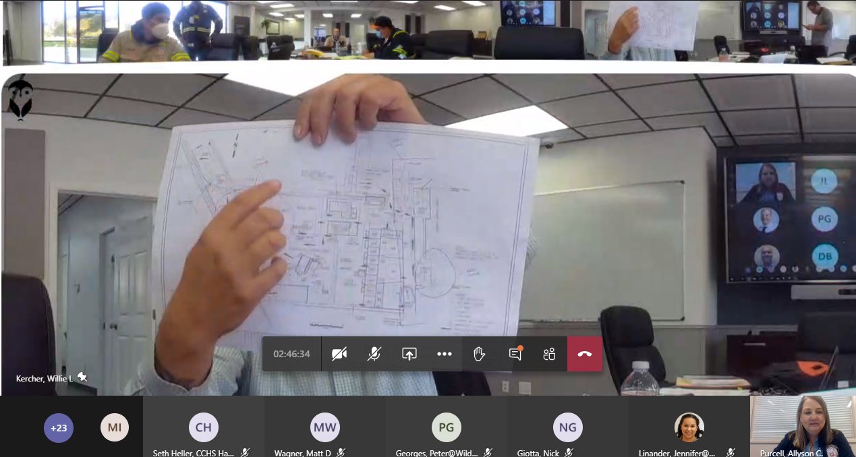
Teams – 1st virtual TTX in California
12

Slide 13
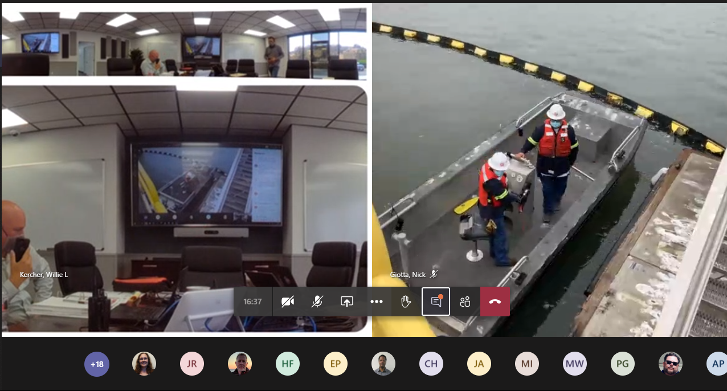
Teams – Safety 1st, in the field & ICP
13

Slide 14
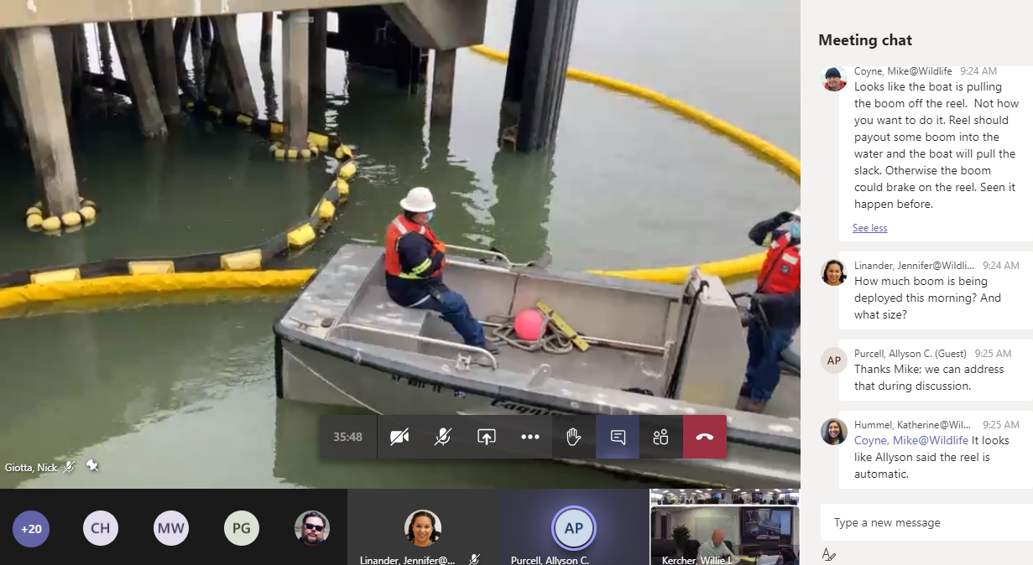
Teams – Realtime field observations & chat
14

Slide 15
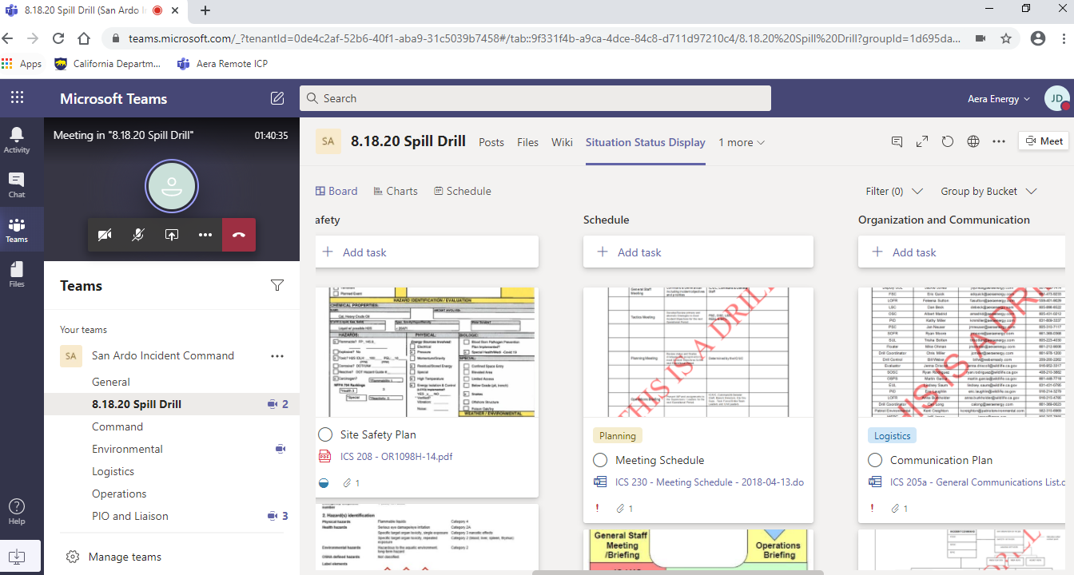
Teams – Situation Unit Display
15

Slide 16
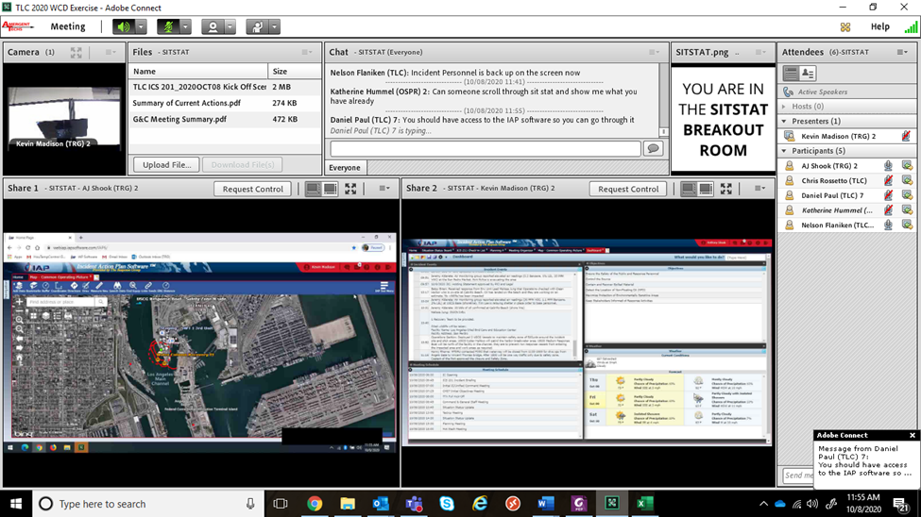
Adobe Connect – Situation Display
16

Slide 17
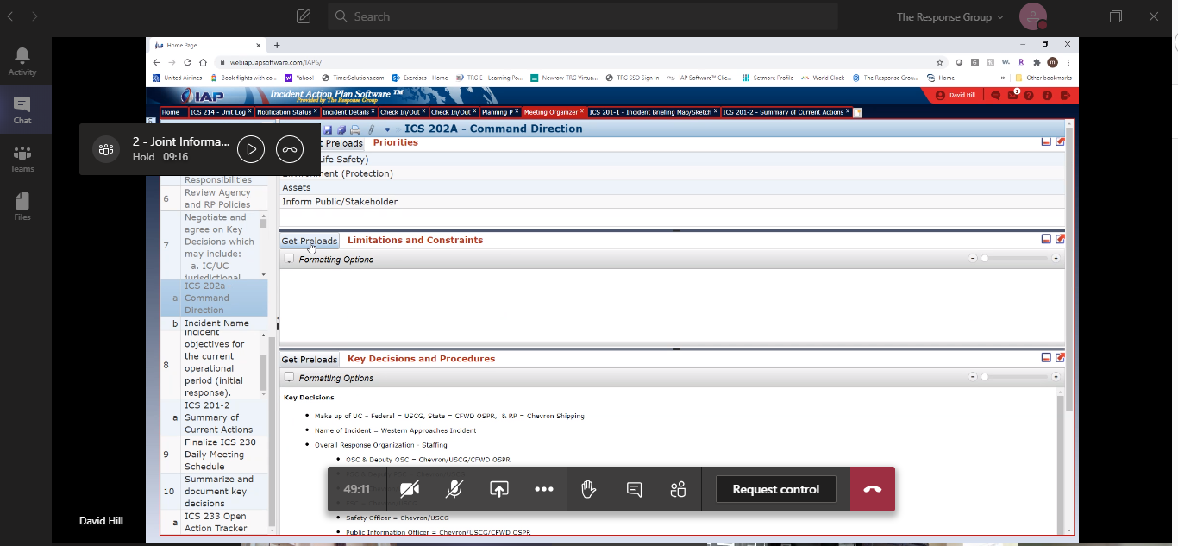
Teams – IAP Software
17

Slide 18
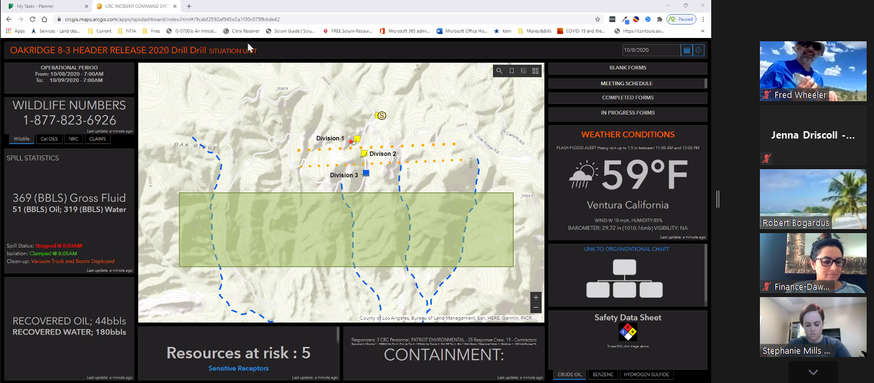
Multiple Platforms
Zoom - Display / Teams – Internal Meetings
18

Slide 19
Teams – ICS 201 briefing
19

Slide 20
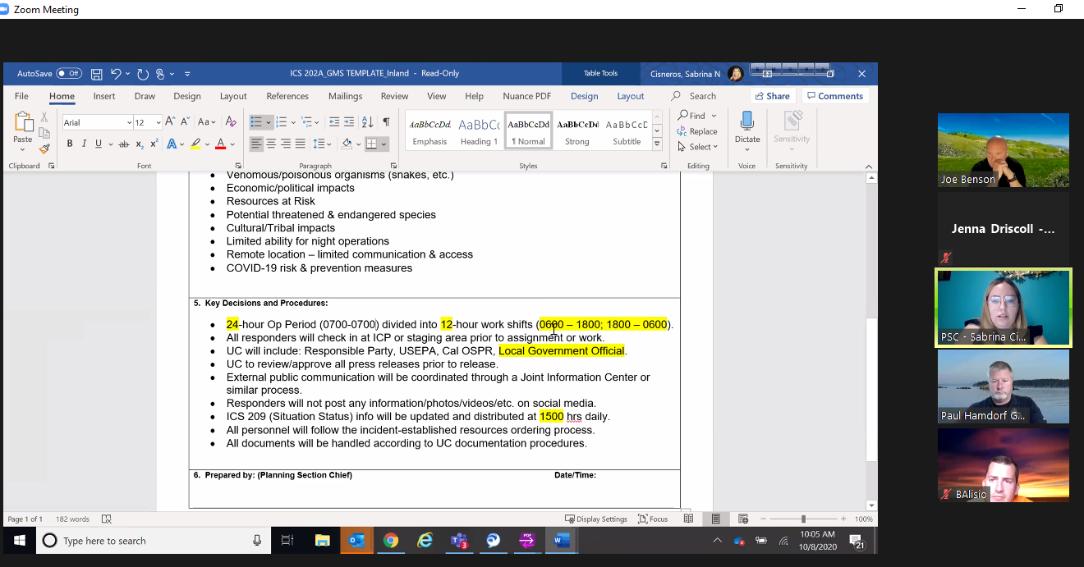
Zoom – ICS 202A update
20

Slide 21
Teams – IAP Software
21

Slide 22
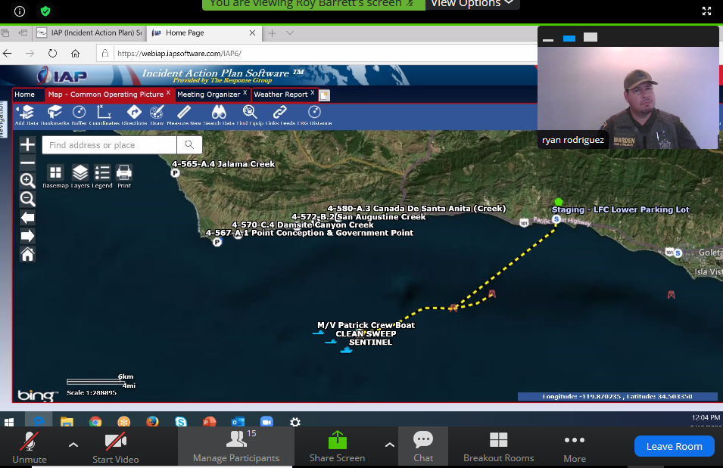
Teams – IAP Software
22

Slide 23
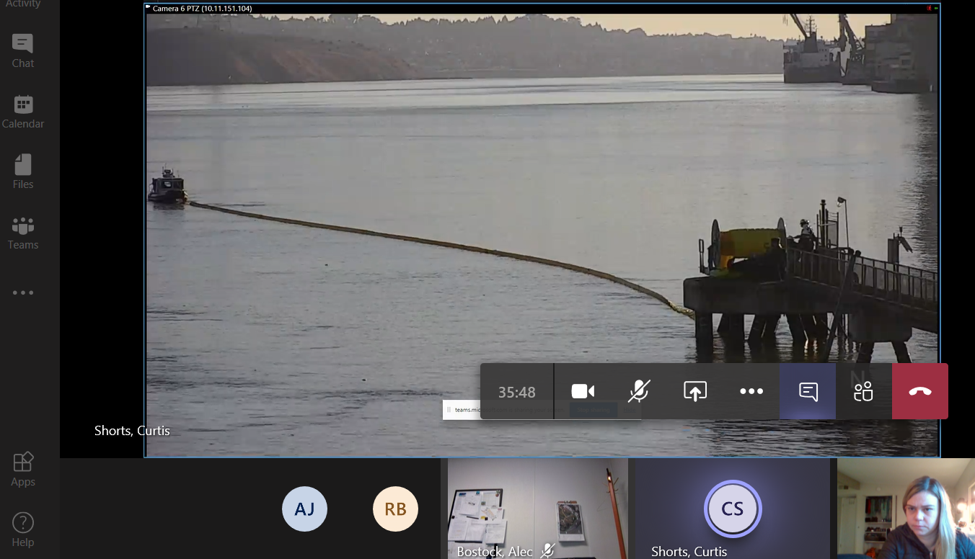
Teams – Gear deployment
23

Slide 24
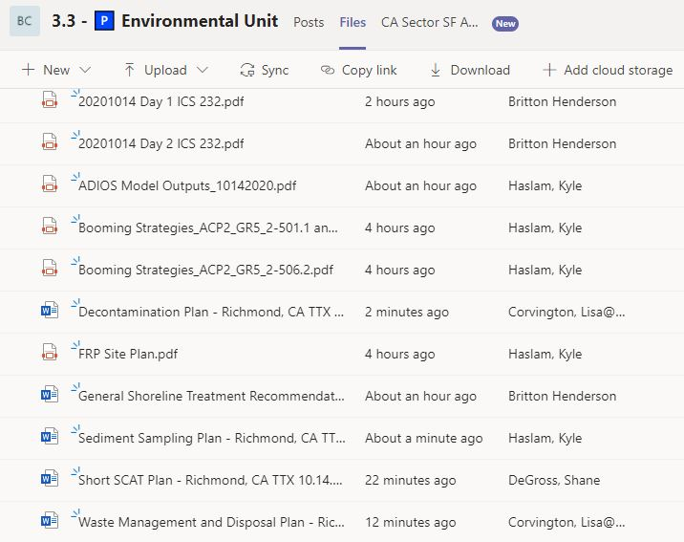
Documents in Environmental Unit Channel
Teams – The details
24

Slide 25
UC message
Inject discussion
Message
Teams – The details
25

Slide 26
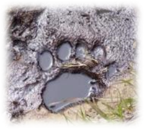
Contact Information
Chris Thixton
Senior Environmental Scientist - Supervisor
Drills & Exercises Unit, CDFW-OSPR
email: chris.thixton@wildlife.ca.gov
cell phone: 562-233-7095
26

