Slide 1
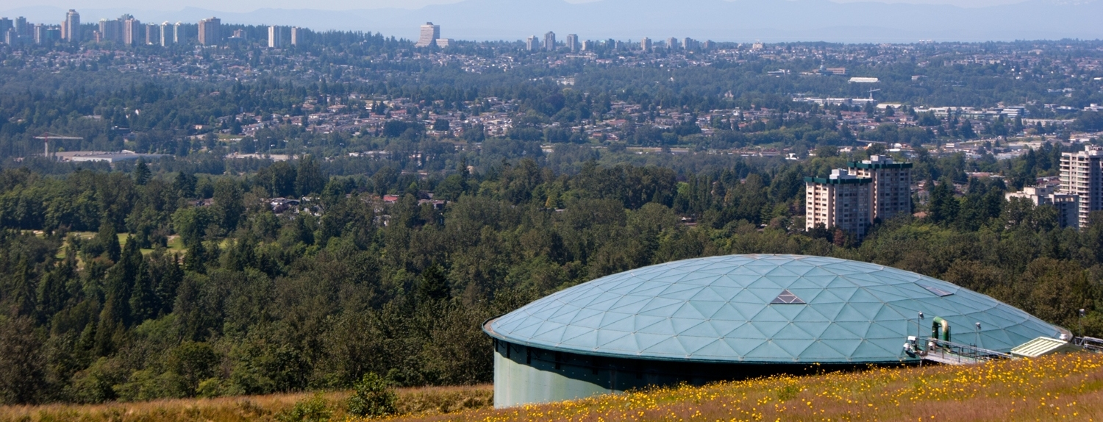

Oil Spill Task Force Annual Meeting
Responding to an Oil Spill during COVID-19 Pandemic
November 18, 2020

Slide 2
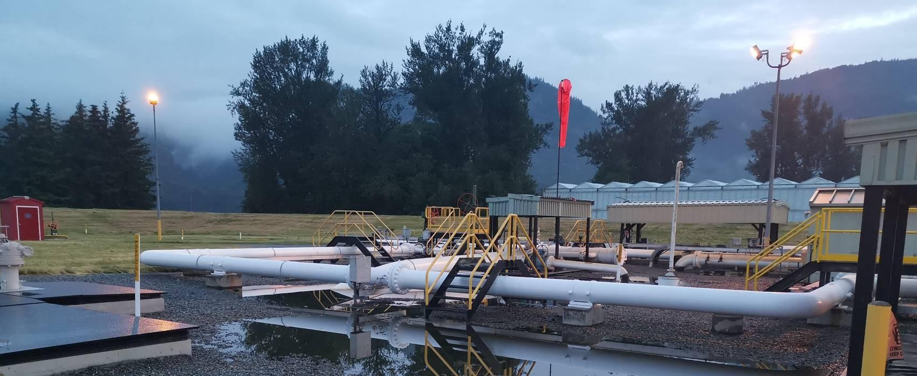
Incident timeline

Slide 3
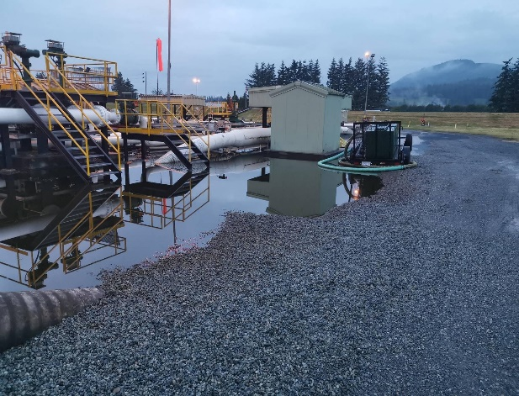








Incident Timeline
13th
14th
19th
24th
20th
7th
1st
June
July
August
September
October
June 13
Release occurs at Sumas Pump Station in Abbotsford, B.C.
Alarm received at Edmonton Control Centre.
Immediate shut down of pipeline and crews dispatched to investigate.
Initial Trans Mountain responders conduct site investigation.
Initial Incident Command Post established.
Notifications made to the local authority, indigenous communities the province and federal regulator.
Release fully contained on Trans Mountain property.

Slide 4
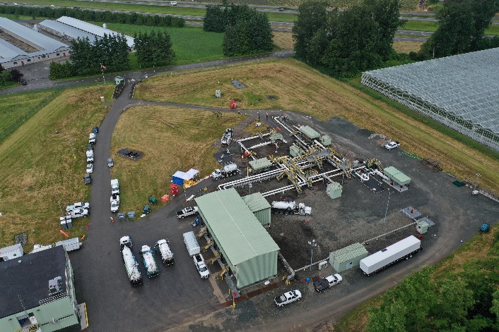
Incident Timeline
13th
14th
19th
24th
20th
7th
1st
June
July
August
September
October
June 14
Clean-up and response efforts continue
Incident Command Post remains active and moved to hotel in Abbotsford. Unified Command is established.
Clean-up is well underway with crews working around the clock.
Remediation efforts continue in coordination with regulators, Indigenous communities and the province.
COVID-19 protocols are being followed both at the
Incident Command Post and at the site of the clean-up.

Slide 5
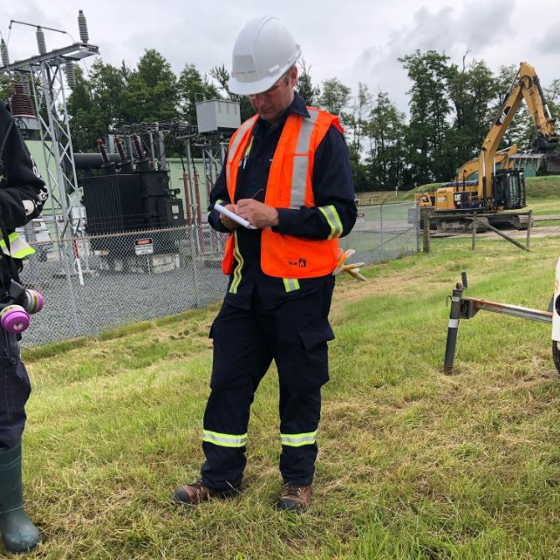
Incident Timeline
13th
14th
19th
24th
20th
7th
1st
June
July
August
September
October
June 19
On-site response concludes
Unified Command terminates the official emergency phase as Project Phase established. Incident Command Post stood down.
Canada Energy Regulator (CER) has concluded its on-site response.
Clean-up and remediation work to continue with the CER Remediation Process Guide.
Trans Mountain is fully cooperating with investigative efforts of the Canada Energy Regulator and Transportation Safety Board.

Slide 6
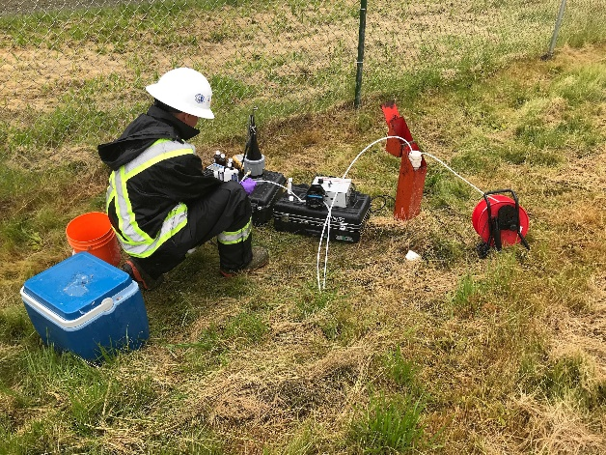
Incident Timeline
13th
14th
19th
24th
20th
7th
1st
June
July
August
September
October
June 24
Site remediation efforts continue
Trans Mountain continues to work 24 hours a day at the Sumas Pump station with a workforce of approx. 70 people.
Contaminated soil is being excavated and removed from the site.
Indigenous representatives have visited the site and monitors are assisting the effort, including the undertaking of archeological investigations on site.

Slide 7

Incident Timeline
13th
14th
19th
24th
20th
7th
1st
June
July
August
September
October
July 20
Clean-up and response efforts continue
Crews continue to work around the clock.
Soil excavation in the field adjacent to the station site is complete.
Excavation efforts continue in the vicinity of the release location.
Water quality monitoring data indicates there is no harm to area drinking water.

Slide 8
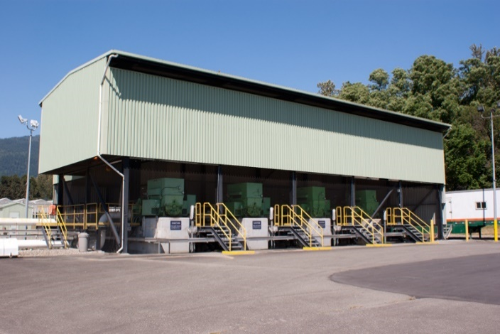
Incident Timeline
13th
14th
19th
24th
20th
7th
1st
June
July
August
September
October
August 7
Recovery efforts remain ongoing
Significant progress in clean-up and remediation efforts.
Trans Mountain continues to provide written reports on site activities, waste volumes, groundwater monitoring and sampling results to regulators and Indigenous community representatives.
Representatives from the Semá:th First Nation continue to visit the site regularly.
An inspection of all similar pipeline fittings across the Trans Mountain system is underway.

Slide 9
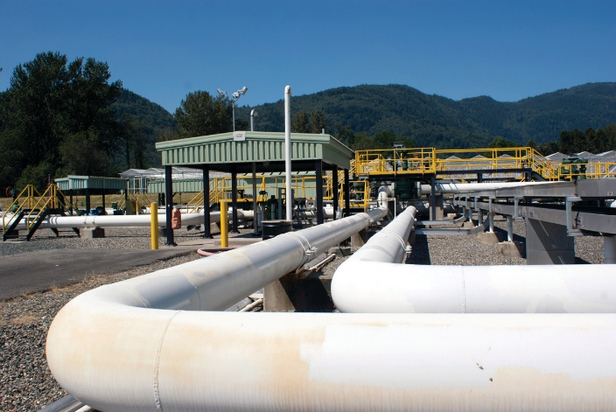
Incident Timeline
13th
14th
19th
24th
20th
7th
1st
June
July
August
September
October
October 1
Response phase nears completion
Trans Mountain continues to work in close cooperation with Stó:lō representatives regarding monitoring and site activities.
An Action Plan is being developed in accordance with the CER Remediation Process Guide and will outline the remediation strategy for the next year.
Release confirmed to be related to a fitting on a small diameter (1”) piece of pipe connected to the mainline.

Slide 10
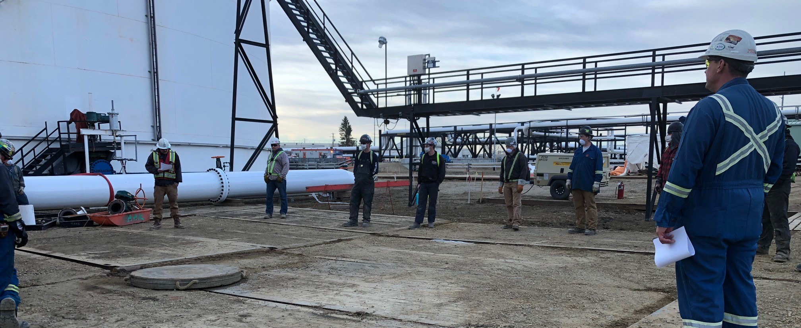
Response During Covid-19

Slide 11


Process and Procedures
Able to adhere to COVID-19 protective measures while responding to an emergency and standing up an ICP
No COVID-19 cases presented themselves during the
Sumas Pump Station response

Slide 12
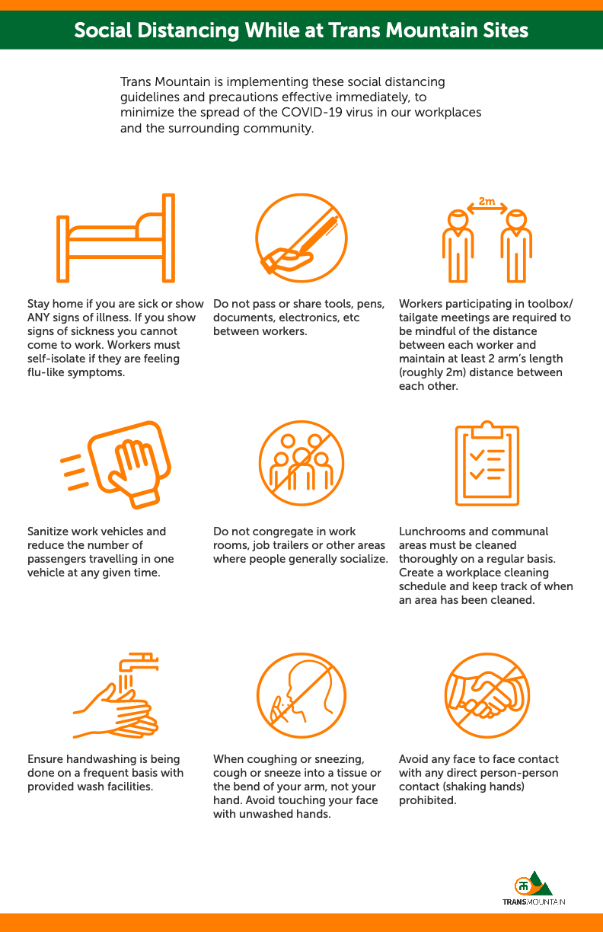
Process and Procedures
Trans Mountain was prepared with a number of protection measures in place, including
  processes,
  protocols, and
  plans
to prevent the spread of COVID-19.
Notes:
Trans Mountain was prepared with a number of protection measures in place, including processes, protocols, and plans to prevent the spread of COVID-19.
In response to the pandemic, Trans Mountain developed an initial Pandemic Plan to support its Crisis Management Plan and to enhance agility and responsiveness as the pandemic evolved.
The Pandemic Plan was officially implemented in February 2020 and serves to minimize impacts to workers and contractors from illness and reduce risks to critical business functions.
As an early response planning action, Trans Mountain acquired additional enhanced PPE supplies to augment internal and contractor inventories.

Slide 13
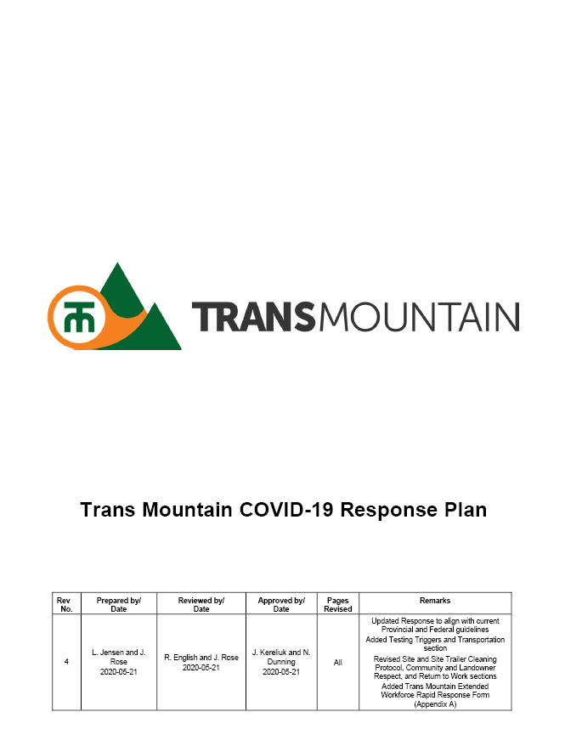
Process and Procedures
COVID-19 Response Plan (“COVID Plan”) outlines requirements, guidelines, and precautions for:
  communication and awareness
  cleaning protocols
  personal protective equipment
  physical distancing
  site operations
  interactions with communities and landowners
Notes:
A specific COVID-19 Response Plan (COVID Plan) for Trans Mountain and TMEP was formalized in March 2020.
The COVID Plan outlines requirements, guidelines, and precautions for:
communication and awareness
cleaning protocols
personal protective equipment
physical distancing
site operations
interactions with communities and landowners
The COVID Plan:
Addresses what workers must do if feeling ill, as well as procedures for returning to work.
Defines Trans Mountain’s requirements of its Contractors during the pandemic.
Is continually reviewed and updated in accordance with current health authority guidelines.

Slide 14
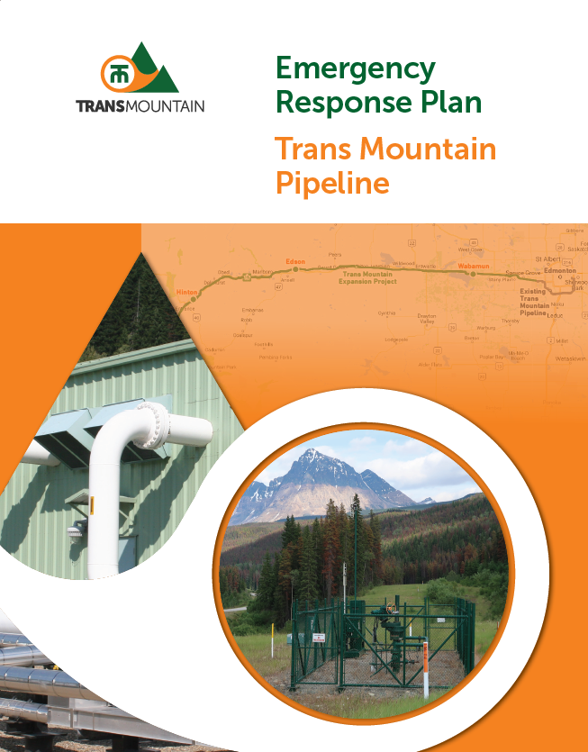
Immediate Response
The Emergency
Response Plan –
Trans Mountain Pipeline
was activated in
conjunction with the
COVID-19
Response Plan.
Site Supervision and Health & Safety Teams continuously monitored pandemic related guidelines and protocols, in conjunction with Trans Mountain’s existing emergency response safety measures.
Notes:
The Emergency Response Plan – Trans Mountain Pipeline was activated on June 13th, 2020 in conjunction with the COVID-19 Response Plan.
Trans Mountain’s response to the Sumas Pump Station incident was carried out in accordance with the directives from federal and provincial health authorities at the time.
COVID protocols were followed at all response sites by Trans Mountain response personnel and contractors, including in the ICP and at the Pump Station.
Throughout the response, Site Supervision and Health & Safety Teams continuously monitored pandemic related guidelines and protocols, in conjunction with Trans Mountain’s existing emergency response safety measures, to ensure efficacy and compliance.

Slide 15





Activation of the ICP
Combined physical and virtual ICP
Numbers and distancing as per the directives from federal and provincial health authorities at the time
Critical Incident Management Team (IMT) and Incident Command System (ICS) staff present, including Unified Command
Virtual communication was made possible through Microsoft Teams
Planning Section utilized Sharepoint
Notes:
Note: Trans Mountain utilizes an ICP and not an EOC for command and control functions.
A physical ICP was activated on June 13th 2020, with critical Incident Management Team (IMT) and Incident Command System (ICS) staff present, including Unified Command.
The response was supported virtually by additional staff and appropriate external entities.
Virtual communication was made possible through Microsoft Teams. Planning cycle meetings, section briefings, and various other sessions related to the response were held virtually.

Slide 16


Protecting People
Incident-specific Health and Safety Plan that included pandemic specific health and safety guidelines and protocols was created for each response site (pump station and ICP)
All responders required to complete
COVID-19 Self Declaration Questionnaire prior to accessing the pump station or the ICP
Notes:
An incident-specific Health and Safety Plan that included pandemic specific health and safety guidelines and protocols was created for each response site.
All responders were required to complete a COVID-19 Self Declaration Questionnaire prior to accessing either the site or the ICP.

Slide 17
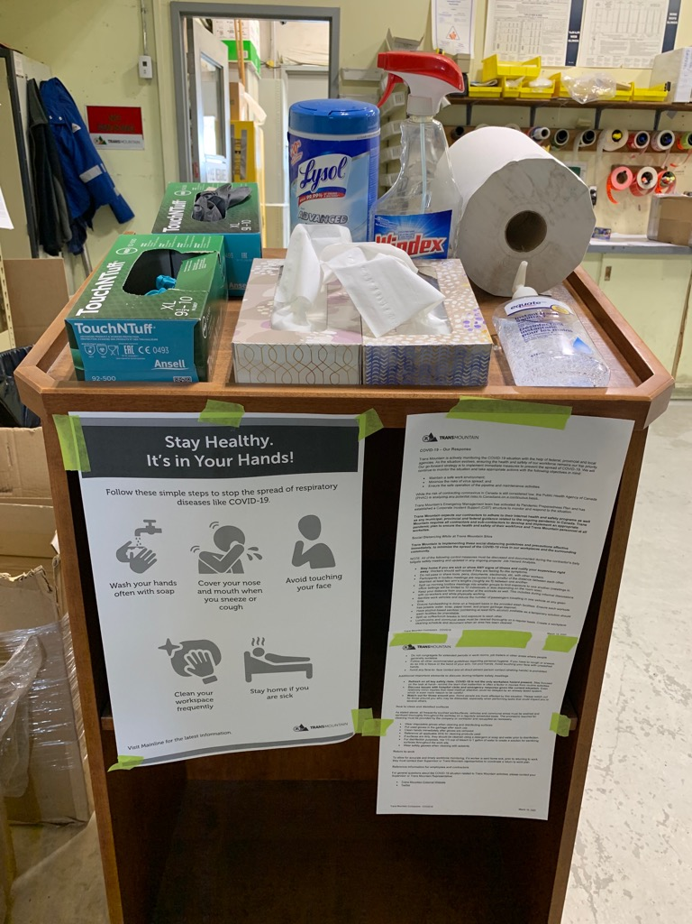
Protecting People
Number of persons present in the ICP and at the Pump Station was limited.
Sites were organized to comply with social distancing requirements and hygiene protocols.
Notes:
The number of persons present in the ICP and at the Pump Station was limited to ensure compliance with responder safety and social distancing protocols.
Response sites were organized to comply with social distancing requirements and hygiene protocols.
Instructions regarding hygiene, transmission prevention protocols and PPE were reinforced frequently through safety briefings, daily/shift briefings, etc.
Pandemic related PPE including non-medical masks, hand sanitizer and Lysol wipes were made available.
All vehicles and manned equipment were sanitized at shift end and between operators.

Slide 18
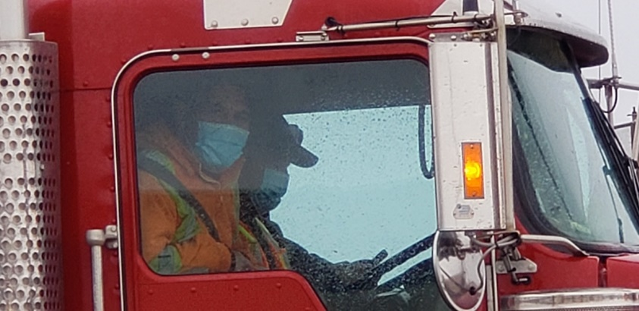
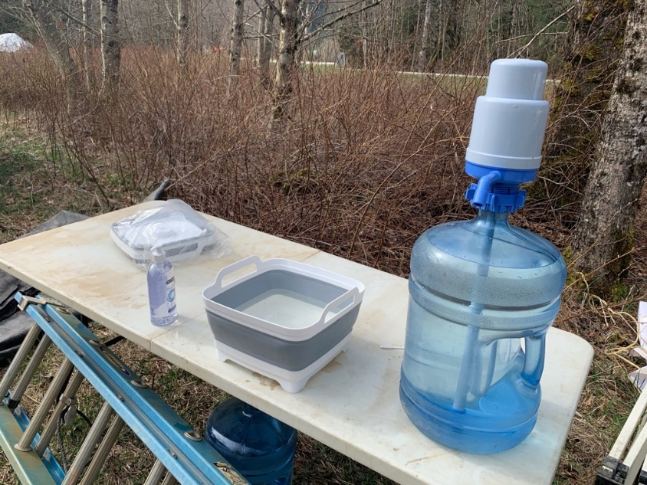
Protecting People
Hygiene Protocols
Instructions about hygiene, transmission prevention protocols, and PPE were reinforced frequently through safety briefings, daily/shift briefings, etc.
PPE including non-medical masks, hand sanitizer and
Lysol wipes were available.
All vehicles and manned equipment were sanitized at
shift end / between operators.
Notes:
Instructions regarding hygiene, transmission prevention protocols and PPE were reinforced frequently through safety briefings, daily/shift briefings, etc.
Pandemic related PPE including non-medical masks, hand sanitizer and Lysol wipes were made available.
All vehicles and manned equipment were sanitized at shift end and between operators.

Slide 19
Lessons Learned COVID Response
The longer people are together the more familiar they become, therefore the closer they are comfortable being.
  This can happen very quickly in some cases where the workers are already familiar or part of the same team
  Dedicated resource to monitor for COVID protocols to ensure continued compliance.
  Protocols were rapidly changing during this time with economies reopening and mask use not yet mandatory or supported by science.

Slide 20

We Want To Hear From You

