Slide 1
Pacific States/British Columbia
Oil Spill Task Force
Annual Meeting 2014
Oregon DEQ
Dick Pedersen-Director
Notes:
Introduction and Thank You

Slide 2
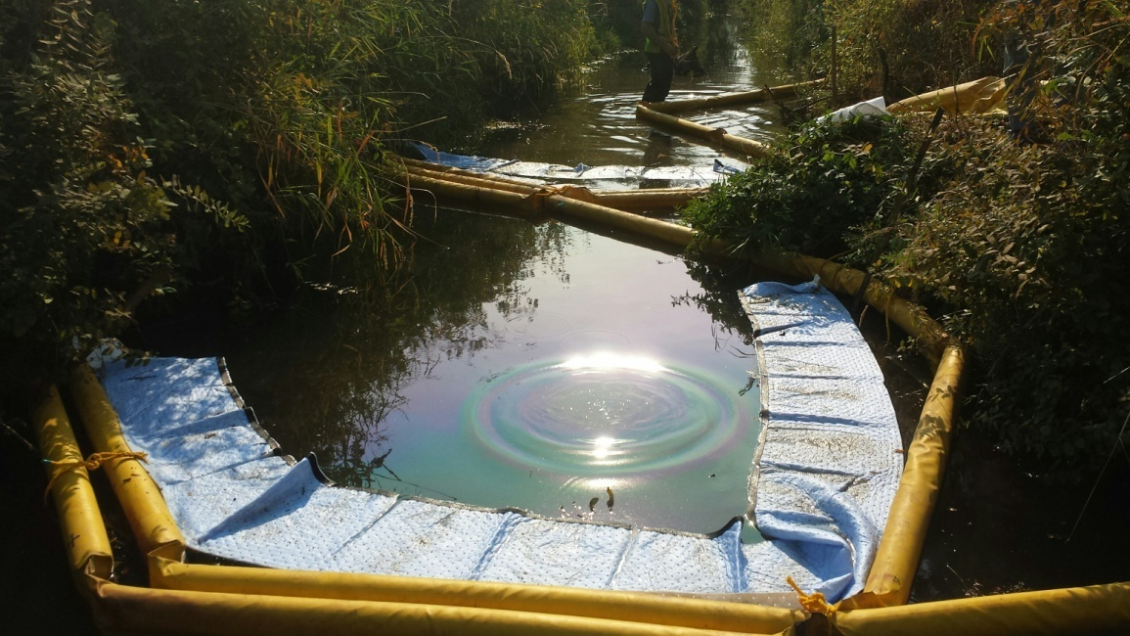
Emergency Response Activities
Received 1325 notices of potential spills of oil or hazardous materials (July, 2013-June 2014)
DEQ response actions provided on 844 cases.
Left: Pringle Creek cleanup from an approximate 2,500 gallon diesel release, September 12, 2014
Photo: Geoff Brown, WR-SOSC

Slide 3
Near Misses
July 14, 2014 - M/V Blue Cat grounding at Clatsop Point
Carried 75,000 gallons of diesel and 23,000 metric tons of copper concentrate
Refloated successfully
August 1, 2014 – derailment upstream of McNary Dam on the Columbia River
13 rail cars; 5 cars ended up in the river.
Fortunately they were empty auto racks.
Notes:
Motor Vessel Blue Cat – refloating the vessel on first high tide was fortunate; failure to do so would have been problematic as subsequent low tide was -10 feet below Mean Sea Level

Slide 4
Emerging Risks Transport of Energy Commodities
Shift from pipelines to rail for crude oil
Export facilities – multimodal transport routes
Tank vessels could be used to transport crude oil in the future
Potential coal shipping via rail, barge and vessels
Proposed LNG facilities would rely in vessels for shipping
Notes:
Export facilities – oil entering states that typically would not be a route of crude oil transfer to refineries.
Oil transfers from 1) rail to tank, 2)tank to barge and finally 3)barge to refinery – added risk for each event.
Coal and crude oil barges increase traffic on the river
Increased tanker traffic along Oregon and BC Coastlline.

Slide 5
Oregon currently has two crude oil trans-loading/storage facilities: Clatskanie-Columbia River and Portland-Willamette River
Bakken and Other Crude Oil Shipping
Mostly by Rail and Barge
The facilities and vessels are required to have approved Oil Spill Contingency Plans
Notes:
In December 2012 a facility on the Columbia River began export of Bakken Crude Oil. That facility now receives approximately 3 unit trains per week.
DEQ completed contingency plan review and approval at both facilities in 2014. Significant increase in public awareness generated significant comments – increase in workload to address public concerns. (lead in to next slide)

Slide 6
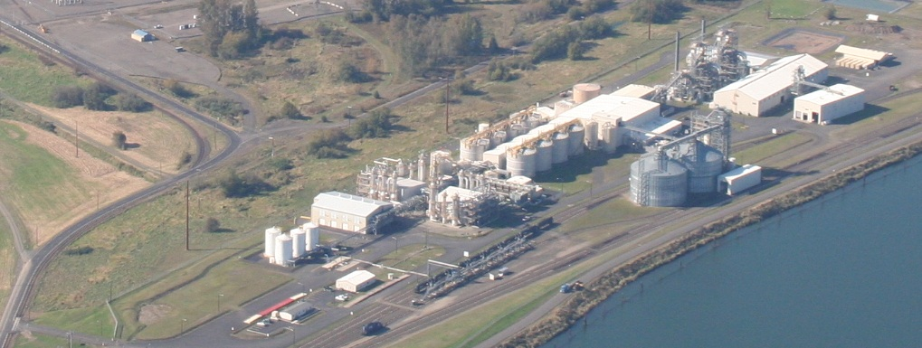
Columbia Pacific Bio-Refinery
Public Notice and Comment
Received over 1400 comments on the Air Quality Permit
Received 100 comments on the Oil Spill Contingency Plan
Several months to complete process
http://www.oregon.gov/deq/Pages/ColumbiaPac/ColumbiaPac.aspx
Notes:
Columbia Pacific Bio-Refinery was recently issued a new air quality permit and their oil spill contingency plan was approved.

Slide 7
Jordan Cove in Coos Bay (concept drawing above)
Currently there are two LNG Proposals in Oregon both Requiring Pipeline Connections
Oregon LNG in Warrenton

Slide 8
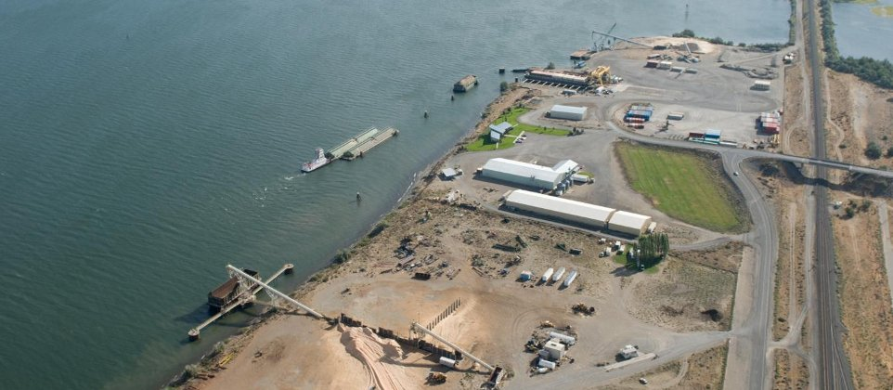
Proposal for Coal Exports
on the Columbia River
Coal would be transported from Wyoming to Coyote Island Terminal at the Port of Morrow near Boardman, Oregon
Coal transferred from trains to barges to take the coal down the Columbia River to Port Westward in Clatskanie
Coal transferred from barges to ocean going ships for export
Current Status: Permit review has been placed on hold due to the recent denial and subsequent appeal of the Department of State Lands Permit.

Slide 9
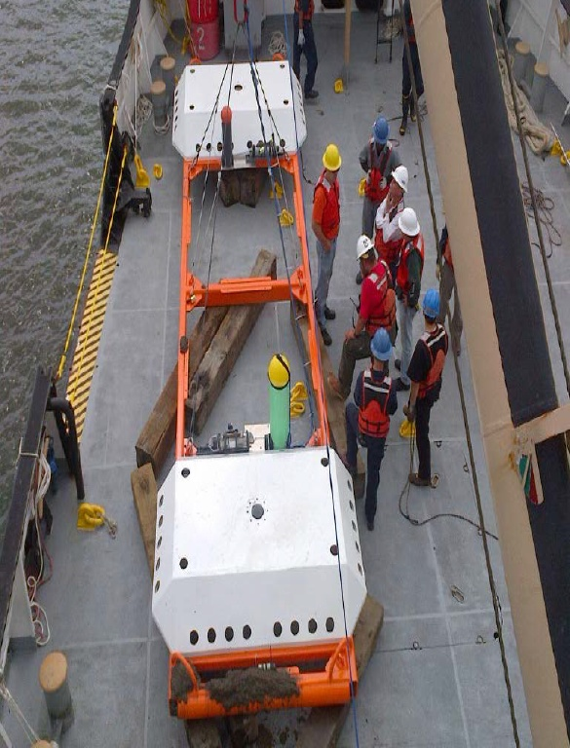
Oregon Wave Energy Trust
Submerged Wave Energy Experiment
Camp Rilea Marine Zone
Notes:
Development of sustainable energy systems along coastal zones poses new challenges in maritime response. – places of refuge, etc.

Slide 10
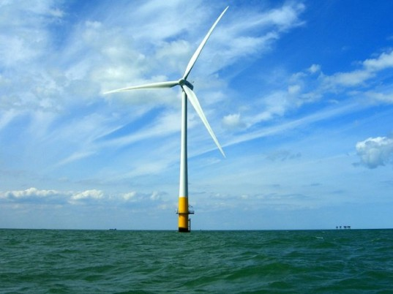
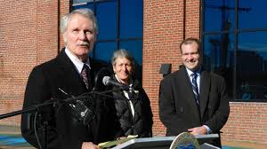
Offshore Wind Projects
Pacific pilot project – Coos Bay
Newport South Energy test site

Slide 11
Future Challenges – Climate
Increased incidents of extreme drought in summer/fall – maintaining shipping channels
Cost of dredging operations to maintain channel depth on the Columbia River
Winter storm events may become more severe
increase the risk of spills from oil transport on rail and vessels.
Wildfires increase risk of landslides
Notes:
On the Columbia River, dredging operations have been ongoing throughout the summer and fall to maintain commercial vessel traffic and commerce

Slide 12
Preliminary Statewide Rail Safety Review
Provide Policymakers in Oregon a background on issues related to the transport of crude oil by rail, along with a series of recommendations and findings.

Slide 13
Preliminary Statewide Rail Safety Review
Overview of key issues
Roles of federal and state agencies
Findings and recommendations related to the transport of crude oil in Oregon
The report can be found at:
http://www.oregon.gov/gov/docs/transportation/Train_Safety_Report_72514_final.pdf
Notes:
Key Points:
Rail notification to emergency responders on oil and hazmat transport; includes access to train manifests in response to derailment
Adequate rail inspectors in Oregon to ensure track maintenance and train safety requirements being met.
Update regulations to address change in transportation risks and rail safety
State review of rail oil spill contingency plans, which should identify equipment caches and response time objectives; GRP development for inland rail corridors

Slide 14
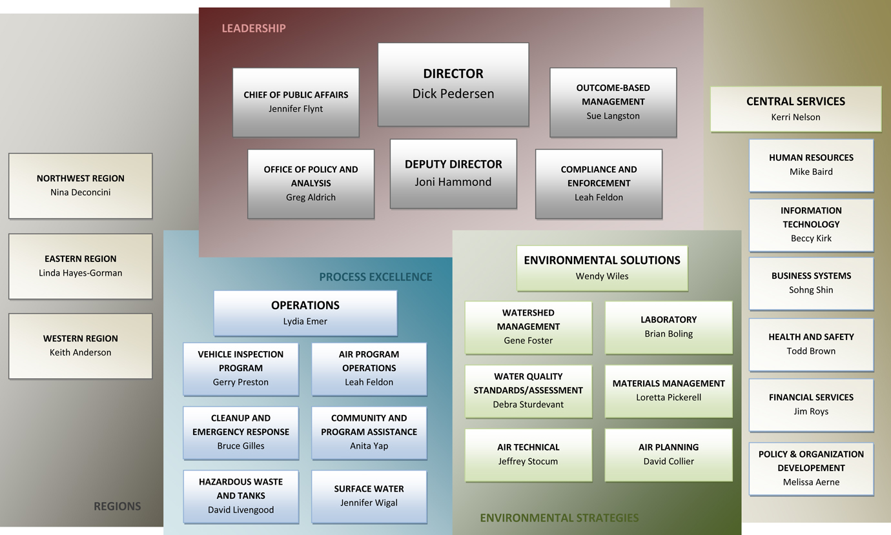
DEQ’s Organizational Structure
For Cleaner Air, Land, and Water

Slide 15
Thank You
Dick Pedersen
Director, Oregon DEQ
Notes:
Concluding Remarks

