Slide 1
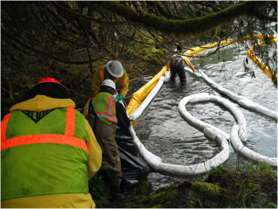
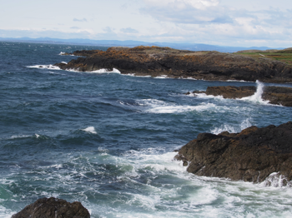
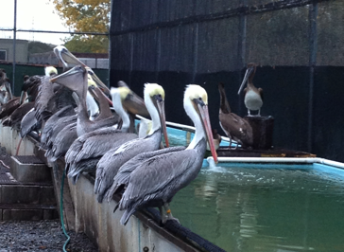
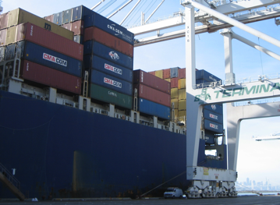
Preventing Oil Spills Through
Regional and Transboundary
Communication and Coordination
The story of POSPET*
*Pacific Oil Spill Prevention and Education Team
2016 Salish Sea Ecosystem Conference
Aaron Barnett, Washington Sea Grant
Hilary Wilkinson, POSPET Lead
Michelle Young, Georgia Strait Alliance
Notes:
I’m going to provide an overview of what the Pacific States/BC Task Force is, specifically the role of one of the group’s programs - POSPET – the Pacific Oil Spill Prevention Education Team
I’m joined by two of our POSPET members – Michelle and Aaron. Each of them will provide an example of the work their individual organization is doing related to spill prevention, with a focus on how the efforts have been enhanced through participation in POSPET
This presentation will provide a short history of POSPET, and will highlight success stories from POSPET members, including but not limited to the Clean Marine BC Eco-Certification program and Washington Sea Grant’s small spills program.
.

Slide 2
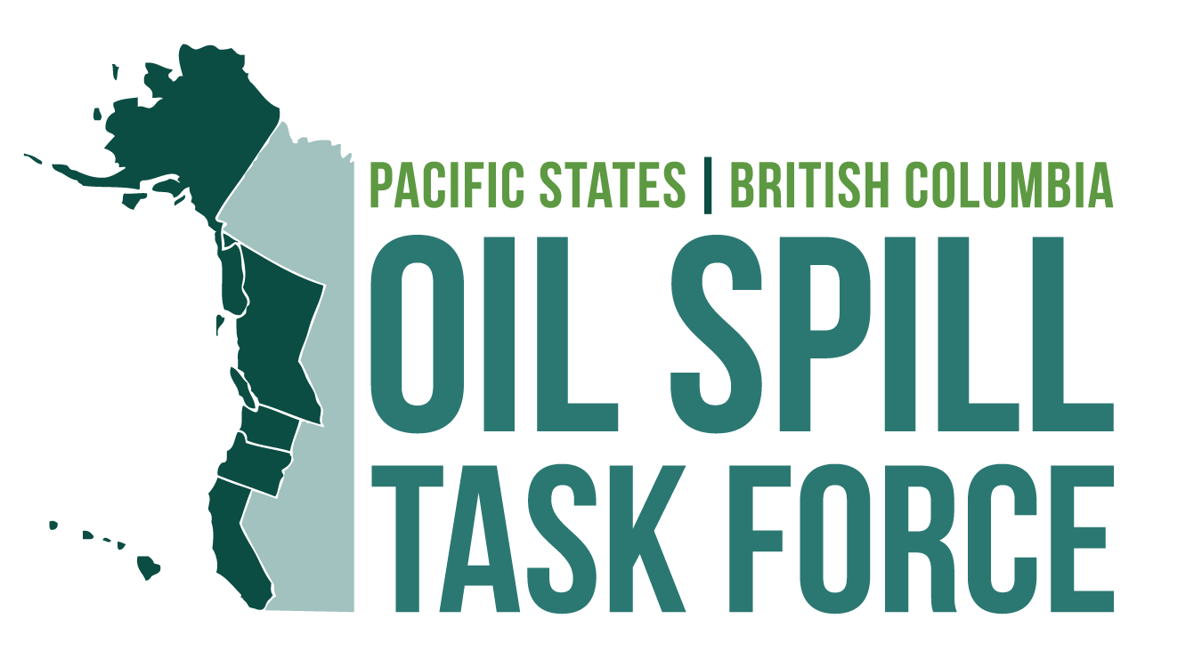
Notes:
Overview of the Task Force

Slide 3
The barge Nestucca in the Columbia River Estuary,
December 24, 1988
Photo by Jon Neel, ECY
Notes:
A very brief history of the Task Force –
This is the barge Nestucca after it collided with it’s tug, the Ocean Service, about 3 km off the coast near Grays Harbor, WA. Approximately 175,000 gal of fuel oil spilled, and was transported by ocean currents from OR to BC.
Note: wood pegs jammed in gash to slow the leakage, near the deck just to left of word “NESTUCCA.”
Following the Nestucca spill Premier of B.C. Vander Zalm, and WA Governor Booth Gardner established the Washington/B.C. Task Force on Oil Spills.
About 6 months later, the day after the first Task Force meeting, the Exxon Valdez ran aground in Prince William Sound…..

Slide 4
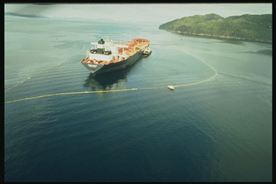
The Exxon Valdez on Bligh Reef in Prince William Sound, Alaska
grounded March 24, 1989
Photo by Jon Neel, ECY
Notes:
Eight of the eleven tanks damaged Exxon Valdez spilled more than 11 million gallons of crude oil into Prince William Sound, affecting 1,200 miles of shoreline.
The Exxon Valdez spill spurred the Task Force to expand to include AK, Oregon and California.
Purpose; to enhance prevention and response, technology sharing and share info on financial recovery after a spill.
The Valdez motivated the newly formed Task Fore to work together in sharpening their own state policies and pass legislation.
During that time some Task Force members also flew to Washington DC and testified before Congress, providing state input into the draft federal Oil Pollution Act of 1990 that was being created.

Slide 5
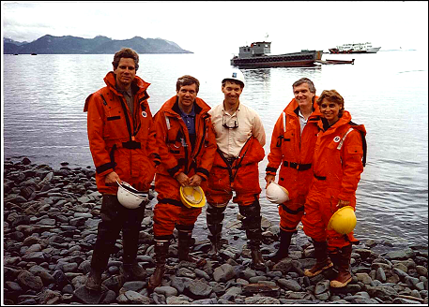
Original Task Force Members, Prince William Sound, 1990
Photo by Jon Neel
Notes:
Over a year after the Valdez spill, in July 1990, Task Force members and staff flew to Alaska to see first-hand the clean up operations and progress in Prince William Sound. Much of the Sound still had a black ring around its shoreline.
Cleanup support vessels in background.
From left to right members are:
BC - Richard Dalon, Deputy Minister, Ministry of the Environment
WA - Christine Gregoire, Director Department of Ecology
HI not yet a member of the Task Force.

Slide 6
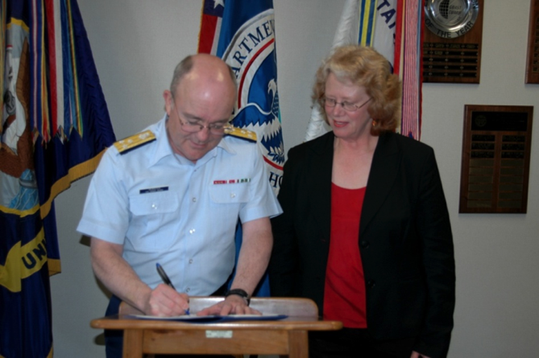
Task Force Timeline
1988 – WA and B.C. Task Force Established
1989 – Memorandum of Cooperation:
AK, CA, OR
2001 – HI joins
2008 – MOU: US Coast
Guard Pacific Area
VADM Charles D. Wurster with
Jean Cameron, May 27, 2008
Notes:
MOU with US Coast Guard:
Serve as a forum for discussion of marine safety and oil spill prevention and response
Coordinate implementation of measures in spill prevention and response
Continually look for opportunities to improve our collective efforts on oil spill prevention, preparedness and response

Slide 7






Member Agencies
AK Department of Environmental Conservation
B.C. Ministry of Environment
WA Department of Ecology
OR Department of Environmental Quality
CA Department of Fish and Wildlife
HI Department of Health
Notes:
These are the agencies represented on the Task Force today.

Slide 8
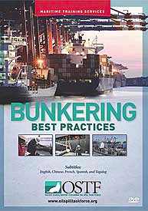
Our Work
Share information
Coordinate and facilitate collaboration
Create tools and resources
Notes:
Share information on regional and national oil spill programs, policies and emerging technologies with member jurisdictions, stakeholders and the public;
Coordinate and facilitate projects, workshops and round-table forums on oil spill prevention and response topics of concern;
We help create tools and resources to foster and encourage best industry practices;

Slide 9
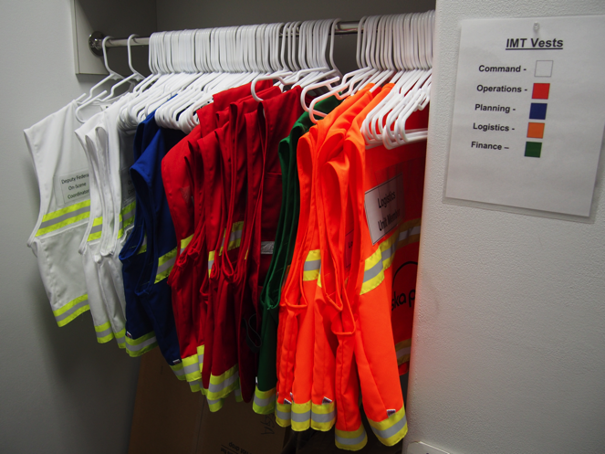
Our Work
Support policy and legislative initiatives
Engage with industry
partners
Outreach and
communications
Notes:
As a collective, we support policy and legislative initiatives that help prevent oil spills and protect resources at risk.
We engage with industry partners in spill prevention and response planning;
Our outreach and communications activities focus on sharing our project updates, products and Task Force Member accomplishments while providing opportunities to hear and learn from our stakeholders and the public.

Slide 10
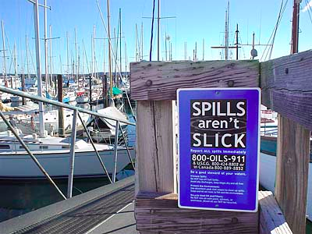
POSPET
Pacific Oil Spill Prevention Education Team
Overview
Formed in 1991
OILS-911 Reporting
Focus on small spills
Signage and outreach materials
Notes:
The Pacific Oil Spill Prevention and Education Team (POSPET), founded in 1991, is a collaboration of educators and outreach personnel from four Western U.S. states and the province of British Columbia. POSPET evolved from the simple premise that small oil spills can add up to cause significant environmental and economic harm, and that regional collaboration and coordination is the most efficient approach for addressing the problem.
POSPET members include representatives from state and federal agencies, industry associations and nonprofit groups from Washington, Oregon, California, Alaska and British Columbia. For more than a decade, POSPET members have focused on educating boaters and marina managers on best management practices to reduce spills resulting from maintenance operations, sewage discharge, and fuel transfer operations. Two of the most visible programs undertaken by POSPET members include tracking and certifying “Clean Marinas” and “Clean Harbors”, and running the “Spills aren’t Slick” campaign, including publicizing 1-800-OILS-911, a toll-free number for the public to report spills.

Slide 11
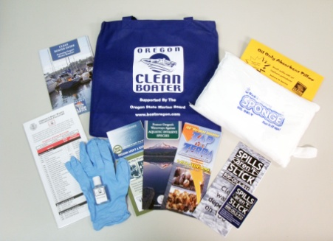
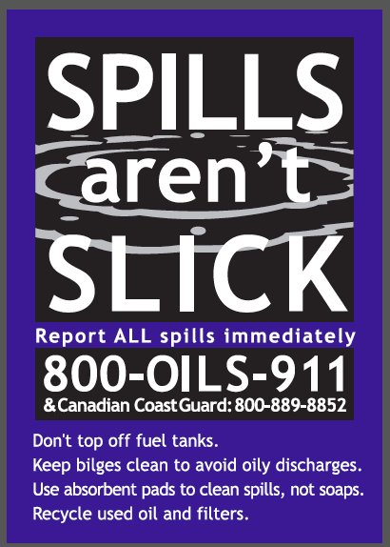
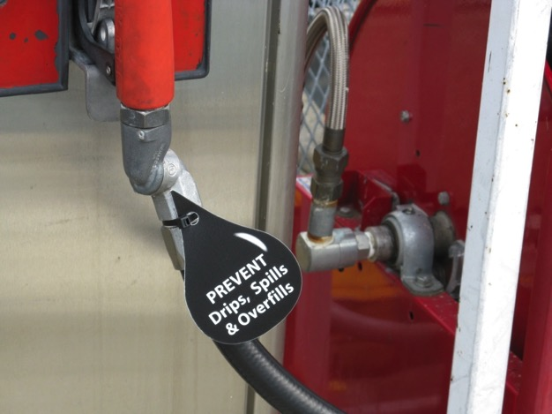
Notes:
Easy number to remember
Call Coast Guard too

Slide 12
1-800-OILS-911
Notes:
14 years of call history.
Can’t really make connection between outreach effectiveness and # spills reported.

Slide 13
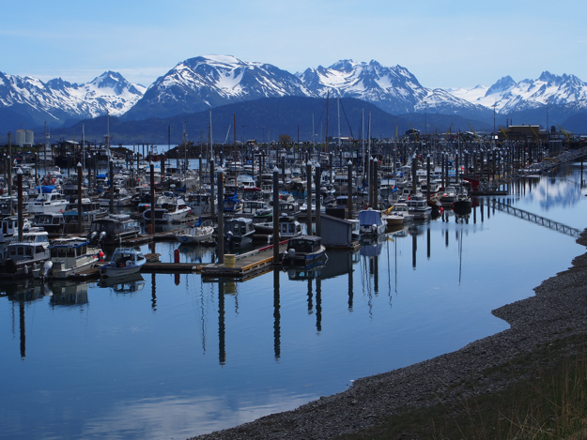
Clean Marina Program
Certified Clean Marinas (2014)
Alaska 3
British Columbia 9
California 118
Oregon 58
Washington 66
PHOTO OF MARINA
Notes:
The POSPET team members also track the number of certified “Clean Marinas” and “Clean Harbors” within their jurisdictions, where these programs exist.
Table 1 lists the current number of facilities certified in Alaska, British Columbia, California, Oregon and Washington. These certification programs recognize marinas and harbors that educate boaters on spill and pollution prevention practices. Each certified facility must be re-certified every 1-3 years.

Slide 14
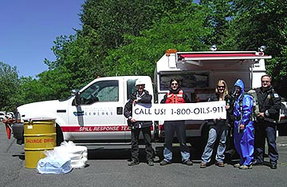
Online Resources
www.oilspilltaskforce.org

