Slide 1
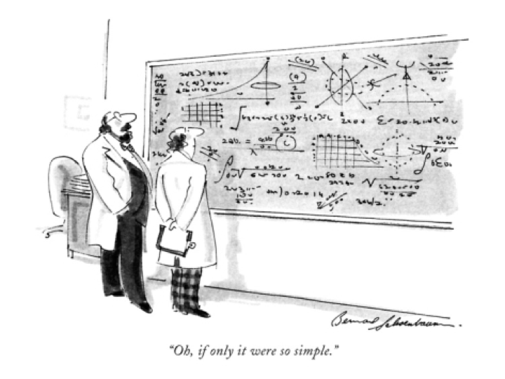
Pacific States/British Columbia Oil Spill Task Force
COMMUNICATION WORKSHOP
The New Yorker
Clean Pacific June 16, 2015
Notes:
Sarah’s welcome here:

Slide 2
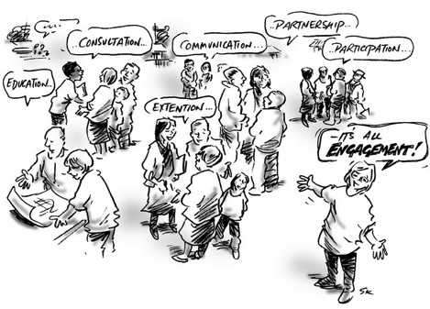
3 step Process
For Developing a Stakeholder Engagement Plan
Notes:
Thank you Hilary.
What does public engagement mean? There are many ways to define what engagement is, it could be communicating, consulting with, partnering with, or informing and educating. In essence Engagement is by definition a two-way process, involving interaction and listening, with the goal of generating mutual benefit.
I want to recognize that public engagement is not simple. There seems to never be one way that works for all. You feel like you can’t do enough and the benefits are sometimes not evident and in many cases, you find that you get more negative feedback than positive feedback on your process. So why do it?
Simply not doing it, is NOT an option. Not doing it is far more detrimental to your reputation than if you tried and failed.
We live in a world in which our work impacts people and because of that we must do our best to engage with the our stakeholders in an intentional and meaningful way.
We’ve put together 3 step process with some tools that will help you put identify who your stakeholders are, determine how you will engage with them and how you can put together a plan that will help you execute a public engagement strategy.

Slide 3
Step 1:
Identify Your Audience
Stakeholder Mapping
Notes:
Identifying your audience.
This is key to your success. Knowing who you are impacting and how you are impacting them is essential in crafting your strategy.
In your Resource Guide, Tab 1 Public Participation. You will find several tools that will help you think through the process before your put together your engagement strategy.
The first tool is the Stakeholder Engagement Strategy Tool Pack. This is the instructional for each of the steps for creating a stakeholder map. The instructions corresponds to the template by steps.

Slide 4

1
Stakeholder Analysis – STEP 1
www.ChangeAccelerator.com
Name of Stakeholder Group | Individuals Associated with the Group | # | Business Area or Team | Physical Location | Impact | Influence | Disposition | Comments
Marketing Team - West (EXAMPLE) | Jane Doe (Team Lead), John Smith (Manager), Sally Jones (Products), Mark Miller (Services), Support Staff | 15 | Sales Operations | Denver | 4 | 3 | 2 | Major concerns about productivity dip as a result of the new CRM system rollout
Legend: Impact (1 Little Impact - 5 Significant Impact) / Influence (1 Minimal Influence - 5 High Influence) / Disposition (1 Very Resistant - 5 Change Champion)
Notes:
Step 1 is the stakeholder analysis which where you identify the groups of stakeholder – you will identify who they are and using the scale below in the legend, assign them a value number on a scale for each of the impact, influence and disposition.

Slide 5
2
Stakeholder Prioritization Map – STEP 2
www.ChangeAccelerator.com
Address Concerns
Involve Extensively
High
Marketing Team - West (EXAMPLE)
IMPACT
Extent to which stakeholder is impacted by the Initiative
Low
Keep Informed
Enlist as Needed
Low
High
INFLUENCE
Extent to which stakeholder group can influence the initiative’s success
Legend
= 1-10 Stakeholders = 11-50 = 100+
Notes:
Step 2: Using the Impact and Influence values from Step 1 plot each of the stakeholder groups.
The impact scale is here.
The Influence scale is here.
The size of the dot is based on the number group size.

Slide 6
3
Stakeholder Engagement Methods – STEP 3
www.ChangeAccelerator.com
Stakeholder Engagement Methods | Marketing Team - West (EXAMPLE)
Collaborate Explicit development of opportunities to work on shared objectives.
Engage Initiating or participating in two-way dialog focused on mutual learning and solutions. Requires a commitment to openness, and can have higher expectations for future engagements. | 
Consult Soliciting explicit feedback or input on a project or plan. There are no commitments made regarding action related to the feedback/ input. | 
Advocate Enlisting support for a specific effort or position where there is an imbalance or implication of power/ influence affecting the relationship.
Inform Targeting messages to important stakeholders for the purpose of education. These messages can come through internal publications, meetings, social media, etc.
Monitor Paying attention to the actions. This may include dialog with other parties, water cooler chatter, etc.
Ignore Not directing communication or messages. Not monitoring or responding to their actions.
High Engagement
Low Engagement
Notes:
Step 3: Assign 2 methods of engagement for each group based on where they are map in Step 2.

Slide 7
4
Tactical Stakeholder Engagement Plan – STEP 4
www.ChangeAccelerator.com
Stakeholder Group | Engagement Method(s) | Engagement Tactic(s) | Desired Outcomes | Responsible for Engagement | Timing of Engagement Tactic(s)
Marketing Team - West (EXAMPLE) | Consult & Engage | Face-to-face team meeting to communicate the benefits of the new system and to walk through the deployment and risk mitigation plan. | Decreased concern, better understanding of the benefits | Jane Doe (Team Leader) with support from Joe Martin (Exec. Sponsor) | Week of 10/29
Notes:
Step 4: is a combined list of the last 3 steps in addition, identify the desired outcome for each group.

Slide 8
1
Stakeholder Analysis – EXAMPLE
www.ChangeAccelerator.com
Name of Stakeholder Group | Individuals Associated with the Group | # | Core Interest Area | Physical Location | Impact (extent to which stakeholder group is impacted by the initiative) | Influence (extent to which stakeholder group can influence the initiative’s success) | Disposition (thoughts, words, and actions directed toward the initiative) | Comments
Alliance Properties | Ralph and Mike Black | 4 | Developers | Bellingham | 3 | 3 | 2
Bellingham Bay Habitat Action Team | Lucy MacInerney, Project Manager; Mike Stoner (Port of Bellingham) | 10 | Bellingham Bay habitat improvements | Belllingham | 5 | 5 | 5
BIA-Whatcom County |  |  |  |  | 5 | 5 | 1
City of Bellingham-Planning Dept | Kim Weil (Planer); Jeff Thompson (Director) | 25 | Planning | Bellingham | 5 | 5 | 3
City of Bellingham-Parks Dept | James Luce | 25 | Parks development and protection | Bellingham | 4 | 4 | 3
City of Bellingham-Utilities |  |  |  |  | 3 | 3 | 3
Dept of Ecology-BFO | Kurt Baumgarten | 5 | Ecosystem protection | Bellingham | 1 | 5 | 5
Greenways Committee | Linda Grant | 5 | Greenways enhancement | Bellingham | 2 | 3 | 4
Neighborhood Associations |  | 27 | Neighborhood protection | Bellingham | 5 | 5 | 4
Mayor’s Neighborhood Advisory Commission |  | 5 | Supporting the neighborhood associations | Bellingham | 3 | 3 | 4
Legend: Impact (1 Little Impact - 5 Significant Impact) / Influence (1 Minimal Influence - 5 High Influence) / Disposition (1 Very Resistant - 5 Change Champion)

Slide 9
2
Stakeholder Prioritization Map – EXAMPLE
www.ChangeAccelerator.com
Address Concerns
Involve Extensively
Neighborhood Associations
Bellingham Bay Habitat Action Team
High
COB Planning; Parks and Rec
Whatcom Assn of Realtors
Mayor’s Neighborhood Advisory Council
Whatcom MRC
Whatcom Builders
Noxious Weed Control Board
RE Sources
BIA Whatcom County
Alliance Properties
S Side Neighborhood Assn
Port of Bellingham
IMPACT
Extent to which stakeholder is impacted by the Initiative
Responsible Development
COB Utilities
N Cascades Audubon
Lummi Nation
Parks and Rec Advisory Board
Greenways Committee
Whatcom County
Whatcom Land Trust
Sustainable Connections
Wendy Harris
WWU
Ecology--BFO
Low
Keep Informed
Enlist as Needed
Low
High
INFLUENCE
Extent to which stakeholder group can influence the initiative’s success
Legend
= 1-10 Stakeholders = 11-50 = 100+

Slide 10
STEP 2:
Decide how you will engage with your audience
Public Participation Spectrum
Notes:
As part of Step 2 of this process – being intentional about how you want to engage with your stakeholders is important because it will help you understand your level of commitment to your stakeholder and thereby help you plan your resources around that commitment.

Slide 11
Notes:
This chart was developed by the International Association Public Participation here in British Columbia.
This public participation Spectrum is another tool to help you identify the different levels of engagement and the requirements for how to fulfill that engagement.
On the top line is the different types of engagement that you could use – be mindful that for each group you will likely have a different level just like you laid out in the earlier section.
Also keep in mind that the more controversial your issue, the higher the level of engagement level should be used.

Slide 12
STEP 3:
Writing Your Plan
Outreach Plan Outline
Notes:
In this final step: now that you have identify who and how you want to engagement with. You need to put together a plan.

Slide 13
PUBLIC OUTREACH
AND STAKEHOLDER ENGAGEMENT PLAN
I. Introduction and Background (1-2 pages)
II. Approach (~1 page)
III. Prioritized List of Stakeholders
IV. Stakeholder Engagement Strategy (2-4 pages)
V. Key Messages (1-2 pages)
VI. Recommended Timeline(1 page)
VII. Overview of Outreach Methods (1-2 page)
VIII. List of Issues, Obstacles, and Concerns (1-2 pages)
Notes:
In your Resource Guide is a template outline for a Outreach Plan. You have done many of your thinking around this with the previous steps.
The plan should include key messages around your issue. This helps you keep everyone on the same page as they communicate the issue.
You will need to put together a timeline for your strategy. Timing is important. You don’t want to rush through the process and risk leaving folks out or not giving enough time for interaction with people.
The meat of your plan will be your methods. What tools will you use to engage. This is where you can be creative and think outside of the box. Don’t get stuck in rut doing the same old things especially if it has been successful in the past.
Be aware of any obstacles, issues and concerns as it can also help you and your team manage them as they come up.

Slide 14
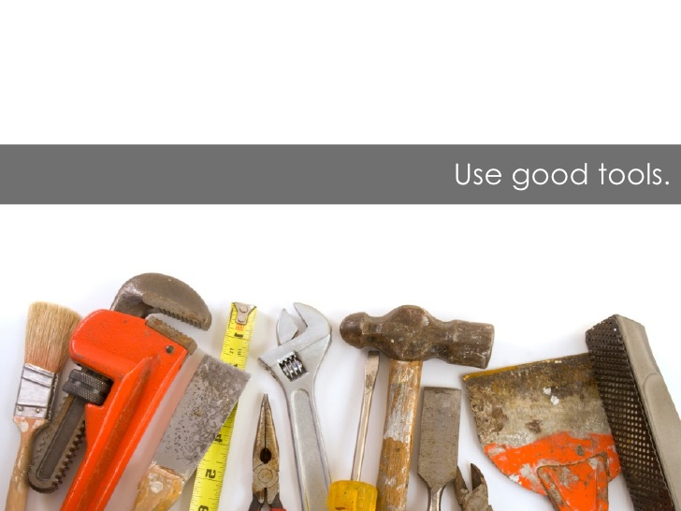
Thank You – Questions?

Slide 15
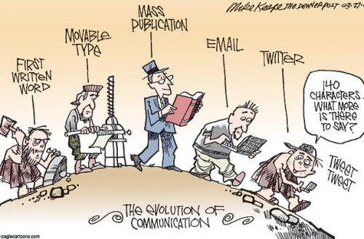
5 SOCIAL MEDIA RULES
For developing
your plan
Notes:
Thank you Hilary.
You just heard Dr. Starbird give some great on data on how social media was used during the DWH.
The focus of the workshop are tools that can be put in place before a spill occurs and social media is a tool that must be in place before the bad day.
I would like to give some additional information on some basic rules to follow as you put together your social media plan.

Slide 16
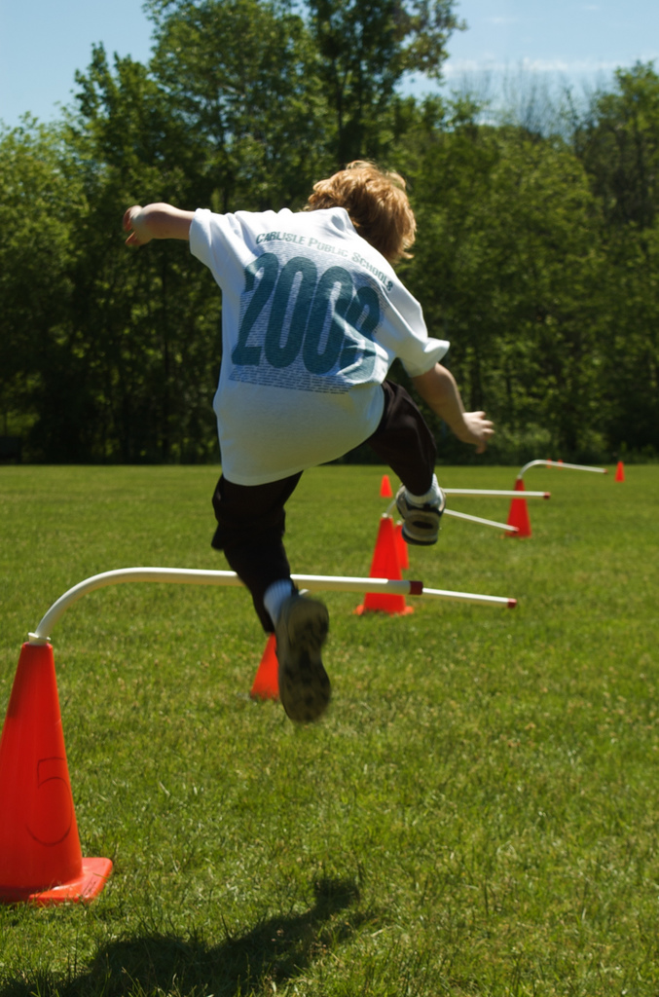
Rule #1.
JUST DO IT!
Be present or be
Invisible.
Ignored.
Unheard.
Distrusted.
Photo credit: flickr/qwrrty
Notes:
First and foremost rule – Just do it.
If you are not present you are invisible, ignored, unheard and distrusted.
Online social engagement is no longer a option.
It is here, now as an integral part of how we communicate online.

Slide 17
Social Networking Site Use by Age Group, 2005-2013
% of Internet users in each age group who use social networking sites
Rule #1.
Source: Pew Internet
Notes:
Source: Pew Internet & American Life Project. 2012. “Pew Internet: Social Networking (full detail)” http://pewinternet.org/Commentary/2012/March/Pew-Internet-Social-Networking-full-detail.aspx (accessed December 28, 2012).
Social Networking Site Use by Age Group, 2005-2013
% of Internet users in each age group who use social networking sites
This data is from the Pew Internet and American Life Project and represents the break down of internet users by age group that are on social networking site.
The white line here represents all internet users and shows that 78% of all internet users are on social media sites.
By age group – not surprising that virtually all people 18-29 age group are on social media sites.
For everyone else, more than half of people on the internet users are on social media site.
There is a very good chance that your targeted audience is on social media – and so should you be.

Slide 18
SOCIAL MEDIA BENEFITS
Rule #1.
Credibility and trust
Encourage action
News and Information
Mobile access
Expand your reach
Online conversation
Notes:
Credibility and trust - Helps you to build credibility and trust – In the study from the Pew Institute indicates that most social media site users are very trusting. FB users seem to trust more than others.
Encourage action - Social media can be used to organized around a call to action – such as volunteerism.
News and Information - It’s a great tool for getting information and news out.
Mobile access - People can access from anywhere any time.
Expand your reach – Your ability to expand your reach on any particular issue is unlimited.
Online conversation – You can have real time conversations with your audience.

Slide 19
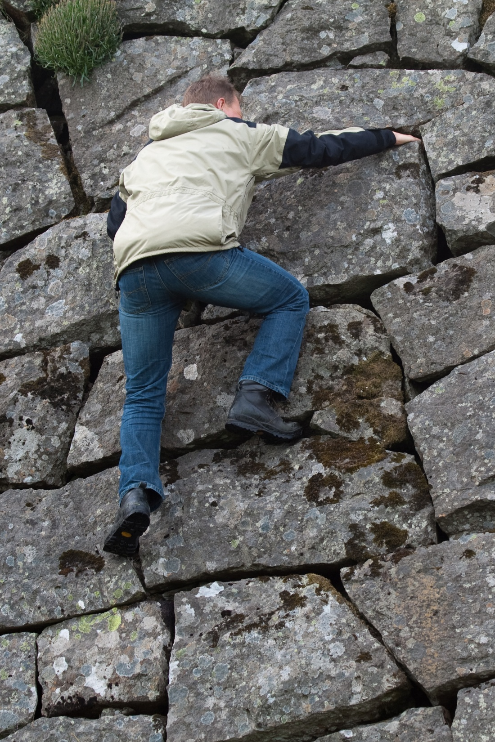
Rule #2.
GO WHERE YOUR AUDIENCE IS
If you build it, they won’t necessarily come.
Photo credit: flickr/stignygaard
Notes:
When you are considering which tool to use, you should do some research on where where your brand’s presence makes sense.

Slide 20






TOP SOCIAL NETWORKS by millions of active users
Rule #3.
Notes:
Source:
Statistic Brain - http://www.statisticbrain.com/
Social Bakers - http://www.socialbakers.com/
https://plus.google.com/+DustinStout/posts/P3UP6ZgCyrY

Slide 21
Rule #2.
GO WHERE YOUR AUDIENCE IS
Some consideration to keep in mind:
Leverage existing connections and tools first.
Don’t join every social network just to be there.
Consider staff time, budget, and (most importantly) the time and needs of your audience.
Notes:
Leverage existing connections and tools first. For example if you have a great website that gets a lot of traffic, launch your social media site from there.
Don’t join every social network just to be there – Don’t just get on all social media site just to be there. Social media takes time and management so you want to maximize your resources at sites that will yield the bet return.
Consider staff time, budget, and (most importantly) the time and needs of your audience. During a non-spill event you may not have a need for a lot of resources, but would need more during a spill event. You should be training to have a depth in your personnel that could step to do social media.
At this point – most people expect organizations to at least be on FB and Twitter.

Slide 22
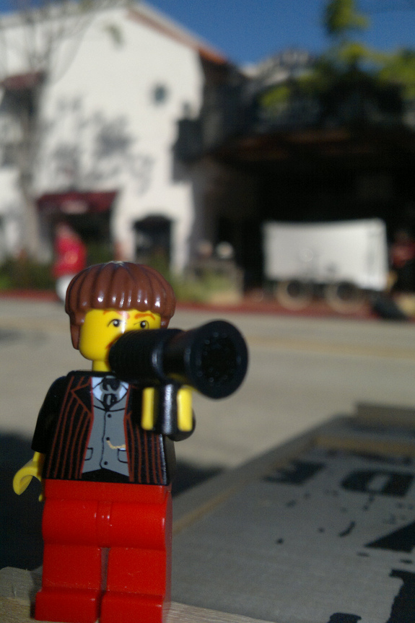
Rule #3.
ESTABLISH YOUR VOICE
It’s not about you.
It’s about the value
you bring to others.
Photo credit: flickr/Hazzat

Slide 23
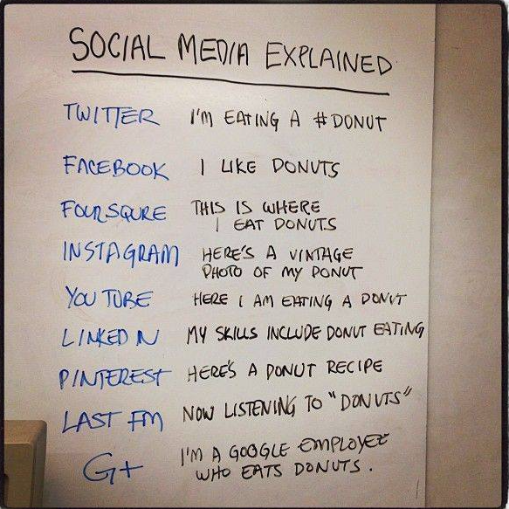
Notes:
So how do you know what to say and where do you say it.
This is picture is a great simple way to explain what the different “voices” that are used on the different social media site.
June 5th is national donut day – you didn’t know that there was such a thing right. But saw a bunch of my friends posting about donuts and came across this.
For example….

Slide 24
VOICES MOST TRUSTED
Rule #3.
Edelman Trust Barometer
Notes:
When you are considering your voice – keep in mind that Experts are highly regarded and sought after.
It is a mistake if your brand experts are not online.
You heard this to be true earlier in Dr. Starbird presentation which showed that during discussions on Twitter many scientist were quoted and followed.

Slide 25
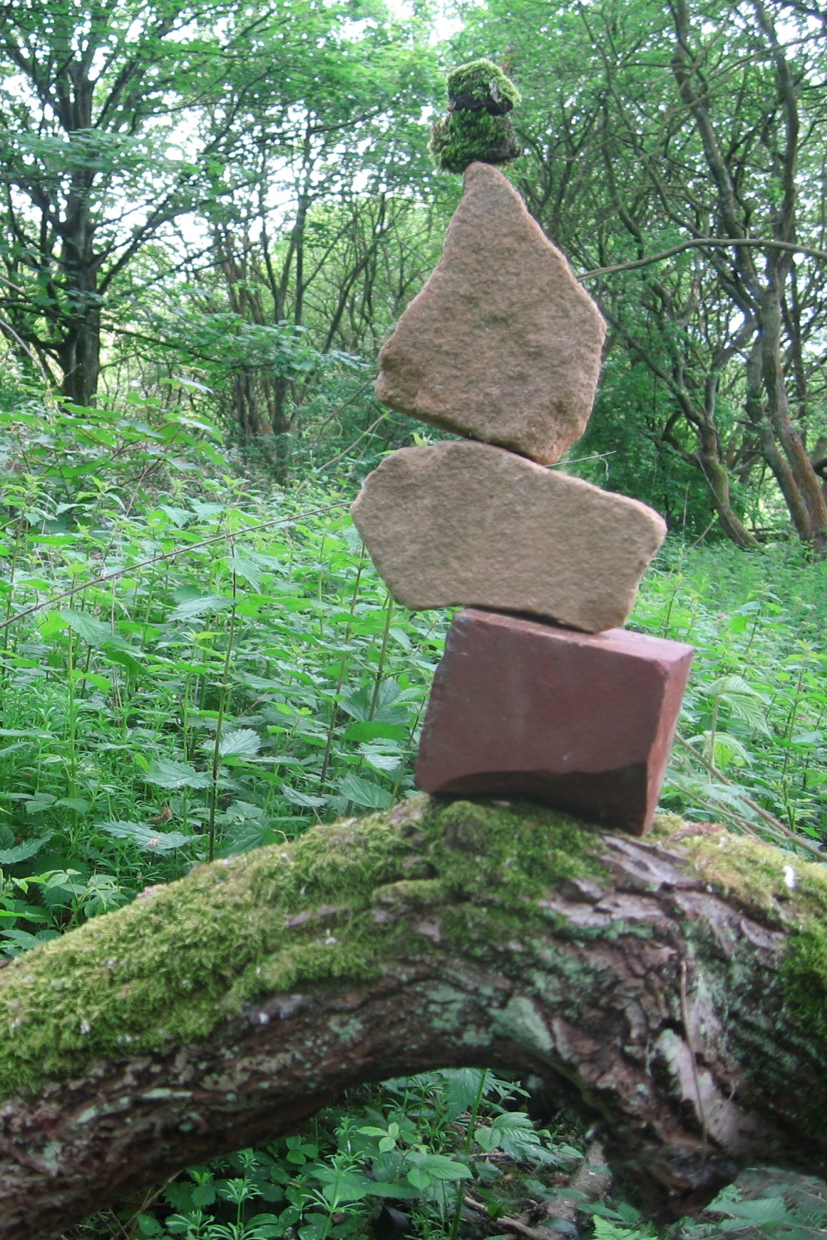
Rule #4.
TAKE TIME TO ENGAGE
“It’s not enough to be busy, so are the ants. The question is, what are we busy about?”
Henry David Thoreau
Photo credit: flickr/ what_i_see
Notes:
We know that building a relationship on social media takes time and doesn’t happen overnight. Once you have built your social media presence you have engage with people - This all takes time.

Slide 26
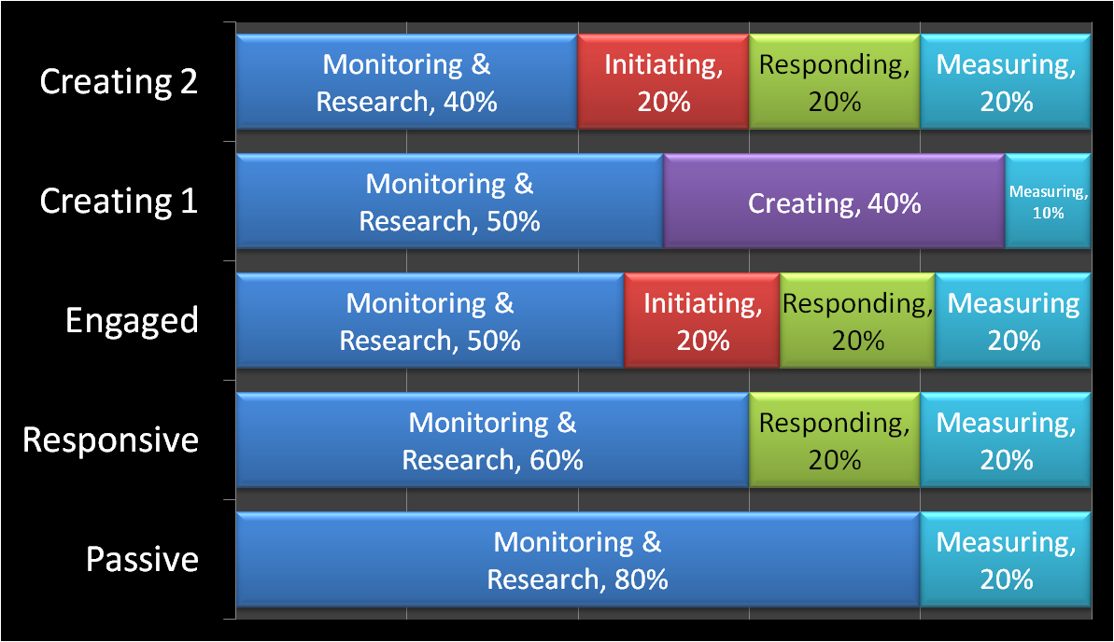
SOCIAL MEDIA TIME MANAGEMENT
Rule #4.
Total Time Commitment
Source: Amber Naslund. 2010.
Notes:
Source: Amber Naslund. Amber Naslund. 2010. “Fitting it All In: Time Management Strategies for Social Media.” Slide 9.
http://www.slideshare.net/AmberNaslund/social-media-time-management-2248737
This graph depicts the different level of time commitment based on the level engagement you.
You may not always be at these 2 creating levels all the time. But you should strive to be at the engaged level.

Slide 27
“Social Media is about relationships, trust and interaction.”
Information Seeker
Repeat Visitor
Marketer
Advocates, Ambassadors
Partners, Donors
Action
Trust
Relationships
Notes:
The ripple effect: As we strengthen our online relationships we increase the impact of our work and our brand.
Information Seeker – people may come initially to your site to find information. You have something they want to learn about.
Repeat Visitor – You have what they want and they come back.
Marketer – Your content is credible and they talk about your site to their friends.
Advocates and Ambassadors – You’ve sold them on what you have and they advocating for your content and reputation. For example Dr. Starbird mentioned in her presentation that people corrected each other when mis-information was being circulated.
Partners and Donors – They want to collaborate with you.

Slide 28
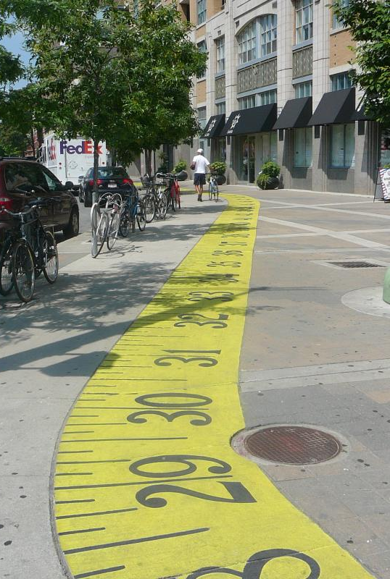
Rule #5.
MEASURE AND TRACK
“Measurement is your map, and metrics are your signposts.”
Beth Kanter,
Katie Delahaye Paine
Photo credit: flickr/stevenharris
Notes:
Lastly, you need to measure and track your progress and make changes and adapt.
It’s import to build in the capability to measure your success ahead of time – it is difficult to retrofit

Slide 29
SOME BASIC METRICS | NUMERICAL
Rule #5.
Growth – friends, followers, fans, connects, subscribes
Twitter – shares, retweets, mentions, clickthroughs
Facebook – shares, likes, comments, messages
LinkedIn – shares, comments, views, clicks, likes
YouTube, Slideshare, Flickr, Vimeo – views, embeds, comments, favorites
Email, RSS feeds – opens, views, clickthroughs
Social bookmarking – saves, likes, clickthroughs
Website – pageviews, visits, time on page, shares, connects
Notes:
Here are some examples of basic metric terms for social media site.
Track more than stats – track content and people

Slide 30
5 SOCIAL MEDIA RULES
Just Do it!
Go Where Your Audience Is
Establish Your Voice
Take Time to Engage
Measure and Track
What does YOUR social strategy look like?

Slide 31
SOCIAL MEDIA
Break Out Session
Notes:
Thank you Hilary.
You just heard Dr. Starbird give some great data on how social media was actually used during the DWH.
The take away from all that is that it is here and you can no longer afford to not be part of the conversation.
I would like to share 5 social media rules that you if you follow can help you put together a comprehensive social media plan for your organization.

Slide 33
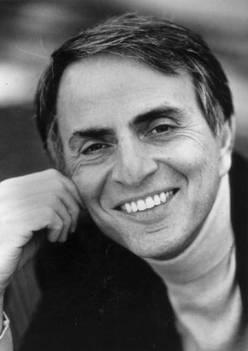
Science and technical communication
What would Carl Sagan say?
Photo Source: Carl Sagan Collection www.csiop.org
Notes:
. Next session involves science and technical communication. Our objective here is to demonstrate tools and techniques for channeling Carl Sagan, and effectively communicating science and technical information to stakeholders, including the public.
Carl Sagan is a household name, in part because he was a skilled communicator, a master at connecting with ordinary people and explaining complicated science in terms they could understand.
I’m going to spend some time framing the problem, then hand it to Sarah and Stokley who are going to demonstrate and share tools that should help.
Recognize that most of our audience here is in a position of both interpreting for scientists as well as briefing scientists to communicate. In times of crisis, especially in oil spills, people want to hear from the experts, and you’ll be the ones to help them get ready to deliver it. So have designed this session for both purposes: helping scientists with their own communication, and delivering effective science/technical communications that you are interpreting from others.

Slide 34
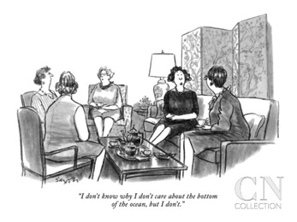
Source: The New Yorker. Cartoon by Charles Saxon
Notes:
I love this cartoon because it captures the gist of the problem in terms of science and technical communication today.
Lack of understanding results in apathy, which in turn can lead to inaction on very important problems, or worse, action without accurate understanding of the technical issues.
We feel strongly that there is something wrong with the story of how we’re talking about science and technical issues today. It’s interesting to talk to people about, because it appears that the technical people want to blame the public, and the public wants to blame the technical people, and everyone wants to blame the government. So who is right?
1. DWH Lessons Learned
William Lehr, NOAA
From: http://www.ioscproceedings.com/doi/pdf/10.7901/2169-3358-2014.1.1141
A great deal of confusion occurred because of media and politician misinterpretation of the controversial Oil Budget Calculator pie chart. No spill professional would
Conclude that this pictorial representation of the operational oil budget table showed that spilled oil that is not in the remaining (surface) category was removed from the environment. However, a high-level government official, unfamiliar with spill response terminology, made just this claim on national television. Hindsight suggests that conclusions released by scientific teams should carefully define, in layman language, terms not familiar to those outside the spill response field.
[Gist: science mis-communication led to erroneous reporting by a gov’t official on TV – led to distrust of scientists]
2. From "BP: Lessons in Crisis Public Relations" file:///Users/sarah/Dropbox/Veda%20(all)/Projects/Current/Veda%20-%20Communication%20Workshop/Task%202%20Develop%20workshop%20content/Curriculum/Sci%20Comm%20session/background%20materials/BP:%20Lessons%20in%20Crisis%20Public%20Relations%20-%20Makovsky.webarchive:
SIN NUMBER SIX: ABDICATING ON EDUCATION
Most environmental crises present the public with a set of unfamiliar technical terms and procedures. The oil spill, with its “blowout preventers” and “junk shots,” was no exception. Unfortunately, BP ceded responsibility for educating the public to the media. As a result, the company lost a golden opportunity to enlist the public as sympathetic allies.
Eventually, BP offered an array of educational tools on its own website … but too late to make an appreciable difference in the battle for credibility. Moreover, the company’s static graphics were more difficult for a layman to understand than the interactive animations available on the website of, for example, The New York Times.

Slide 35
Scientific Literacy in the US:
A Test (part 1):
Question #1:
What percentage of American adults are able to read the NY Times Science section?
20% 40% 70%
Notes:
Let’s take a little test about scientific literacy in the U.S. today
80% of Americans cannot read the NY Times science section.
Only half of the adult populace knows the earth orbits the sun once per year. (from p. 13 “Unscientific America”)

Slide 36
Scientific Literacy in the US:
A Test (part 1):
Question #2:
What percentage of American adults know that the earth orbits the sun once per year?
  30% 50% 70%
Notes:
Let’s take a little test about scientific literacy in the U.S. today
80% of Americans cannot read the NY Times science section.
Only half of the adult populace knows the earth orbits the sun once per year. (from p. 13 “Unscientific America”)

Slide 37
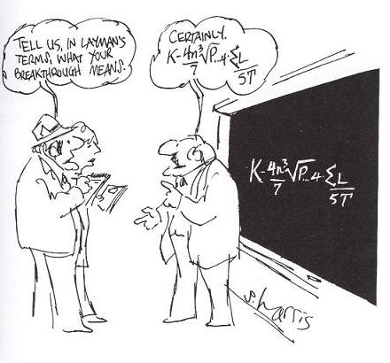
Source: Cartoonstock.com. Cartoon by S. Harris
Notes:
But of course we all know that some of the blame can squarely be put at the foot of scientists and technical people
Raise your hand if at least some of your gray hair or worry lines are due to infuriating moments in the presence of science and technical people
Scientists trained to communicate in a very specific framework
Abstract
Background
Methods
Results
Discussion
Conclusion
Very little room for creativity unless you want to risk derision by colleagues, or publication opportunities, etc.
From my own experience working with environmental scientists over 15 years.
Informal observations at endless numbers of scientific conferences– vast majority of presenters did not follow basic rules of PP, and did not tell their findings in a way that even their colleagues could immediately grasp or comprehend.
Battle over “bioretention facility” versus “rain garden” for a public sign in Whatcom County
“Juvenile Salmonids” versus “baby salmon” story (KUOW reporter)

Slide 38
“We have now reached the point where the most technical literature….falls outside the possibility of public comprehension...”
- Stephen Jay Gould, 1999
Notes:
1945 – 5-10K scientific journals
1990s: 100,000
So…science/technology people are partially to blame. What else is going on?

Slide 39

Notes:
According to this book, public interest in science and technology in the U.S. has ebbed and flowed over the decades, but is currently in a state of crisis. A few facts and figures:
Scientists in general are no longer “cool and trusted”.
40% of Americans distrust what scientists say about the environment, a considerable increase from previous years (p. xi of Unscientific America)
At present, only 18% of Americans know a scientists personally.
Attention to science in traditional news media is in freefall. A 2008 analysis by the Project for Excellence in Journalism found that if you tune in for 5 hours of cable news, you will probably only catch 1 minute’s worth of science and technology – compared to (from p. 6 of Unscientific America)
10 minutes of “celebrity and entertainment”
12 minutes of “accidents and disasters”
26 minutes or more of crime
Newspapers: ‘89 to ‘05, two thirds reduction in weekly science or related sections
2008: CNN shut down its science, space technology and environment unit
2009: Boston Globe killed its esteemed science section.
This book argues that the resource in shortest supply is people’s attention, and as science and technical communicators, you literally have 1 minute for every 5 hours of programming to get people’s attention.

Slide 40
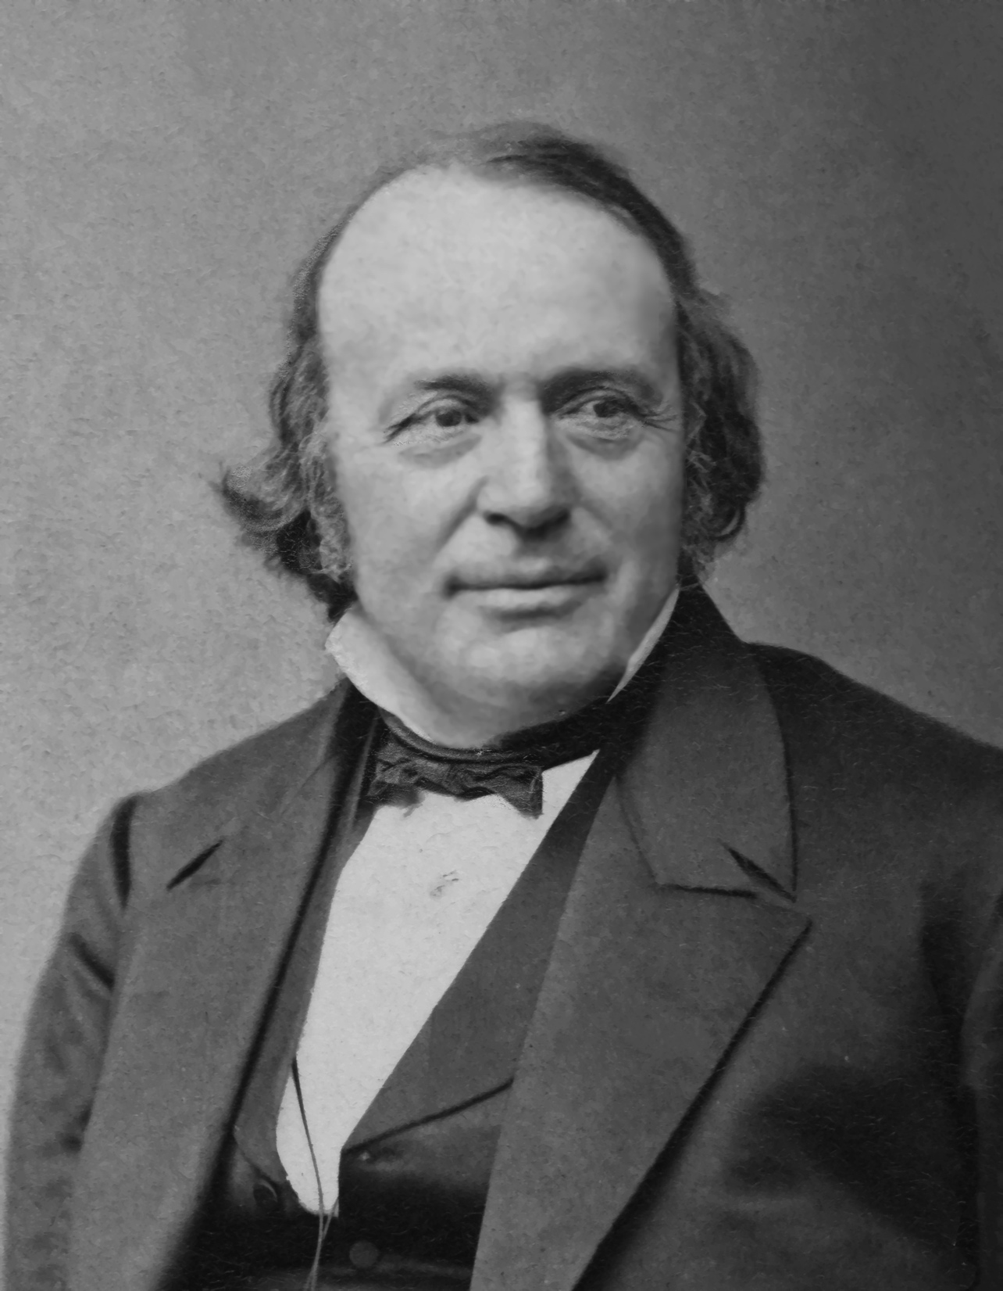
- Louis Agassiz, 1807-1873
Additional Challenges
Notes:
. Example of Louis Agassiz – Harvard fish expert – 3 hr lectures in Cambridge Commons that were packed
I have devoted my whole life to the study of nature, and yet a single sentence may express all that I have done. I have shown that there is a correspondence between the succession of fishes in geological times and the different stages of their growth in the egg — that is all. It chanced to be a result that was found to apply to other groups and has led to other conclusions of a like nature.

Slide 41
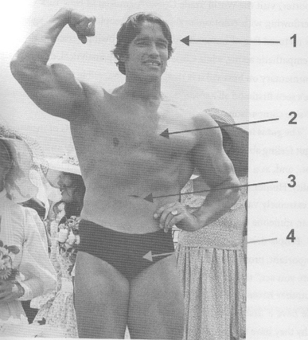
Source: Stop Being Such a Scientist!
Notes:
So now is the time for some solutions.
The “big picture” concept we want to share is one framed best by Randy Olson in “Don’t be Such a Scientist”. In order to reach your audience – in order to make them really hear and understand you, you need to move your message from the brain (where science/technical communication usually is focused) down the body. The lower you go, the more you’ll resonate.
Our aim for this workshop is the gut - #3. We’ll leave Hollywood and others to address #4.
Sarah Brace to share “message box” tool to craft a coherent message that resonates with your target audience and helps move
Stokley Towles to demonstrate one of the most common delivery mechanisms for the message – PPT – and how to use it effectively

Slide 43
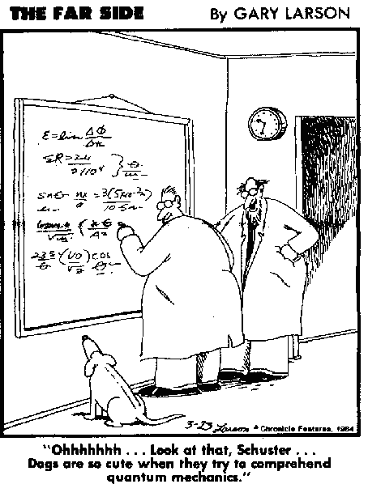

Slide 44
Know your audience
Managers
Policy Makers
Scientists
Message
So what?
Media
NGOs
Public
(From: Escape from the Ivory Tower. Baron 2010)
Notes:
You heard from Nhi on the importance of mapping your stakeholders. This is important in not only planning and targeting how you will engage them in your planning process (e.g. do you want to just feed information or engage them on an Advisory Committee role),
It is also important to identify your audience for when delivering your communications messages and technical information.
This diagram sums up the first step in crafting the message(s) that you are communicating: WHO CARES? SO WHAT?
The idea is that for each of your stakeholders, there’s a message that will resonate, but it may not be the same message across ALL stakeholders.

Slide 45
SO WHAT?
Manager | Will it solve problems on the ground?
Policy makers | Does this support/refute my legislation?
NGOs | How does this fit in our agenda?
Scientists | How does this relate to my work – is it groundbreaking?
Media | Is this news/ Will it sell?
Public | Why does this matter to me?
SO WHAT
Managers
Policy Makers
NGOs
Scientists
Media
Public
(From: Escape from the Ivory Tower. Baron 2010)

Slide 46
FROM SCIENTIST TO AUDIENCE
Science Message Box
Abstract
Background
Methods
Results
Discussion
Conclusion
Problem?
Audience
Benefit?
Issue
So What?
Solutions?
(From: Escape from the Ivory Tower. Baron 2010)
Notes:
As Hilary mentioned, scientists are not always the best communicators. In addition, they face an audience largely disengaged from science.
You, the communications professionals, are key in getting scientific and technical information out to the public. If you can’t get the science well delivered to you, now do you expect to be able to send messages out to stakeholders?
What I’d like to talk about with you today is how can YOU work with scientists in your organizations better communicate THEIR technical information.
One tool out there was developed by COMPASS, an organization co-founded by Jane Lubcenco (famous marine scientists at OSU)
MISSION: to help scientists effectively share their knowledge in the public discourse and decision-making.
This tool is called the message box, and can be used to help distill and synthesis key pieces of technical and scientific information when communicating to your target audience.
[This is in your binder in Tab 3.]
The message box is a deceptively simple tool that helps you sift through
the mountain of information in your mind and focus on the few key messages
that will be most salient for your audience.

Slide 47
MESSAGE BOX
Audience: _________________________
Specific piece of the issue?
Problem?
Issue
(From: Escape from the Ivory Tower. Baron 2010)

Slide 48
MESSAGE BOX
Audience: _________________________
What does it matter
to my audience?
Issue
So What?
(From: Escape from the Ivory Tower. Baron 2010)

Slide 49
MESSAGE BOX
Audience: _________________________
Issue
Solutions?
What are potential solutions?
(From: Escape from the Ivory Tower. Baron 2010)

Slide 50
MESSAGE BOX
Audience: _________________________
Potential benefits of resolving the problem?
Benefits?
Issue
(From: Escape from the Ivory Tower. Baron 2010)

Slide 51
MESSAGE BOX
Audience: _________________________
Legislator
People don’t know what it is – gooey, sinks
Could harm shellfish and fish habitat, beaches
Problems?
Bakkan crude oil is harmful to aquatic systems
Benefits?
So What?
Solutions?

Slide 52
MESSAGE BOX
Audience: _________________________
Legislator
Problems?
Aquaculture
Risk to shellfish-growing areas
Bakkan crude oil is harmful to aquatic systems
Benefits?
So What?
Solutions?

Slide 53
MESSAGE BOX
Audience: _________________________
Legislator
Problems?
Bakkan crude oil is harmful to aquatic systems
Benefits?
So What?
Solutions?
Require planning to address Bakken
Laws to improve Bakken transport safety

Slide 54
MESSAGE BOX
Audience: _________________________
Legislator
Public feels safe
Shellfish
industry protected
Problems?
Bakkan crude oil is harmful to aquatic systems
Benefits?
So What?
Solutions?

Slide 55
MESSAGE BOX
Audience: _________________________
General public – shellfish grower
High PAH content (toxic)
Sinks and coats seafloor
Slow to degrade
Smothers organisms
Problems?
Bakkan crude oil is harmful to aquatic systems
Benefits?
So What?
Solutions?
Notes:
Consider the VALUES of the shellfish grower: making a living from harvesting shellfish.

Slide 56
MESSAGE BOX
Audience: _________________________
General public – shellfish grower
Problems?
Shellfish mortality
Loss of harvest and $
Bakkan crude oil is harmful to aquatic systems
Benefits?
So What?
Solutions?

Slide 57
MESSAGE BOX
Audience: _________________________
General public – shellfish grower
Problems?
Bakkan crude oil is harmful to aquatic systems
Benefits?
So What?
Solutions?
Shellfish toxicity studies
Equipment for protecting shellfish areas

Slide 58
MESSAGE BOX
Audience: _________________________
General public – shellfish grower
Problems?
Protect local economy and community resources
Bakkan crude oil is harmful to aquatic systems
Benefits?
So What?
Solutions?

Slide 59
MESSAGE BOX
Audience: _________________________
General public – shellfish grower
High PAH content (toxic)
Sinks and coats seafloor
Slow to degrade
Smothers organisms
Problems?
Protect local economy and community resources
Shellfish mortality
Tissue toxicity
Loss of harvest and $
Bakkan crude oil is harmful to aquatic systems
Benefits?
So What?
Solutions?
Shellfish bed monitoring
Equipment for protecting shellfish areas
Notes:
The message box is not a product, it is a process.
This work is for YOU to create your messages.
There may be several message boxes depending on the information you are trying to get out.

Slide 60

To be successful your message must be easily understood, memorable, and, most important, relevant to your audience.

Slide 61
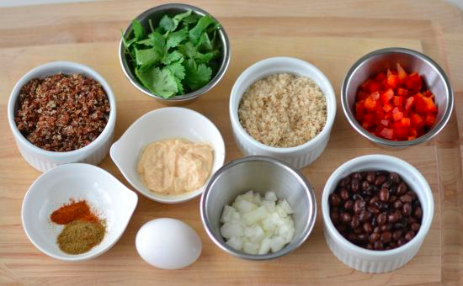
Prepare
Notes:
The point of the message box is to help you prepare ahead of time.
Think of it like a recipe to help you:
• Explain what you do to nonscientists
• Prepare for interviews
• Refine your thirty-second elevator speech for talking to policymakers
• Polish an abstract or cover letter for a publication
• Write an effective op-ed or press release
• Storyboard your website
MANY SCIENTISTS and communicators have found this tool to help them craft their message.

Slide 62
MESSAGE BOX
INGREDIENTS
Specific piece of the issue?
Problem?
What are the potentail benefits of resolving the problem?
What does it matter
to my audience?
Issue
Benefit?
So What?
Over-arching topic
Solutions?
What are the potential solutions?
(From: Escape from the Ivory Tower. Baron 2010)
Notes:
To wrap up:
Know your audience, what are their values? What do they care about?
Ask your scientists for clear pieces of information – be specific about what you want from them
Keep your message simple
Practice your message – elevator, during your walk, commute, etc.

Slide 64
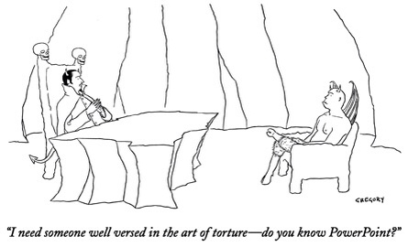
The New Yorker, 2013

Slide 66
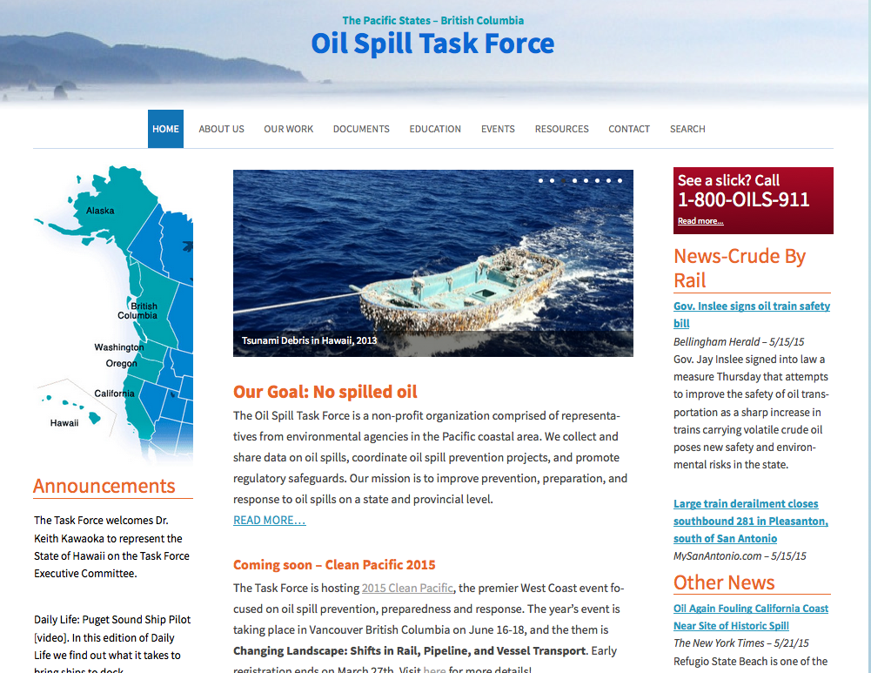
Pacific States/British Columbia Oil Spill Task Force www.oilspilltaskforce.org
Notes:
.

Slide 67
Pacific States/British Columbia Oil Spill Task Force
COMMUNICATION WORKSHOP
Planning Committee
Alexia Retallack, California OSPR
Suzanne Lagoni, Northwest Nexus
Mark Dix, NOAA
Craig Ogawa, BSEE
Scott Wright, WCMRC
Tom Coolbaugh, ExxonMobil
Doug Helton, NOAA
Michael Lowry, WCMRC
Jennifer Flynt, Oregon DEQ
Dave Owings, SEAPRO
Notes:
.

