Slide 1







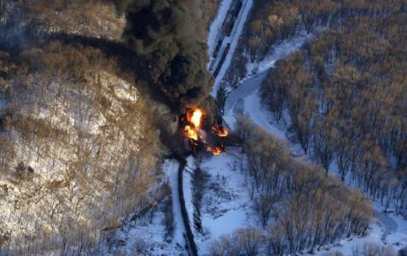
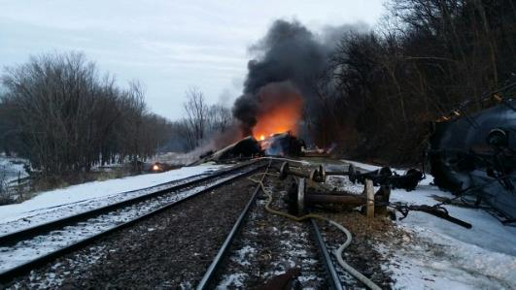
Jaime Brown
U.S. EPA Region 5
Lessons Learned – Galena, Illinois Derailment
Pacific States/British Columbia Oil Spill Task Force Roundtable – 11/5/2015

Slide 2
Objective
Communicate some lessons learned from incident
How events influenced rail preparedness planning in:
  City of Galena
  Jo Daviess County
  State of Illinois
  Region 5 (MN, WI, IL, IN, OH, MI)

Slide 3
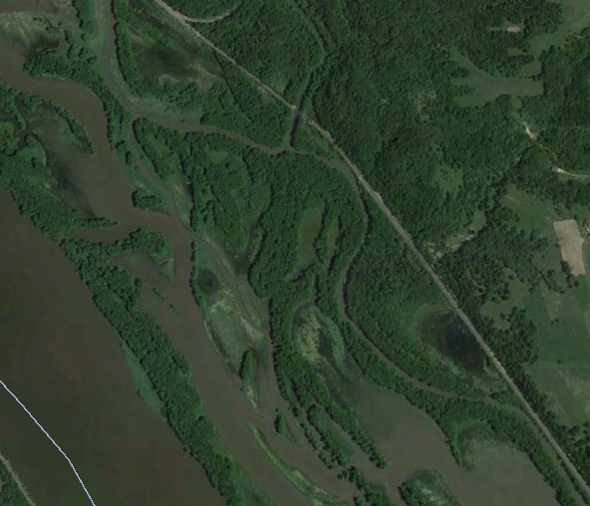
Quick Incident Summary
3 miles to Galena, IL
1324hrs on March 5
21 of 105 cars derailed
Crude oil released to ground & burned
Initial response focus =
  Life safety
  Incident stabilization
  Protection of environment
415 personnel initially
  Local (City/Co/Township), State, Federal, Contractors
Galena River
Harris Slough
BNSF Rail Line
Mississippi River

Slide 4

State Incident Response Center (SIRC)
Activated on March 5, 2015 at 1700
Agencies include:
  Illinois Emergency Management Agency
  Illinois Commerce Commission
  Illinois Environmental Protection Agency
  Illinois State Police
  Illinois Emergency Service Management Association
  Illinois Department of Natural Resources
  Mutual Aid Box Alarm System
  American Red Cross
  Illinois National Guard
  Illinois Department of Transportation - Aeronautics

Slide 5
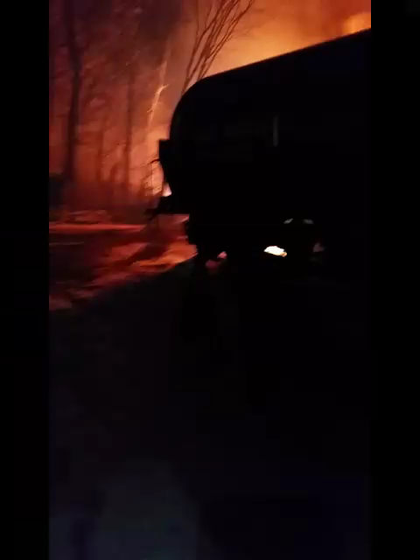
5 March PM Video

Slide 6
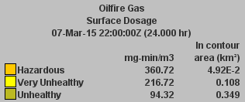
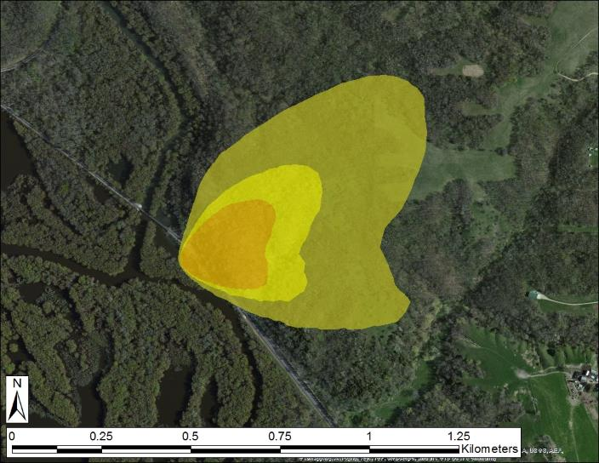
Contingency Planning - Modeling
This quick response used a weather prediction model; and was not coordinated with other IMAAC participants. Coordination will follow, and product will be updated as needed.
FACTS
Galena, IL
Location:
42.374470° N / 90.4443060° W
Event Time: 1725, 06MAR2015
Type: Bakken Crude Oil
Amount: 60,000 gallons
Dissemination: Rail Accident
Weather: 12 km NAM
Model: HPAC 5.3
Static Population Estimates:
LandScan 2013

Slide 7
Initial Response Activities
Extinguished fire, investigate, assess scene
Roadway access to difficult area
Vacuumed out crude from impacted cars & ground
Removed damaged cars from right-of-way
Excavated contaminated soils under tracks
Replaced damaged track & resume track ops
  100 trains had backed up
Emptied, cleaned, purged, cut up & scrapped cars (hauled out by truck)

Slide 8
Initial Regulatory Permits
1) USACOE Nationwide Permit
  Sect. 10 – Rivers & Harbors Act of 1899 & Sect. 404 – CWA
  Authorizes specific activities* in areas under COE jurisdiction
  * includes activities subject to NCP
  NWP #20 - Oil Spill Response
    Determination of applicability (USACOE)
    Includes general permit conditions that must be followed
  Alternatives = ‘Regional General Permit’ or ‘Individual Permit’
2) Storm water Construction Permit (IEPA)
  Sect. 401 Clean Water Act, NPDES
  SWPPP required

Slide 9
PPE Planning
Zone delineation
VOCs
LELs

Slide 10
ESA
NOAA SSC initiated consults
IDNR &US FWS
did not identify endangered species at derailment site

Slide 11
Monitoring & Sampling
Air
Product
  Fingerprint, SDS, analysis
Surface Water
Soil

Slide 12
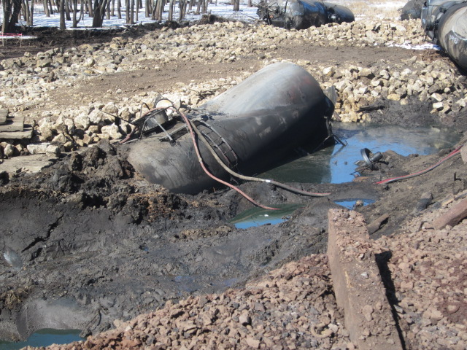
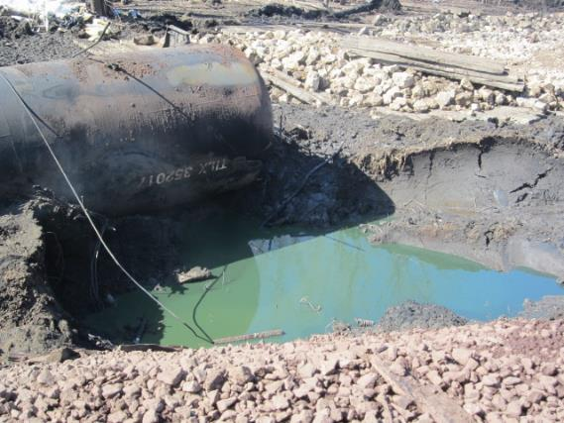
Bakken Crude was Green in Color

Slide 13
Air
Fixed @ 9 locations
3/5 – 3/11
VOCs & PM2.5
- 4300 readings recorded w/ no detections
- PM2.5 consistent w/ ambient readings
Grabs @ 5 locations
3/5 – 3/12
VOCs & PAHs
- 75 samples taken, no detections for crude above health guidelines
Benzene
Carbon Monoxide
Hydrogen Sulfide
PM 2.5 Particulates
Lower explosive limit
Nitrous Oxide
Sulfur Dioxide
Toluene
VOCs

Slide 14
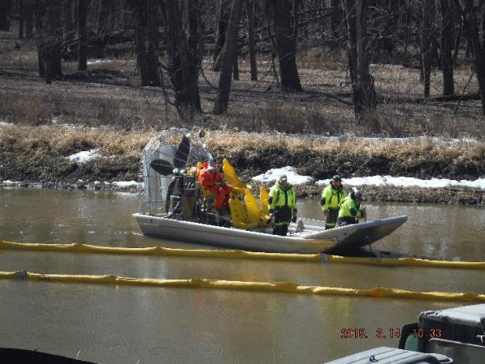
Surface Water
Field parameters:
(depth, flow, DO, ORP, temp, cond, pH)
VOCs
PNAs (SVOCs)
BTEX
TPHs
(DRO, GRO, ORO)
- No exceedances of Illinois EPA Surface Water Quality Standards
4 up, source, 5 down
3/7 to 3/11
2 up, source, 2 down
3/11 to 3/27
2 up, source, 2 down
If > 1” rain
3/27 to present

Slide 15
Area of Most Significant Impact – 12 cars

Slide 16
Soils
- 143 samples from 35 borings screened
39 samples to lab
PNAs n(0’-3’, 4’-8’)
BTEX
TPH (DRO, GRO, ERO)

Slide 17
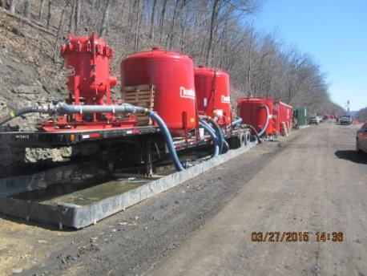
Remediation Activities
Remove crude (mass balance)
Sheet pile impacted area
Excavate impacted soils
  Disposed of at Subtitle D landfill
Flush ballast / ramp & recover oil
  Water Treatment
  FOSC exercised NCP, CWA Sect. 311(c) & NPDES Section 122.3(d) authority to exempt NPDES permit until state issued permit
Backfill & restoration (USACOE)
Long term monitoring

Slide 18
Sheet Pile Containment

Slide 19
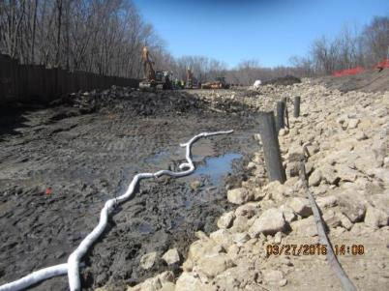
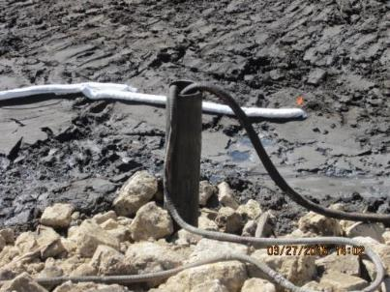
Metrics
Product | Total
Crude Oil (recovered) | 221,421 gal
Contact Water (treated) | 1,700,000 gal (+)
Contaminated Soil | 4,748 tons (+)
Tankers wrecked | 12

Slide 20
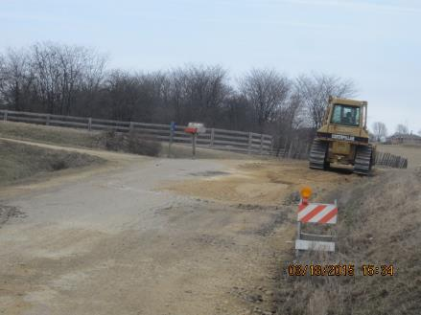
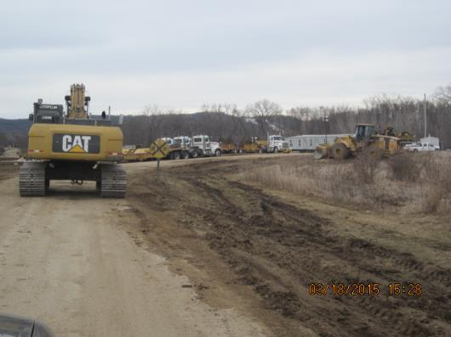
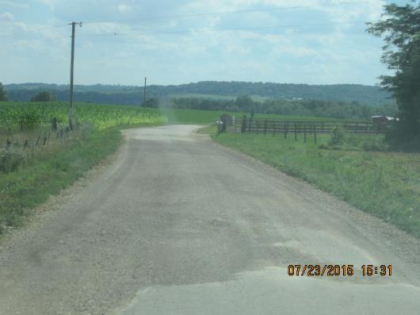
Local Roadways – Access to Site

Slide 21
Equipment Staging Area – Private Land

Slide 22
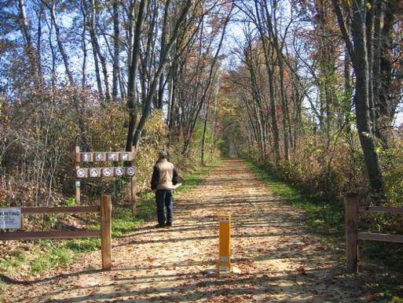
Bike Trail

Slide 23
Response/Recovery Transition
IL-Incident Management Team (IMT) met with USEPA to discuss integration
UC selected based on:
  Responsibility, Authority, Expertise
Day 3 Incident Action Plan (IAP) was a combination of the BNSF IAP & IL-IMT IAP from Day 2
IL-IMT worked together with USEPA to establish transition plan
IL-IMT stepped back to support role for Day 5 IAP
IL-IMT stepped out of command structure on Day 6

Slide 24
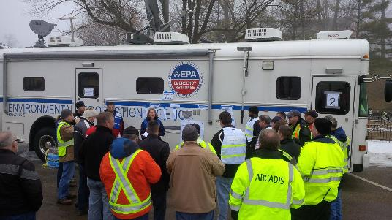
IC to UC Transition Issues
Composition of UC
  PHMSA, FSA, OSHA, IEMA, IL IMT left off
Selection of 1 individual was challenging:
  BEFORE = AFTER
  1 IC = 4(UC)
  5 PSCs = 1 (CTEH)
  6 SOs = 1 (BNSF)
  4 OPSs = 1 (BNSF)
  3 ENVLs = 1 (ARCADIS)
Strategy to populate KLPs w/ qualified personnel w/ longevity on site (EPA shadow or deputy)
IAP software utilized

Slide 25
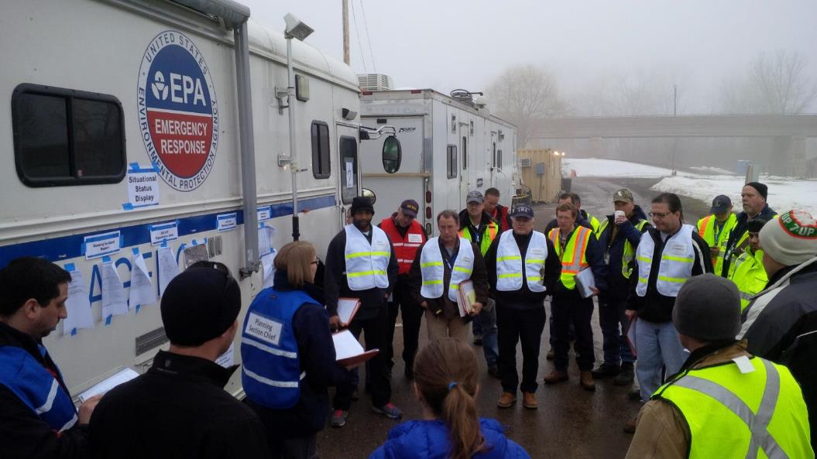
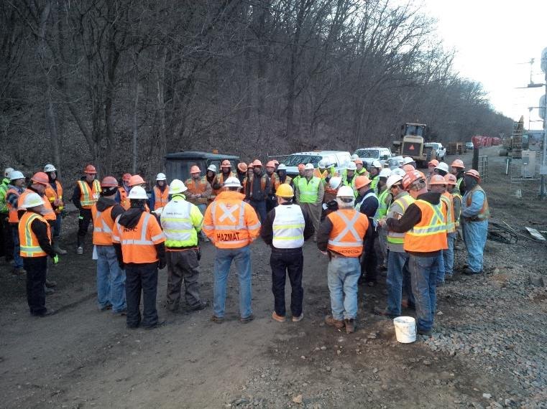
OPS Briefings
DAY 6
DAY 12

Slide 27
Work Plan Tracking

Slide 28

to transition
Transition plan/schedule developed w/ IEPA (3/19)
US EPA memo to IEPA SRP Unit Leader (3/20)
UC dissolution memo (3/24)
NPDES Permit
  Water Treatment Unit - US EPA FOSC email exercising NCP, CWA Section 311(c) & NPDES Section 122.3(d) authority to exempt NPDES permit (3/24)
  Construction Site – General permit issued by IEPA (3/27)
  Water Treatment Unit – NPDES permit issued by IEPA (7/1)

Slide 29
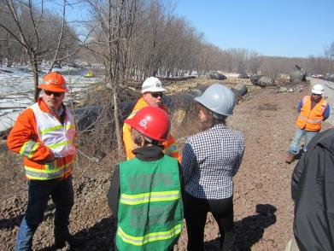
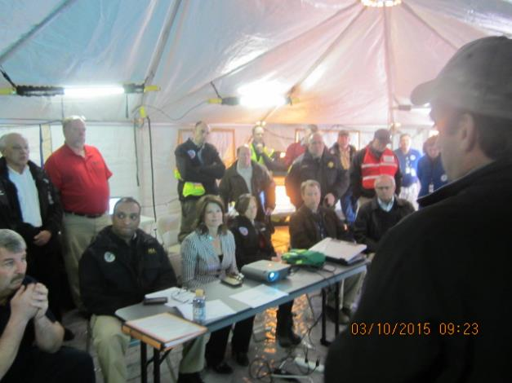
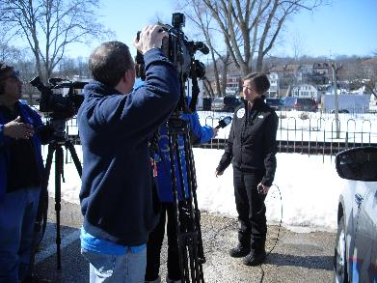
Communications - VIPs

Slide 30
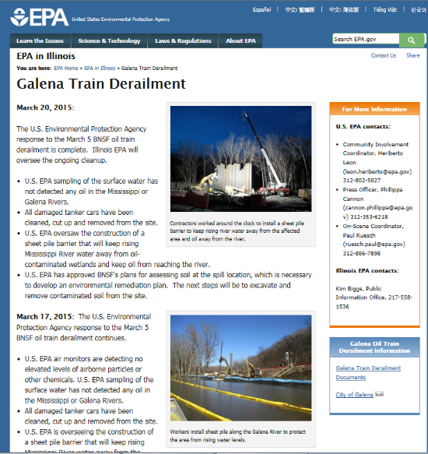
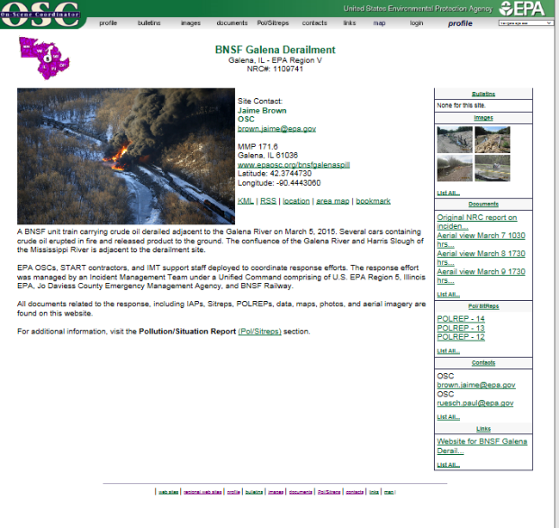
Websites
http://www2.epa.gov/il/galena-train-derailment http://www.epaosc.org/bnsfgalenaspill

Slide 31
AAR
Operational objectives analyzed:
  Notification
  Initial Response
  Incident Stabilization
  Transfer of Command
Analysis of core capabilities:
  Public information & warning
  Environmental response / H&S
  Operational Coordination
  Situational Assessment
  On-Scene Security & Protection
  Operational Communications
  Planning
  Intelligence & Information Sharing

Slide 32
AAR
Ratings:
  Performed w/o challenges, w/ some challenges, w/ major challenges
  Unable to be performed
For each objective & core capability:
  Strengths
  Areas for improvement
    Reference & analysis
Appendix A – Improvement Plan
  For each objective, core capability & area for improvement –
    Corrective action
    Primary responsible organization & POC
    Start & completion date

Slide 33
Improvement Plan Highlights
Policies and procedures
  EOP Updates
    Declaration of a disaster
    Chain of Command
    Decision-making & spending authority
    Train derailment annex
  Release of information to the public
    Emergency notification system
    Facebook & Twitter accounts established
Training
  Galena FD attended SERTC (PER-327)
    http://sertc.org/courses/crude-by-rail-emergency-response-cbr/
  Coalition-building with surrounding counties
Equipment
  Cell phones, comms tower, light tower
  MCP upgrades
  Updated inventory of resources county-wide

Slide 34
State & Regional Impacts
Joint EPA / AAR Meeting
  August 15th (Chicago)
  November 5th (Indianapolis)
EPA & States seeking to share & coordinate ER planning info/resources w/ Class 1 RRs sending unit trains thru Region 5
    Joint training (TRIPPR, TRANSCAER, etc)
    Local tabletop exercises (3-4 planned for CY2016)
    Full scale exercises
Minnesota
  State laws (part of omnibus budget bill) went into effect July 1 requiring:
    Submission of Prevention & ER plans by RRs to State (DOT & DPS)
    Increased safety inspections
    Emergency response training
    Improved response capacity
  Jan 2015 & Jan 2017 reports to State Legislature

