Slide 1
Working Remotely and
Incident Response
Alyeska Pipeline Service Company Processes and Lessons Learned
The Pacific States – British Columbia Oil Spill Task Force
November 18, 2020

Slide 2
2020 COVID-19 Response Timeline
March 3 | Alyeska began screening travelers
March 11 | Public Health Disaster Emergency Declaration signed by Governor Dunleavy
March 17 | Alyeska office staff began working remotely
March 24 | Business travel plans submitted to State of Alaska
March 31 | First positive COVID-19 case identified on North Slope Facility (not Alyeska)
April 12 | Valdez Marine Terminal Incident Response

Slide 3
Prepare and Practice
Equipment and Field Personnel Training
  Preventive Maintenance / Equipment Training
Periodic Exercises
  Large – support / IMT integration and communication
  Small – improvise and be flexible
IMT Procedure

Slide 4
Facilities
Valdez Emergency Operations Center (VEOC)
  Dedicated facility
Hotel / Convention Centers
  Conference rooms and meeting rooms
Remote Camp Facility
  Generally have meeting rooms or large common areas (Cafeteria)
Segregated Sections when possible
  Dividers as a backup plan
Food Service – An army marches on its stomach

Slide 5
Communication
Communication is still an issue, perhaps the same issue
  Understanding might be enhanced
  Secure access into IAP software
  Employee access to work systems remotely
JIC
  Reviews/Approvals in person
  Practice Press Conference
Wildlife Working Team
  External SharePoint Site

Slide 6
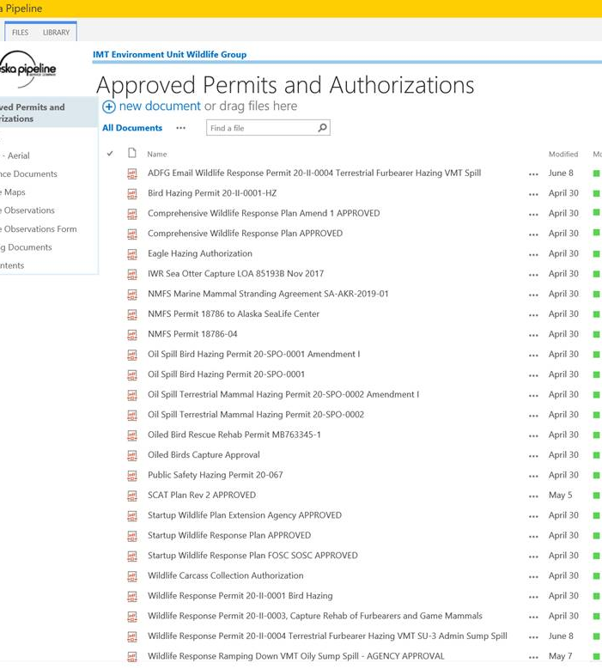
External Environment Unit SharePoint

Slide 7
Process
Incident Command System
  Procedure and practice
  Scale and deviate IMT when necessary
  Meeting schedule management
Electronic ICS/201
  Documentation Unit update and maintain
WebEx meeting management
Area for improvement
  Staging areas/equipment tracking

Slide 8
Relationships
Depth
  Incident Management Team assembled from throughout Alaska and beyond.
  Factor travel restrictions (or other restrictions) into contingencies.
Delegation
  Approvals or reviews within command post if possible.
Trust

