Slide 1
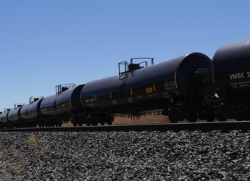
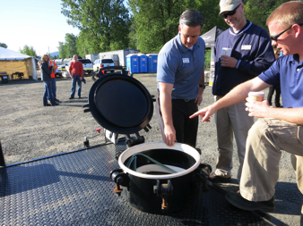
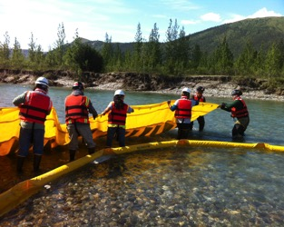
Pacific States British Columbia
Oil Spill Task Force
2021 Annual Meeting
Sarah Brace and Hilary Wilkinson,
Executive Coordinator Team
November 17, 2021

Slide 2

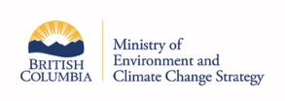




Member Agencies
AK Department of Environmental Conservation
B.C. Ministry of Environment and Climate Change Strategy
CA Department of Fish and Wildlife
HI Department of Health
OR Department of Environmental Quality
WA Department of Ecology
Notes:
The Task Force is represented by the Spill Programs across the 6 jurisdictions listed here. The Task Force founded in 1989.

Slide 3
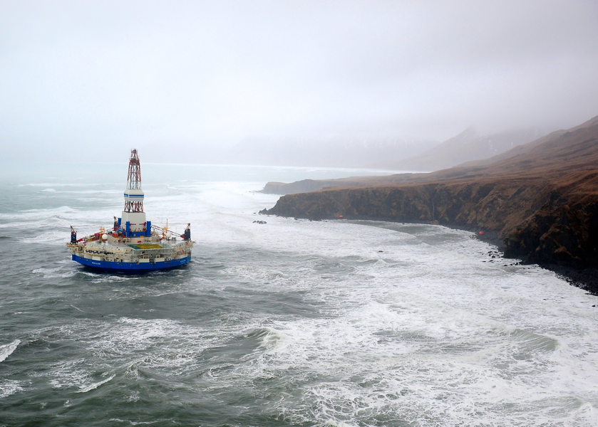
Key Partners
Oil industry
Response companies
Public interest groups
State/local govt’s
Notes:
Our work includes collaboration with many partners including..

Slide 4
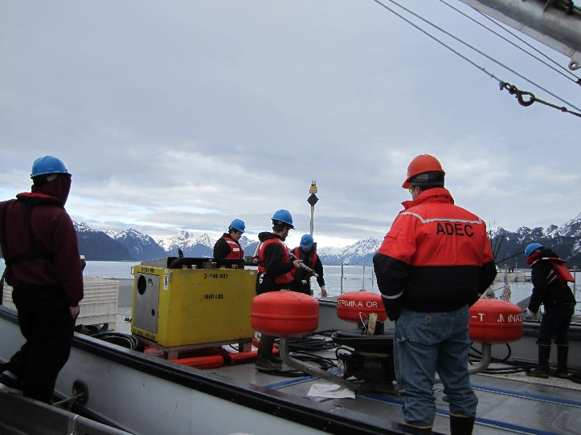
Key Partners
Tribes and Indigenous Nations
U.S. and Canadian Federal Agencies
Associations
Citizen groups
Notes:
Most of the Task Force projects and activities involve working closely stakeholders including those listed here.

Slide 5
Notes:
The backbone of our work is our Strategic Plan, which was recently updated in 2019.
Our vision is: No Spilled Oil
Our Mission is:
Our goals are:
These goals are the foundation of out biennial work plans.

Slide 6
Our Current Work
Notes:
This has been a big year for shifting our work perspectives and how we work together!
All of our work shifted nearly entirely to the virtual platform, and in some cases, there’s no going back.
We’ve saved time and resources by meeting on Zoom, Teams and Webex.
But we’ve lost some of the connection we appreciate when we’re together in person.
I’ll talk now about our current work in the

Slide 7
PREVENTION
Notes:
Our work in prevention continues to focus on abandoned and derelict vessels.
I’ll had the mic over to Hilary to provide an update on our efforts to address ADVs across the Task Force jurisdictions.

Slide 8
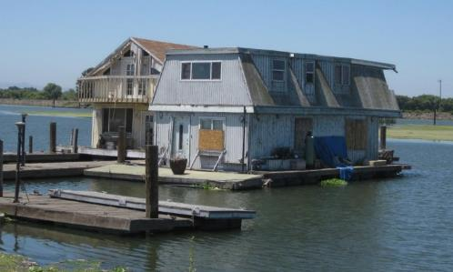
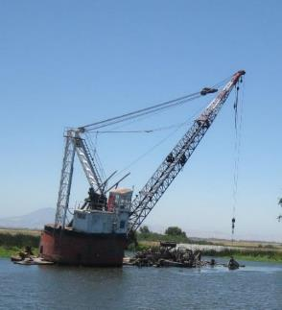
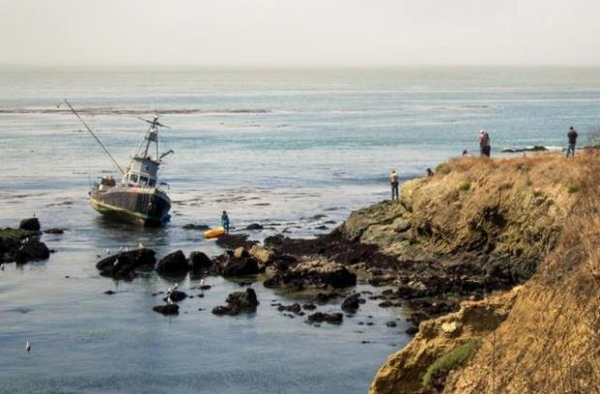
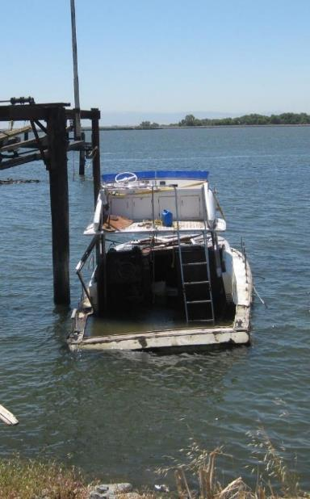
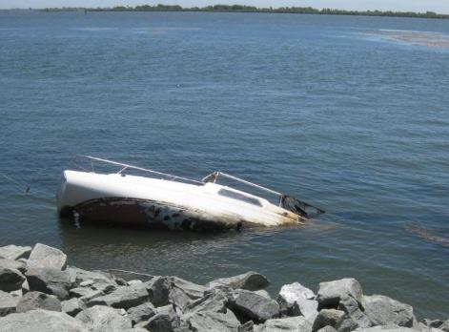
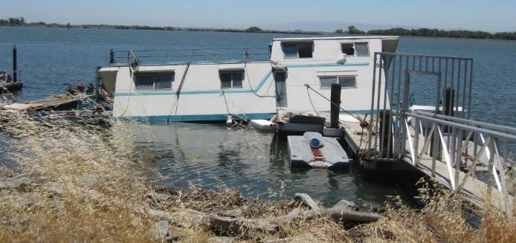
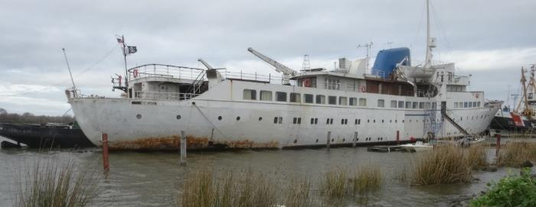
Abandoned and Derelict
Vessels
Notes:
Identified this as an emerging, common issue across TF jurisdictions in 2017. Has gotten more urgent in the intervening years; esp with the pandemic and increasing popularity of recreational boating in particular.
Formed a workgroup in 2017; 18 ADV experts/program managers from TF jurisdictions.
WG’s first report: white paper.

Slide 9
American Challenger 2021
Notes:
In 2017, the issue of common concern: Abandoned and Derelict vessels.
The incident portrayed in this pic is a near-perfect example of what Task Force jurisdictions are facing.
2017, the Point Estero ran aground near Cayucos State Beach, California. The US Coast Guard removed the oil but then departed. Vessel removal costs were estimated at $70,000. The uninsured owner walked away. The vessel was not eligible for the state’s recreational ADV program, and there is no commercial program. Both the county and the State Lands Commission have authority to remove the vessel, but no funding to do so. As of 2019, the vessel remains.

Slide 10
TASK 1:
White Paper
Goal
Quantify scope and scale of problem across west coast
Identify what is working elsewhere
Notes:
Major findings of this report:
State programs vary widely. Only one (WA) can be considered comprehensive.
Most have insufficient funding to address ADVs.
Estimated $20 million per Task Force jurisdiction is needed to address the backlog of ADVs.
A program to address ADVs needs five core elements:
Authority
Funding
Removal and Deconstruction
Prevention
Public Outreach and Education
Second: ADV Blue Ribbon Program (current focus)
The problem of ADVs includes both commercial and recreational vessels.
· The majority of ADVs are recreational, yet commercial vessels are typically larger and on a per vessel basis, can cost several orders of magnitude more than recreational vessels to remove.
· In addition to a steady stream of newly abandoned vessels, most states also face an increasing backlog of existing or “legacy” ADVs.
· In general, government policies have not been created to address this problem. For example, there are significant discrepancies between how abandoned cars and abandoned vessels are addressed.
· In the US, there is no comprehensive federal program. The few federal agencies that are involved in this issue (the US Coast Guard and the US Army Corp of Engineers) have limited roles.
· State programs vary widely. Only one (Washington) can be called comprehensive. Most state programs have insufficient funding to address ADVs.
· In Canada, the federal Abandoned and Wrecked Vessel Act is comprehensive yet underfunded, and this federal program takes precedent over provincial programs.
· No jurisdiction has a comprehensive outreach and education program associated with ADVs.

Slide 11
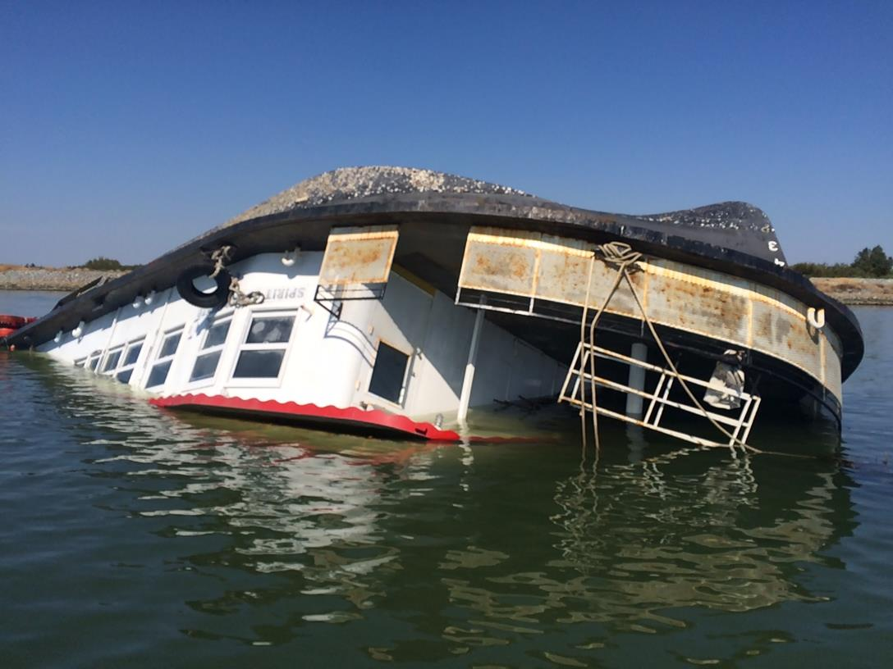
Task 2:
Blue Ribbon Program
Goal
Create the framework for a model program that that can be adopted by West Coast states
Notes:
Task Force is developing a Blue Ribbon Program, pulling together elements from existing programs as well as addressing on-going challenges
Our goal; Create the framework for a model program that includes these elements that can be adopted across the West Coast.
The idea of the model “Blue Ribbon ADV Program” is to lay out the elements of a state-level program that would more effectively/comprehensively address ADVs.
The Blue Ribbon program is a compilation of current best practices occurring within west coast states, plus a few others – such as Vessel Turn-in Programs.

Slide 12
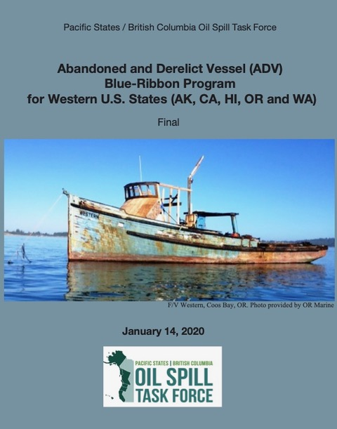
Available at:
http://oilspilltaskforce.org

Slide 13
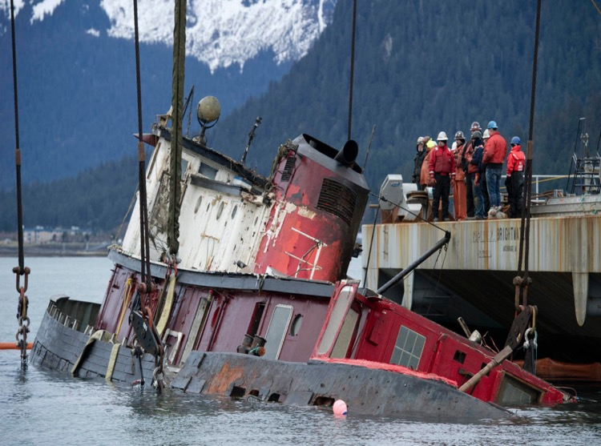
Blue Ribbon Program Components
33 recommendations for states:
Authorities
Prevention
Funding
Removal and Deconstruction
Public Outreach and Education
Six recommendations for federal partners
Photo: Michael Penn, Juneau Empire

Slide 14
ADV - NEXT STEPS
Reconfigure ADV Workgroup to address implementation
Now
Roundtable to highlight progress in implementing
state recommendations – Winter 2022
Continue efforts to
advance federal recommendations
Notes:
Share OR progress! The Oregon Marine Board’s Clean Marina Program is focused on ADV outreach for 2020-2022 as a result of a $100,000 NOAA Marine Debris grant that they recently received. There will be a $100,000 state match, bringing the total to $200,000. The focus of the funding is:
Visiting all 60 certified clean marinas and try to clear them out of existing ADVs.
Working with marina managers to enact specific BMPs that will reduce future ADVs. For example, requiring insurance policies of all vessels, and making sure those insurance policies cover “salvage”. The new BMPs are part of the new standards to achieve clean marina certification.
In terms of the removal efforts, the focus will be on recreational vessel of concern that:
are no longer seaworthy
have expired registration tabs
The most common of these “vessels of concern” are 20-30’ recreational sailboats that typically have 10-50 gallons of fuel in the tank and haven’t left the marina in years.
OR State Lands is an important partner in this. They will be adjusting lease agreements to reflect new standards around ADVs (including potentially increasing the fees). Currently, there is no expectation that marinas have to meet standards, but they are hoping to change this.

Slide 15
Pacific Oil Spill Prevention
Education Team (POSPET)
Overview
Formed in 1991
OILS-911 Reporting
Focus on small spills
Signage and outreach materials
Notes:
The Pacific Oil Spill Prevention and Education Team (POSPET), founded in 1991, is a collaboration of educators and outreach personnel from four Western U.S. states and the province of British Columbia. POSPET evolved from the simple premise that small oil spills can add up to cause significant environmental and economic harm, and that regional collaboration and coordination is the most efficient approach for addressing the problem.
POSPET members include representatives from state and federal agencies, industry associations and nonprofit groups from Washington, Oregon, California, Alaska and British Columbia. For more than a decade, POSPET members have focused on educating boaters and marina managers on best management practices to reduce spills resulting from maintenance operations, sewage discharge, and fuel transfer operations. Two of the most visible programs undertaken by POSPET members include tracking and certifying “Clean Marinas” and “Clean Harbors”, and running the “Spills aren’t Slick” campaign, including publicizing 1-800-OILS-911, a toll-free number for the public to report spills.

Slide 16
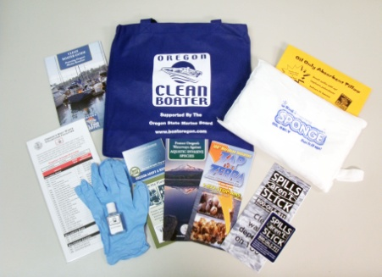
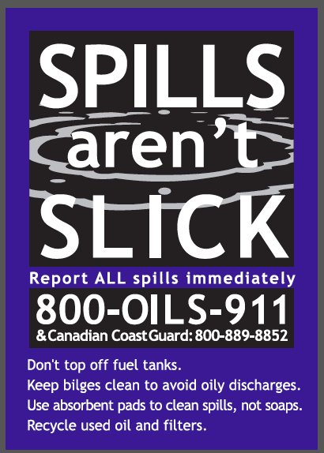
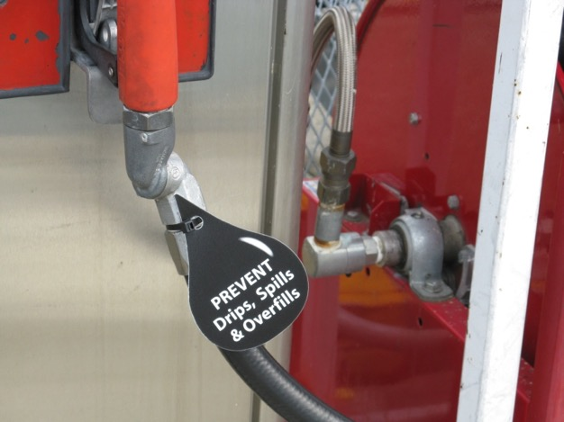
Notes:
Easy number to remember
Call Coast Guard too

Slide 17
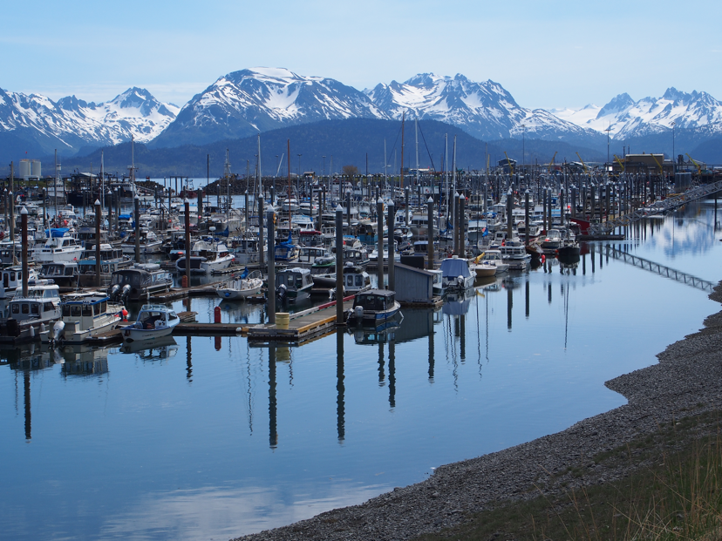
Clean Marina Program
Certified Clean Marinas
(July 2021)
Alaska 5
British Columbia 33
California 82
Oregon 61
Washington 72
PHOTO OF MARINA
Notes:
The POSPET team members also track the number of certified “Clean Marinas” and “Clean Harbors” within their jurisdictions, where these programs exist.
Table 1 lists the current number of facilities certified in Alaska, British Columbia, California, Oregon and Washington. These certification programs recognize marinas and harbors that educate boaters on spill and pollution prevention practices. Each certified facility must be re-certified every 1-3 years.

Slide 19
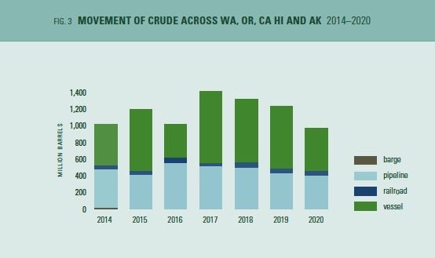
Crude Transport in Task Force Jurisdictions
2014-2020
Full report: www.oilspilltaskforce.org
Notes:
Our on-going work includes:
1. Crude movement across the west coast – we track volumes of crude transported by rail, pipeline, vessel and barge.
Our products are
Map of routes, locations of facilities and refineries
Data Report on annual volumes transported
This year we will begin tracking additional fuel types including renewables.

Slide 20
Oil Spill Database
2002-2021
Full report: www.oilspilltaskforce.org
Notes:
2. On-going oil spill database tracking spills across the Task Force jurisdiction.
NEW in 2020 – British Columbia contributed their spill data for the first time.

Slide 21
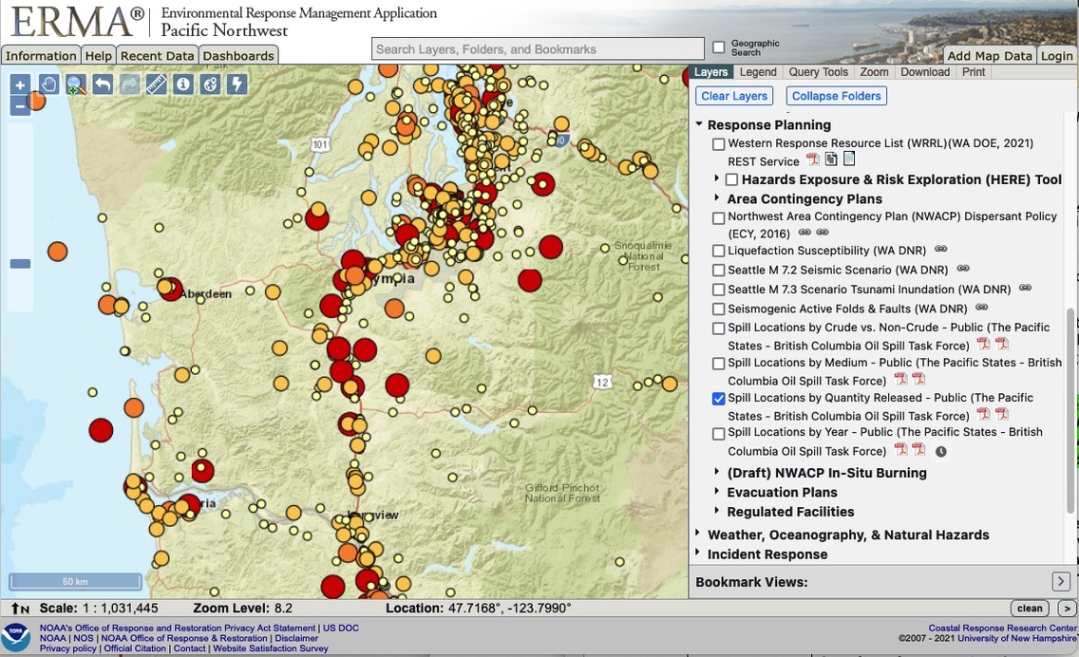

Slide 22
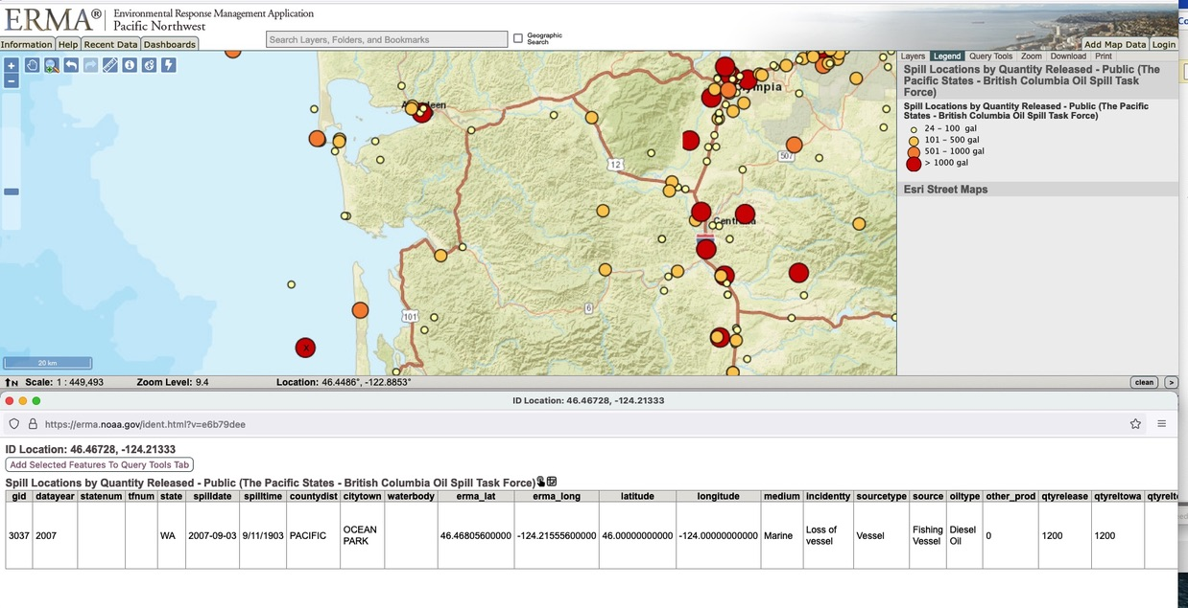

Slide 23
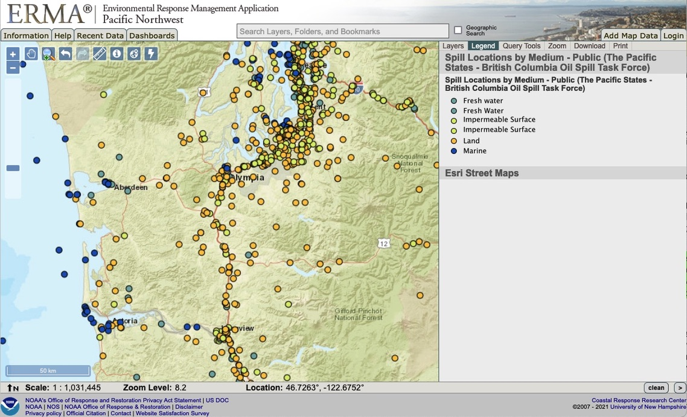
Oil Spill Database
2002-2020
Notes:
Also search by Crude vs. non-crude and by year.

Slide 24
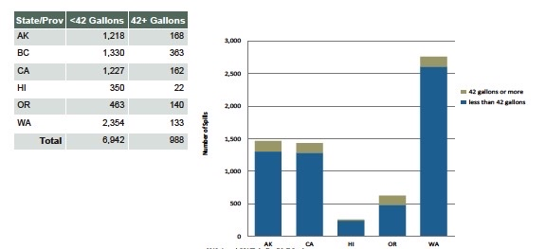
Oil Spill Database
2002-2020
Notes:
We started tracking the number of small spills a few years back. Quite helpful to see that the number of small spills far outnumbers
the 42 gal and greater size spill.
Goes to show we have a long way to go I preventing small spills.

Slide 25
PREPAREDNESS
AND
RESPONSE

Slide 26
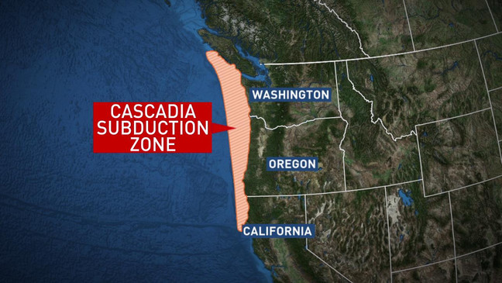
Cascadia Rising Exercise 2022
Notes:
Cascadia Rising June 2022: Exercises to look at the response and recovery from a Cascadia Subduction Zone earthquake across the Pacific Northwest.
Spill of National Significance: There will be an oil spill component of the Cascadia Rising 2022.
BC’s Exercise Coastal Response is also taking place in 2022
Task Force: We will be exploring a role for the Task Force in supporting the preparation and planning of these exercises that involves several of our member jurisdictions.

Slide 27
Drills and Exercises Workgroup
Lessons learned from
drills during COVID
Hybrid approach
Design time
Technology challenges
Facilitation

Slide 28
Drills and Exercises Workgroup
Cross-jurisdiction objectives and requirements
Available on www.oilspilltaskforce.org
Notes:
We continue to explore how to handle drills and exercises in a virtual environment. This includes sharing lessons learned from recent drills. Really important!
\

Slide 30
PUBLIC OUTREACH
AND COMMUNICATIONS

Slide 31
Webinars and Roundtables
Green Boating
Virtual Drills
Renewable Fuels
Green boating photo?

Slide 32
Webinars and Roundtables
(Proposed in 2022)
ADV Blue Ribbon Program
Transboundary Spill
Planning
Non-floating oils

Slide 33
Communications
Download report: www.oilspilltaskforce.org

Slide 34
Outreach Events

Slide 35
Sarah Brace
Executive Coordinator
www.oilspilltaskforce.org
Hope to see you in person again soon!

Slide 36
END

Slide 37
Oil Spill Database workgroup
Full report: www.oilspilltaskforce.org

Slide 38
The barge Nestucca in the Columbia River Estuary,
December 24, 1988
Photo by Jon Neel
Notes:
This is the barge Nestucca after it collided with it’s tug, the Ocean Service, about 3 km off the coast near Grays Harbor, WA. Approximately 175,000 gal of fuel oil spilled, and was transported by ocean currents from OR to BC.
Note: wood pegs jammed in gash to slow the leakage, near the deck just to left of word “NESTUCCA.”
Following the Nestucca spill Premier of B.C. Vander Zalm, and WA Governor Booth Gardner established the Washington/B.C. Task Force on Oil Spills.
About 6 months later, the day after the first Task Force meeting, the Exxon Valdez ran aground in Prince William Sound…..

Slide 39
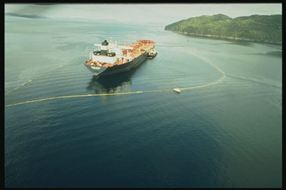
The Exxon Valdez on Bligh Reef in Prince William Sound, Alaska
grounded March 24, 1989
Photo by Jon Neel
Notes:
Eight of the eleven tanks damaged Exxon Valdez spilled more than 11 million gallons of crude oil into Prince William Sound, affecting 1,200 miles of shoreline.
The Exxon Valdez spill spurred the Task Force to expand to include AK, Oregon and California.
Purpose; to enhance prevention and response, technology sharing and share info on financial recovery after a spill.
The Valdez motivated the newly formed Task Fore to work together : they initiated and completed an independent hull inspection of the Exxon valdez, and developed an oil spill contingency plan to ensure the badly damaged tanker could be safely moved down the west coast to a dry dock for inspection and repair.
This work helped TF member agencies to sharpen their own state policies and pass legislation.
During that time some Task Force members also flew to Washington DC and testified before Congress, providing state input into the draft federal Oil Pollution Act of 1990 that was being created.

Slide 40
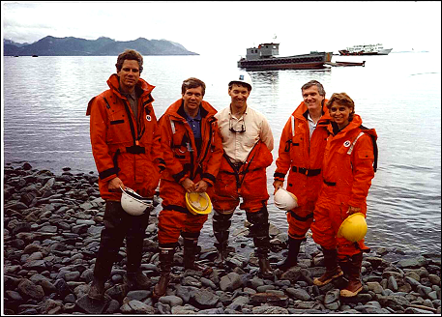
Original Task Force Members, Prince William Sound, 1990
Photo by Jon Neel
Notes:
Over a year after the Valdez spill, in July 1990, Task Force members and staff flew to Alaska to see first-hand the clean up operations and progress in Prince William Sound. Much of the Sound still had a black ring around its shoreline.
Cleanup support vessels in background.
From left to right members are:
CA - Michael Kahoe, Assistant Secretary, California Environmental Affairs Agency
OR - Fred Hanson, Director, Oregon Department of Environmental Quality
AK –Dennis Kelso, ADEC Commissioner
BC - Richard Dalon, Deputy Minister, Ministry of the Environment
WA - Christine Gregoire, Director Department of Ecology
HI not yet a member of the Task Force.

Slide 41
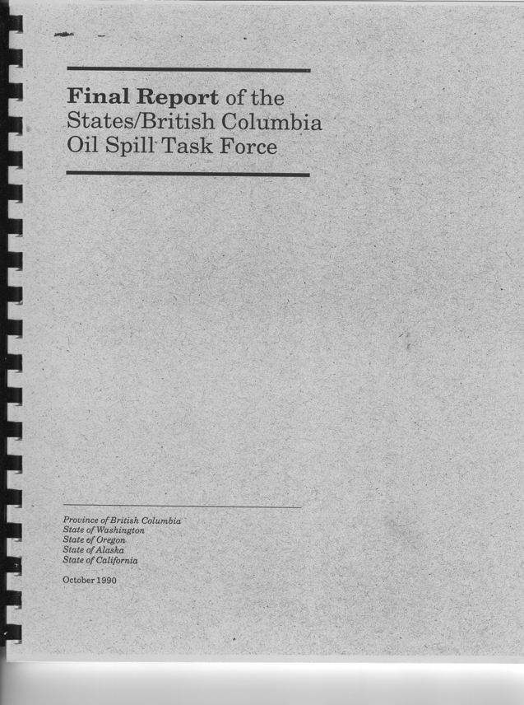
Landmark Report
46 recommendations
for spill prevention and response
Recommendations for each jurisdiction
Oil Pollution Act of 1990
Canadian Shipping Act Amendments 1993
Notes:
Task Force releases a report including major findings from recent spills
inadequate training, vessel design shortcomings, traffic mgt issues, regulatory gaps.
46 Recommendations for reducing spills and collaborative response across the west coast
Targeted recommendations for within each jurisdiction
This report influenced the OPA 90 and Canadian Shipping Act Amendments of 1993

Slide 42
Task Force Structure
Task Force Executives
Agency or Program Directors
  Strategic direction
  Guidance
  Partnerships
Executive Coordinator
Project manager
Facilitator
Cat herder
Coordinating Committee
Spill Program Managers/Staff
Project tasks
Work Plan Implementation
Cross-jurisdictional exchange

Slide 43
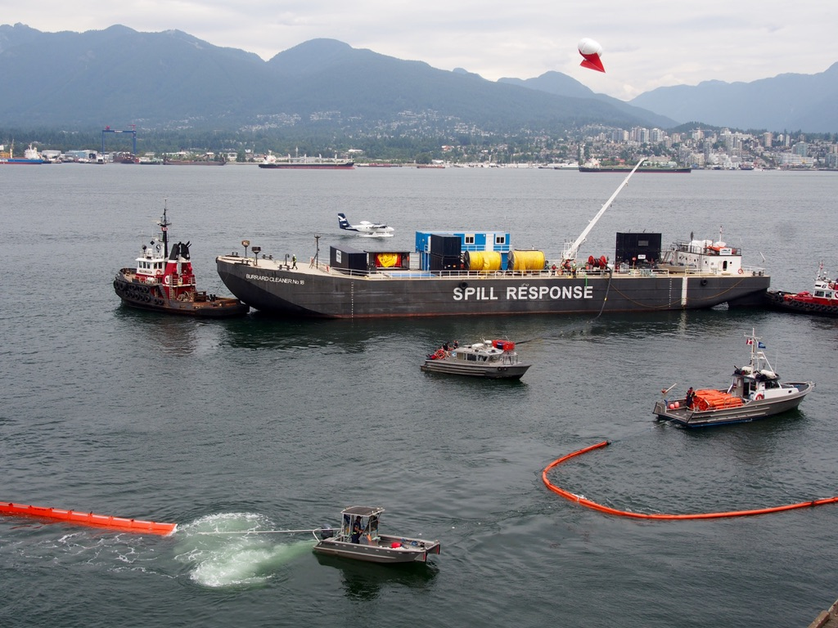
Spill Capacity workgroup
Notes:
New workgroup in 2019-20 to review and update our Mutual Aid Agreement.
Who’s in workgroup: Task Force member agency staff who are involved in spill response planning
Purpose;
1. Develop a system for listing the spill equipment and staff capabilities across the jurisdictions (OSTF agency staff) . This inventory is intended for internal OSTF use, to be able to quickly find out which agency has trained or certified staff in ICS positions, in order to cascade (share) staff during a spill incident.
2. Review and update the Task Force Mutual Aid Agreement, to ensure policies and agreements are up-to-date. Last update: 2011. Plan to do a tabletop drill with Mutual Aid Agreement later next year.
Products for this workgroup:
1. A roster of ICS-certified and trained staff across each jurisdiction;
2. Agency equipment posted on the WRRL (World Response Resource List)
3. Revised Mutual Aid agreement with personnel and equipment resources updated.

