Slide 1
Hawaii Report November 17, 2021 Presented by Kathleen ho Deputy Director for Environmental Health Department of Health

Slide 2
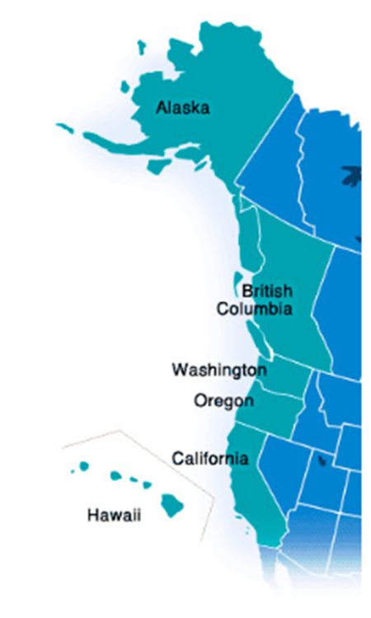
The Hawaiian Archipelago

Slide 3
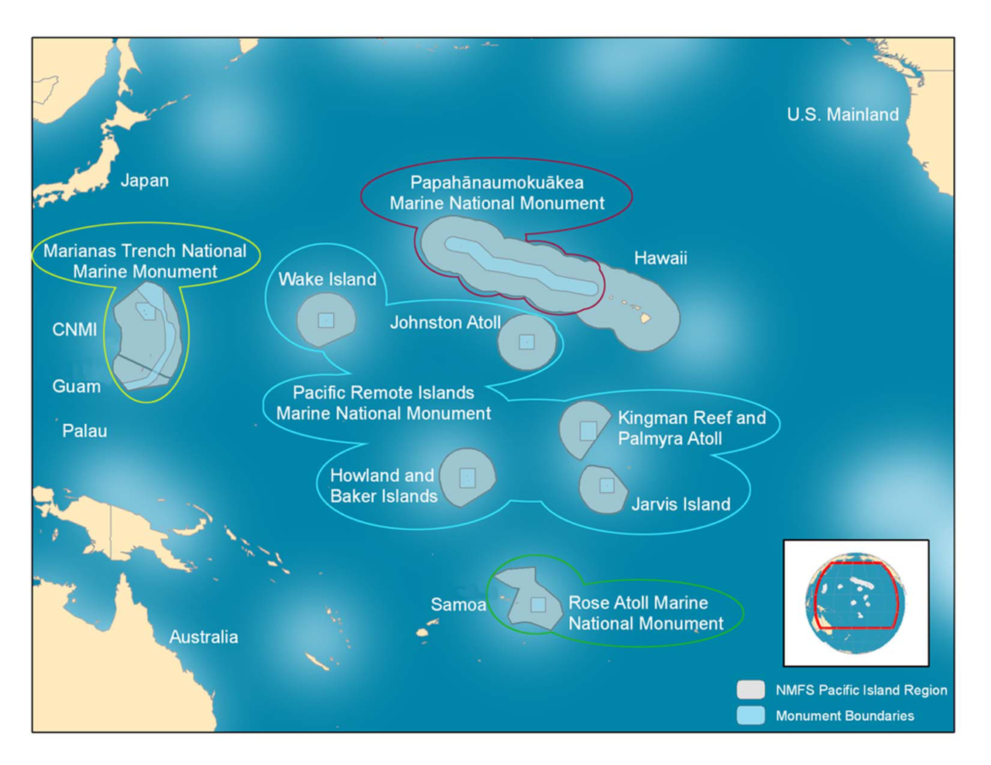

Slide 4
Hawaii’s OIL SPILL RESPONSE AUTHORITY and funding
Hawaii Environmental Response Law (HRS 128-D)
Hawaii State Contingency Plan (HAR 11-451)
Environmental Response Revolving Fund source: 5 cents tax per barrel of petroleum products, and civil penalties from environmental enforcement

Slide 5
OIL MOVEMENT
As COVID-19 restrictions have been easing up, Hawaii has seen an increase in fuel consumption
http://dbedt.hawaii.gov/economic/energy-trends-2/

Slide 6
INCIDENTS & ACTIVITIES
30,000 gallons Jet-A fuel spill
737 cargo plane emergency ocean landing
Updates on Red Hill Tanks & pipeline releases at H & K piers
Industry-led dispersant exercise receiving USCG validation
USCG ADDS certification annual training
Dispersant efficacy testing of crude oils

Slide 7
30,000 gallon Jet A fuel spill
Daniel K. Inouye International Airport
March, 2021
Pipeline was drained to install new valves inside of a fuel vault
Valves were not checked prior to recharging the pipeline
Jet A fuel flowed out of the new valves, overfilled the fuel vault, ponded on tarmac, and disrupted airport operations
Spilled fuel did not enter navigable waters

Slide 8
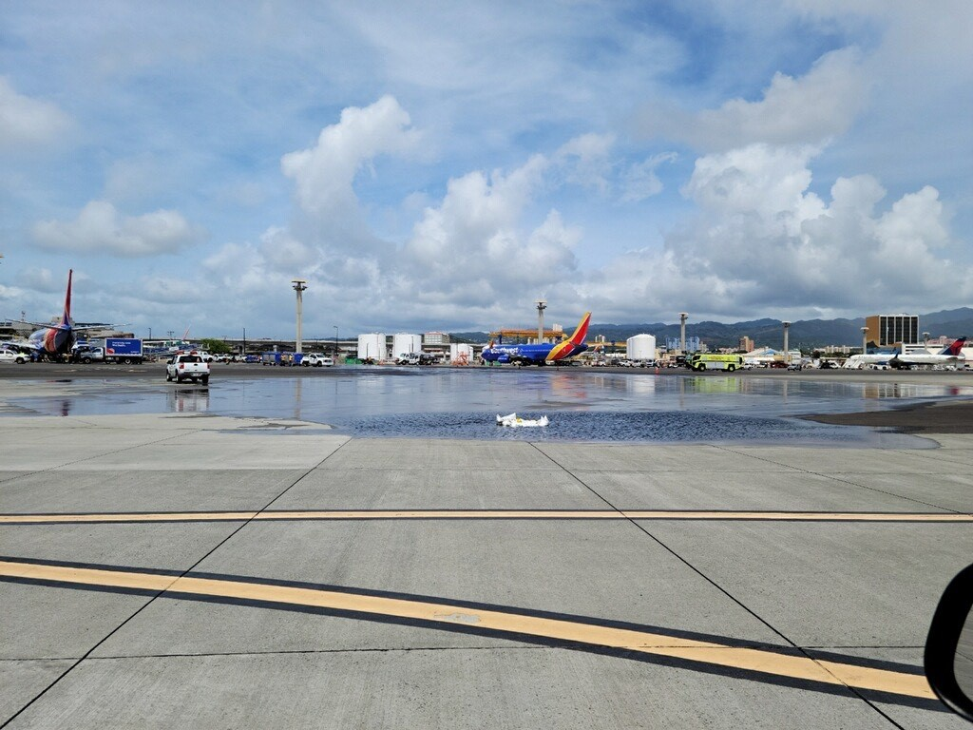

Slide 9
Boeing 737 cargo plane emergency water landing
2 miles off shore Ewa Beach
July, 2021
Cargo plane took off from Daniel K. Inouye International Airport and shortly afterwards experienced engine failures
The flight crew of 2 landed the plane in the ocean, escaped, and were rescued
The plane broke apart & sank in 300’ of water
2000 gallons Jet A fuel reported on board
NTSB recovered the wreckage in Oct.

Slide 10
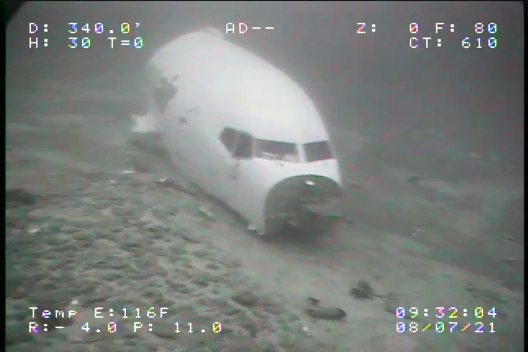
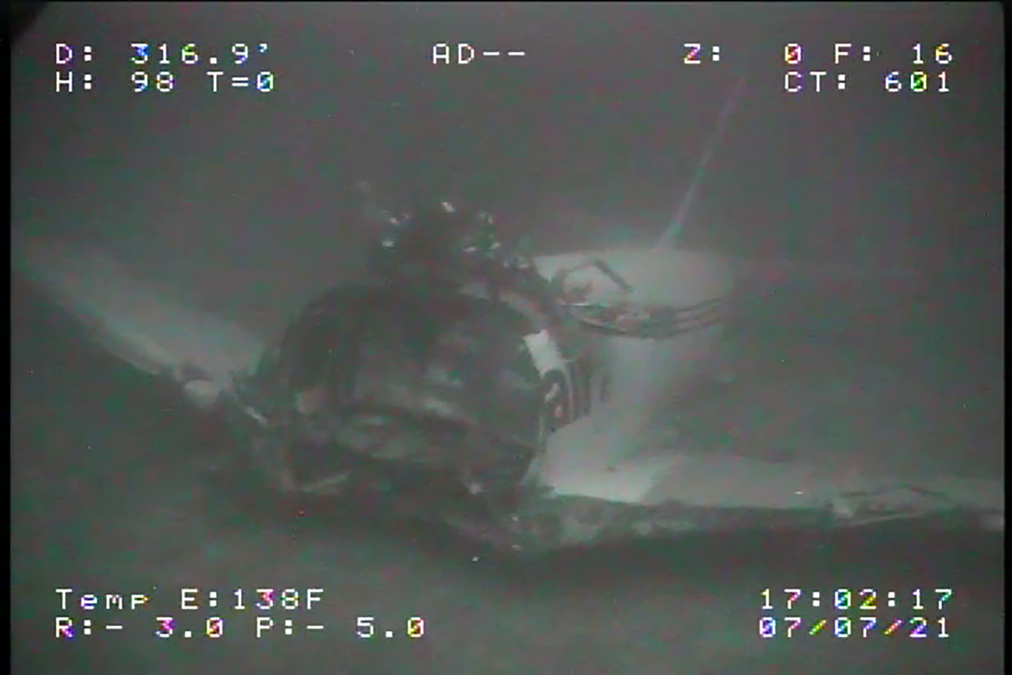

Slide 11
Navy’s Red Hill bulk storage tank,
K Pier, and H Pier releases
Navy’s Red Hill contested case hearing waiting DOH Director’s decision
Navy declares Critical Infrastructure Security on records related to Red Hill and its harbor pipelines
Sierra Club sues DOH requesting Navy records
Cleanup cost for pipeline releases at K Pier and H Pier nears $2 million.
DOH fines Navy $325,182 for safety violations at the Red Hill facility

Slide 12
Dispersant Exercises with Fluorometer
Jan 2021 - OSRO flew their DC-6 airplane modified to deliver dispersants
August 2021 – USCG annual certification & OSRO flew helicopter dispersant bucket

Slide 13
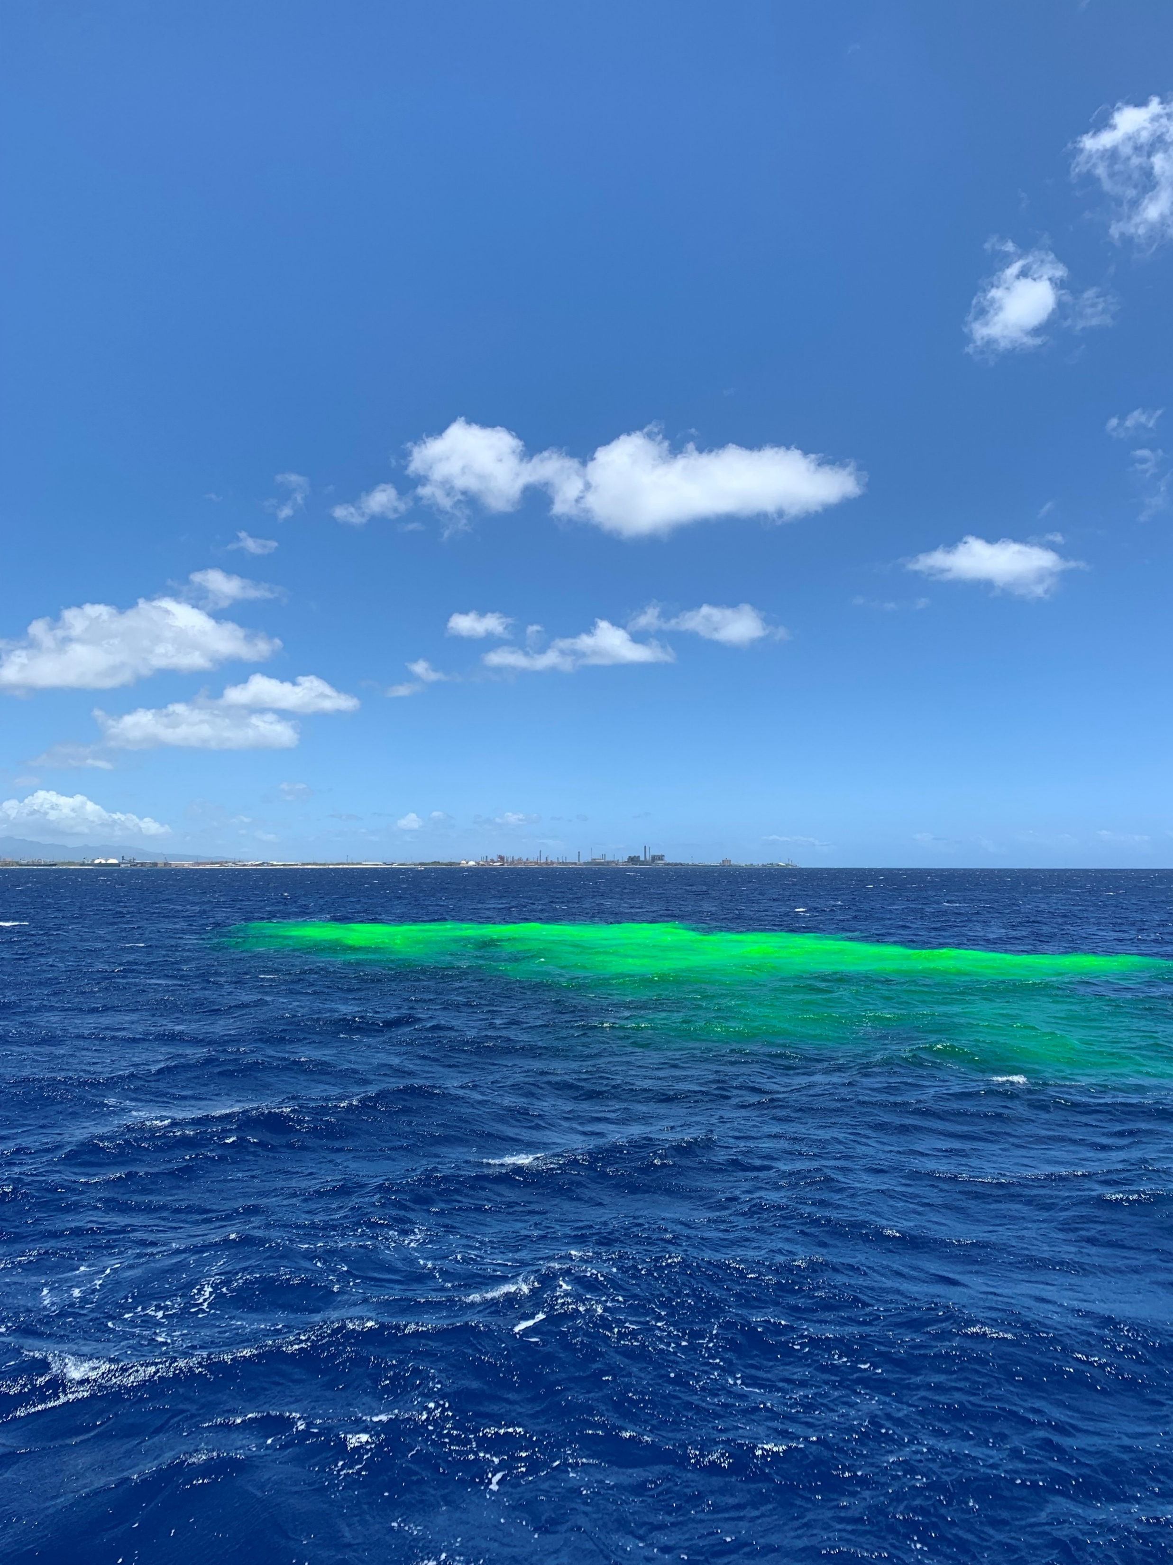
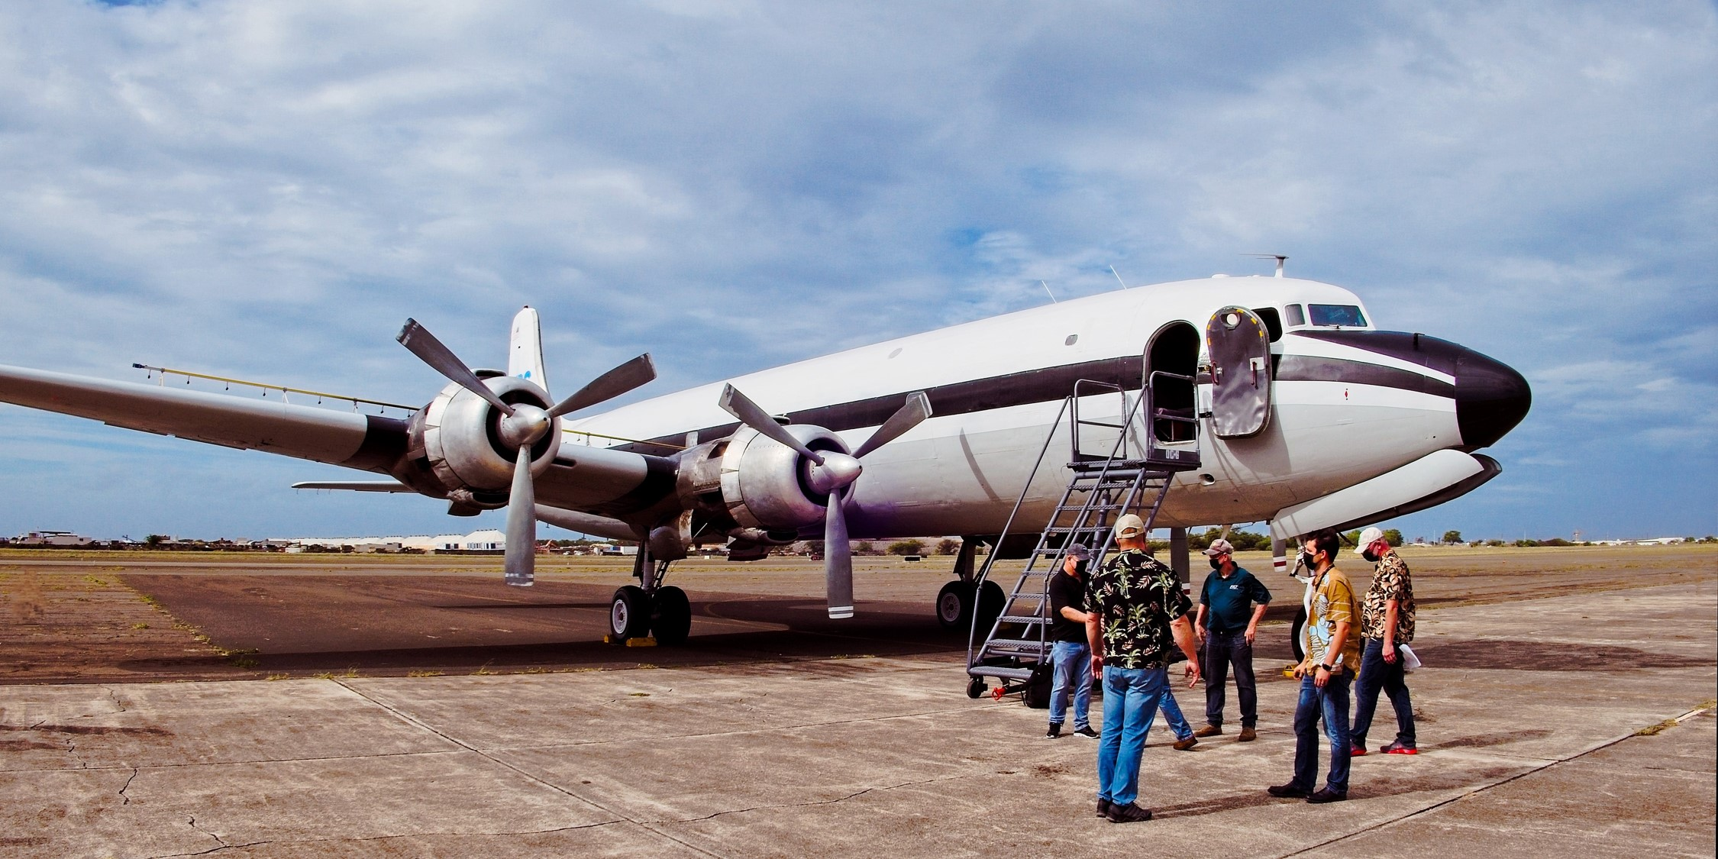
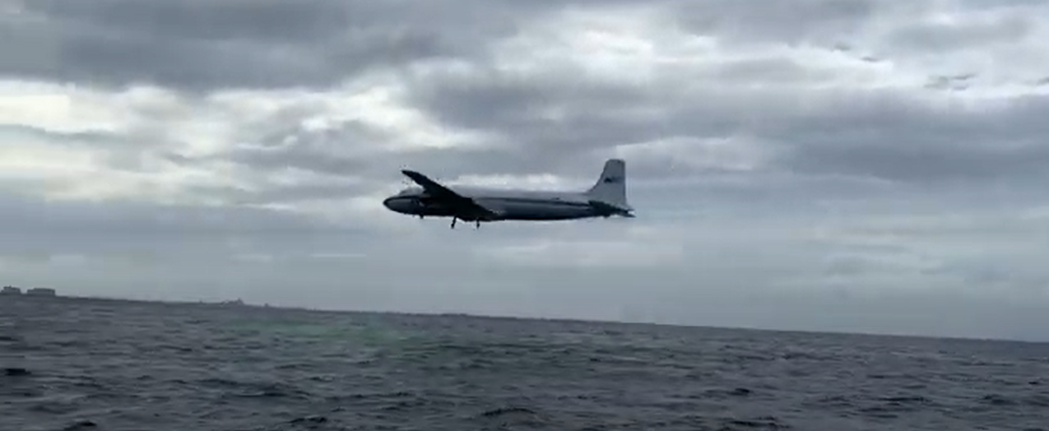
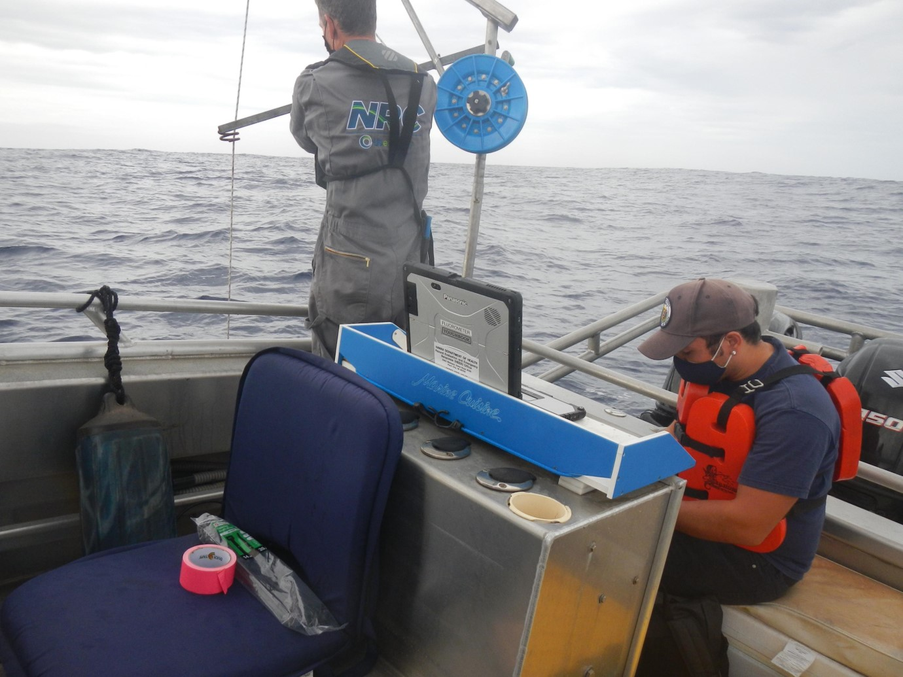

Slide 14
USCG ADDS certification training with Fluorometer deployment
August, 2021
Team effort (USCG, State, & Industry)
USCG flew their newest C-130, the J model
OSRO also flew their helicopter dispersant delivery bucket
HECO operated State’s Fluorometer on OSRO’s OSRV
PENCO operated the ADDS
USCG Pacific Strike Team and Sector Honolulu were observers

Slide 15
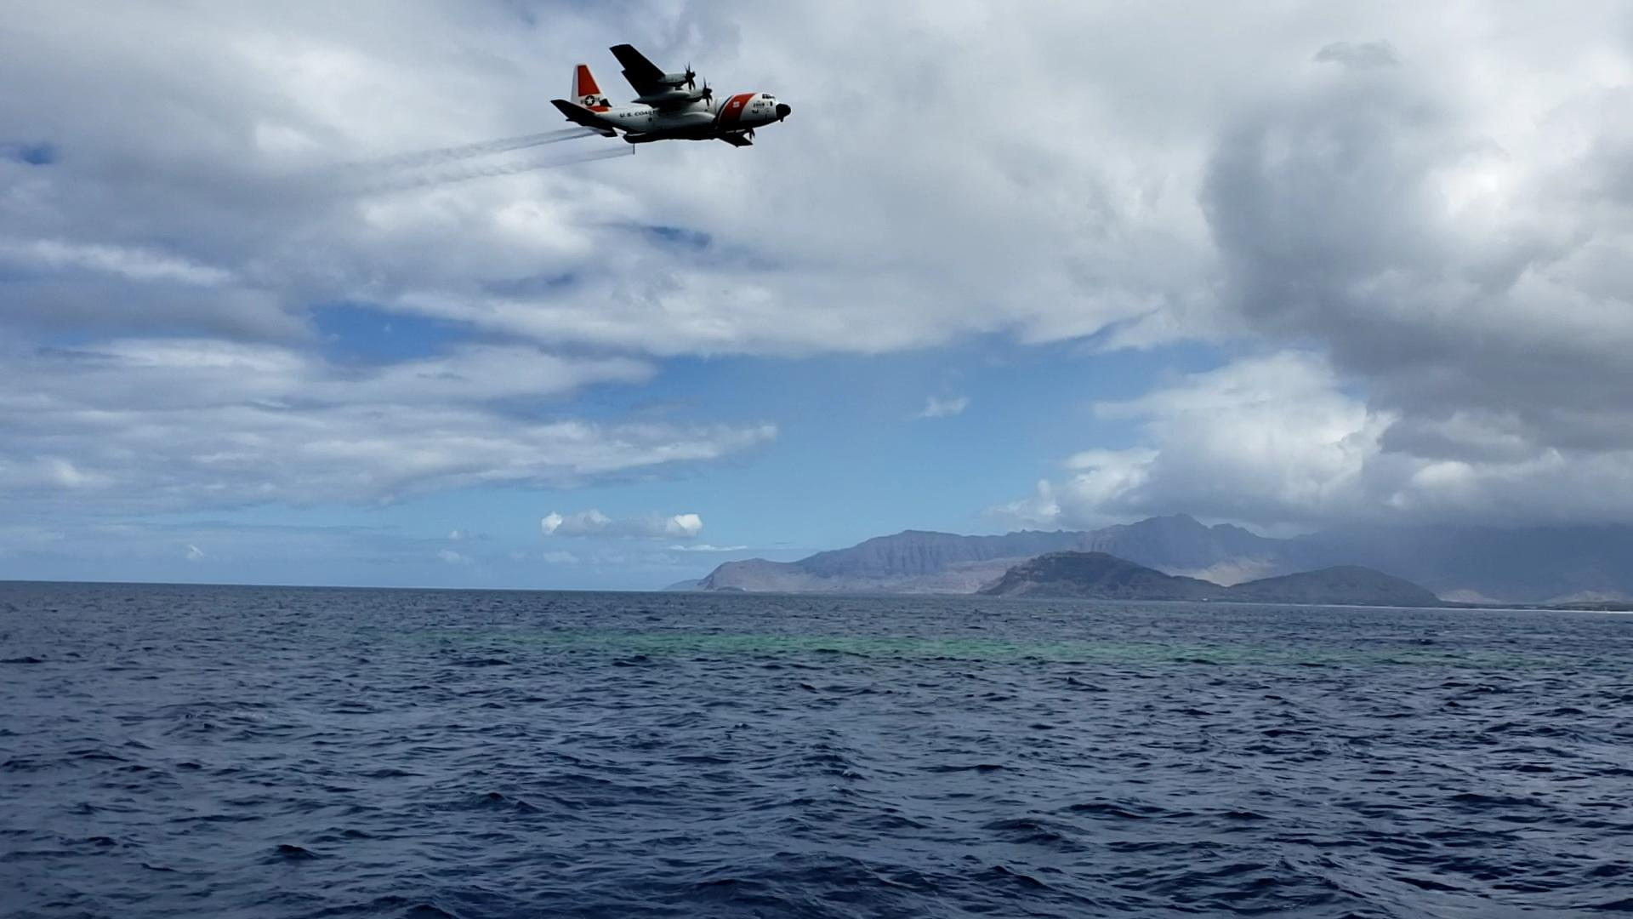
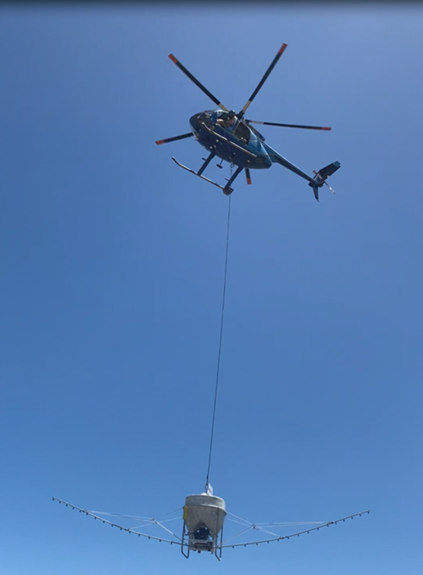
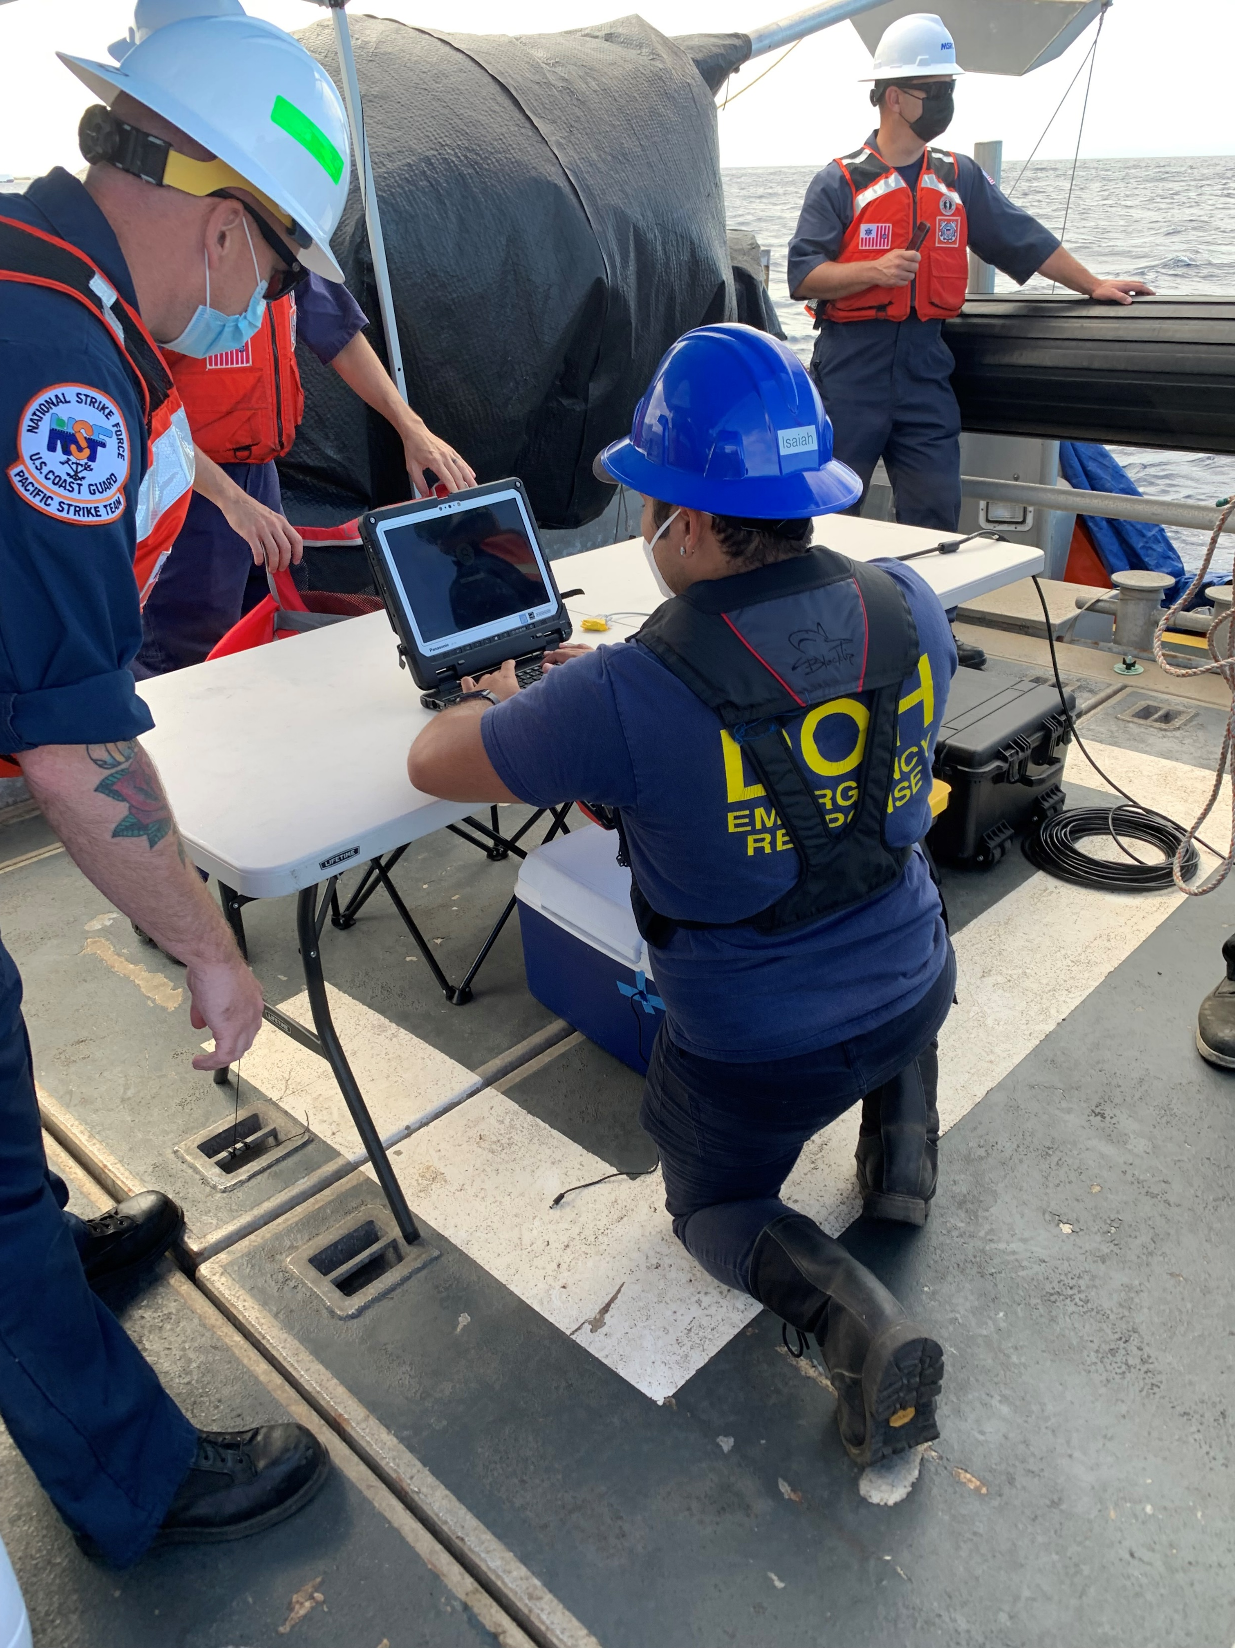

Slide 16
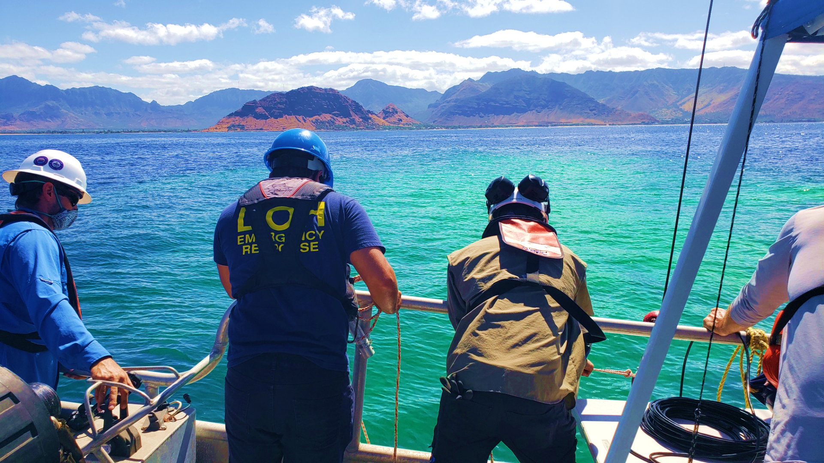
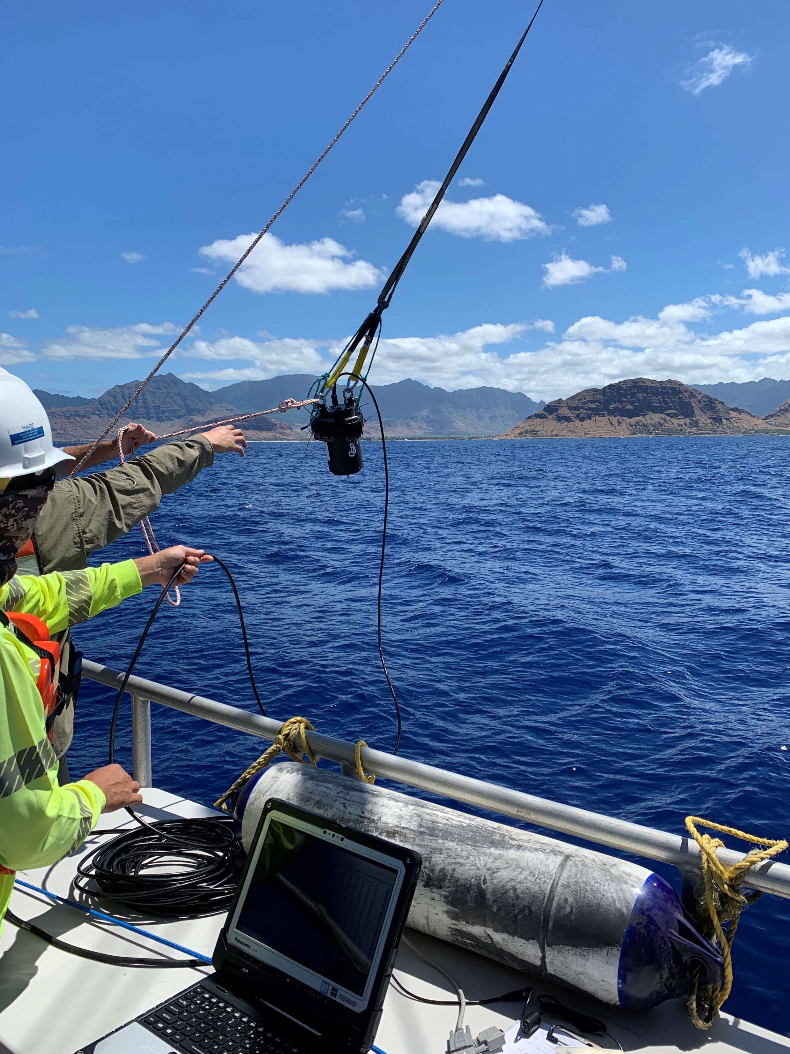
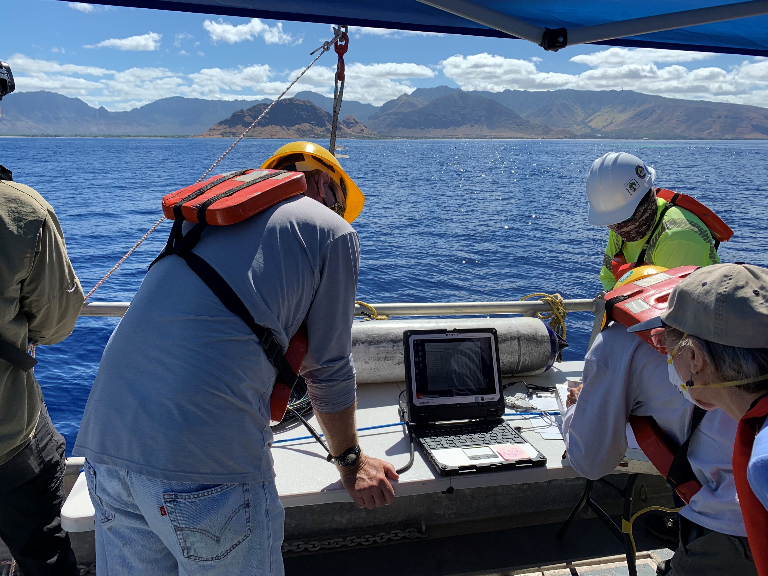

Slide 17
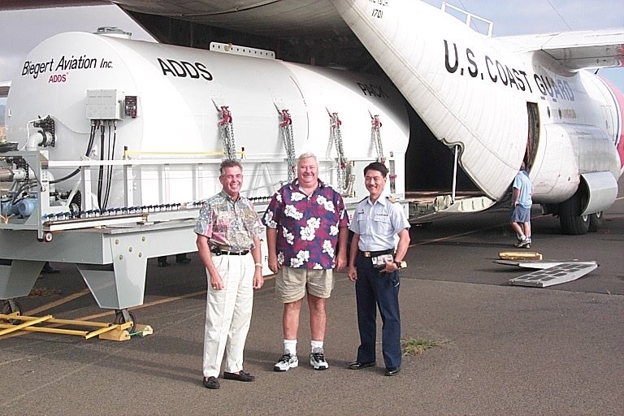
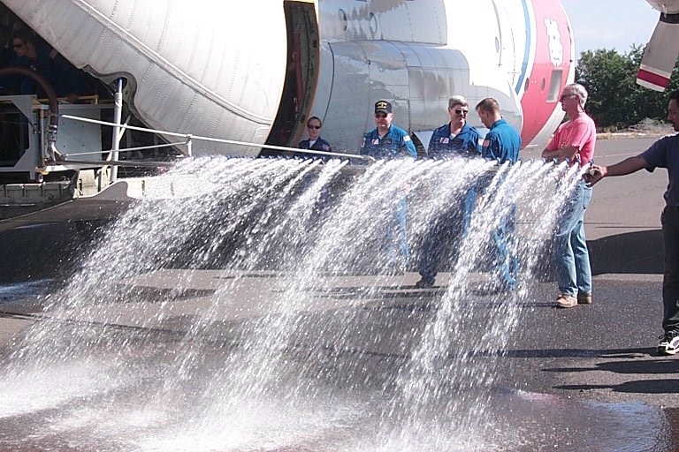
Hawaii’s unique Team for aerial dispersant applications

Slide 18
Dispersant efficacy testing on imported crude oils
PAR Hawaii Refinery imports 18 types of crude oil
Dispersants FINASOL and COREXIT stand ready to use in Hawaii
Efficacy testing follows procedures developed by the former Clean Islands Council

Slide 19
https://health.hawai.gov/heer/
"E mālama i ka honua. Imua!"

Slide 20
ALOHA
Mahalo!

