Slide 1
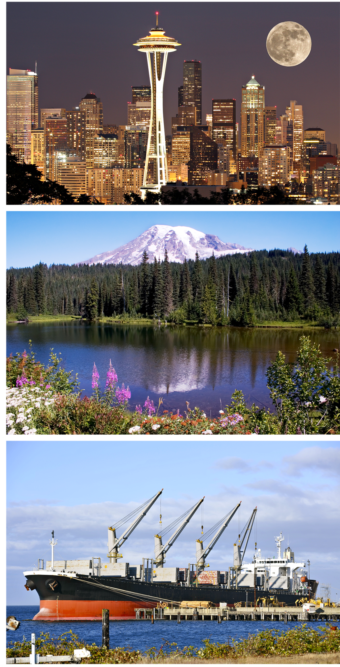
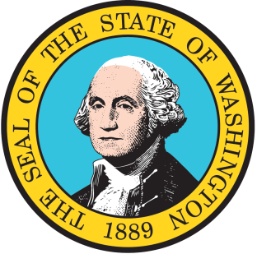
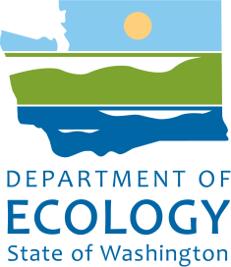
PS/BC OIL SPILL TASK FORCE
Annual Meeting 2014
Jurisdictional Update
Presented by Dale Jensen
Program Manager
WA State Dept of Ecology
Spill Prevention, Preparedness & Response Program

Slide 2
PROGRAM DATA (JULY 2013-JUNE 2014)
Spills management annual tabletop drills | 16
Worst case scenario tabletop drills | 12
Deployment drills | 101
Total number of vessels entering WA waters | 3938
Vessel inspections | 370
Oil transfer inspections (vessels and facilities) | 880
Total number of reported incidents | 3,961
Number of field responses conducted | 833
Notes:
Year at a glance … it’s been a busy one.

Slide 3
2014 Events
Notes:
And the majority of events we respond to involve oil spills.
You can see most responses are to oil and our system captures all reports to air, water quality or toxics cleanup.
Most of what we respond to are small spills and its been several years since WA’s seen a major spill.

Slide 4
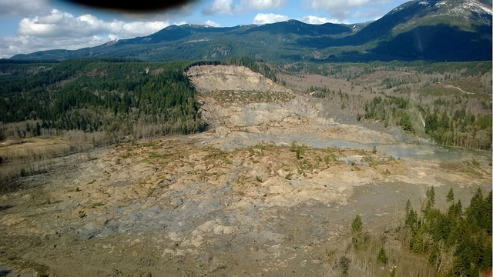
Oso Landslide
Notes:
The most notable incident of the year was the Oso landslide in Snohomish County, north of Seattle.
On Saturday, March 22, 2014, at 10:37 a.m. local time, a major mudflow occurred 4 miles (6.4 km) east of Oso, when a portion of an unstable hill collapsed, sending mud and debris across the North Fork of the Stillaguamish River, engulfing a rural neighborhood, and covering an area of approximately 1 square mile (2.6 km²).
Forty-three people were killed.
Responders worked the incident for 5 weeks and recovered/disposed 450 containers of hazmat: propane tanks, pesticides, fuels, compressed gases, etc:
Hired EPA through Mission Assignment to perform water sampling
Coordinated with Secret Service for President Obama visit (and expedited removal of remaining large propane tanks)
Designed decontamination system – staffed by National Guard
Over 100 Ecology staff (including WCC) participated in the response, and every program in the agency (except nuclear waste)

Slide 5
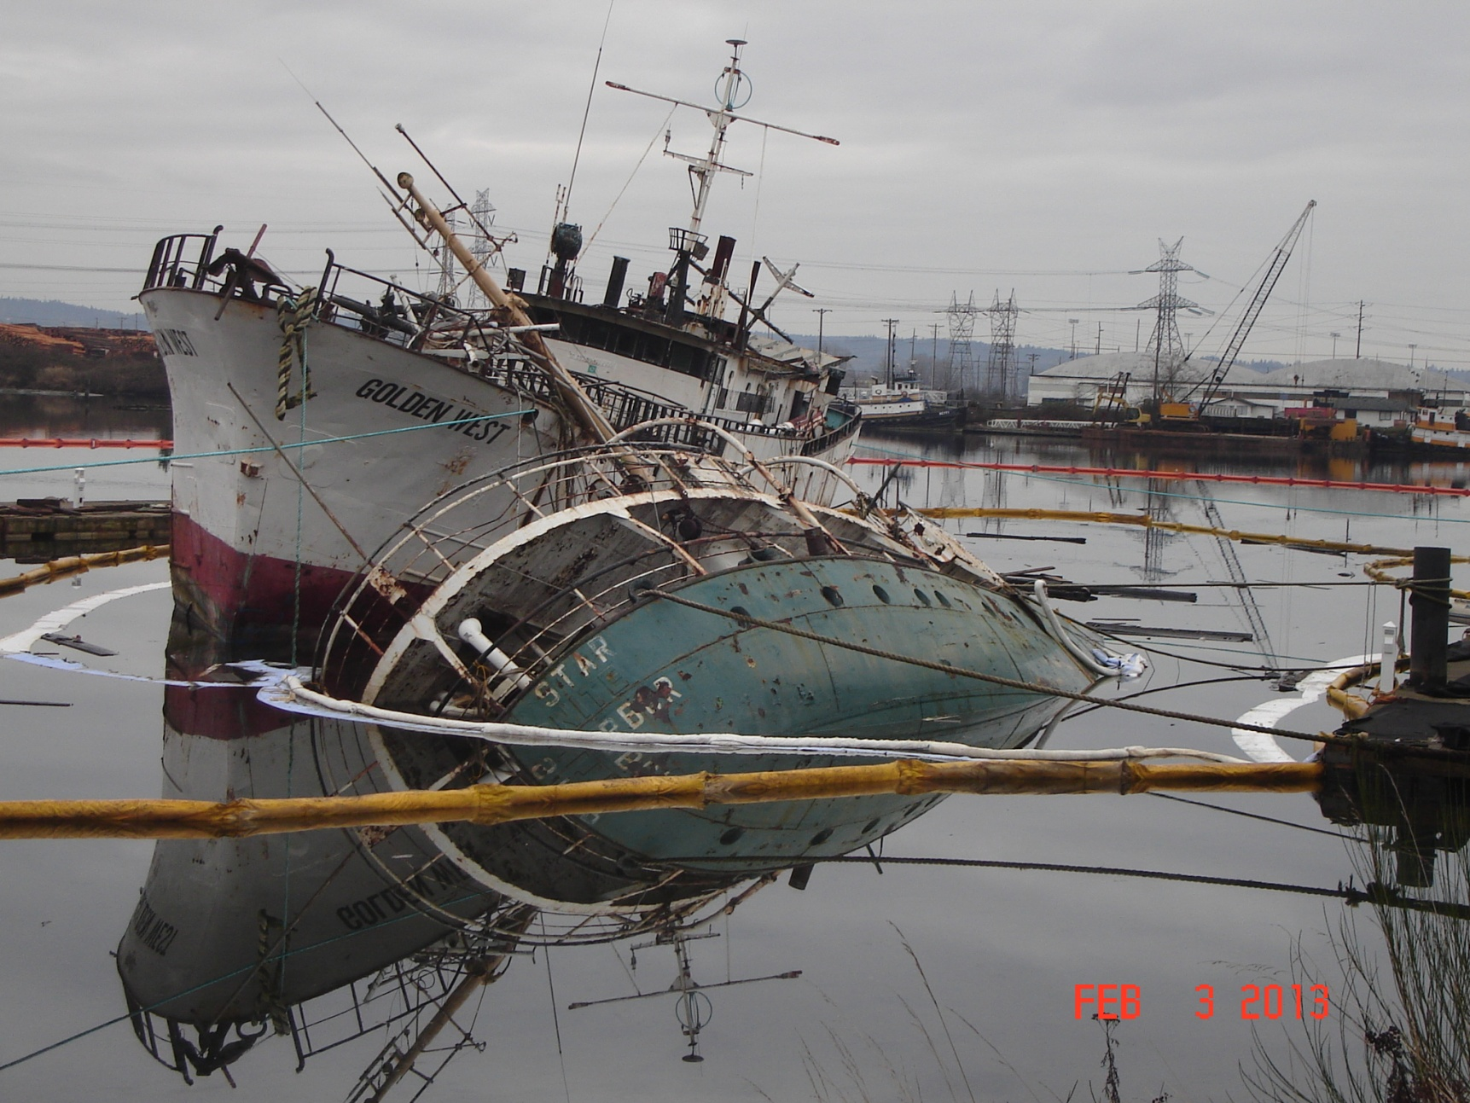
Helena Star & Golden West
Notes:
Above are Derelict Vessels Helena Star and Goldne West that were removed and deconstructed in Tacoma. The response was coordinated amongst the US Coast Guard, Department of Natural Resources, Ecology and private diving and salvage companies.
Derelict vessels have been quite a problem for us.
We struggle with how to leverage federal authority and funding AND state authority and funding to deal with these vessels.
Fortunately we’re closing the gap through our partnerships and work with the coast guard and DNR.

Slide 6
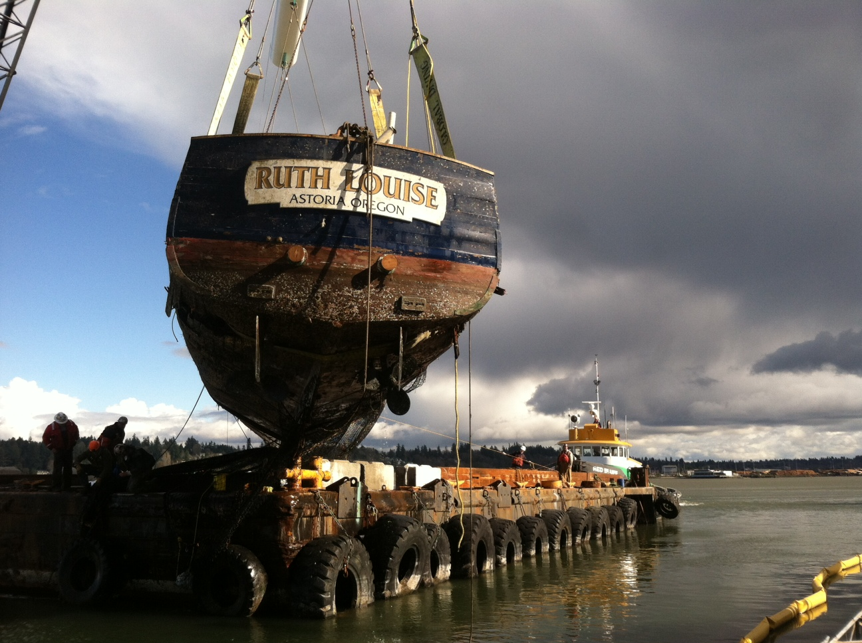
Derelict Vessel Update
Notes:
And there’s been some legislative action.
Thanks to our forward leaning Legislature and the passing of HB 2457 now:
Old/large vessels are required to have insurance and survey prior to ownership transfer
Private marinas must have insurance and must require vessels to show proof of insurance
Tax exemption for vessel deconstruction
Revenue extended to commercial vessels through $1/foot/year fee
Moorage providers must collect and share owner information with agencies

Slide 7
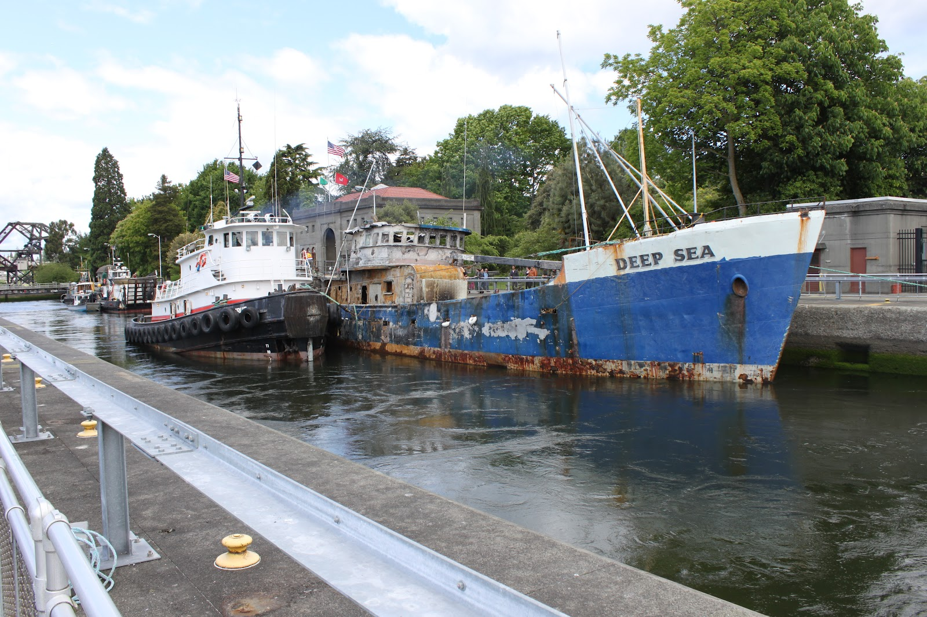
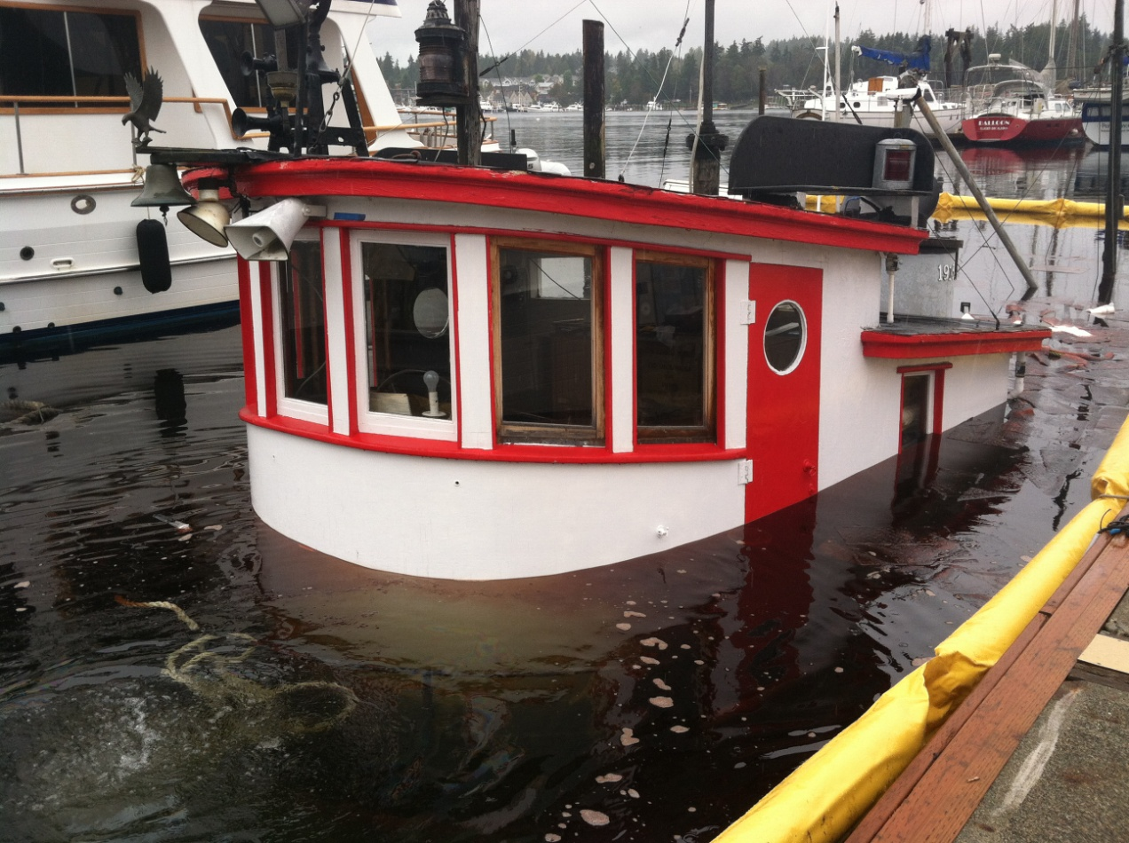
Criminal Charges by WA Attorney Gen.
Notes:
And in addition, we have our Attorney General taking actions.
WA AG Bob Ferguson has filed criminal charges for 3 derelict vessel cases – one has plead guilt and settled
These cases are:
Helena Star
Tug Chickamauga
M/V Forus/Brandon Traner (Tri-Cities): $144,000 for cleanup costs (60,000 to DNR and 84,000 to the CPF), 20 days in jail, 2 years probation and $540 in additional fines.
Additionally, using state authority, the Island County Prosecutor has filed criminal charges in on case:
Deep Sea (Owner still faces 301,000 ECY penalty plus cost recover by the NPFC)

Slide 8
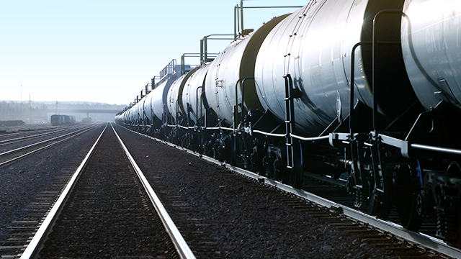
2014 Current & Emerging Issues
Notes:
Even with all of that going on, we’re dealing with a new dynamic in our state …

Slide 9
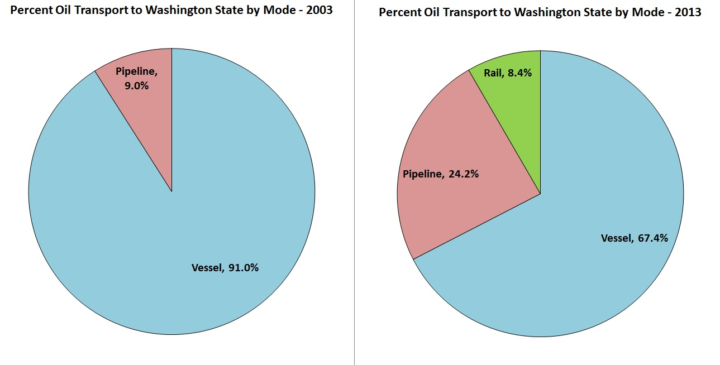
First Oil Train in WA 2012
Notes:
Modes of transporting oil have changed drastically nationwide and Washington is feeling the effects.
In fact… It wasn’t until 2012 that the first shipment of crude oil traveled by rail to our Tesoro Refinery.
This caused us to make an immediate mind shift to enhance our spills program’s capabilities.
It’s not just the mode of transport that’s new to us … it’s the volume and type of product.
Washington isn’t accustomed to dealing with crude oil on the inland side of our state.
And the amount of product that trains can carry poses threats to our inland rivers… streams… and groundwater.
This is the first time in history that crude oil has crossed our inland sections.

Slide 10
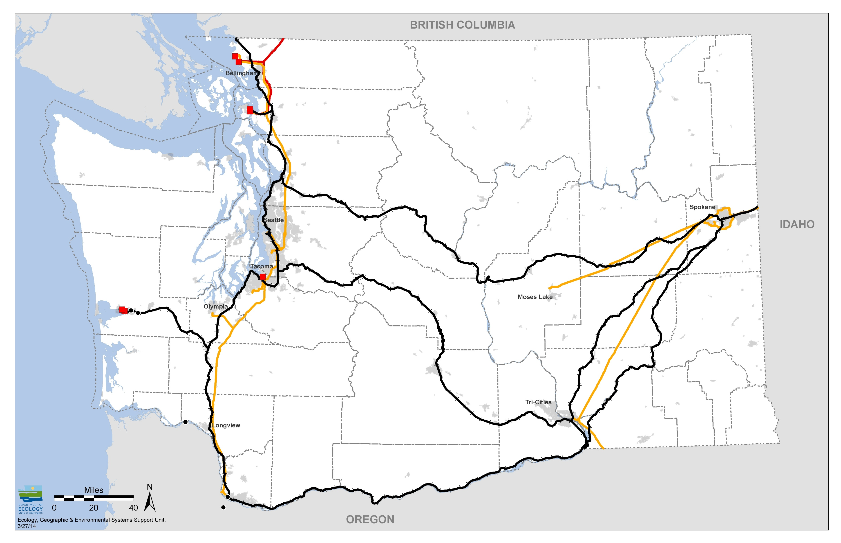
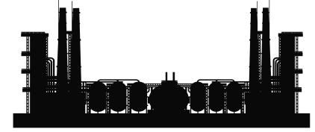
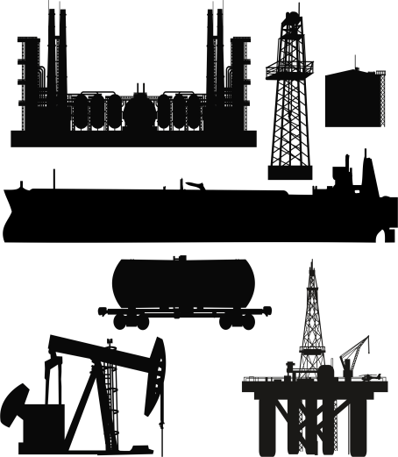

Conceptual Model of Oil Movement In & Out of Washington State
Kinder Morgan Transmountain Pipeline
Phillips 66 Ferndale Refinery
BP Cherry Point
Tesoro Anacortes Refinery
Shell Puget Sound
Oil sands from Canada and Bakken shale oil from North Dakota and Montana coming by railcar to WA refineries
Olympic Pipeline
Yellowstone Pipeline
Imperium Biodiesel
Refinery with proposed expansion
Proposed Grays Harbor Rail Terminal
US Oil & Refining
Targa Sound Terminal
Proposed Westway Expansion
Bakken oil moving north by railcar to refineries
Tesoro Pipeline
Bakken oil by railcar transfer to a barge bound for CA
Tidewater Pipeline
Crude by Rail
Proposed Vancouver Energy
Crude Pipeline
Refined Product Pipeline
Notes:
Because of the development of Bakken fields in North Dakota, we’re now seeing a substantial increase in the amount of bulk oil traveling to and through WA by rail and a decrease in the amount we carry by pipeline.
The route traveled is from Idaho to Spokane, to the Tri Cities and along the Columbia River and up the I-5 corridor.
This route has shifted the risk factors to sides of the state that previously haven’t carried this type of risk before.
And because our previous prevention, preparedness and response program was developed around the mechanism of tanker ships, we now lack the response plans and responder capabilities needed to adequately protect our state.
Currently 19 loaded train cars travel in our state per week. In 2020 that number is projected at 112 trains weekly.

Slide 11
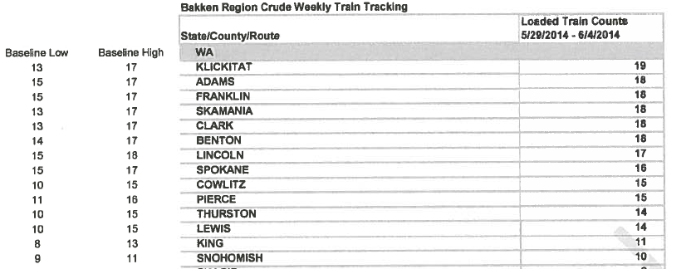
US DOT Order for Reporting Oil Movement
Notes:
Recent explosive oil spills in other states (N. Dakota, Quebec, Lynchburg VA) got people worried.
June 6 the US DOT issued an emergency order to RR carrying a million gallons + of crude oil thru states to report it to the State Emergency Response Committiees.
RR rebutted with a confidentiality waiver.
BNSF claimed federal regulations prohibit release - not so
BNSF claimed information was proprietary and confidential, security sensitive, etc.
WA declined because of our Public Disclosure Act
Crude data posted on EMD web site
We are glad for the information but would like more transparency.
When people don’t the info they need they get scared.
And if we could supply the information on quantities and types of oil our communities could be better prepared and less scared.

Slide 12
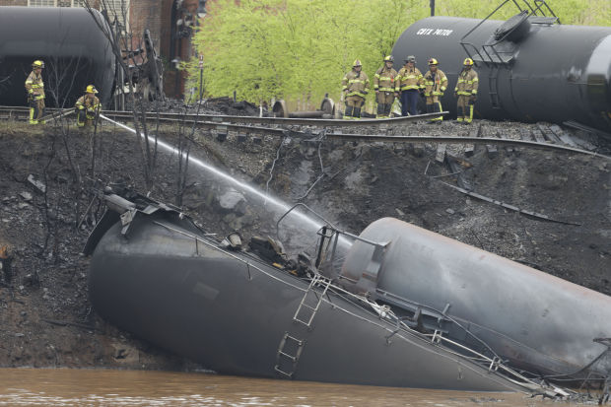
US DOT issues order for safer rail cars
Notes:
July 23, 2014 – USDOT issues notice for safer rail cars within two years.
The Pipeline and Hazardous Materials Safety Administration (PHMSA) along with the Federal Railroad Administration (FRA) jointly through the United State Department of Transportation (USDOT) proposed a number of regulations for train cars.

Slide 13
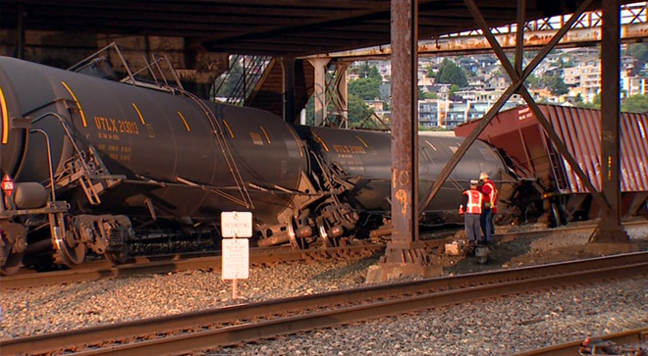
BNSF Bakken Crude Oil Derailment
Notes:
One day later an oil train derailed under Seattle’s Magnolia Bridge.
July 24 2014 – with a number of response challenges
Initial report came in from BNSF as “derailment with no injuries, no hazmat and no potential for any”
Slow moving derailment at BNSF yard in Seattle, picture shows support for critical bridge to Seattle Magnolia neighborhood.
2 rail cars damaged, including shearing off bottom valve
No site control by BNSF – onlookers wandering all over the scene
Rail construction contractor welding on full rail cars
Very scary, with little hazard recognition by BNSF
Nothing resembled ICS
Ecology and other agencies commented on the fed’s proposed rule making. We’ve asked for even more stringent guidelines for rail car safety and oil spill response plans.

Slide 14
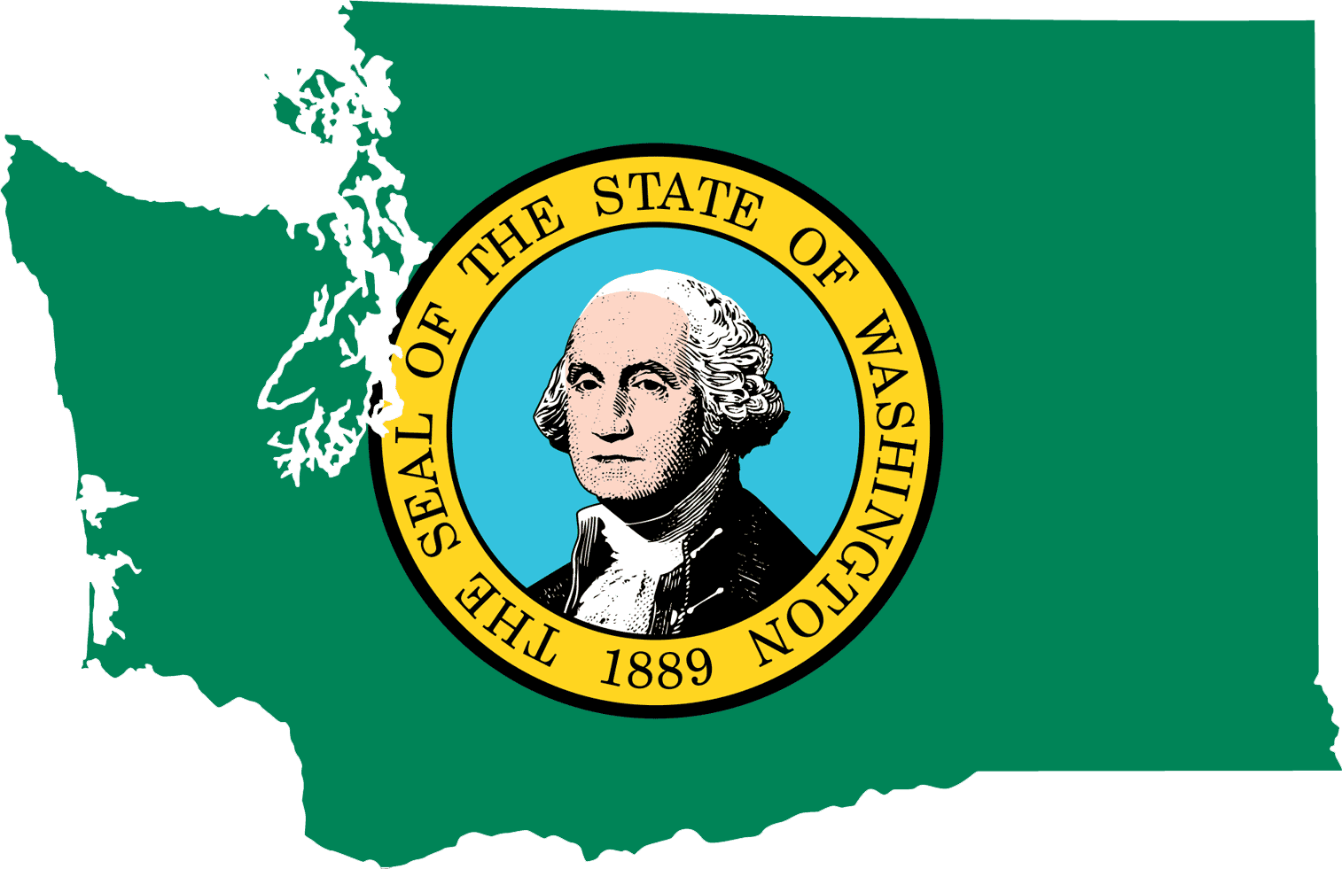
Legislative Initiatives
Developing legislation to address new oil movement dynamic
Investing in rail expertise
Developing and updating our inland geographic response plans
Notes:
Since 2013, at the state level we’ve been keying up legislation to deal with this issue.
We’re investing in rail expertise in an effort to bring our inland spills program systems up to par with our marine side.
We’re looking at the areas along the rail corridors that need plans in place in case an oil spill happens in those communities – places two years ago we didn’t need to look.
And we’re viewing this as a multi year strategy as the energy picture continues to change.

Slide 15

2014 Legislative Initiatives
Notes:
We asked for 5 full time FTEs; a marine expert; a rail expert and three employees to develop and update our GRPs. We received funding for the FTES for for one year only. With that we are completing nine updated and new GRPs.
3 FTEs for Local Response Plans
These FTEs will develop, test and then maintain needed GRPs in the inland areas along the rail corridors. Ecology has prepared for this opportunity by applying Lean principles to the GRP process and modernized the tools and methods used to create the plans. As many as 100 field visits per plan, as well as community meetings, will be needed to document conditions and create oil spill response tactics for specific locations. Once developed, strategies in each GRP will be tested through drills and maintained over time to ensure they include the most up-to-date information.
1 Rail FTE
This FTE will focus on inland crude oil transport by rail by:
• Evaluating federal and state regulatory structure of crude oil movement by rail to document the gaps.
• Gathering data on the growing number of transfers of crude oil from rail to oil terminals.
• Developing targeted policy or statutory changes for the 2015 legislative session and future sessions.
1 Marine FTE
This FTE will focus on marine and river oil spill risk assessment and prevention by:
• Conducting vessel traffic risk assessments to identify gaps in the system.
• Seeking voluntary actions that may be used in the development of standards of care and best industry practices.
• Developing targeted policy or statutory changes for the 2015 legislative session and future sessions.

Slide 16
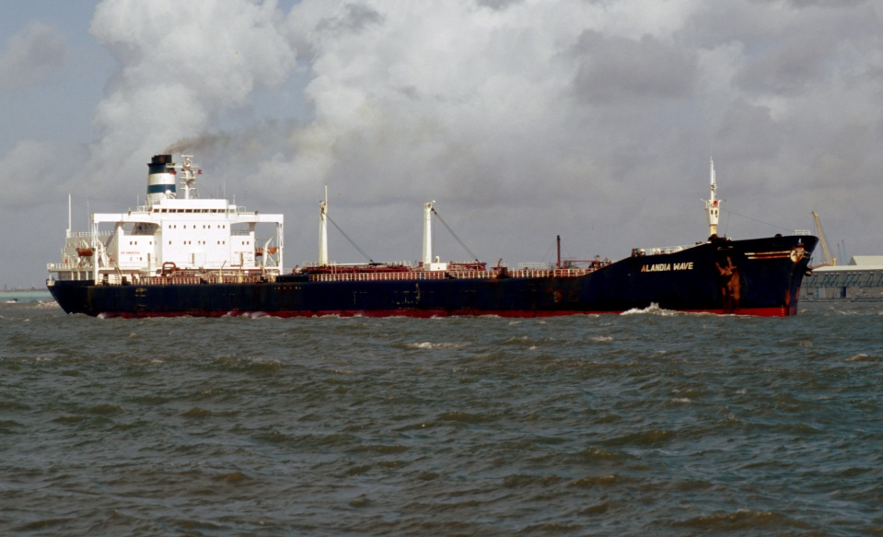
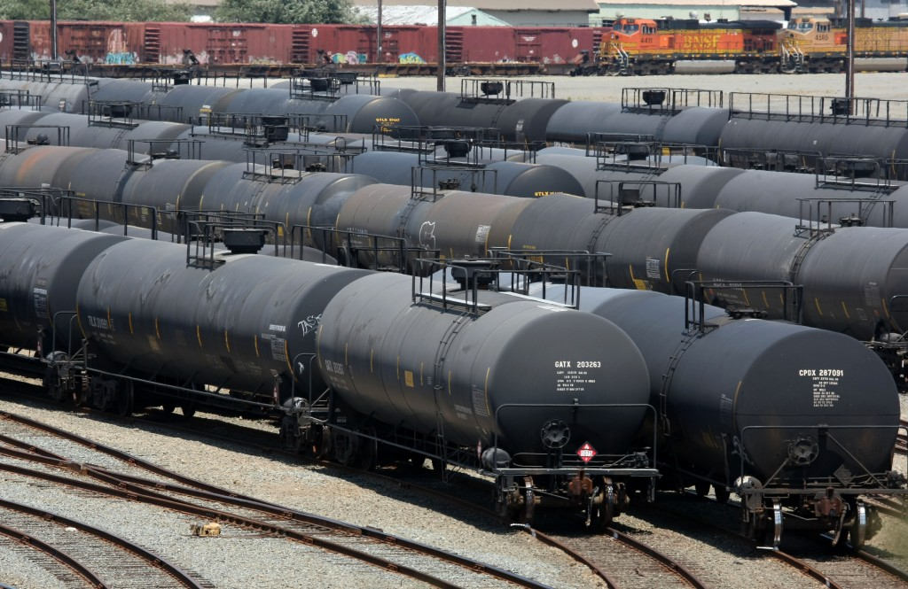
Gov’s Supplemental Budget
$300,000 to conduct a study of oil shipment through the state.
Study purpose is assess public health and safety , and environmental impacts.
Study must provide data and analysis of statewide risks, gaps, and options for increasing public safety and improving spill prevention and response readiness.
Notes:
Along with the one-time funding, Ecology was tasked with developing a study to look at the impacts to public health and safety and the environment in our state from marine and rail oil transport.
$300,000 state toxics control account - state appropriation is provided solely for the department to conduct a study of oil shipment through the state.
The purpose of the study is to assess public health and safety as well as environmental impacts associated with oil transport.
The study must provide data and analysis of statewide risks, gaps, and options for increasing public safety and improving spill prevention and response readiness.
A final report is due March 1, 2015.

Slide 17
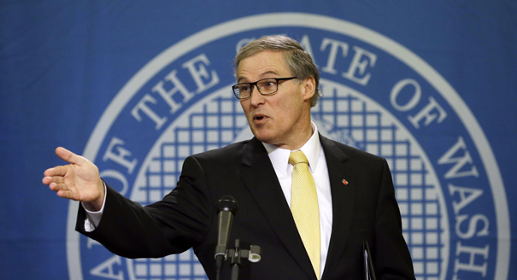
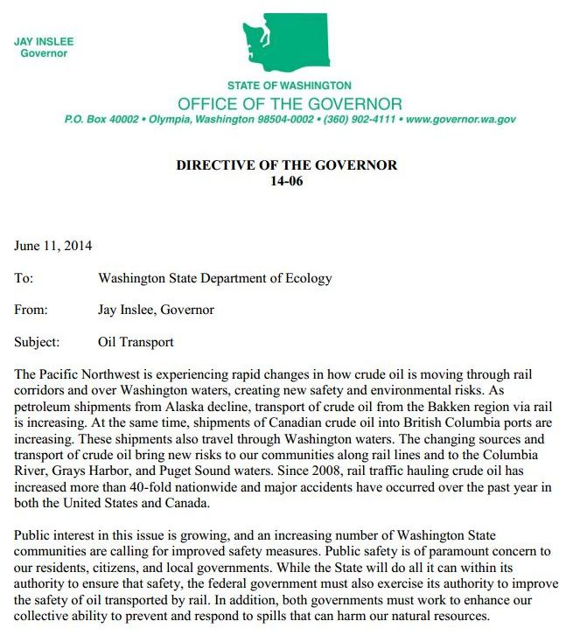
WA Governor’s Directive
Notes:
But our governor is so concerned he doesn’t want to wait until March 2015 to get results.
In June Gov. Inslee issued further directions for us to characterize risk of accidents along rail lines and deliver preliminary findings and recommendations by Oct. 1.
• Review state and federal laws and rules with respect to rail safety and identify regulatory gaps.
• Assess the relative risk of Bakken crude with respect to other forms of crude oil.
• Identify data and information gaps that hinder improvements in public safety and spill prevention and response.
• Begin development of spill response plans for impacted counties.
• Identify potential actions that can be coordinated with neighboring states and British Columbia.
• Identify, prioritize, and estimate costs for state actions that will improve public safety and spill prevention and response.
• For Governor’s 2015-17 budget propose funding strategy.

Slide 18
Oil Transportation Study
DRAFT REPORT TO GOVERNOR
PRELIMINARY DRAFT TO GOVERNOR
FINAL
REPORT TO GOVERNOR
RESEARCH
OUTREACH
JULY 2014
OCT 2014
DEC 2014
FEB 2015
MAR 2015
Notes:
Currently we’re almost 6 months into the study.
In fact we turn in our Preliminary Findings and Recommendations to the governor tomorrow, today.
Thus far we’ve reached out to experts, community and business stakeholders, tribes and the public. Two public meetings with hundreds expected are

Slide 19
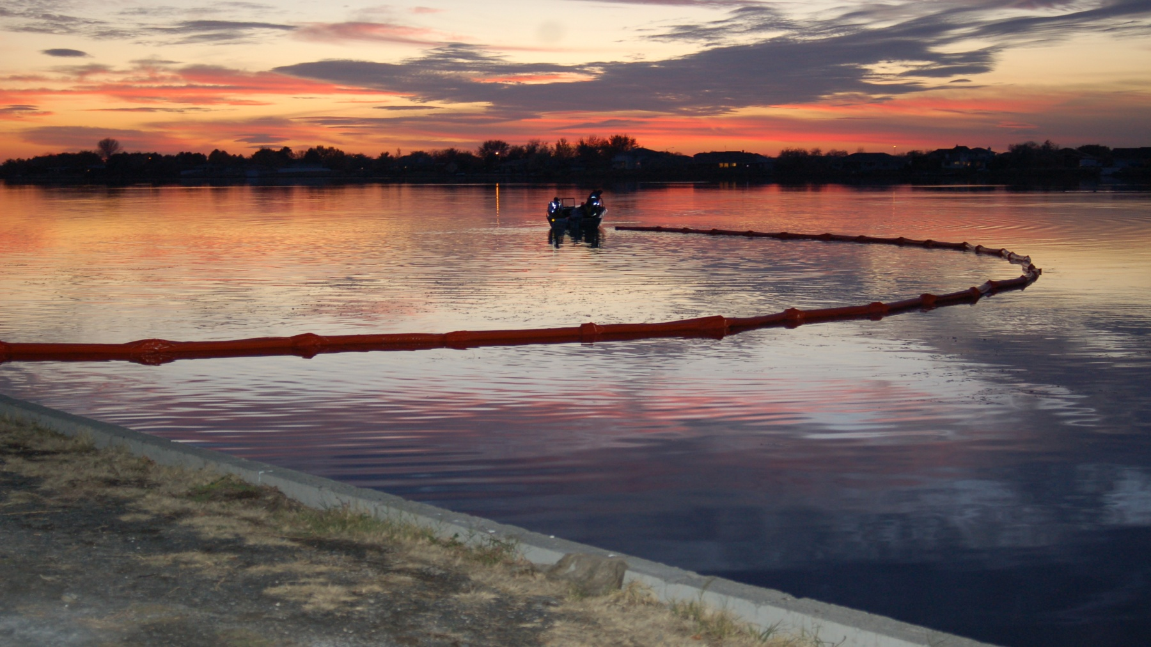
Moving forward, next steps
Notes:
We’re going to continue to take steps to protect our state from the threat of oil spills. In the 2015 Legislative session we’ll be looking for support to implement activities today, that protect public health and safety and the environment now from the daily-changing energy picture.
Many of the measures we seek will be direct recommendations from the Oil Transport Study.
(More to come in the next preso)

Slide 20
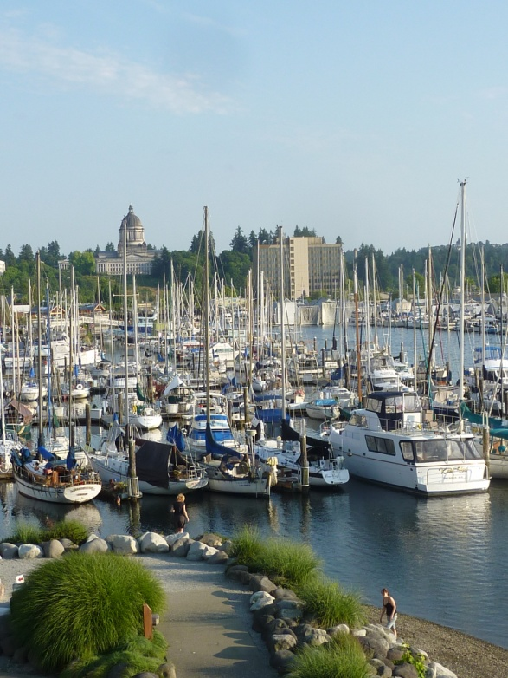
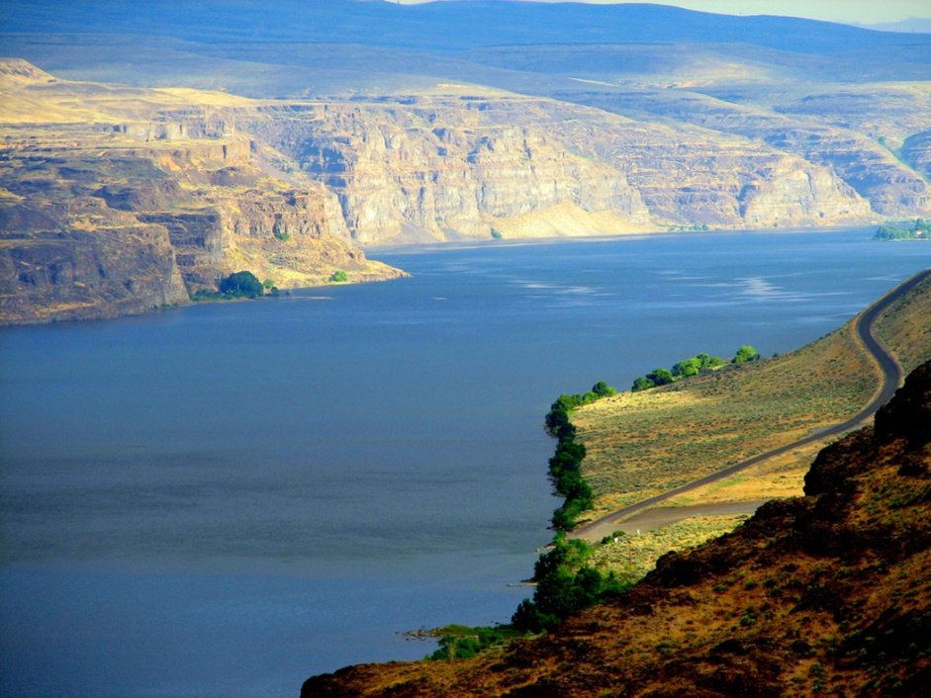
Questions?
Dale Jensen, Program Manager
Dale.jensen@ecy.wa.gov
www.ecy.wa.gov/programs/spills/spills.html
www.rrt10nwac.com

