Slide 1
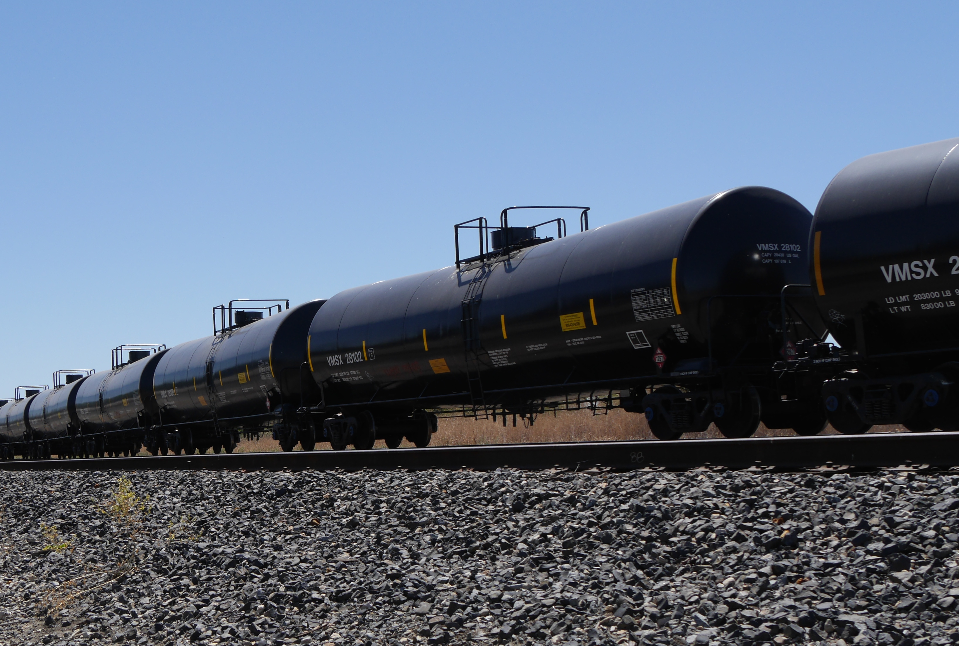
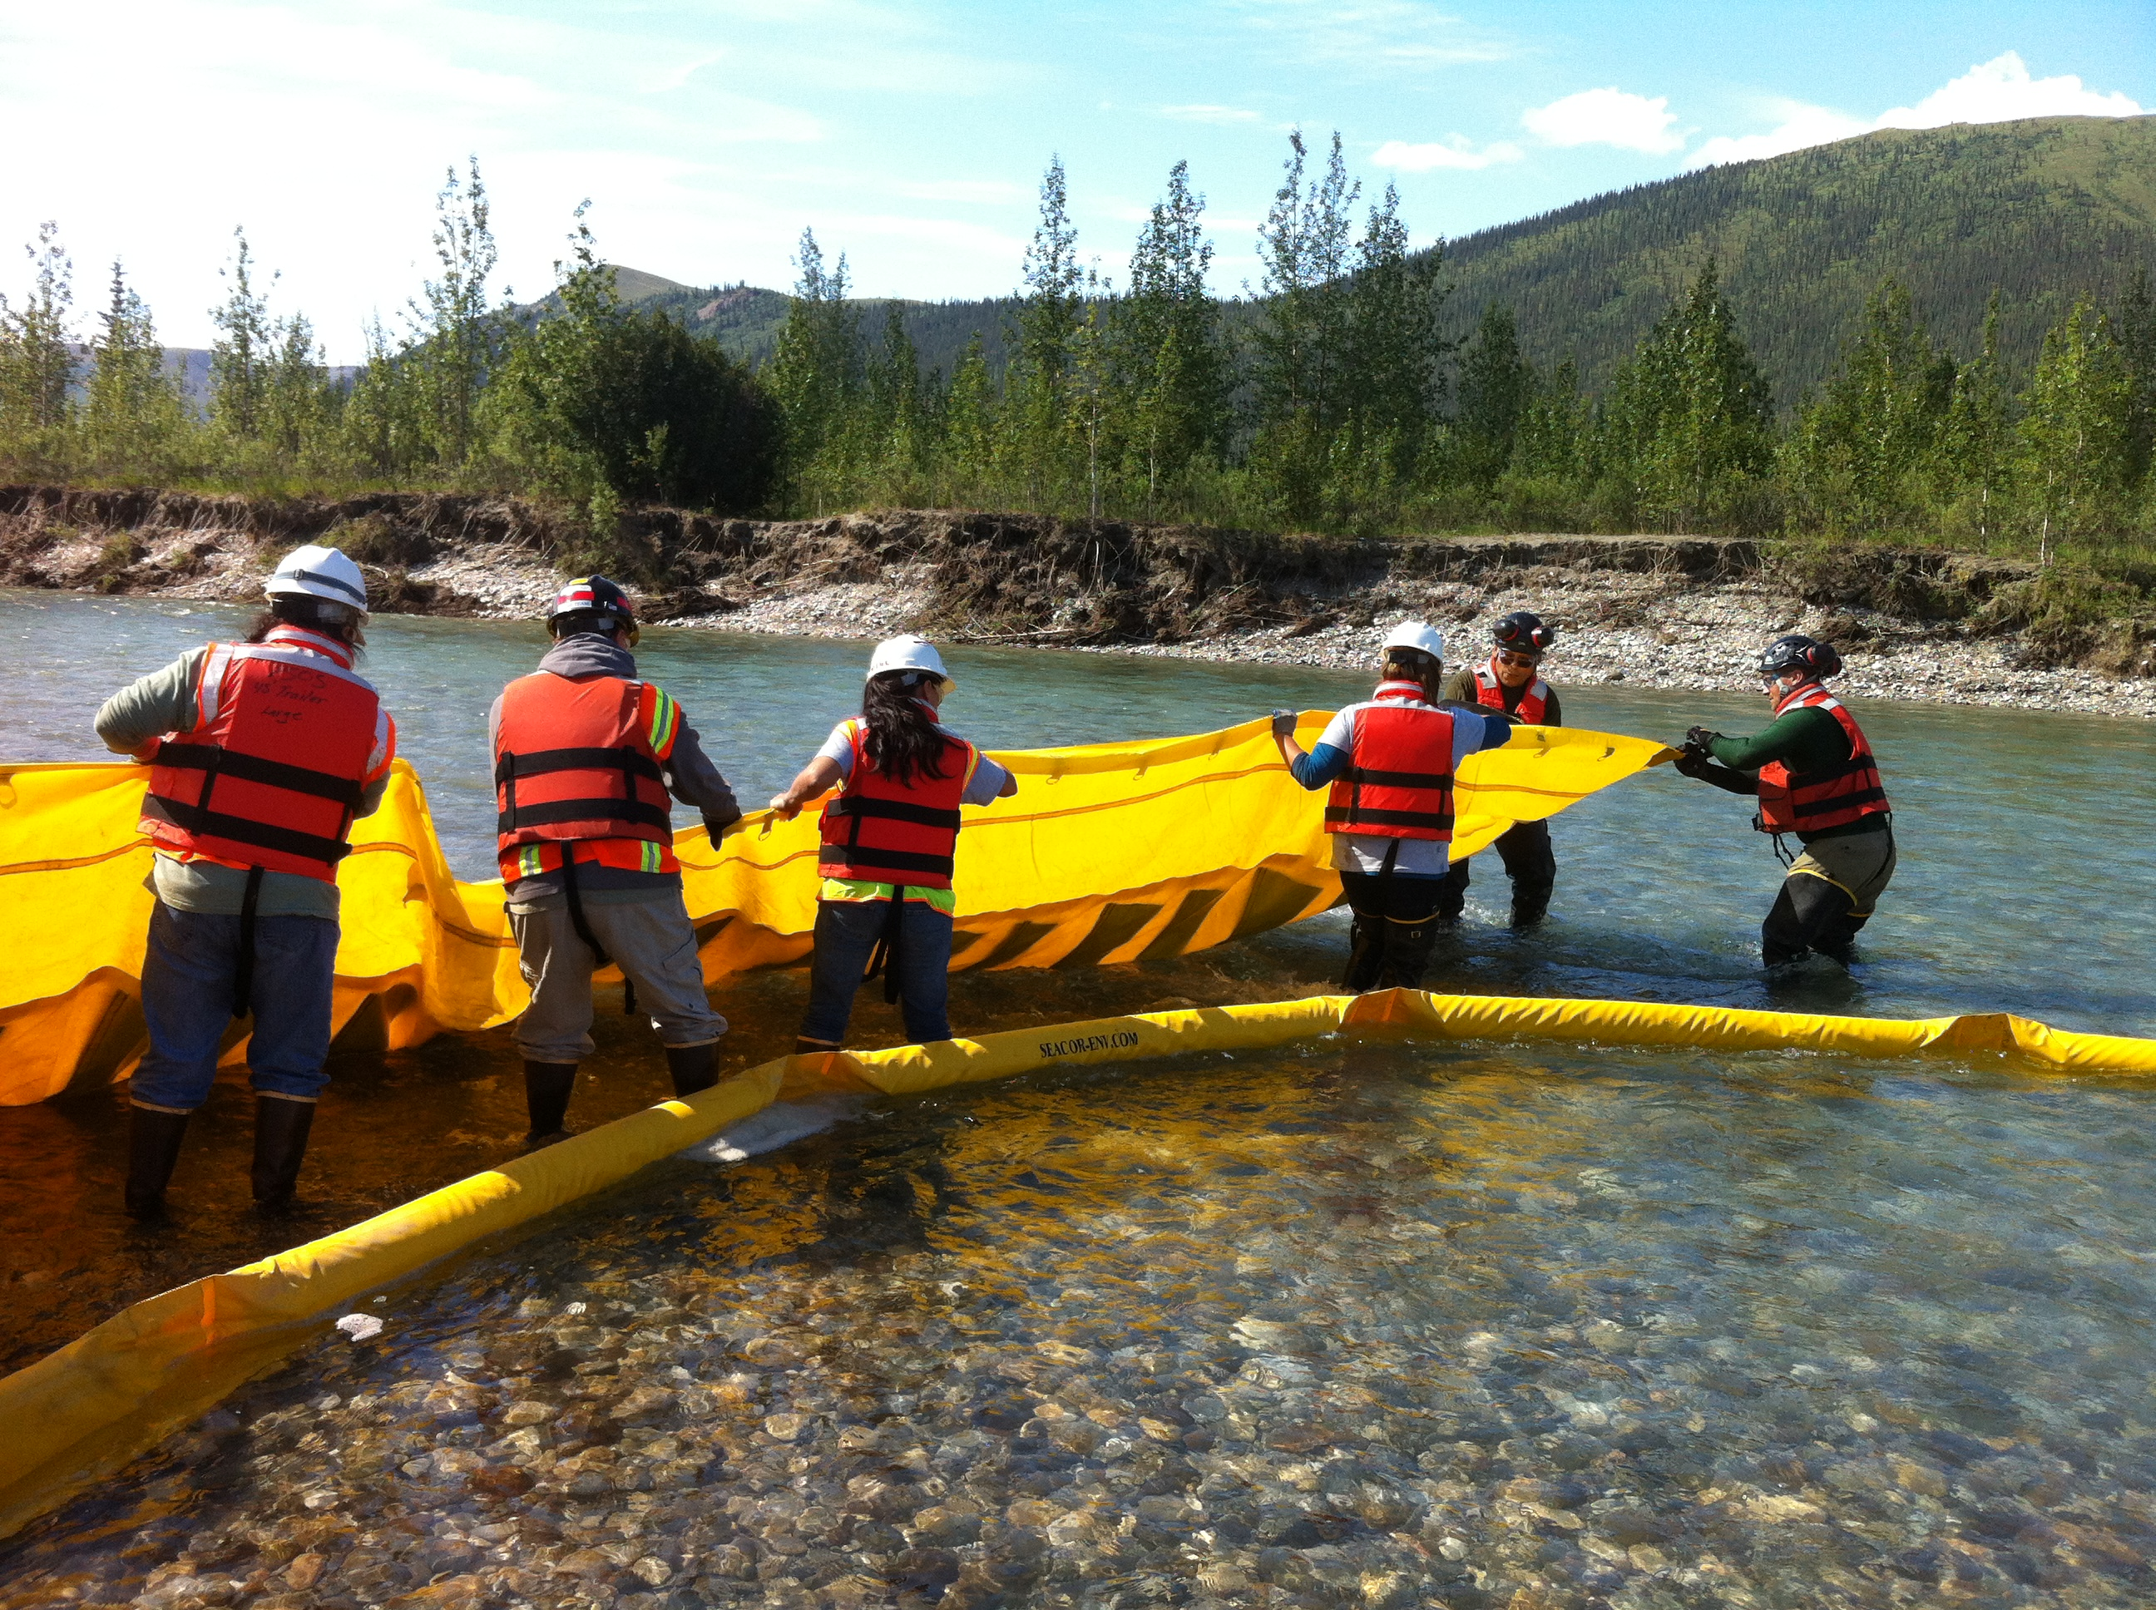
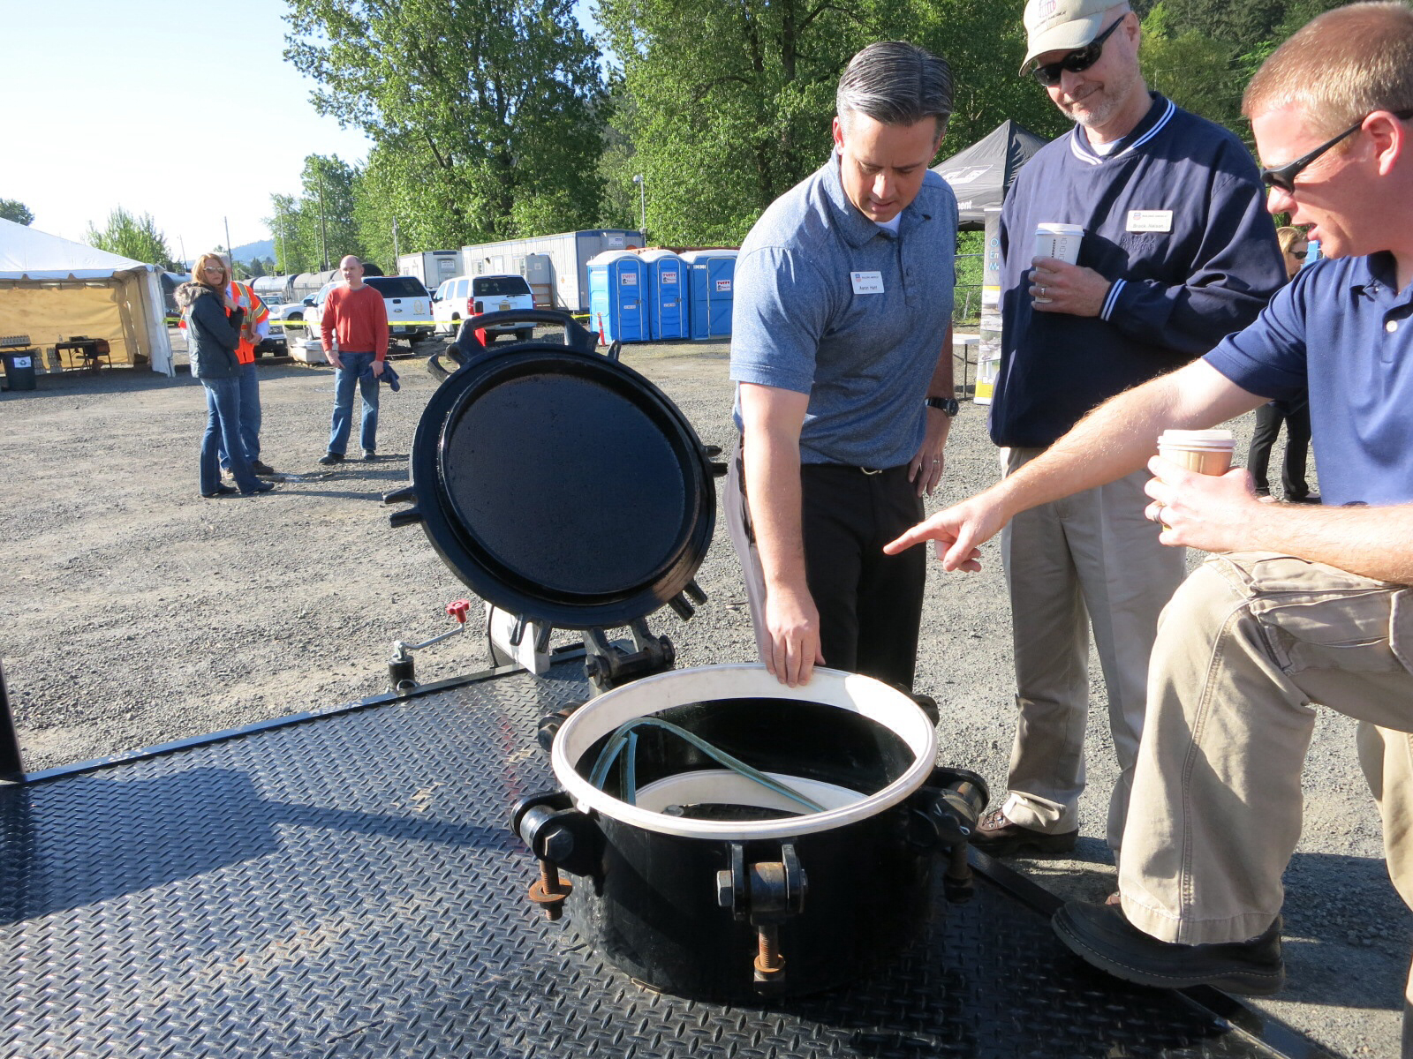
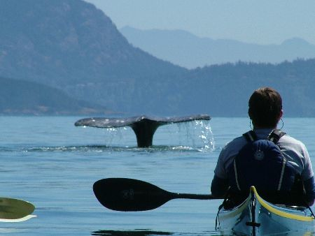
Pacific States British Columbia Oil Spill Task Force
2014 Annual Meeting
Sarah Brace, Executive Coordinator
October 1, 2014
Notes:
Thanks Dick,
I’m going to provide an overview of Task Force projects and activities we’ve accomplished or are still underway for since our last Annual Meeting, last September in Seattle.

Slide 2
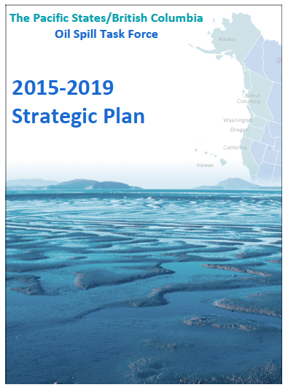
Accomplishments and Progress
2013-2014
2014-2019 Strategic Plan
2014-2015 Annual Workplan
Notes:
One of our big planning efforts carried out a Strategic planning process. For this we looked at where we’ve been and where we’d like to go. Our mission of “No Spilled Oil” remains the same, and we’ll continue address our core areas of work focusing on oil spill prevention, preparedness, response and communication.
This year we’ve added a new objective – Recovery. That is, the Recovery of ecosystems, communities and economies following a spill.
Our Strategic Plan drives our Annual Workplan, in which we lay out the work for the coming year. Our 2014-2015 Annual Workplan is in the final stages of completion; I’ll share highlights of our 2014-2015 Annual Workplan in a few minutes.

Slide 3
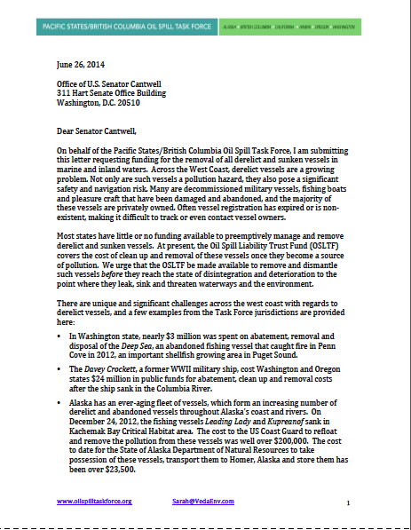
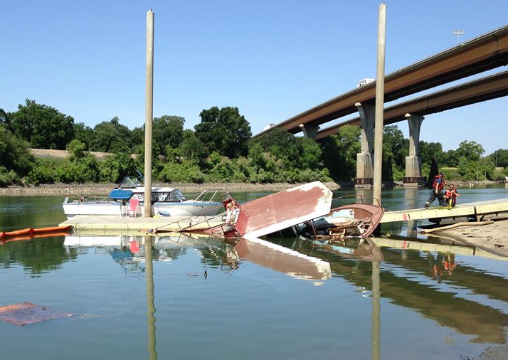
Oil Spill Prevention
Oil Spill Data Dictionary update
Derelict vessels
Notes:
This year, we updated out Oil Spill Data Dictionary, the basis for our on-going oil spill database. In the data dictionary we’ve attempted to create a common language and terms for reporting spills so that we can compare data across jurisdictions. A summary of our complete 2013 oil spill dataset will be available on our website later this fall.
Another area we’ve focused attention is in the prevention of spills from derelict and abandoned vessels.
Last winter, the governors of WA and OR Governors submitted a letter to congress requesting the Oil Spill Liability Trust fund to be available to remove and decommission retired federal. The task force submitted a letter as well requesting that the Oil Spill Liability Trust Fund be made available remove all derelict and sunken vessels including recreational vessels, which make up a large portion of the derelict vessels across the Task Force jurisdictions.
We’ve also been help to coordinate the incorporation of the various Task Force derelict vessel location data into NOAA’s ERMA mapping tool.

Slide 4
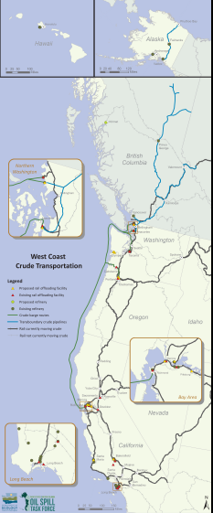
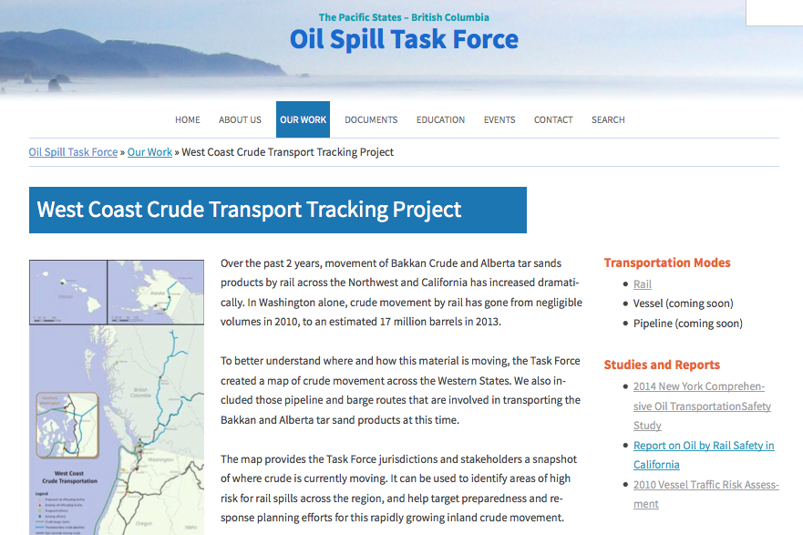
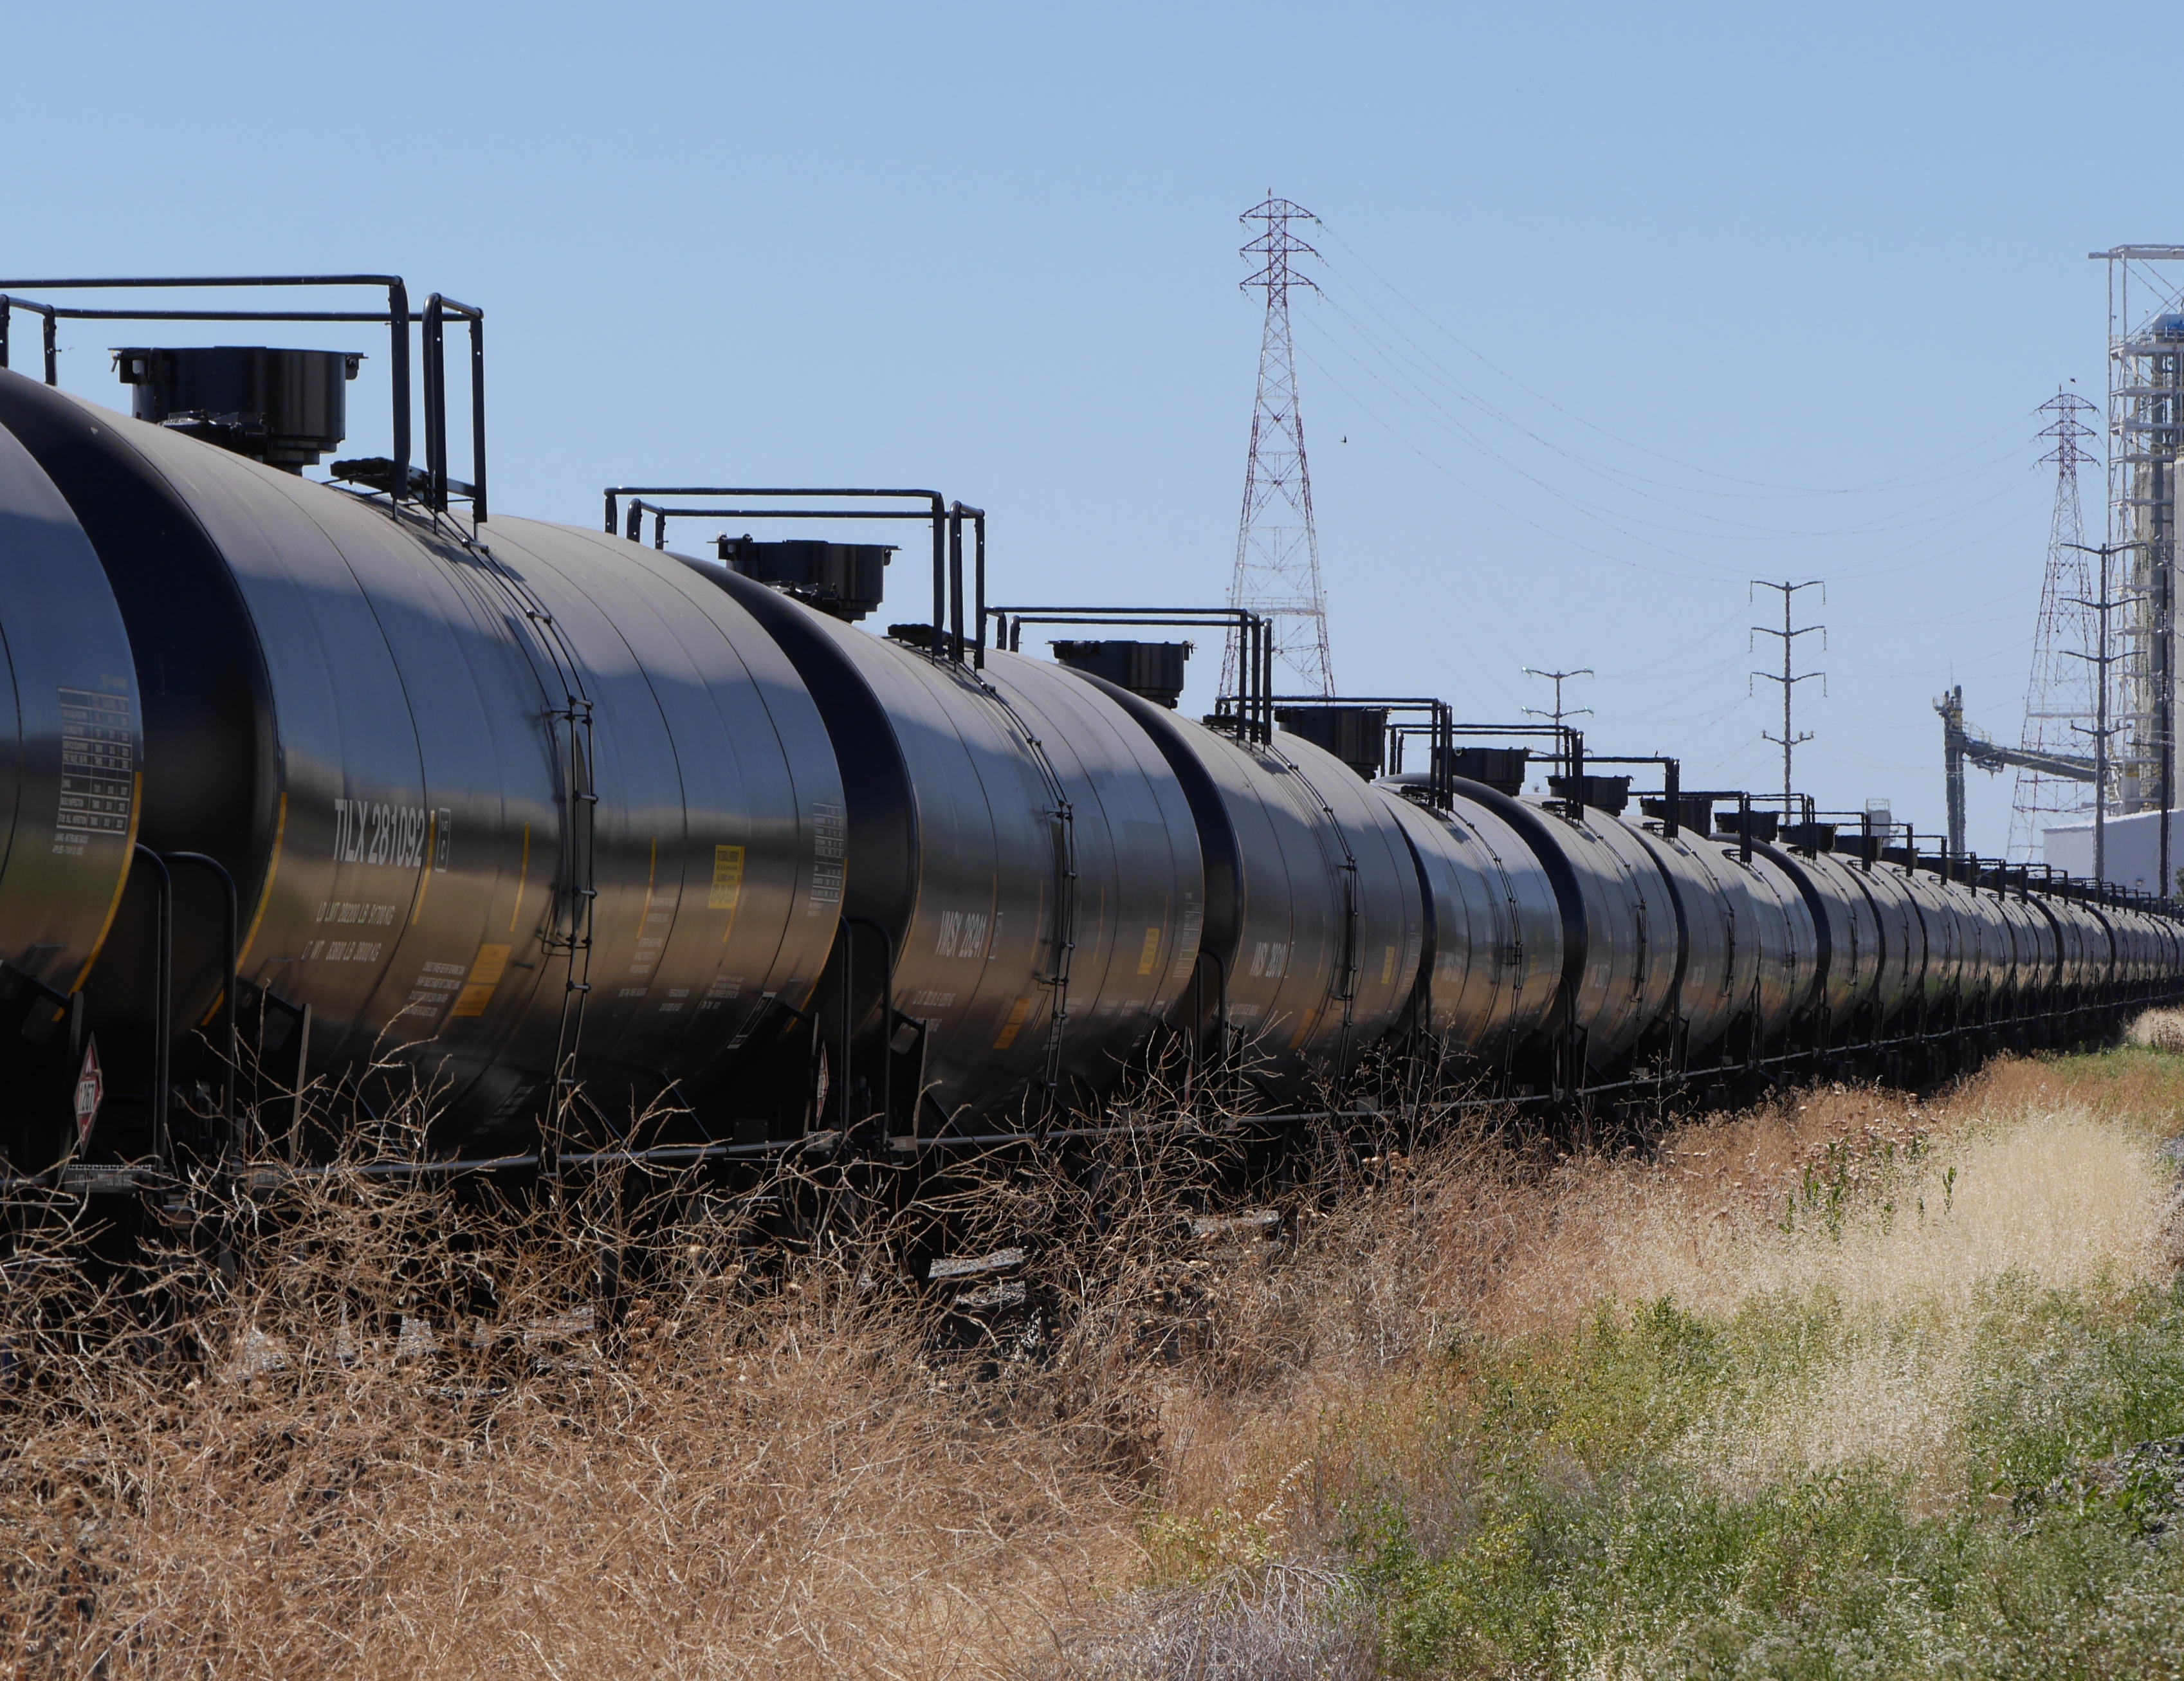
Oil Spill Prevention
West Coast Crude Transport Project
Notes:
This year we began our West Coast Crude Transport Project:
We developed a map depicting the transport of oil across west coast -- mapping transport routes, vectors and endpoints including refineries and off-loading terminals (both existing and proposed).
We’ve also created new pages on our website where the map, news clippings and other resources are available – see links on right….
We’ll conduct funding analysis across the Task Force jurisdictions to determine if there will be revenue challenges as a consequence of shifting transport means.
Looking ahead, we will also look at other materials – ethanol, LNG, and other fuel types – and may develop additional maps depicting the movement of these other products across the West Coast as well.

Slide 5
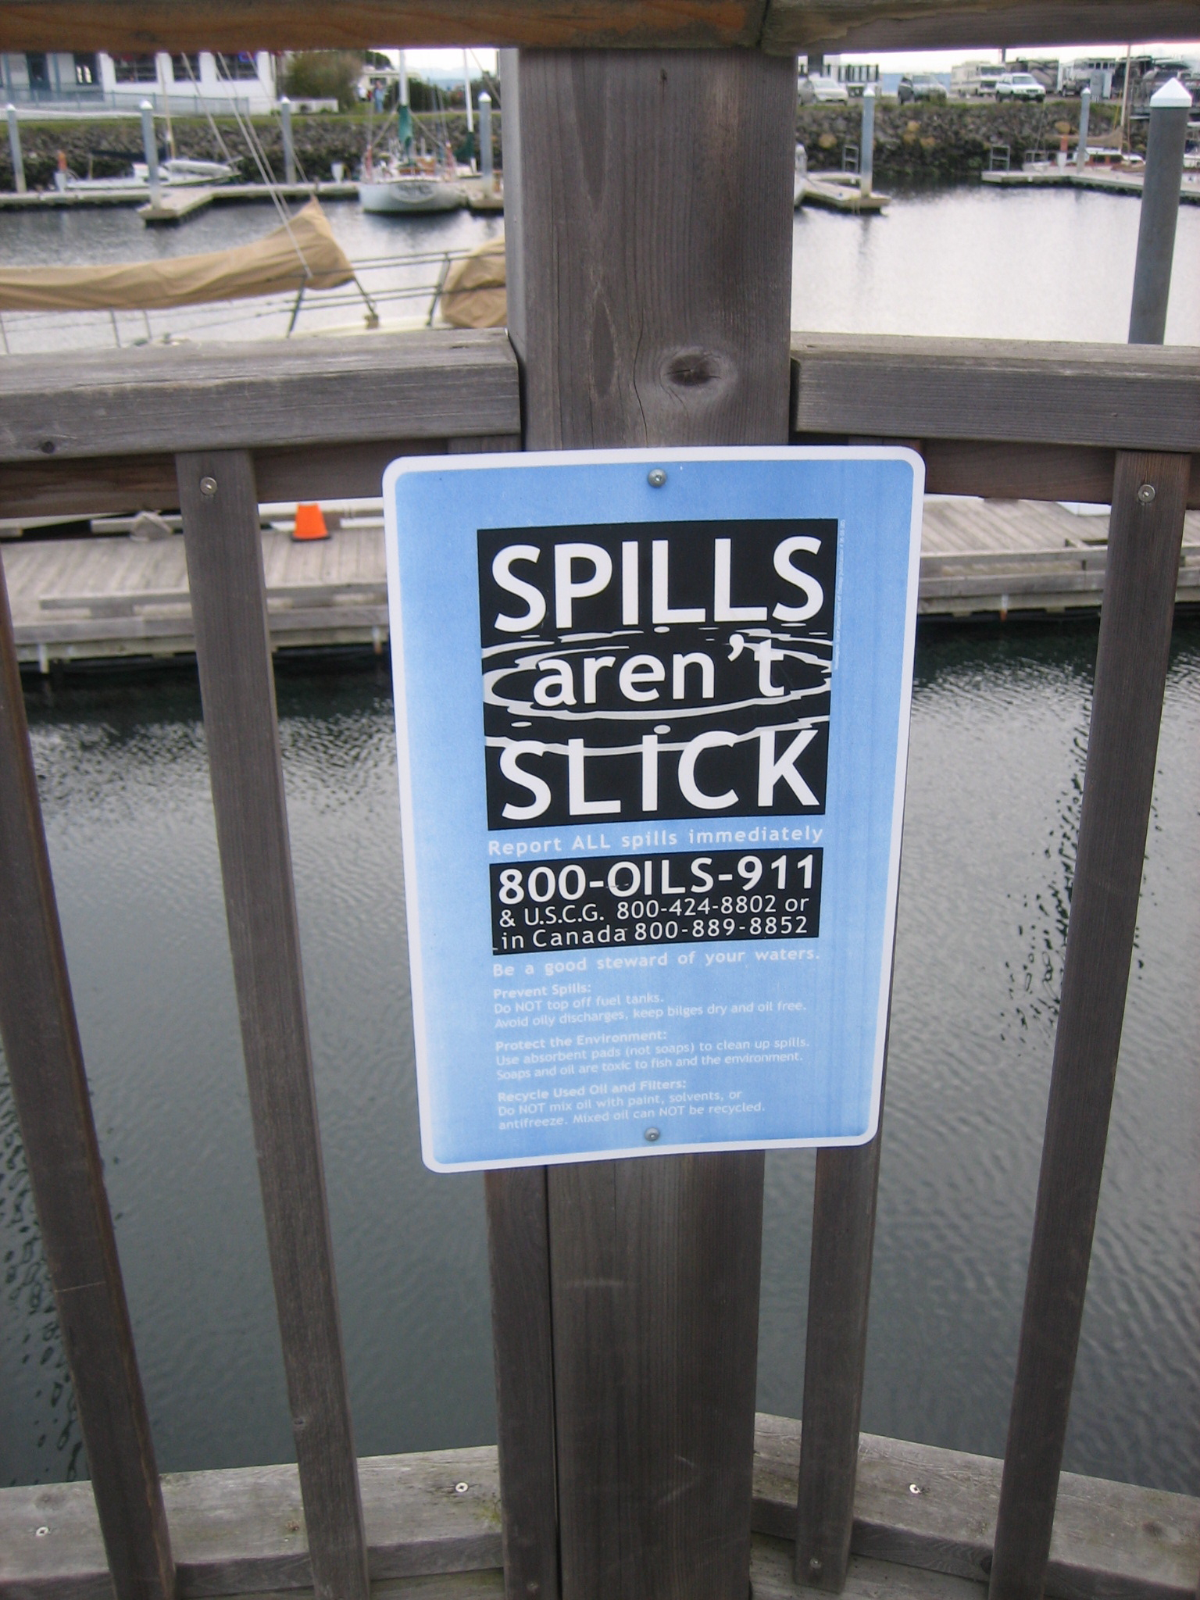
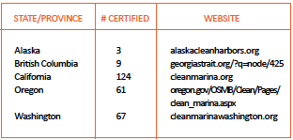
Oil Spill Prevention
264 Clean Harbor/Clean Marina Programs (13 new)
Notes:
The Pacific Oil Spill Prevention Education Team (POSPET), a program that the Task Force Coordinates, has been busy with oil spill outreach to boaters.
This year, 13 new marinas and harbors across the West Coast were certified as Clean Marina/Clean Harbors, a certification program for that recognizes these facilities for the pollution prevention measures they adopt.
POINT OUT SIGN

Slide 6
Oil Spill Prevention
OILS-911 Reporting
Notes:
Spikes may not reflect an overall increase in the amount of oil sited, rather an increase in the number of calls placed.

Slide 7
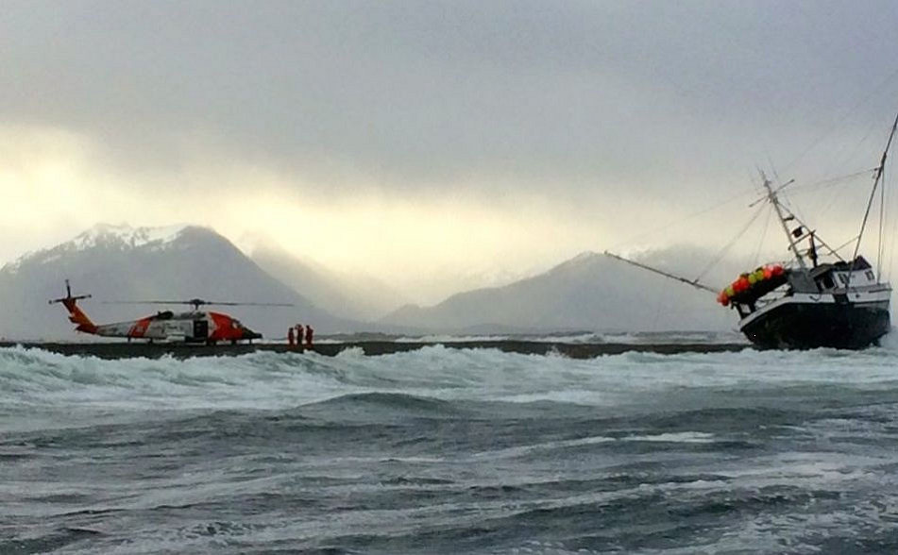
Preparedness and Response
WCOSVTRM Project 5-year update
West Coast Oil Spill Financial Responsibility Requirements update
Notes:
1. West Coast Offshore Vessel Traffic Risk Management Study – Second 5-year review since 2004. This review was to assess if recommendations were implemented, on issues such as:
Rescue tug availability
Improvements to navigation
Data requirements
A final summary of the 2014 review will be available this fall.
2. In 2009, the Task Force compiled a table comparing each jurisdictions' financial responsibility with regards to spills from:
Tank and non-tank vessels,
Small and large tank barges
Rail tank cars
Other vessels.
We are in the process of updating this table to reflect any changes in each juriscitions’s financial responsibility in since 2009.
This is an example of a project that provides useful information among Task Force jurisdictions of eachother’s policies, or in this case funding structures. One of the benefits of working collaboratively across jurisdictions.

Slide 8
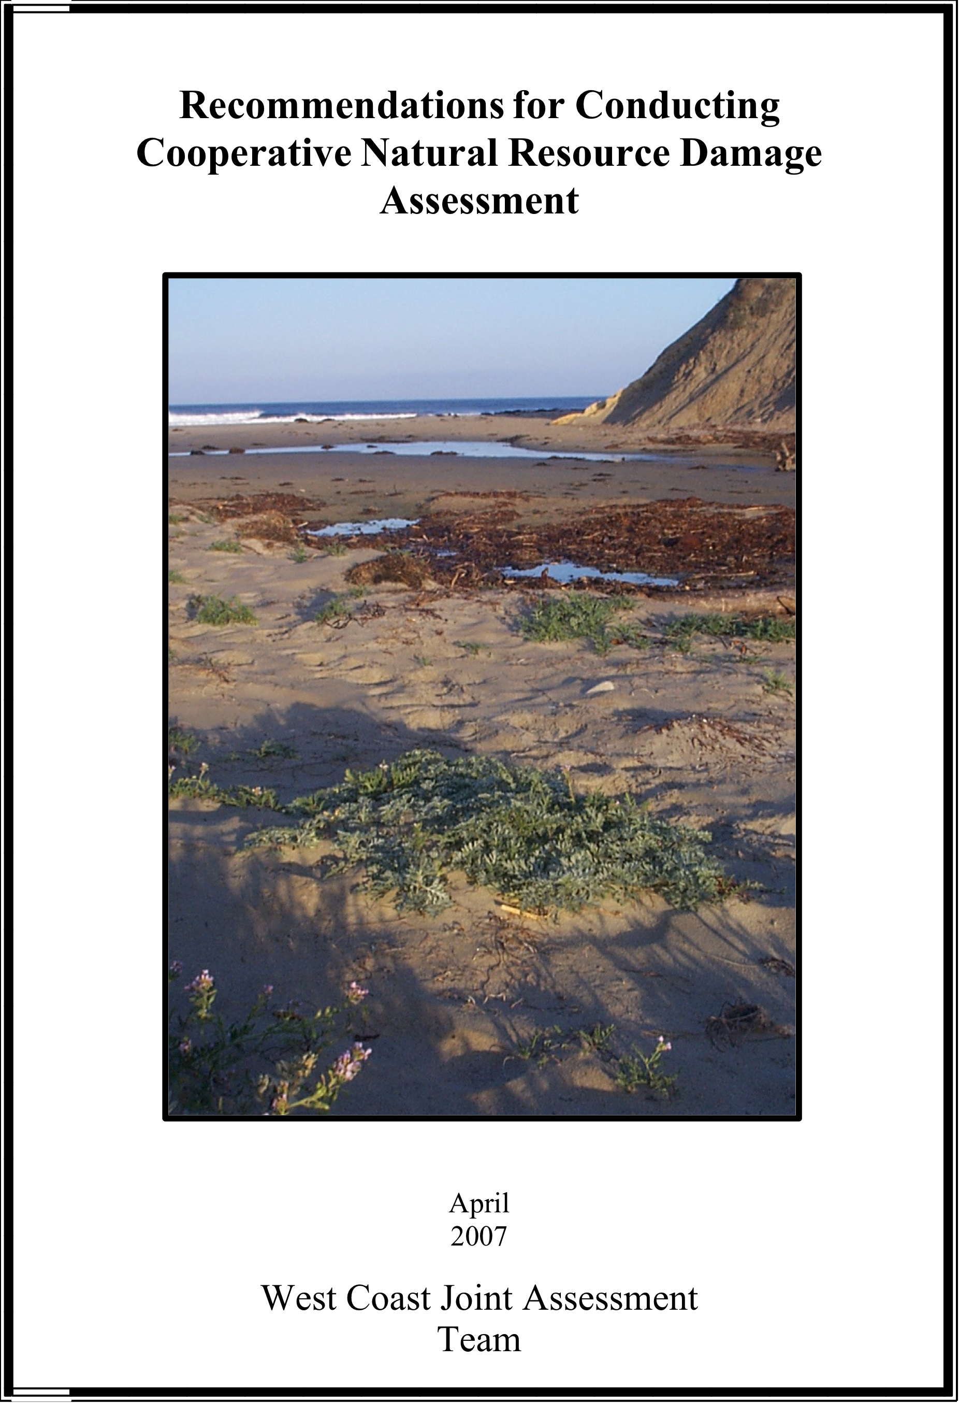
Recovery
West Coast JAT -- Update West Coast NRDA Guidance Document (in progress)
Notes:
The Task Force particiaptes on the West Coast JAT. This Cooperative Natural Resources Damages Assessment document provides
guidance on steps from the notification of a spill onward, including guidance on:
Communication and Coordination between NRDA and Incident Command
NRDA Team organization
Ephemeral data collect
Data mgt.
Pprovides guidance that has emerged since DWH on NRDA
We hope to complete this update this winter.

Slide 9
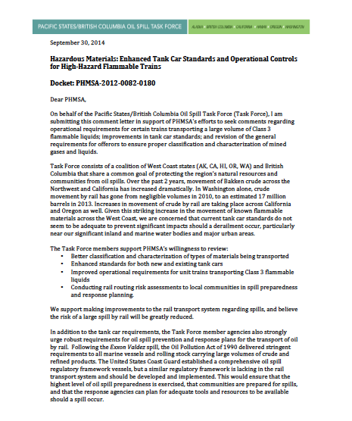
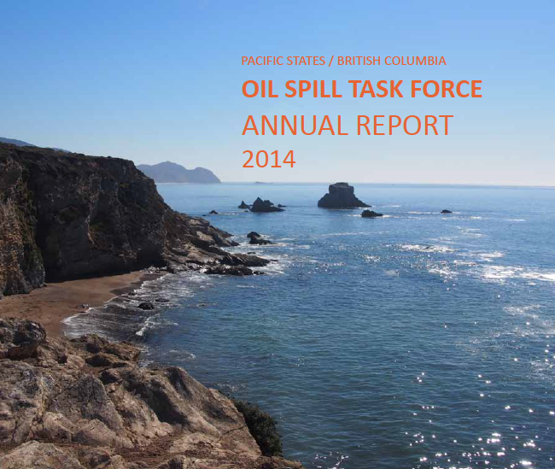
Communication and Outreach
Letters and Comments
2014 Annual Report
2014 Annual Meeting
IOSC
Salish Sea Conference
New logo
Notes:
This year, we submitted:
A letter to Congress regarding federal funding of the removal and cleanup of derelict vessels.
USCG regarding Federal preemeption
Comments on PHMSA’s DOT tank car and response plan requirements

Slide 10
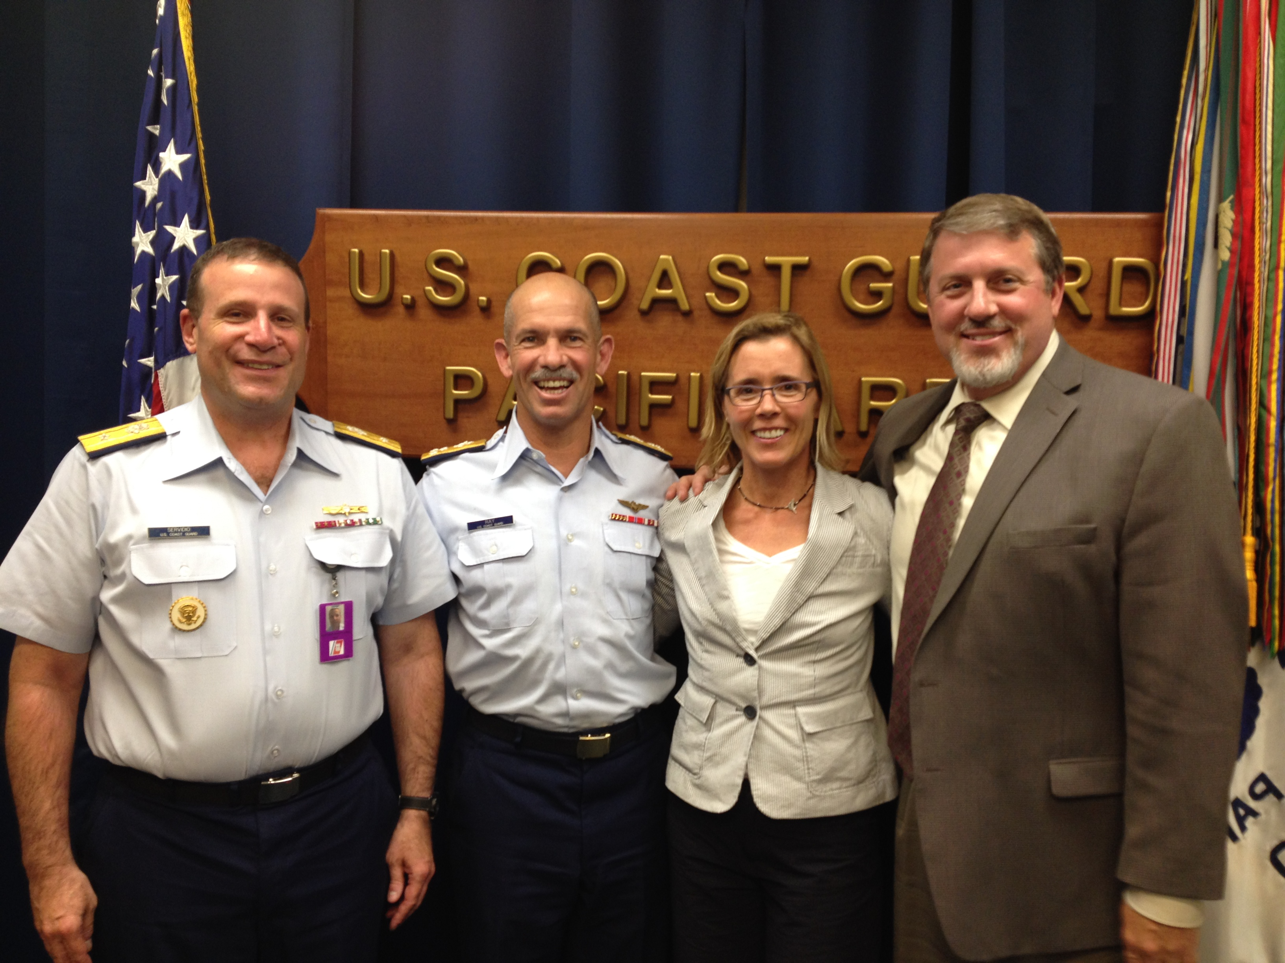
Communications and Outreach
Stakeholder survey
VADM Ray briefing
API SAG
AWO QSC
RADM Servidio and VADM Ray
with Sarah and Tom Cullen
Notes:
Stakeholder survey ; 55 surveys
USCG: We have a memorandum of agreement with the USCG PAC Area and meet annually with our Coast Guard partners. We also brief the VADM and other PAC Area
Leadership when there is a change in command.
API SAG I regularly attend the API SAG meetings to bring west coast issues and concerns forward to partnering industry and federal agencies who serve on this committee
AWO We also work serve on AWO’s Quality Steering Committee to discuss common issues of concern with regard to the tug and barge industry.

Slide 11
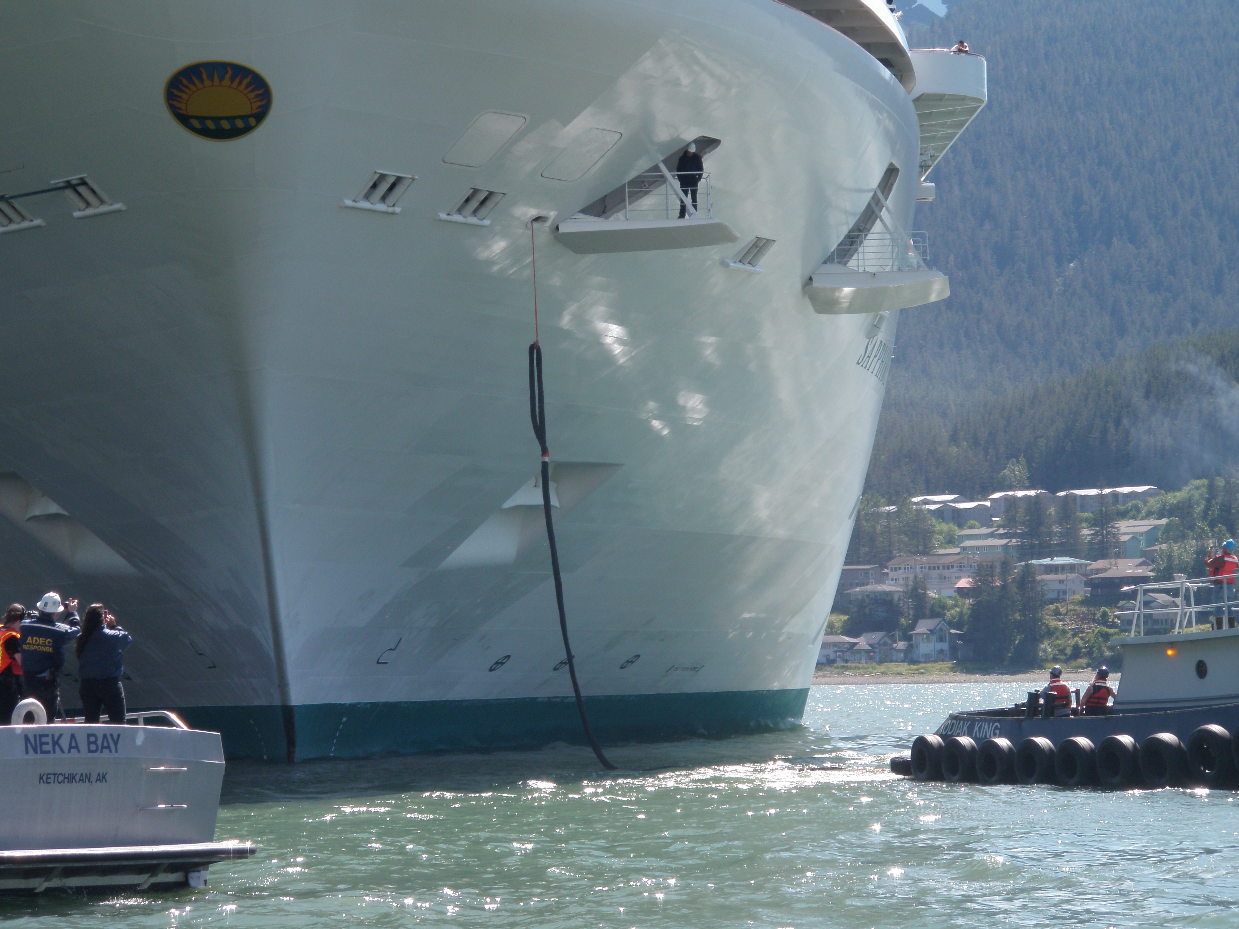
What’s ahead

Slide 12
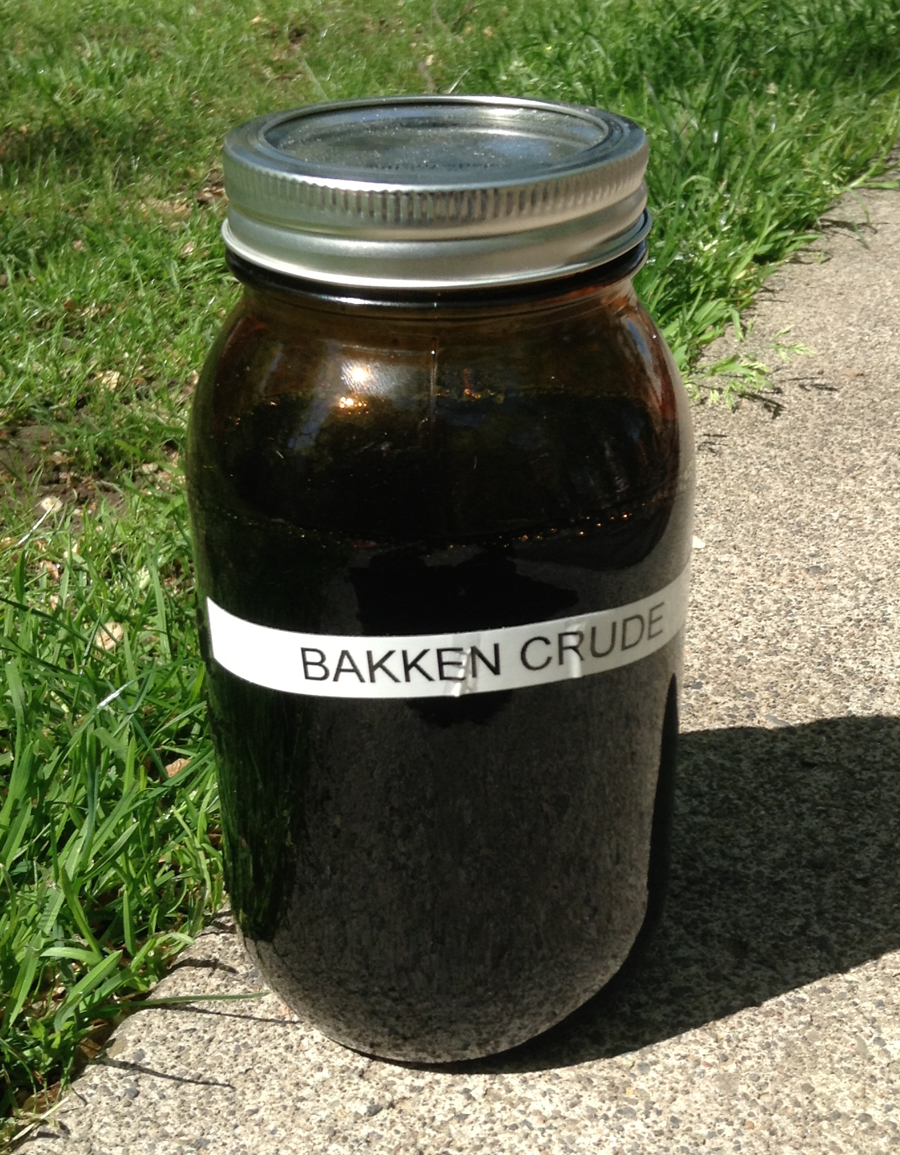
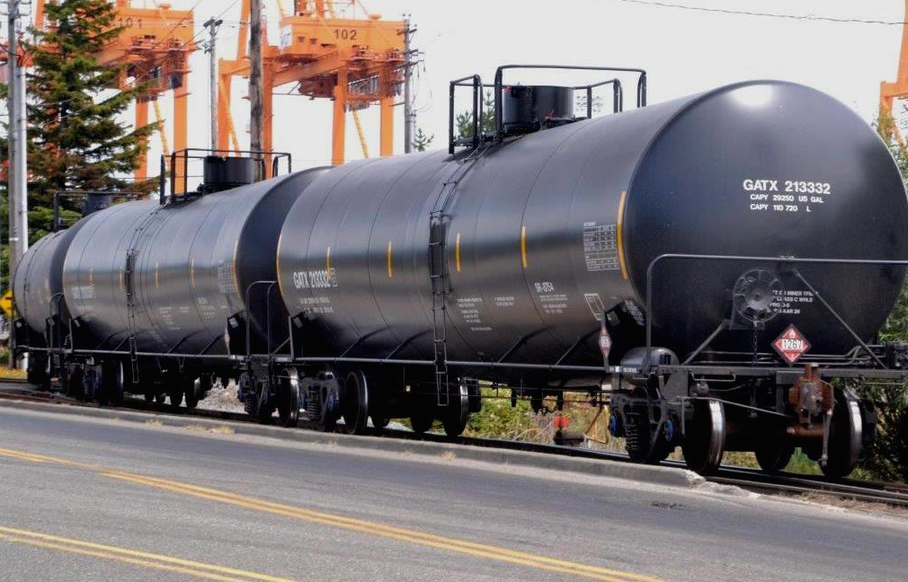
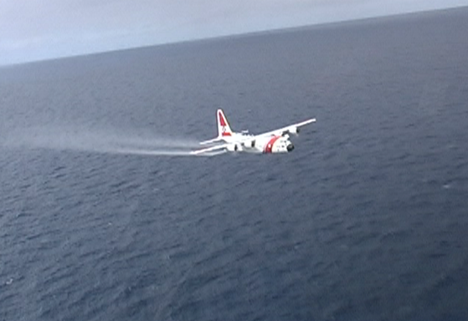
2014-2015 Projects and Activities
Crude by rail
Non-hazardous spills
Heavy oils
Dispersants
Communications and Public Involvement
Notes:
1.Crude by rail
Continue to watch changes in movement across the west coast
Begin compiling volume data on material being moved by rail, pipeline and barge across the region
Support Task Force member jurisdictions as they consider policy options for improving the safe transport of crude
2. Looking at comparing how the different Task Force jurisdictions handle spills from non-hazardous, non-regulated materials such as molasses.
3 Continue to track the science and state of the knowledge of heavy oils and how they behave in marine and aquatic environments
4. Track the science of dispersants and lessons learned from DWH and other applications.
5. Explore ways to improve risk communication with regard to spills and also how to engage and involve the public in the the prevention area as well as in preparedness and response.
Our 2014-2015 Annual Workplan will provide more detail on these efforts, and this will available on our website later this month.
Finally…..

Slide 13
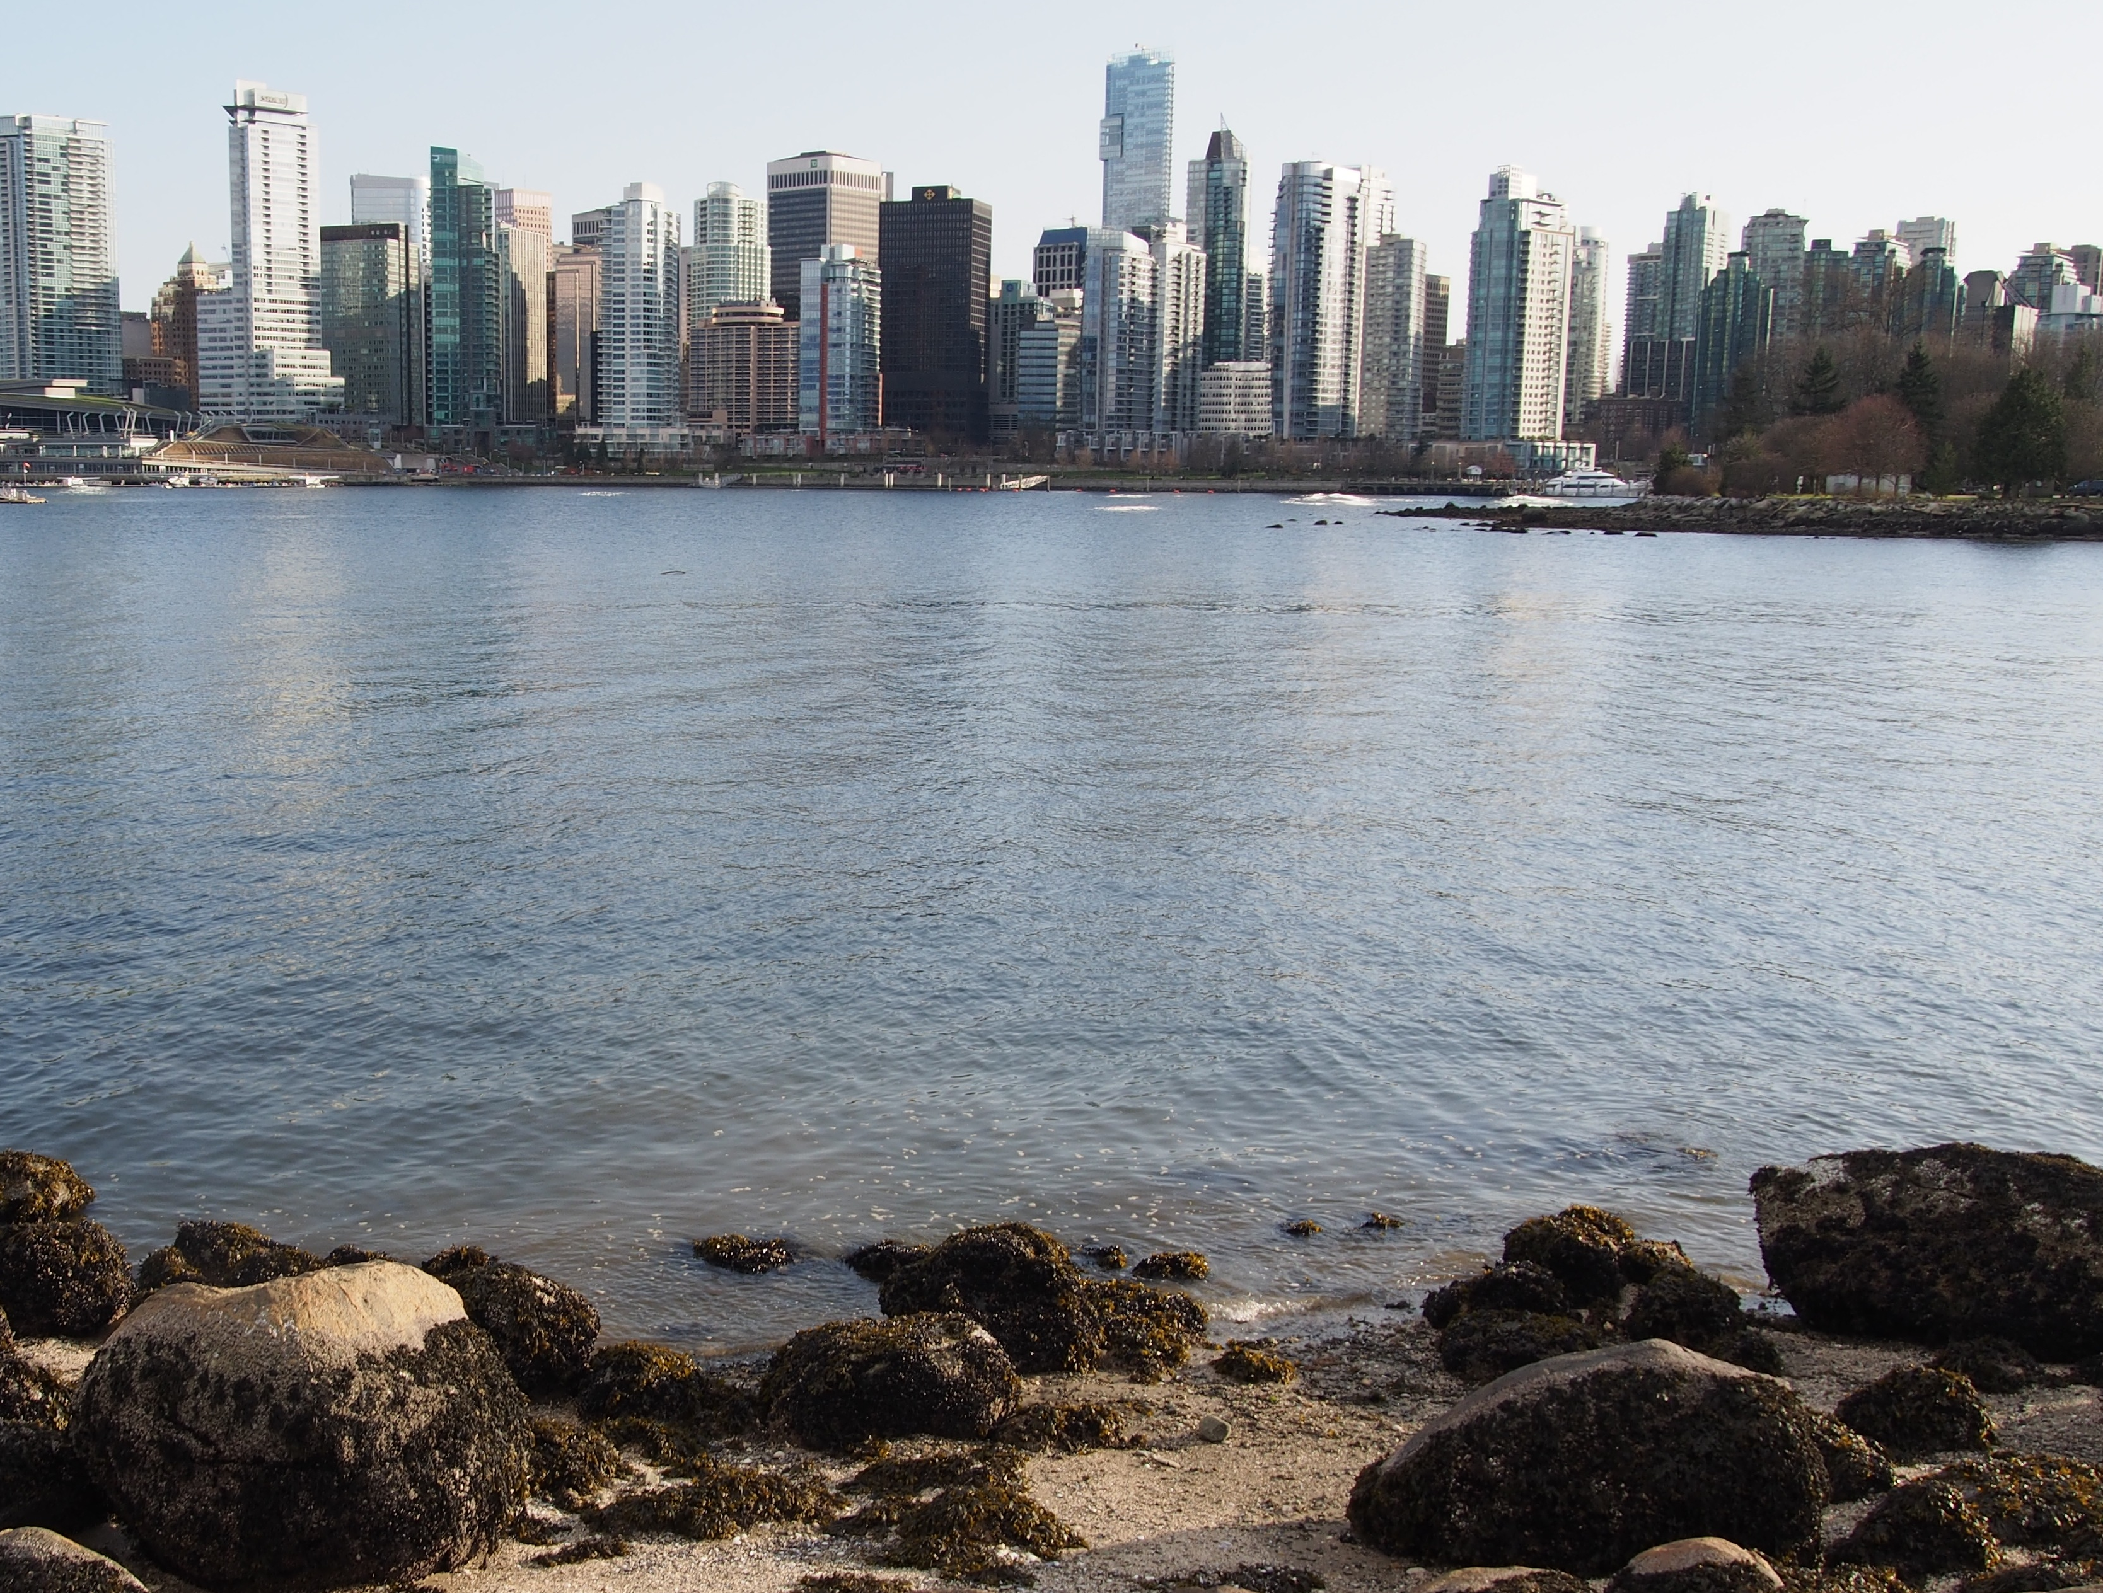
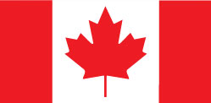
Clean Pacific Conference
June 16-18 2015 in Vancouver, B.C

