Slide 1
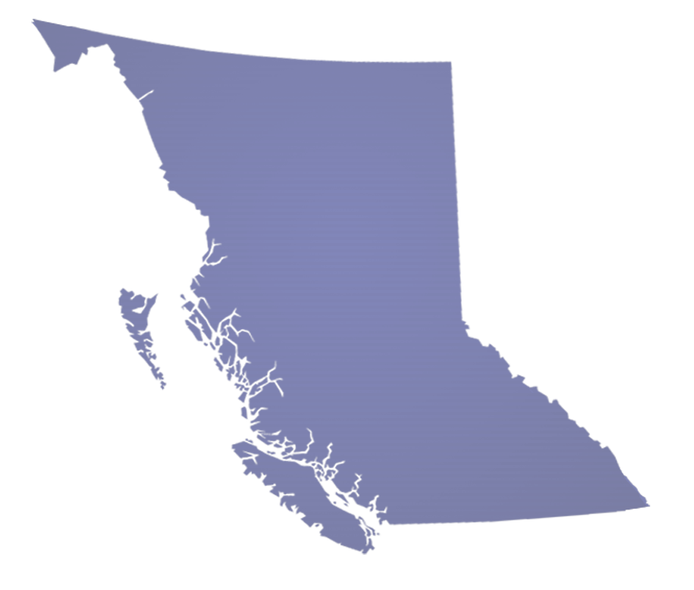
British Columbia Agency Update
Pacific States / BC Oil Spill Task Force AGM
October 1, 2014
Wes Shoemaker, Deputy Minister
BC Ministry of Environment

Slide 2
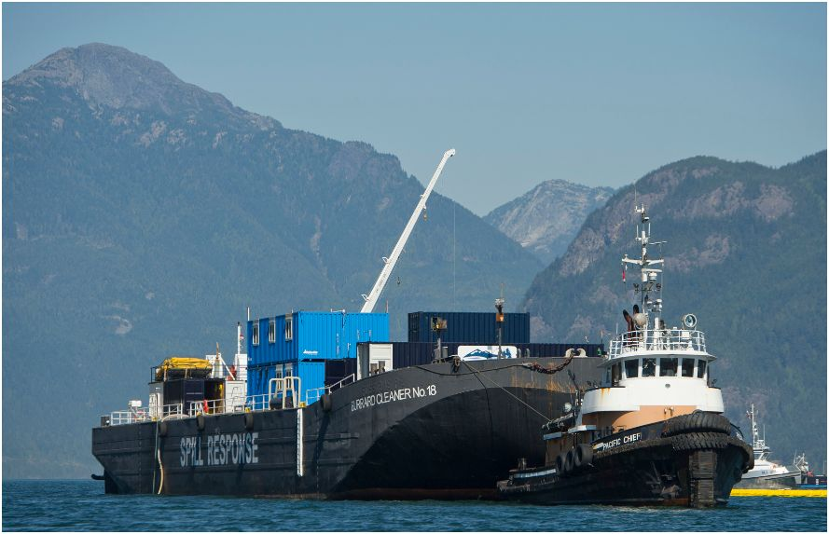
Presentation Overview
Program Activities
Legislative Review
First Nations and Federal Initiatives
Notable Spill Operations
Future Activities
Notes:
Photo: Brigadier General M.G. Zalinksi Oil Recovery Operation, October 2013
Introduction
Good Morning.
I am Wes Shoemaker, Deputy Minister of BC’s Ministry of Environment.
I would like to thank you for providing BC with the opportunity to update you on some of the Ministry’s activities over the last year.
I would like to begin by walking you through some of the Environmental Emergency Program’s recent activities, our Ministry’s major projects and work with other agencies as well as some notable spill operations, and some of the Program’s future activities.

Slide 3
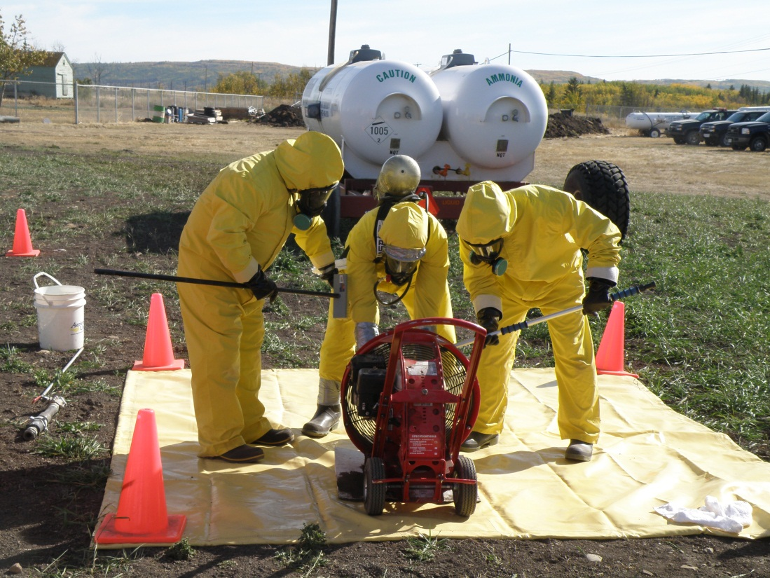
Program Activities
Staff Resources
Training Activities
Spill Data
Notes:
Photo: 2012 EERO Refresher Training
Program Activities
Staff Resources
Our program is currently comprised of 12 highly trained Environmental Emergency Response Officers located in regional offices throughout the province available to respond to spills.
As well as 6 Program headquarters staff, including an Aboriginal Youth Intern.
For large and complex spill incidents, the Ministry has an Incident Management Team and access to Technical Specialists from across government who may be called upon to provide incident specific knowledge and expertise as needed.
Training Activities
This year program staff participated in refresher Shoreline Cleanup and Assessment Technique and Incident Command System courses and exercises with participation from partner agencies and key stakeholders.
Annual Response Officer refresher training took place in Cranbrook BC in September.
Incident management team training is planned for November 2014 in Vancouver.
Spill Data
In 2013 EEROs were kept busy with over 3500 Dangerous Goods Incidents (DGIR) calls (including oil spills), a record number for the the province.
Approximately 5% of these were incidents of high enough risk to require field response by our Regional Environmental Emergency Response Officers.

Slide 4
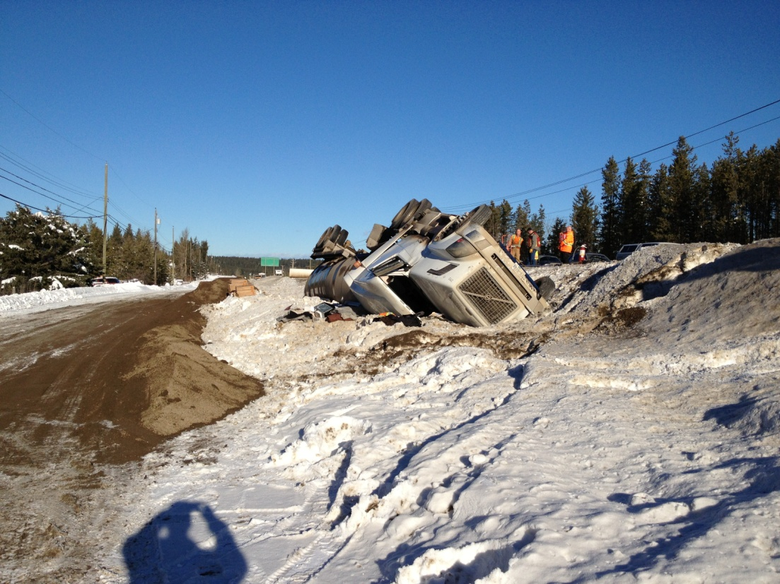
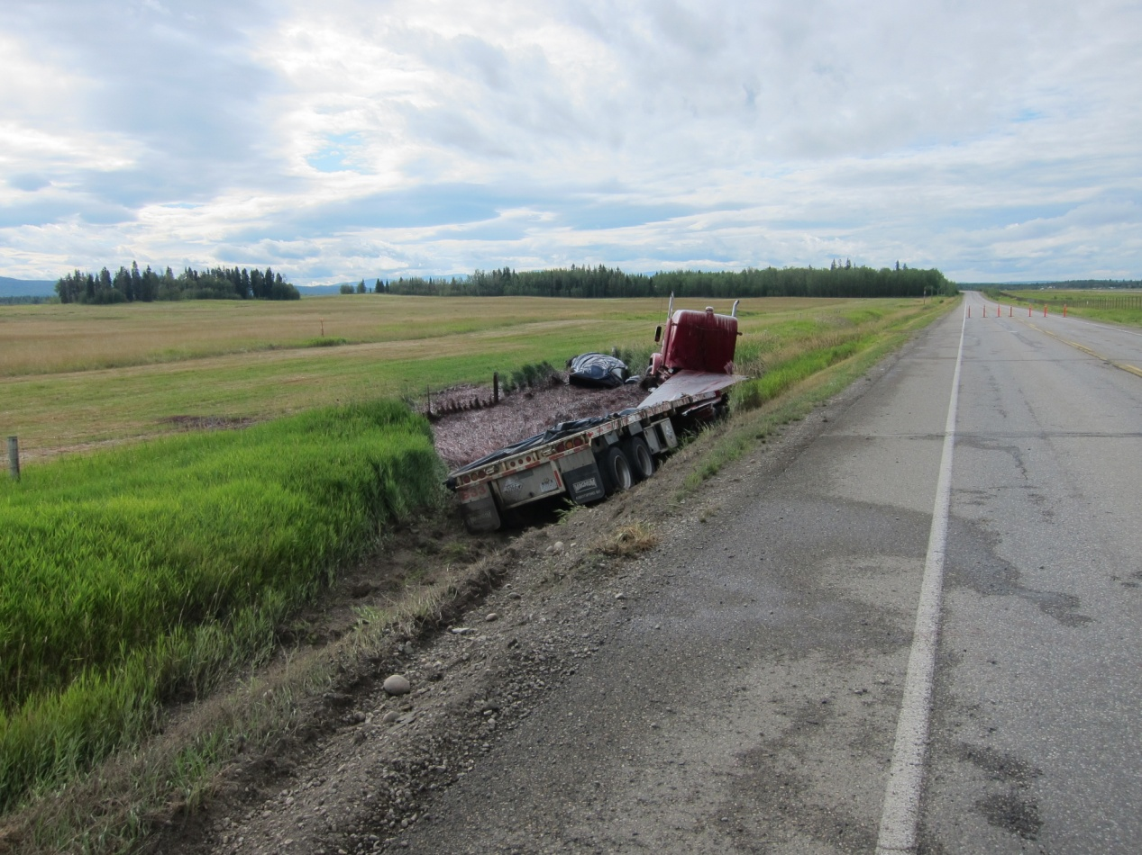
Legislative Review
Proposed world leading land based spill preparedness and response regime, including:
Improved spill preparedness, response and restoration standards
A provincially regulated and industry funded spill preparedness and response organization
An enhanced Provincial Environmental Emergency Program
Notes:
Photo 1: Ammonia nitrate tanker motor vehicle accident spill, January 2013 (Williams Lake/Wildwood).
Photo 2: Phenol formaldehyde resin motor vehicle accident spill, August 2013 (Old Cariboo Highway/Prince George Regional Airport).
New Legislation
The Ministry of Environment has been formally consulting on, researching and analysing options for a world leading land-based spill preparedness and response regime since July 2012.
This has included a series of multi-stakeholder consultations, intergovernmental discussions with Alberta and federal departments, a symposium that brought together spill response experts, discussion papers, and two public consultations centred on policy intentions papers. The most recent of which was a three-month public consultation on a proposed new spill response program, which closed in July.
Based on its expertise, work and the comments received, the program is now in the process of preparing a proposal that includes both policy options and an implementation plan for government’s consideration.
The policy options being considered can be found on the Ministry’s website in the Ministry of Environment’s second intentions paper for consultation. Briefly they include:
Improved clear and effective spill preparedness, response and restoration requirements that all potential spillers will be required to meet.
A provincially regulated preparedness and response organization, which all companies above a defined level of risk would fund and hold membership in.
An enhanced Provincial Environmental Program to ensure spill planning and preparedness is appropriate to address existing risks and anticipated growth in industrial activity
This proposal will serve as a significant contribution towards Condition 3 of the BC provincial government’s five requirements for consideration of heavy oil transport by pipeline or rail: world leading practices for land oil-spill prevention, preparedness, response and recovery systems to manage and mitigate the risks and costs of heavy oil pipelines.

Slide 5
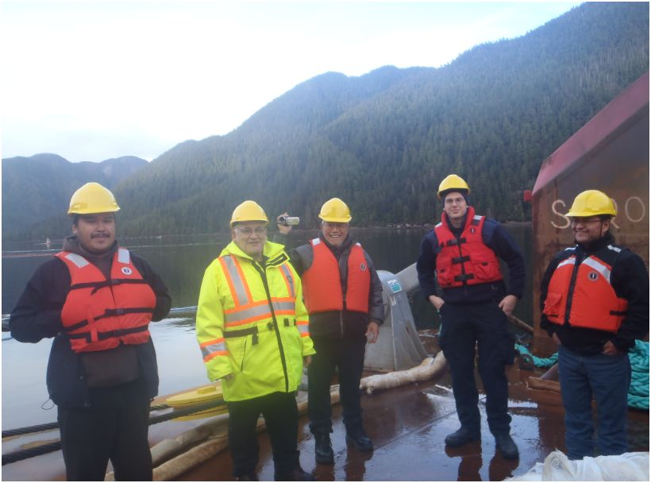
First Nations and Federal Initiatives
Tanker Safety Expert Panel
Enhancing Pipeline Safety
Rail and Dangerous Goods Transport
Environmental Stewardship Initiative
Notes:
Photo: EERO Dale Bull with FN reps on one of the EFAT teams for the Zalinski Operation
First Nations and Federal Initiatives
The Program continues to work closely with First Nations and with federal agencies, such as Natural Resources Canada and Transport Canada, to avoid unnecessary duplication while ensuring the proper rules and regulations are in place. Some examples of First Nations and federal initiatives moving forward this year include:
Tanker Safety Expert Panel
The Panel will submit two reports to the Minister of Transport providing a pan-Canadian review and assessment of Canada's Ship-source Oil Spill Preparedness and Response Regime, as it applies to oil handling facilities and ship-source oil spill preparedness and response.
The first report was completed in November 2013, and addressed the current regime south of 60ºN making 45 recommendations for important improvements. The Panel will submit a second report addressing issues north of 60ºN latitude and hazardous and noxious substances (including liquefied natural gas).
Enhancing Pipeline Safety
The Government of Canada is striving to improve this impressive safety record even further. Through its plan for Responsible Resource Development, the Government is ensuring that our pipeline safety system becomes even stronger by:
Increasing the number of annual inspections by the National Energy Board for oil and gas pipelines by 50 percent;
Doubling the number of comprehensive audits for oil and gas pipelines to identify safety issues before they occur;
Instituting administrative monetary penalties for individuals and companies that violate the National Energy Board Act in July 2013. Penalties are up to $25,000 for individuals and $100,000 for corporations for each day of non-compliance with federal safety requirements;
Announcing our intention to enshrine in legislation the principle of “the polluter pays” and requiring companies operating major pipelines to demonstrate they have the financial capability to respond to any incident and remedy damage. For major crude oil pipeline operators, the Government will expect a minimum financial capability of $1 billion. The proposed legislation also includes new, modern safety regulations for pipelines, such as improving transparency by ensuring that companies’ emergency and environmental plans are easily available to the public and ensuring that pipeline operators are responsible for abandoned pipelines; and
Requiring senior company leadership accountability for building a safety culture and supporting management systems through the appointment of a senior officer to ensure that company management systems and programs are in compliance.
Rail and Dangerous Goods Transport
Following the tragic accident last summer, Transport Canada took immediate steps to protect Canadians and the communities along our country's railway lines. The Government of Canada is building upon this work by introducing concrete measures to further strengthen Canada's regulation and oversight of rail safety and the transportation of dangerous goods. Effective immediately, Transport Canada will:
Issue a Protective Direction removing the least crash-resistant DOT-111 tank cars from dangerous goods service;
Require DOT-111 tank cars used to transport crude oil and ethanol that do not meet the standard published in January 2014 in Canada Gazette, Part I, or any other future standard, to be phased out or refitted within three years;
Issue a Protective Direction requiring Emergency Response Assistance Plans for crude oil, gasoline, diesel, aviation fuel, and ethanol;
Create a task force that brings stakeholders such as municipalities, first responders, railways and shippers together to strengthen emergency response capacity across the country; and
Require railway companies to reduce the speed of trains carrying dangerous goods and implement other key operating practices.
Transport Canada is working closely with stakeholders—railways, shippers, municipalities, first responders, Aboriginal communities, provincial and territorial governments, and U.S. officials— to protect the health and safety of Canadians. The department continues to cooperate fully with the Transportation Safety Board of Canada's ongoing investigation.
Environmental Stewardship Initiative
The Liquefied Natural Gas Environmental Stewardship Initiative was launched in May 2014 as a response to First Nations seeking a government commitment to more collaborative forms of environmental management.
The Province is also engaging federal agencies to develop a shared vision and action plan for the Liquefied Natural Gas Environmental Stewardship Initiative that meets the priorities of First Nations and the other parties.
The initiative complements the existing regulatory process and advances the collaborative relationship between First Nations, governments and industry on key environmental management topics.

Slide 6
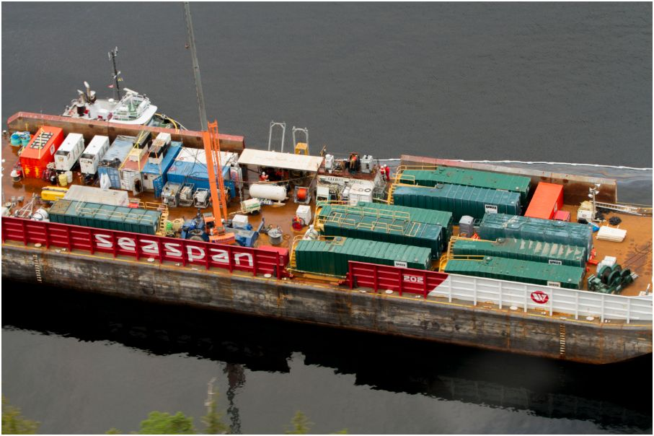
Brigadier General M.G. Zalinksi Oil Recovery Operation
Operation Statistics
CCG Operating Budget: $50 million
Bunker C Oil Recovered: 43.9 t
Oily Waste Water Recovered: 319.4 t
Notes:
Photo: Mammoet Salvage barge with Baker recovery tanks on board
Brigadier General M.G. Zalinksi Oil Recovery Operation, October 2013
The United States Transport Vessel Brigadier General M.G. Zalinski ran aground during a storm and sank in Grenville Channel while enroute to Alaska from Seattle in 1946. It now rests under 90 feet of water, roughly 100 kilometres south of Prince Rupert in Northern BC.
The vessel has been the source of numerous small oil leaks over the last decade as the ship slowly deteriorates, releasing oil from the fuel tanks.
The MOE worked in partnership with the Canadian Coast Guard (CCG), the lead federal agency, and others, to remove most of the remaining oil and other pollutants from the ship that would have threatened the surrounding environment.
The Ministry of Environment’s Environmental Emergency Program, as the lead provincial agency, participated in joint planning for the operation with the CCG and in joint operations at the Incident Command Post in Prince Rupert.
Ministry staff participated in Provincial Incident Command, as Environmental Unit leader and provided technical specialists in Shoreline Cleanup and Assessment Techniques (SCAT), waste management and treating oiled wildlife.
MOE and CCG worked closely with local First Nations in Unified Command, the Environmental Unit and the Environmental Field Assessment Teams, ensuring local fisheries resources and sites of cultural significance were protected during the salvage operation.
A plan is currently being developed for a longer term monitoring and sampling program in the area.
The Zalinski Operation gave Ministry staff a unique opportunity to work with multiple stakeholders, agencies and jurisdictions and identify any challenges in operations before a spill could happen which have become key learnings for the Ministry moving forward.

Slide 7
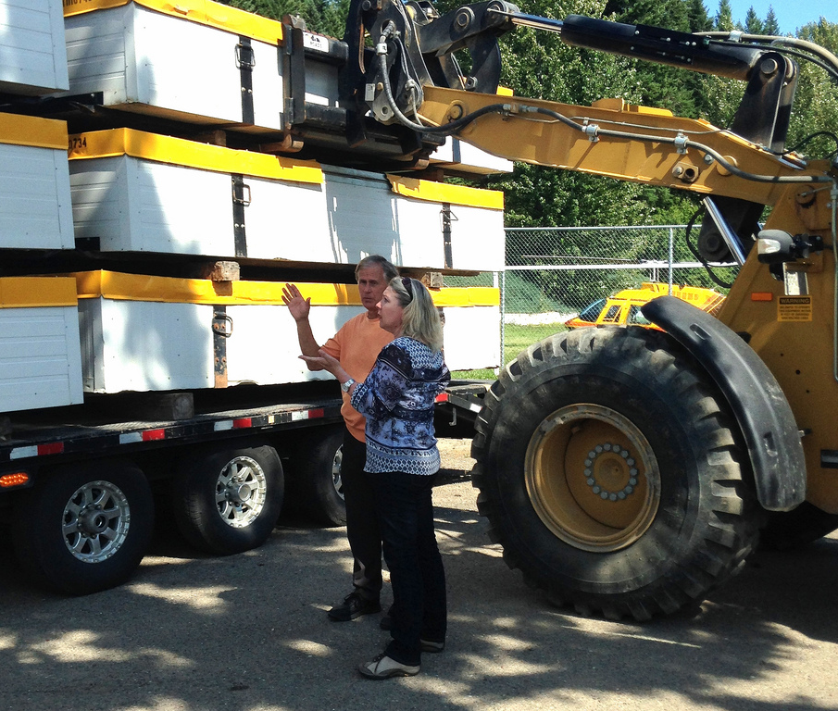
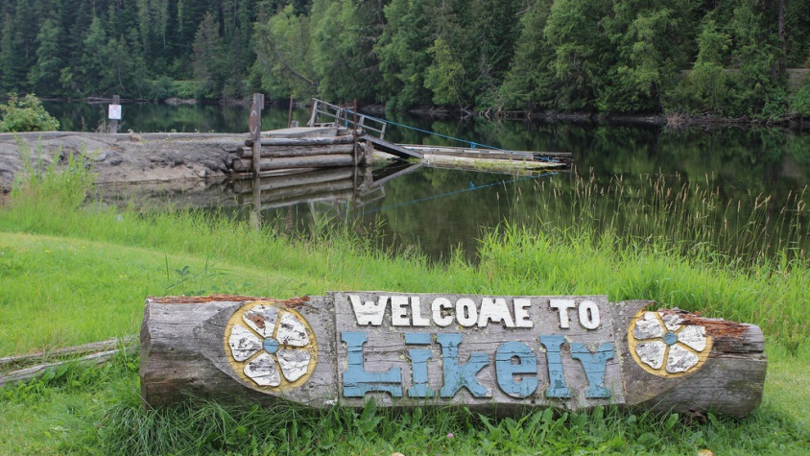
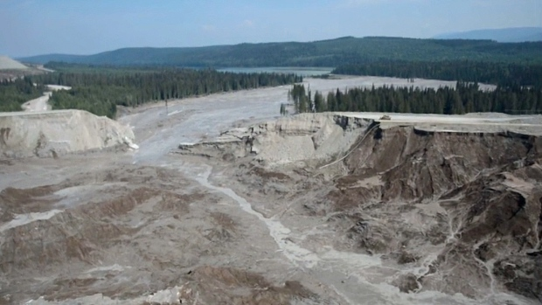
Mount Polley Mine Tailings Pond Breach
Notes:
Photo 1: Potable and grey water containers arrive in Likely, BC.
Photo 2:Mount Polley tailings pond breach took place near the Town of Likely, BC on Quesnel Lake
Photo 3: An aerial view of the Mount Polley mine tailings pond shows the area where the earthen wall gave way (credit: cbcnews)
Mount Polley Mine Tailings Pond Breach, Likely, August 4, 2014
On August 4, 2014, a tailings pond breach occurred at Mount Polley Mine. Mount Polley is an open pit copper/gold mine owned by Imperial Metals in south-central BC, near the town of Likely.
The breach released approximately 10 million cubic meters of effluent and 4.5 million cubic metres of fine sand into Polley Lake, Hazeltine Creek and Quesnel Lake.
MOE worked with EMBC sending resource specialists to support the EOC and is overseeing implementation of the responsible party's pollution abatement action plan.
The cause of the breach is still unknown at this time. Government and Cariboo Regional District officials continue to work together to address and investigate the breach
The Province has also ordered an independent engineering investigation and inquiry to review the cause of the breach and report back to the province and the First Nations by January 31, 2015.
The magnitude of this incident highlights the need for BC to move forward with world leading practices for land based spill preparedness, response and recovery.

Slide 8
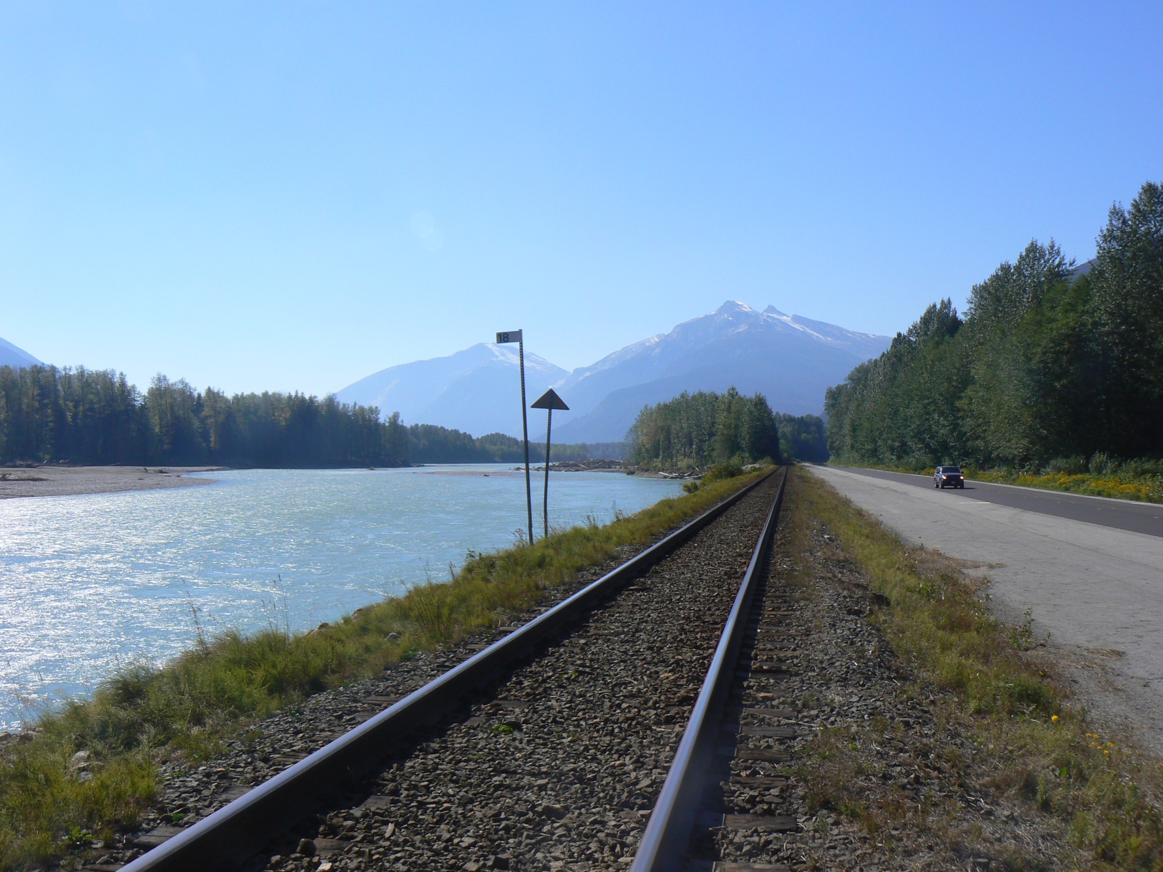
Future Activities
Development Issues
Clean Pacific Conference
Notes:
Photo: Highway 16 transportation corridor emergency response project
Future Activities
Development Issues
BC is experiencing tremendous growth in economic activity that the program is watching closely in relation to spill preparedness.
Proposed developments include:
Enbridge Northern Gateway Pipline Proposal
Kinder Morgan Trans Mountain Expansion Proposal
Kitimat LNG
Ministry staff have been central to the review of both the Northern Gateway Pipelines and Trans Mountain Expansion Project proposals.
Ministry staff continue to work with stakeholders and federal regulatory agencies to address spill preparedness and response issues coming out of these reviews.
Clean Pacific Conference
BC is pleased to be hosting next June’s Clean Pacific Conference in Vancouver.

Slide 9
Notes:
Conclusion
Thank you again for the opportunity to update you on the BC’s Environmental Emergency Program.

